Slide 1


Generalised Minimalist Algebras
Meaghan Fowlie
Universiteit Utrecht
MG+1
August 12, 2023

Slide 2
Today
There are lots of MGs, but there as researchers we have intuitions about what is and is not an MG
Generalised Minimalist Grammars: my stab at formalising that intuition
Generalised Minimalist Algebras: the focus of today: ignore the features, focus on the structure-building
What I hope for from you: does this match your intuition too?

Slide 3
Structure building
Each Merge and Move can be associated with a structure-building operation in an arbitrary algebra
see
( , {})
APP_{O}←
Move
→∗_{left}
(who Dana saw, {})
Dana
who
see
( , {wh: })
who
APP_{S}←
Dana
O
Merge
→∗_{left}
(Dana saw, {wh:who})
see
Merge
Dana
D
(saw, {wh:who})
(Dana, {})
( , {})
( , {wh: })
Dana
who
S
O
saw
=D =D +wh V
who
D -wh
(saw, {})
(who, {})
see
( , {})
( , {})
who
Step-by-step building of interpreted expression in String Algebra
S
O
NEW: ditto in Apply-Modify Algebra over graphs
Derivation Tree

Slide 4


What can an MG build? I argue: Anything!
Move
(
Merge
, {puppy:
})
puppy
=P +puppy P
puppy
P -puppy
... so what is a Minimalist Grammar, generally?

Slide 5
I define Generalised Minimalist Grammars:
Formalise the intuition of what makes an MG an MG
Today: Generalised Minimalist Algebras:
What can an MG build and how can it build it?

Slide 6
Inspiration and approach
Two-step approach (Kobele et al 2007):
  features define a regular tree grammar
  algebra controls the structure-building operations
IRTGs (Interpreted Regular Tree Grammars: Koller & Kuhlmann 2011)
  regular tree grammars control what is allowed
  interpretation into an algebra defines what is built
  synchronous IRTG: more than one interpretation into more than one algebra can build multiple structures at once
Generalised MGs can be seen as a type of IRTG
  regular tree language as in Kobele et al
    (but it's more clear to think of the grammar as a feature-driven MG, not an RTG)
  interpreted into a Minimalist Algebra (to be defined today)
    Minimalist Algebra itself contains an inner algebra that builds the actual output structures. (Feels like an IRTG within an IRTG, but it's not a grammar, just an algebra)

Slide 7
Generalised Minimalist Algebras
link a Minimalist Algebra with an Inner Algebra
Minimalist Algebra
Captures essence of Merge and Move in all possible Minimalist Grammars
Objects: (inner algebra term, mover storage)
Operations: Merge and Move operations
Handles movers
Inner Algebra
Builds output structures
Objects: anything (e.g. trees, strings...)
Operations: build the object (e.g. ∗, APP_{S})
Example term over inner algebra
Move_A
∗
Example term over Minimalist Algebra
Merge_A
who
∗
Merge_Abar
Dana
Dana
saw
saw
who

Slide 8
Minimalist Algebra forms the "shell"
basket
Move
basket of puppies
puppies
basket
, {puppy:
Merge
(
puppies
})
basket of
puppies
O
basket
puppies
basket of
puppies
puppy-basket
=P +puppy P
puppy
P -puppy
O

Slide 9
Prepare packages
Association with a single inner algebra operation is not always enough
e.g. when you Merge a mover, maybe you need:
  head movement first?
  add a trace to a derived tree?
Prepare packages are pairs of tree homomorphisms that update the inner algebra terms before Merge
  e.g. suffix could apply for head movement to a suffix:
    homomorphsm 1: remove the head from the selectee
    homomorphism 2: concatenate it to the right of the head of the selector
  e.g. add_trace_right could apply when right-merging a mover in a tree-building MG
    homomorphism 1: add a trace on the right of the selector
    homomorphism 2: nothing

Slide 10
Example: preparing for head movement
Minimalist term
Selector inner term
prepared selector inner term
Merge_right_hm
[T]
prepare
-
prepared selectee inner term
Merge_right
Selectee inner term
[T]
[T]
has
∗
∗
has
Merge_left
has
∗_L
[empty]
∗_L
Dana
Merge_wh
seen
Dana
seen
Dana
seen
who

Slide 11
Example: preparing for head movement
prepared selector inner term
Minimalist term
new inner term
interpretation
Merge_right_hm
has Dana seen
-
prepared selectee inner term
∗
[T]
Merge_right
[T]
has
∗
-
∗
has
Merge_left
[T]
has
[empty]
∗_L
[empty]
∗_L
Dana
Merge_wh
seen
Dana
seen
Dana
seen
seen
who
who

Slide 12
Minimalist operations partitioned into 4 sets:
Final Merge
Prepare package applied (optional)
movers combined
(prepared) inner terms combined with an inner algebra operation
Merge a mover
Prepare package applied (optional)
movers combined
(prepared) selectee stored in given mover slot
Final Move
Mover removed from given mover slot
Main inner term and mover combined with an inner algebra operation
Non-final Move
Mover removed from given mover slot
Prepare package applied to main inner term and mover (optional)
(prepared) mover stored in other given mover slot

Slide 13
Final Merge
Merge
Derivation tree
Final Merge
Prepare package applied (optional)
movers combined
(prepared) inner terms combined with an inner algebra operation
seen::=D =D V
Dana::D
Minimalist algebra term
Merge_left
seen
Dana
Inner algebra terms over 2 algebras
*
concat_left
Dana
seen
seen
Dana
Dana seen
(Dana, seen, ε)
2 interpretations
String Algebra
String-triple Algebra
2 algebras

Slide 14
Merge a mover
Merge
Derivation tree
Merge a mover
Prepare package applied (optional)
movers combined
(prepared) selectee stored in given mover slot
seen::=D =D V
who::D -wh
Merge_Abar
Minimalist algebra term
seen
who
pairs of inner algebra terms over 2 algebras
trace_right
seen
who
seen
who
>
2 interpretations of main terms
seen
seen
t
String Algebra
Bare tree Algebra
2 algebras

Slide 15
Final move
Move
Merge
Derivation tree-ish fragment
[Q]:: =>T +wh C
Move
(Dana has seen):T; {wh:(who)}
Final Move
Mover removed from given mover slot
Main inner term and mover combined with an inner algebra operation
Move_Abar
Minimalist algebra term fragment
Merge_right
∗
[Q]
Move_A
∗
who
∗
inner algebra term
(actually 2, but they look identical)
-
∗
[Q]
-
Dana
[empty]
∗
[T]
has
seen
[empty]
2 interpretations of main terms
who has Dana seen
(who, ε ε has, Dana ε seen ε)
String Algebra
String-triple Algebra
2 algebras

Slide 16
Non-final move
Move
Merge
Derivation tree-ish fragment
Non-final Move
Mover removed from given mover slot
Prepare package applied to main inner term and mover (optional)
(prepared) mover stored in other given mover slot
[T]:: =>V +nom T
Merge
(has seen Dana):V; {A:(who)}
Move_A_Abar
Minimalist algebra term fragment
Merge_right
[T]
Merge_right
∗
prepared main inner algebra term
and newly re-stored
mover inner algebra term
-
∗
{Abar:Who}
∗
[T]
has
[empty]
∗
[empty]
seen
Dana
has seen Dana
(ε, ε has, ε seen Dana)
2 interpretations of main terms
String Algebra
String-triple Algebra
2 algebras

Slide 17
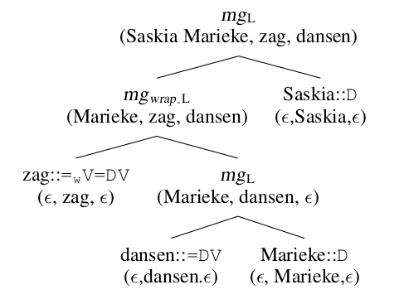
New MG with TAG-like string algebra for derivationally intuitive cross-serial dependencies
Inner algebra includes wrap operations (variation on head movement)
Unlike TAGs, semantically correct selector, selectee; don't use adjoin for arguments
Unlike traditional MGs, no meaningless movement just to get the word order right
Still MCS, same parsing complexity as other head movement MGs

Slide 18
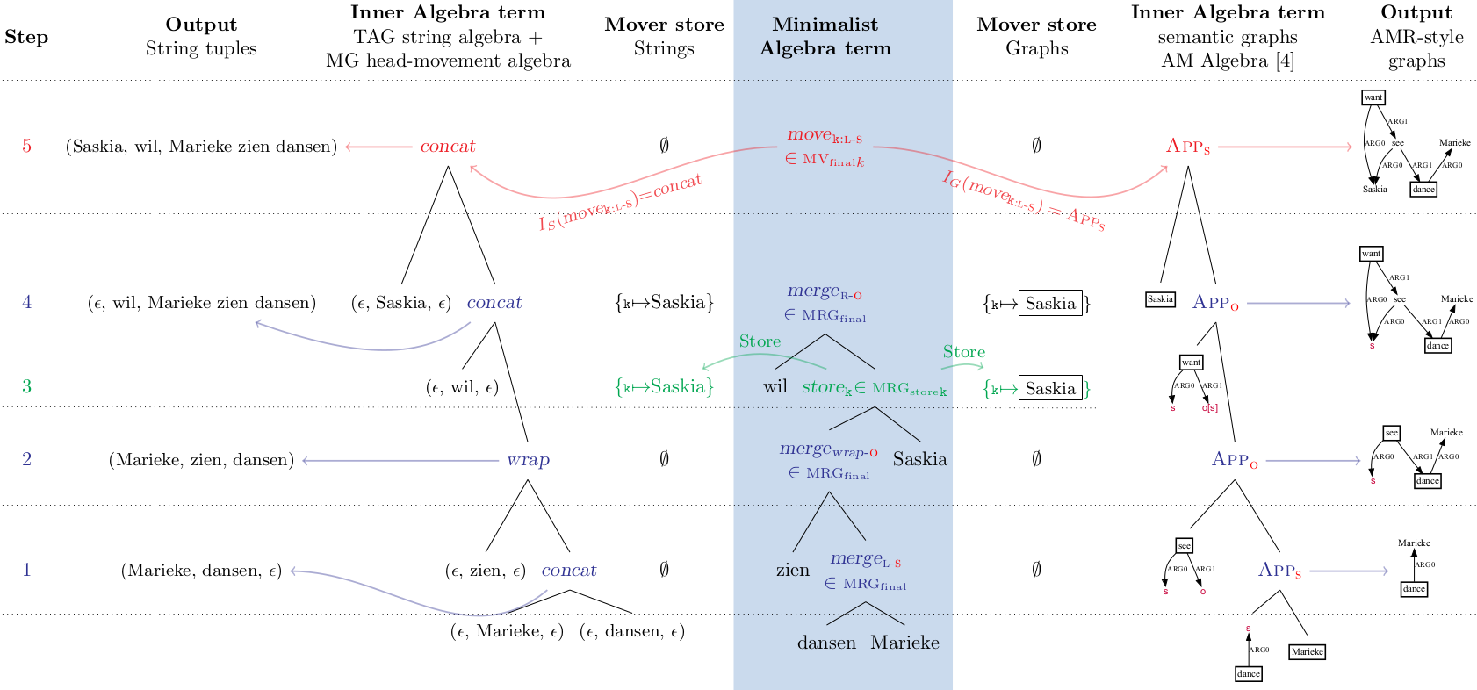
Synchronous MG (TAG-like string tuples + AMR graphs)

Slide 19
Some mathematical properties
MGs with:
Linear inner algebra operations and
Linear prepare packages
are MCS, specifically the same set of classes as traditional MGs
2. MGs with non-linear prepare packages or non-linear algebra operations can be more powerful.
e.g. copy move is a non-linear prepare package:
copy_prepare(main, mover) = ( *(mover, main) , mover )
3. The number of Move and non-final Merge operations is limited by the number of mover slots (e.g. the size of lic)

Slide 20
Contributions
Extend MGs to generate arbitrary kinds of objects
Provide MG definition that is independent of inner algebras
  Define Minimalist Algebras
  Formalise distinction between the Minimalist Algebra (shell) and the Inner Algebra (structure building)
Easy way to design new MGs and synchronous MGs
Provide novel MGs over:
  Graphs (Inner Algebra: Apply-Modify Algebra)
    For semantic graph banks (e.g. AMR)
  String tuples (Inner Algebra: novel Head Movement + TAG algebra)
    combines traditional MG Head Movement algebra with TAG string wrap algebra
    combines best of Minimalist and TAG analyses for wide variety of phenomena including cross-serial dependencies

Slide 21
Questions for you
Does this capture your intuition too?
Is this a useful way to think about MGs for you?
I feel like the "prepare packages" are a bit unintuitive, but I think they're necessary if I want to say that internal and external Merge at the level of the inner algebra are just binary operations that combine the two elements, which seems right.
  What's your feeling on this?
  This seems like it captures the extent to which tampering could be allowed -- tree homomorphisms limit how much you can mess with the trees. Right?
There should be some straightforward equivalences with Thomas Graf's MSO approach, but I don't know what they are yet. Do you see it/see why not?

Slide 22
Thank you!
This work is part of the research programme Learning meaning from structure: neural semantic parsing with minimalist grammars with project number VI.Veni.194.057, which is funded by the Dutch Research Council (NWO).

