Slide 1
Modeling the Progression of Alzheimer's Disease to Explore the Most Influential Components in its Pathway
Meaghan Parks

Slide 2
Overview
Alzheimer’s Disease Background
Model of Pathological Process
Model Creation
Equations
Parameters
Baseline Results
Analysis of the Model
Sensitivity Analysis
Equilibria Analysis
In-silico Treatment Trials
Amyloidβ Aggregation
Tau phosphorylation
Conclusion

Slide 3
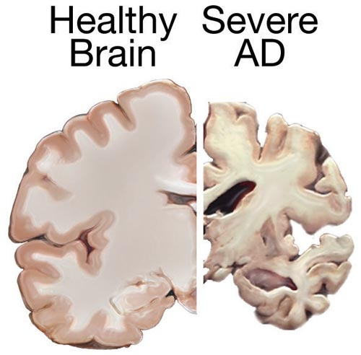
Alzheimer’s Disease
Prevalence
Most common cause of dementia
~5% of the population by age 65
>20% by age 80
Predicted # of affected individuals by 2050 > 100 million (Hanger et al. 1)
Predominant features
Accumulation of amyloid plaques (Aβ)
Creation of neurofibrillary tangles (NFTs)
Both result in neuron death at a rate of ~5%/year
Treatments
Currently no cure
Numerous trials with limited success in all
Treatments geared at controlling elements in pathway leading to plaque and NFT formation
Fig.1 "Alzheimer disease ." U.S. National Library of Medicine, ghr.nlm.nih.gov/condition/alzheimer-disease#definition.
Notes:
Prevalence Data: Hanger/Anderton/Noble http://files.jorge-castillo5.webnode.es/200000106-c6809c7795/paper%20neurodegenerative%20disease.pdf
5% number Hao/Friedman https://bmcsystbiol.biomedcentral.com/articles/10.1186/s12918-016-0348-2

Slide 4
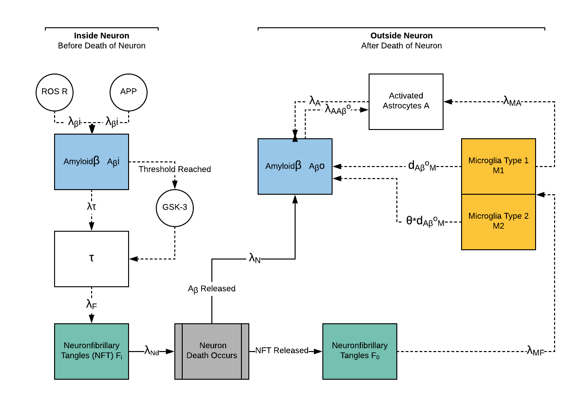
Amyloidβ and NFTs are tracked both inside and outside the neuron
Number of agents increase Amyloidβ and NFTs
Microglia are the cleanup team
Notes:
We track events inside the neurons and outside the neurons after the neurons die and release their NFTs and amyloid Beta that second model followed. We’ve included a couple of elements that exacerbate the disease process such as GSK-3 so we can consider how a treatment targeting them could potentially help treat the disease. Now we’ll take you through the nine equations that apply to this model.

Slide 5
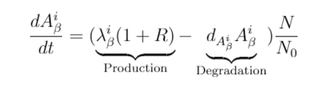
λ_{β}^{i} =normal rate of production of Amyloidβ by Amyloid Precursor Proteins (APP)
R = effect ROS has on increasing production of Amyloidβ
d_{Aβ}^{i} =Normal degradation of A_{β}^{i}
N₀ = initial value
N/N₀ starts at 1 and gets smaller as neurons die
(Hao and Friedman 2)
Notes:
Hao/Friedman
ROS=reactive oxygen(or oxidative) species

Slide 6

λ_{F} =rate of production of NFTs by hyperphosphorylated T
d_{Fi} =Normal degradation rate
As with all internal processes it is proportional to the amount of neurons remaining
(Hao and Friedman 4)
Notes:
Hao/Friedman

Slide 7


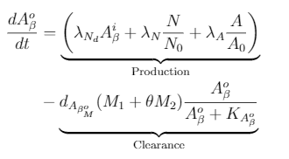
λ_{Nd} = rate of change in number of neurons
λ_{N} = production rate by neurons
λ_{A} = production rate by astrocytes
= clearance rate rate by microglia
= Michaelis- Menten coefficient
θ <1 since M2 is less effective than M1
Notes:
Hao/Friedman

Slide 8
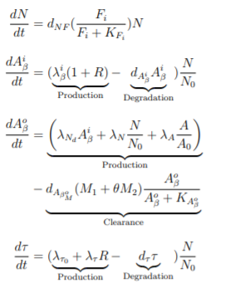
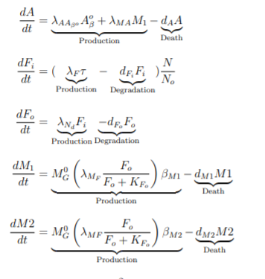
Model Equations
Citation for tau equation (Hao and Friedman 4)
Notes:
Hao/Friedman

Slide 9
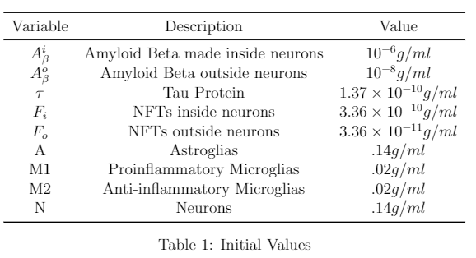
Initial Values
(Hao and Friedman 6)
Notes:
Hao/Friedman

Slide 10
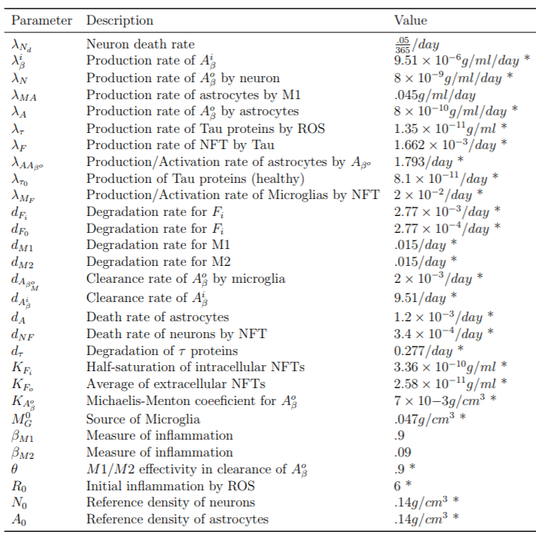
Parameter Values
*(Hao and Friedman 11-12)
Notes:
Hao/Friedman

Slide 11
Parameter Estimation-From Paper
Assumed A^{i}_{β} = Aº_{β}
Normal brain A^{i}_{β} = 10⁻⁶ g/ml/day
d_{Aβ}^{i} =9.51/day, half-life in mice, normal degradation rate of amyloidβ
In a steady state in equation above, R=0 and N/N₀=1 and the rate of change is 0
Therefore, λ_{β}^{i} = d_{Aβ}^{i} X A^{i}_{β} = 9.51 X 10⁻⁶ g/ml/day
(Hao and Friedman 14)

Slide 12
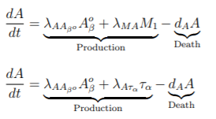
Parameter Estimation-New Parameters
Top equation= our equation for astrocytes
Bottom equation = what we modified since we did not model τ_{α} = amount of TNF-α
Generated λ_{MA} to represent the rate at which M1 creates τ_{α} combined with the rate at which τ_{α} creates astrocytes
Τ_{α} produces astrocytes at a rate of .03 g/ml *
M1 produces Τ_{α} at a rate of 1.5/day *
Combing these rates we get λ_{MA} = .03 * 1.5 = .045 g/ml/day
M₁ Τ_{α} A
*(Hao and Friedman 11)

Slide 13
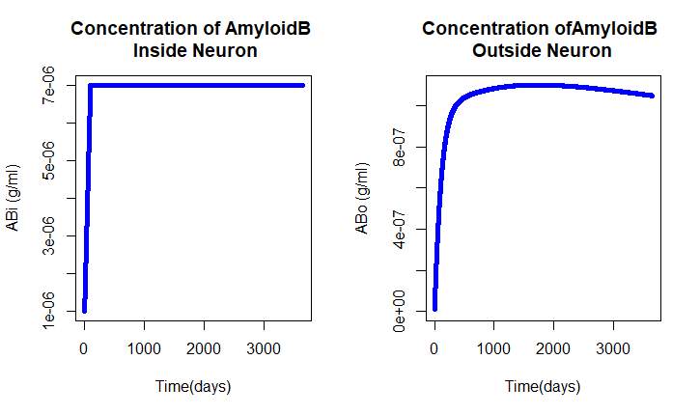
Results: Amyloidβ
Result are consistent with average concentrations found in brains of Alzheimer’s Disease patients (Roher et al.)
Amyloidβ outside the neuron is slightly higher than anticipated since we do not take into account the macrophages
Notes:
1Roher/Esh/.... https://www.ncbi.nlm.nih.gov/pmc/articles/PMC2663406/
Maybe drop second bullet and discuss the disease mechanism that ties this result to R
Note possible equilibria that we will return to

Slide 14
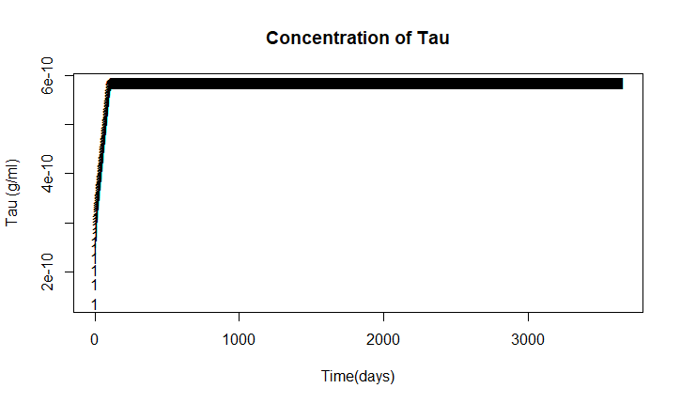
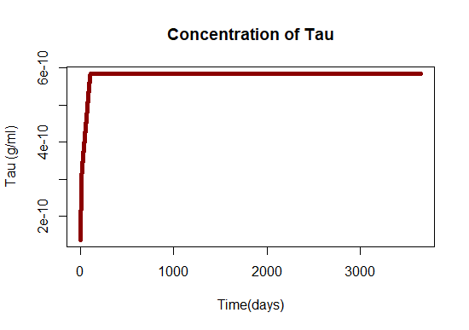
Results: Tau
The concentration of tau increases rapidly then levels off
Notes:
Hao/Friedman
Add 2nd bullet that explains disease mechanism that explains this result

Slide 15
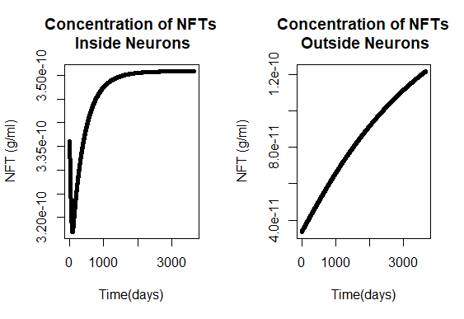
Results: NFTs
NFTs inside neurons approach equlibrium
NFTs outside neurons increase at a steady rate as neurons die
Notes:
Maybe add first bullet to discuss the disease mechanism that ties this result to Tau

Slide 16
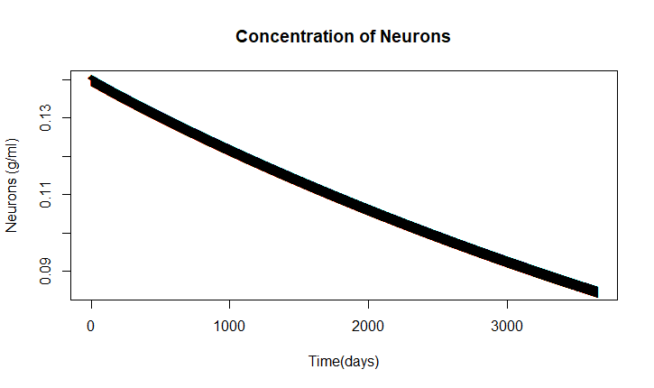
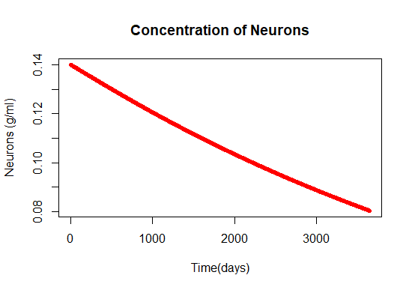
Results: Neurons
Results match expected death rate of neurons of ~ 5%/year.

Slide 17
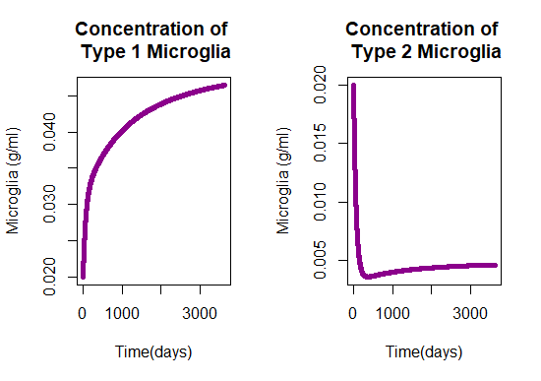
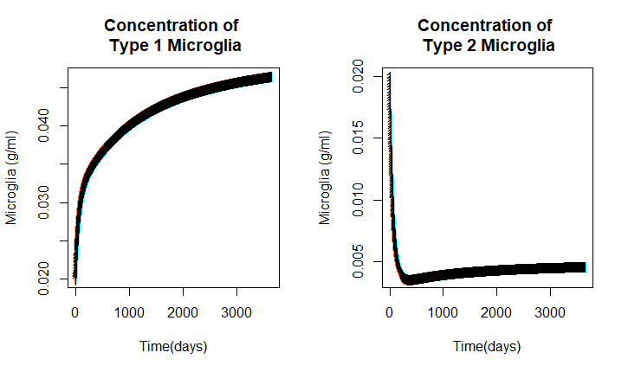
Results: Microglia
Type 1 microglia increases while type 2 decreases
Type 1 is more efficient
Notes:
*Maybe add first bullet to discuss types of microglia

Slide 18
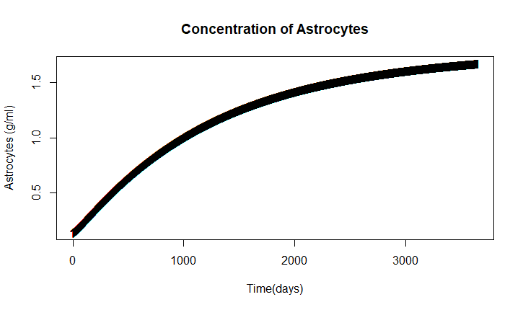
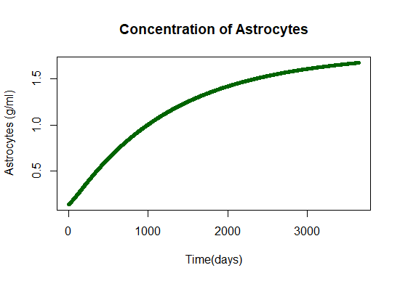
Results: Astrocytes
Results closely correlated with mouse models ( Hao and Friedman 7)
Notes:
Hao/Friedman
*Add discussion of supporting disease process

Slide 19
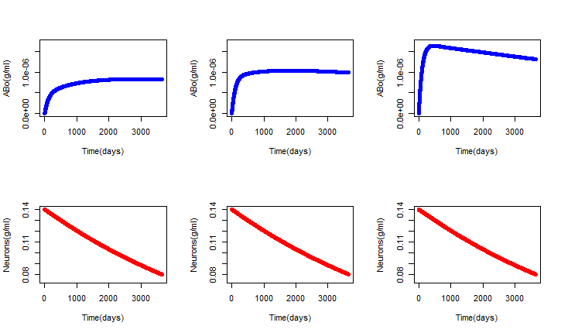
Sensitivity of λ_{N} on Amyloidβ & Neuron Concentrations
λ_{N} Halved
λ_{N}
λ_{N} Doubled
λ_{N} = production rate of Aβ_{o} by neurons
λ_{N} increases => Amyloidβ increases
Does NOT affect the rate of neuron death

Slide 20
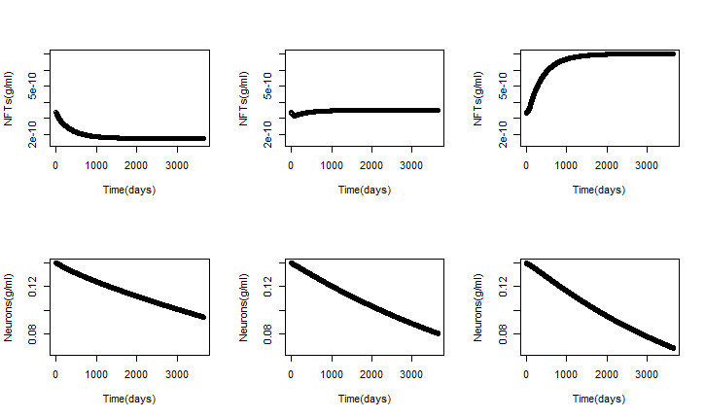
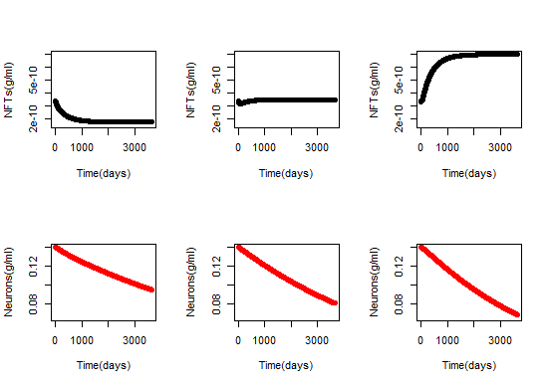
Sensitivity of λ_{F} on NFT & Neuron Concentrations
λλ_{F} Halved
λ_{NF}
λ_{F} Doubled
λ_{F} = production rate of NFT by Tau
λ_{F} increasing => concentration of NFTs inside neurons goes from decreasing to rapidly increasing
& the concentration of neurons decreases more rapidly

Slide 21
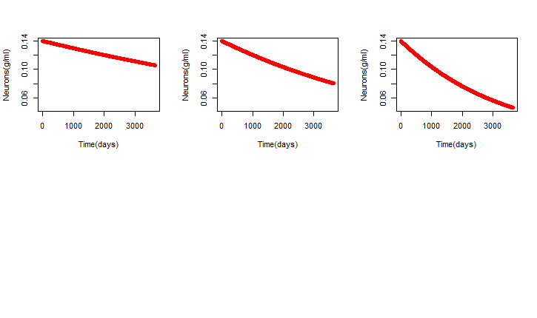
Sensitivity of d_{NF} on Neuron Concentration
d_{NF} increases => neuron death rate increases

Slide 22
Equilibria analysis
Variable | Equilibrium point | Stability
N | 0 | Stable
ABi | 7 X 10 -6 | Neutral
ABo | 1.2 X 10-6 | Unstable
A | 2 | Stable
Tau | 6 X 10 -10 | Neutral
Fi | 3.5 X 10 -10 | Unstable
Fo | 1.4 X 10 -10 | Stable
M1 | 0.05 | Stable
M2 | 0.005 | Stable

Slide 23
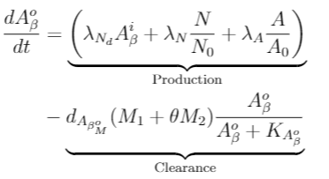
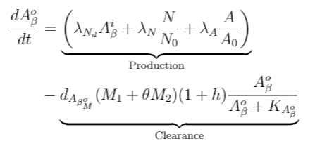
Treatment Model: Amyloidβ Aggregation Reduction
Aducanumab = medication in clinical trials
Provides for microglia-mediated phagocytosis of Amyloidβ
Limited effectiveness alone, may be useful in combination therapy
(Hao and Friedman 7-8)
Original
Treatment

Slide 24
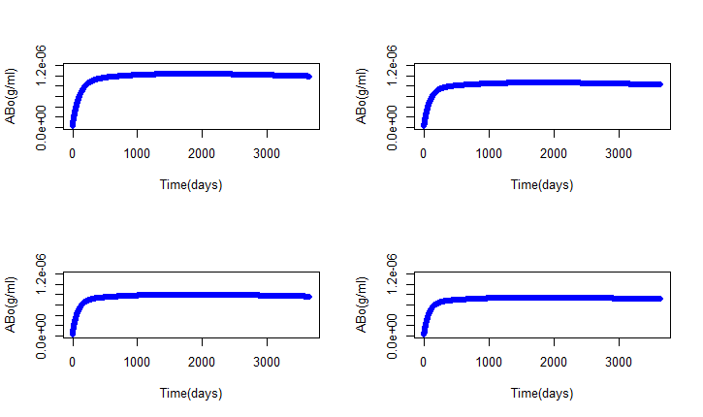
Treatment Results: Amyloidβ Aggregation Reduction
Original
20% Increase in Clearance
20% Improvement in clearance rate => slight change
30% improvement => ~27% reduction
40% improvement => ~36% reduction
The higher levels of improvement are probably overly optimistic
30% Increase in Clearance
40% Increase in Clearance
Notes:
Increase the ability of the microglia to destroy plaque buildups

Slide 25
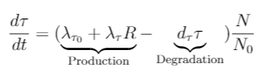

Treatment Model: Reducing Tau via GSK-3 Control
λ_{τ} the production rate hyperphosphorylated Tau can be reduced by reducing GSK-3 which we model in the treatment equation
There are medications in animal trials that reduce GSK-3 and therefore Tau
As Tau is critical to the creation of NFTs and therefore neuron death this holds potential
Original
Treatment
(Hanger et al. 6)
Notes:
Check the state of the trials

Slide 26
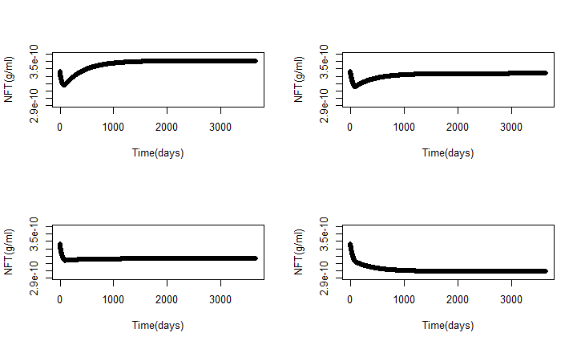
Treatment Results: Reducing Tau/GSK-3
10% Decrease in Production
10% reduction in Tau production rate => slows creation of NFTs
20% and 30% improvement=> significant reduction in NFTs
Reduction in NFTs reduces neuron death
Original
20% Decrease in Production
30% Decrease in Production
Notes:
Increase the ability of the microglia to destroy plaque buildups

Slide 27
Conclusion/Summary
Usefulness
Helps target pathways and predict what mechanisms will be the most beneficial for treatment
Increases understanding and describing the complex system occurring in the brains of patients with AD
Illustrates how important early intervention is as so many key negative factors escalate early
Limitations
Excluded inflammation components which may be critical
Some scientific disagreements about the value of some elements in the system

Slide 28
Acknowledgements
Great Day Organizers
Professor Leary & Professor Hartvigsen
Modeling Biological Systems course TAs: Yi Liu Chen and Alexander Webber
R Core Team
Overleaf

Slide 29
References
"Alzheimer disease ." U.S. National Library of Medicine, ghr.nlm.nih.gov/condition/alzheimer-disease#definition.
Hanger, Diane P., et al. "Tau phosphorylation: the therapeutic challenge for neurodegenerative disease." .
Hao, Wenrui, and Avner Friedman. , bmcsystbiol.biomedcentral.com/articles/10.1186/s12918-016-0348-2.
Puri IK, Li L (2010) Mathematical Modeling for the Pathogenesis of Alzheimer’s Disease. PLoS ONE 5(12): e15176. doi:10.1371/journal.pone.0015176
R Core Team (2018). R: A language and environment for statistical computing. R Foundation
for Statistical Computing, Vienna, Austria. URL https://www.R-project.org/.
Roher, Alex E., et al. "Aβ peptides in human plasma and tissues and their significance for Alzheimer’s disease." .

Slide 30
Backup Slides

Slide 31
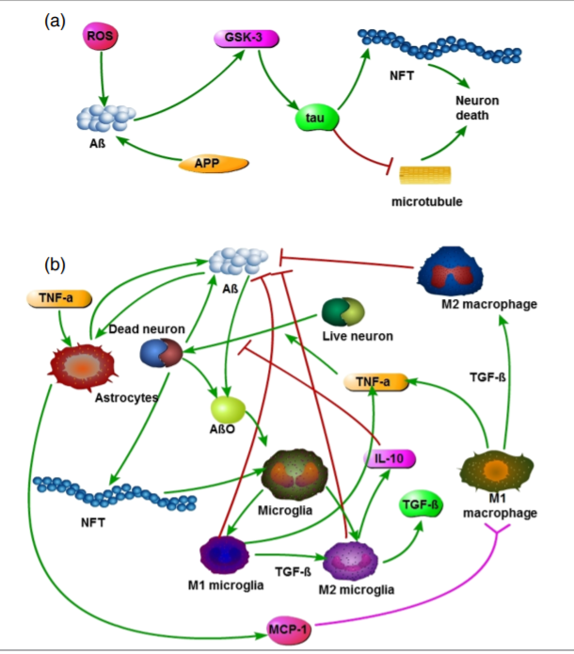
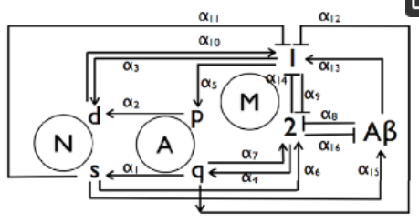
Model Design
Model A (Puri/Li) does not work
Model B (Hao/Friedman) works (mostly) but includes unwanted components
Built a new model:
Elements from A
Modified equations from B
B
A
Fig. 2 Hao, Wenrui, and Avner Friedman. , bmcsystbiol.biomedcentral.com/articles/10.1186/s12918-016-0348-2.
Notes:
Puri/Li: https://journals.plos.org/plosone/article?id=10.1371/journal.pone.0015176
Hao/Friedman https://bmcsystbiol.biomedcentral.com/articles/10.1186/s12918-016-0348-2
Equations are wrong, authors provided corrections but even with those corrections the result did not match the results the article presented. Our guess is that the parameters were significantly off and as the paper offered no justification for their parameters it was difficult to trust them. So we abandoned those equations but we still wanted a model that focused on those primary elements.
At this point as we were trying to fix the first model we came upon model B. It considered many more elements than we wanted to include but it’s results matched research data and the parameters were well justified. It took some wrangling but we were able to tease apart the key elements that we were most interested with relatively minor adjustments to the equations and parameters. By doing this we were able to reproduce the models results for the elements we were considering either exactly or with modest variations that were well explained by the removal of aspects of the model we did not include. So here is what we used.

Slide 32

λ_{To} =normal rate of production of T
R = effect ROS has on increasing production of Tau
Normal degradation of T
When the amount of Amyloidβ hits a threshold GSK-3 promotes hyperphosphorylation of T
Notes:
Hao/Friedman
Except for GSK-3 which is in Hao/Friedman but clearer in Hangar/Anderton/Noble
http://files.jorge-castillo5.webnode.es/200000106-c6809c7795/paper%20neurodegenerative%20disease.pdf
GSK-3 is not in the equation but we will consider it later as it is a current target of treatment to block this step.

Slide 33

Moved to outside the neuron
d_{NF} = death rate of neurons by NFT
Normal degradation
Notes:
Hao/Friedman

Slide 34
Equilibria analysis
There are equilibria at 0, 0, 0, 2.0, 0, 0, 0, 0.05, 0.005
The eigenvalues associated with these equilibria are -0.0155715854, -0.0150000000, -0.0150000000, -0.0011992871, -0.0002770000, -0.0001530612, 0.0000000000 0.0000000000, 0.0000000000
All of these values are either negative or equal to zero, which suggests that the equilibria are neutrally stable.

Slide 35

d_{NF} = death rate of neurons by NFT
K_{Fi} =Half-saturation of intracellular NFTs
Notes:
Hao/Friedman

Slide 36
Moved to outside the neuron
λ_{Nd} = rate of decline in number of neurons
Differ here from model B by parameterizing the rate of decline of number of neurons
Rate we chose is backed up by clinical data
Normal degradation
Notes:
Hao/Friedman

Slide 37


M_{G}⁰ = Source of microglia
K_{Fo} = average of extracellular NFTs
β_{M1} & β_{M2} are inflammation factors
We derived the inflammation factors from model B equilibrium points of factors we did not include in our model
Notes:
Hao/Friedman

Slide 38

λ _{AAβo} = Production/ Activation rate of astrocytes by amyloidβ
λ_{MA} = rate M₁ activates astrocytes by increasing presence of TNF-α
Normal death
We estimated λ_{MA}
Notes:
Hao/Friedman
We estimated lamdaMA since we did not model TNF-alpha

