Slide 1
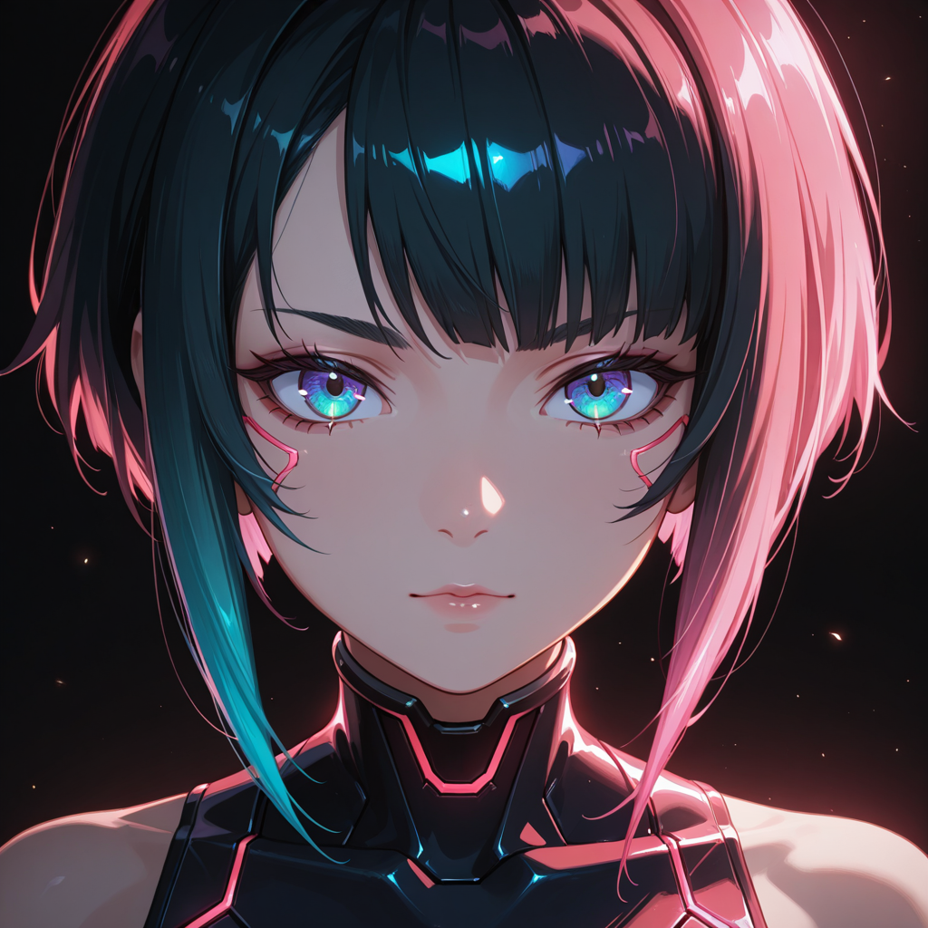
Fixing Stable Diffusion
VAE Spurious Bright Pixels
A Lightweight Traditional CV Approach
Image Processing & Visual Effects | Term Proposal
NYCU | Spring 2026
Notes:
各位老師、同學好，我是Phecda。
我的題目是「Fixing SDXL VAE Spurious Bright Pixels」
這個專題的核心想法非常簡單：解決Stable Diffusion生成圖片時由於VAE產生的被稱為Spurious Bright Pixels的微小瑕疵
Hello everyone, teachers and students.My topic is “Fixing Stable Diffusion VAE Spurious Bright Pixels".The core idea of ​​this project is very simple: to solve the tiny imperfections known as Spurious Bright Pixels caused by VAEs when generating images using Stable Diffusion.

Slide 2
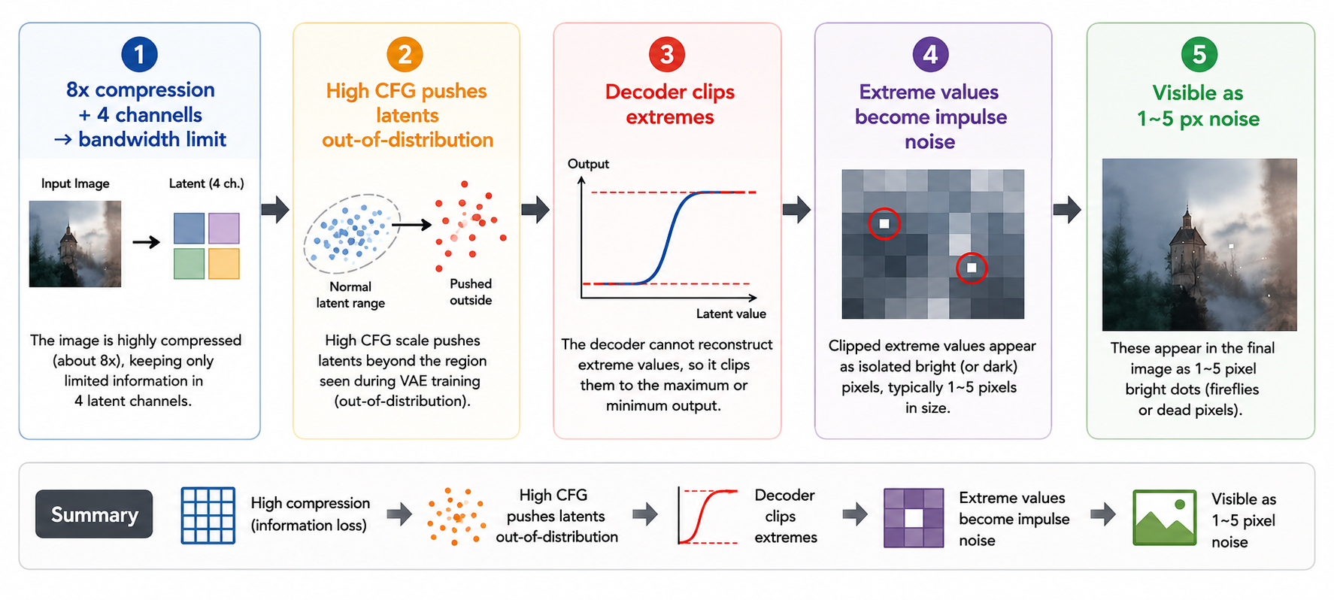
01 PROBLEM & MOTIVATION
What Are VAE Spurious Bright Pixels?
Notes:
那首先，什麼是 VAE Spurious Bright Pixels
VAE的decoder在Stable Diffusion生成圖片的時候負責將Diffusion Model生成的latent image重建為正常大小的圖片
由於Diffusin Model生成的latent image屬於高度壓縮的維度，大量高頻細節資訊只能由Decoder依靠訓練時學到的分布來重建
CFG（Classifier-Free Guidance）則是控制模型遵循 prompt 程度的參數。CFG 越高，模型越會強化由文字 prompt 所引導的生成方向。
然而，文字 prompt 本身只能提供有限的語意資訊，缺乏真實圖像中的大量細節與自然統計特徵。
因此，當 CFG 過高時，latent 可能被推離 VAE 訓練時所見過的自然分布（out-of-distribution）。
當 VAE Decoder 接收到這些超出訓練分布的極端 latent 值時，可能無法穩定重建，進而產生局部輸出飽和（output saturation）或異常高亮值。
在最終圖片中，這些異常值會表現為少量孤立的亮點或彩色像素，稱為Spurious Bright Pixels或者impulse noise
這些 artifact 並不只會出現在暗部或高對比區域，但由於亮度對比特別強烈，因此通常在這些區域最容易被觀察到。
由於這些 artifact 通常只來自少量異常 latent，因此在 1024×1024 圖像中，往往只有 1～5 個像素大小。

Slide 3
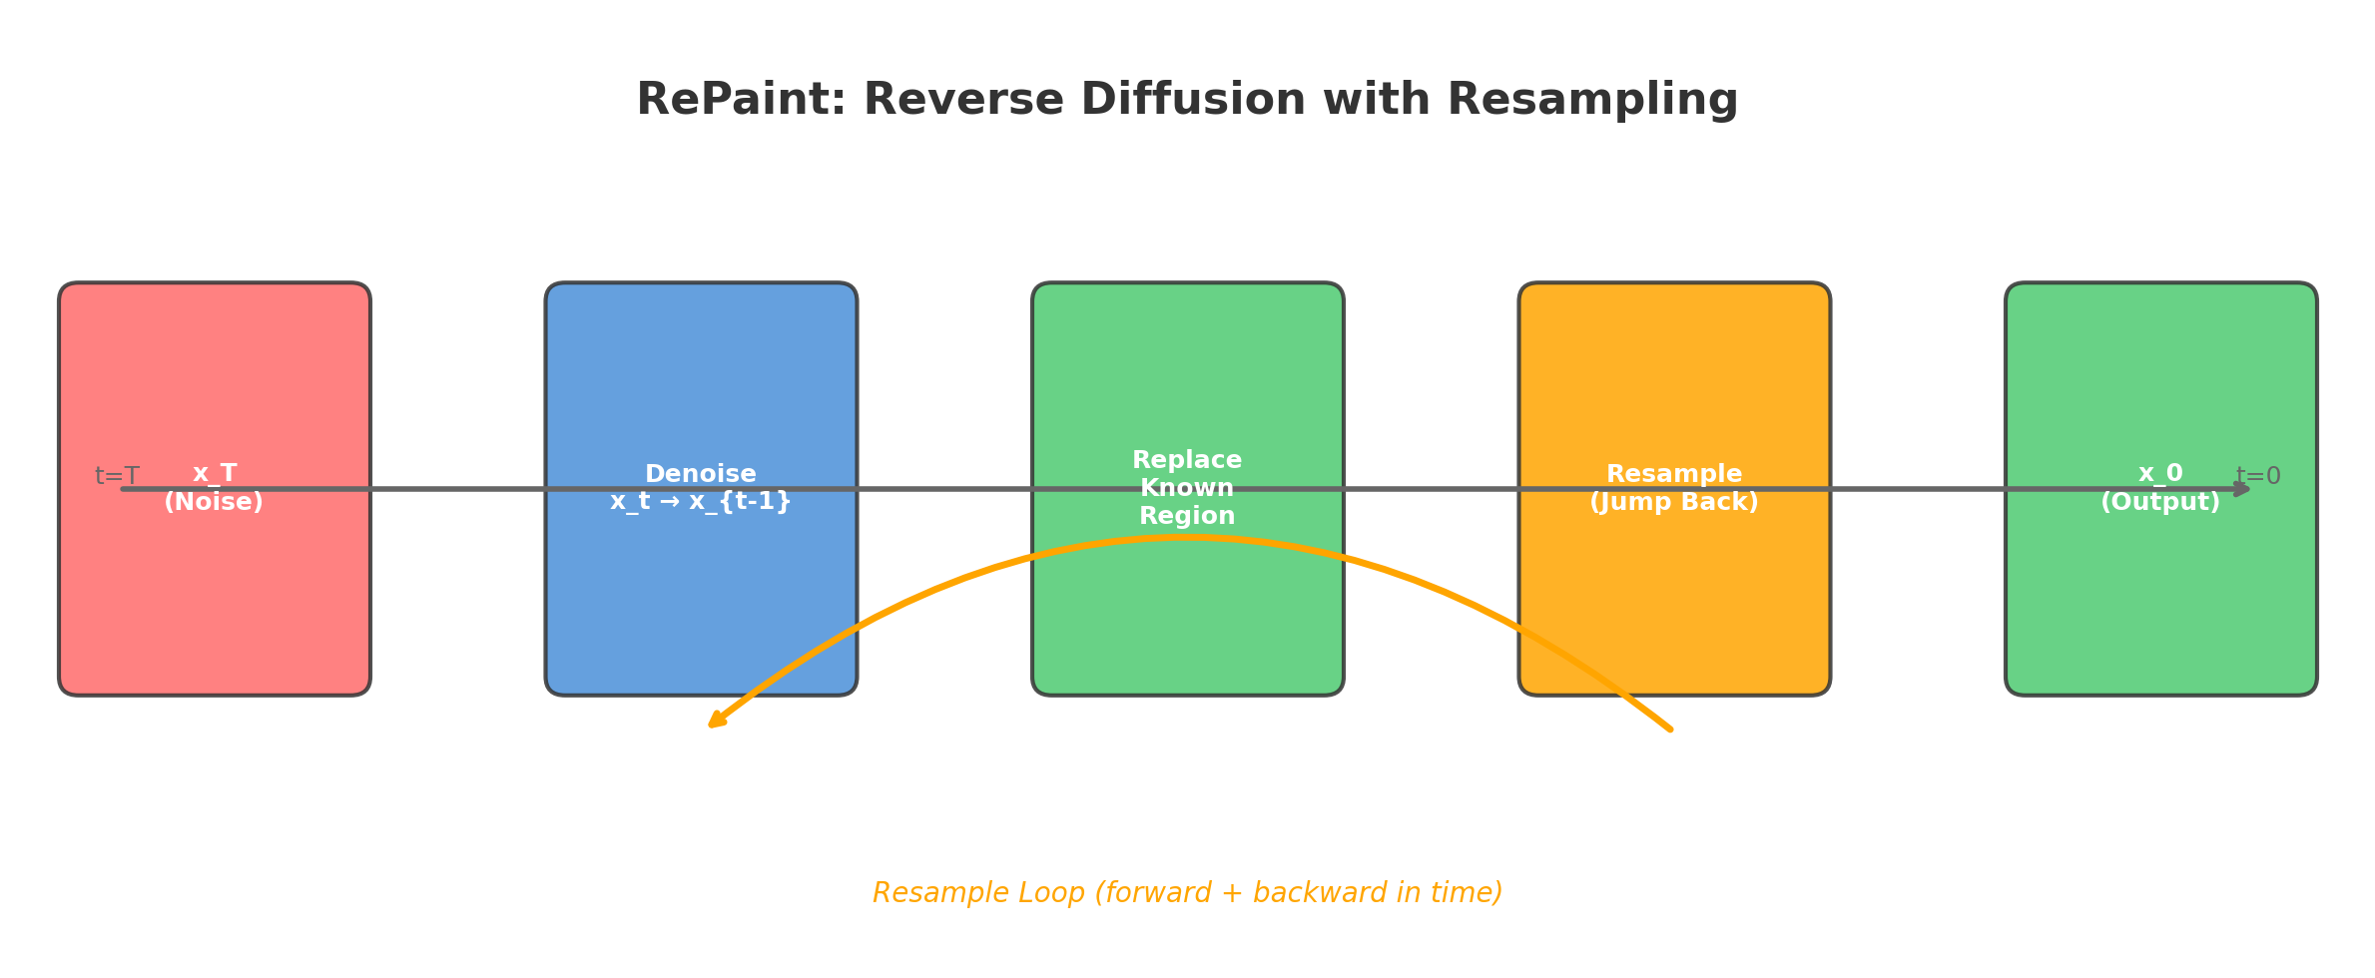
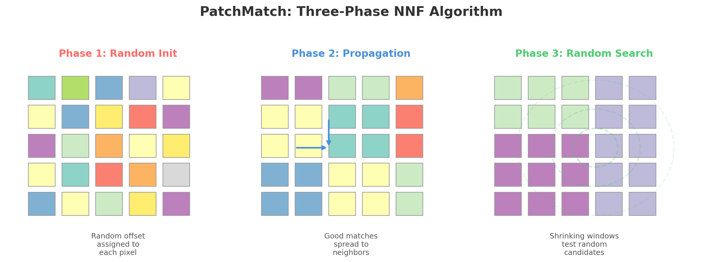
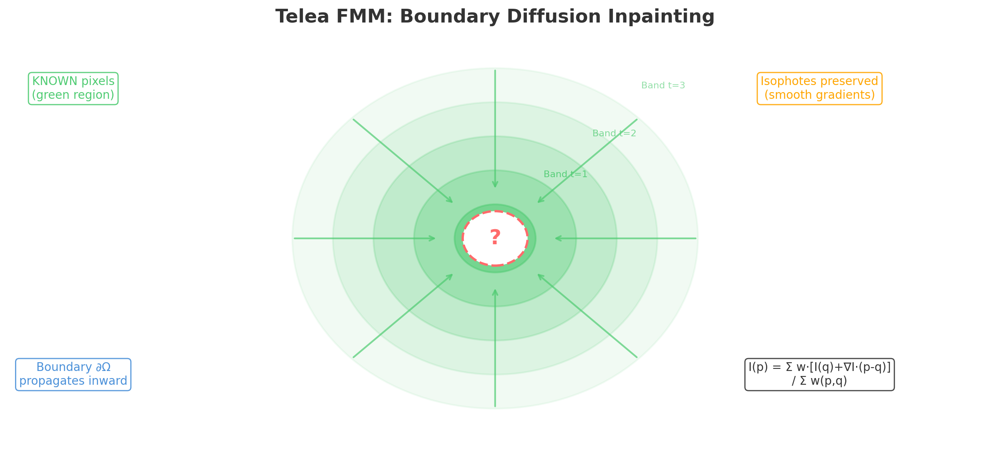
02 RELATED WORK
Three Inpainting Paradigms
Which method best suits micro-scale VAE artifact repair?
RePaint
PatchMatch
Telea FMM
CVPR 2022
ACM 2009
JGT 2004
Diffusion-Based
Patch-Based NNF
Boundary Diffusion
Pretrained DDPM prior;
resample for coherence
Randomized NNF search;
patch copy from full image
Boundary propagation;
isophote-preserving avg
Too heavy for small pixels
Over-engineered for tiny holes
Suitable for small region repair
Notes:
接下來我會介紹三種相關的解決方案
此處選出三種可用於處理前述狀況的方法。
RePaint 代表擴散模型修補，PatchMatch 代表區塊紋理合成，Telea FMM 代表 PDE 邊界擴散。
Next, I will introduce three related solutions: RePaint represents diffusion model patching, PatchMatch represents block texture synthesis, and Telea FMM represents PDE boundary diffusion.

Slide 4
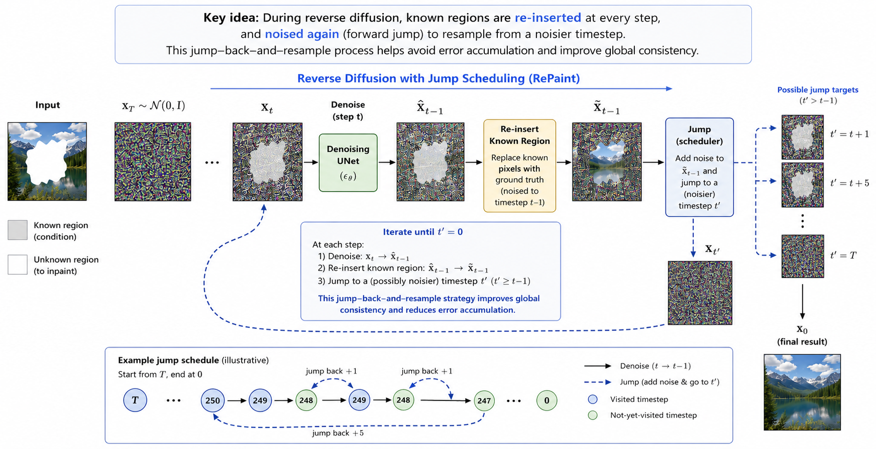
02 RELATED WORK ▸ RePaint (CVPR 2022)
RePaint: Diffusion-Based Inpainting
Why NOT Suitable for Our Problem?
250-1000
8-12 GB
sec ~ min
diffusion steps
for 3 pixels
VRAM at
256x256
latency per
single image
Semantic generation is powerful — but unnecessary for impulse noise repair.
Notes:
第一個方法是 RePaint
其核心機制為，利用mask將待修補圖片分成Known Region與UnKnown Region
在去噪過程中，對於Known Region，會直接用原圖加上對應time step的noise
UnKnown Region則進行正常的去噪流程
兩者會在該步去噪完成後進行拼接
並且為了確保拼接自然，會在拼接後resample到上一步後再次去噪
此外，為了讓模型能在整個去噪過程中更有效地整合語義資訊，RePaint 還引入了跳躍長度 (Jump length)的概念，透過一次跨越多個時間步長進行反覆的正向與反向操作，提升最終圖像的和諧度與語義合理性
雖然這是一個強大的方法，但我認為這不適用於當前情境
為了1~5像素的缺陷要跑兩百五十到一千步擴散、需要八到十二 GB 顯存、延遲是秒到分鐘級並不值得
The first method is RePaint.Its core mechanism is to use a mask to divide the image to be repaired into Known Regions and Unknown Regions.During the denoising process, for Known Regions, the original image is directly supplemented with noise at the corresponding time step.Unknown Regions undergo normal denoising.The two are then stitched together after this denoising step.To ensure a natural stitch, the image is resampled to the previous step and denoised again after stitching.Furthermore, to allow the model to more effectively integrate semantic information throughout the denoising process, RePaint introduces the concept of jump length. By repeatedly performing forward and reverse operations across multiple time steps, it improves the harmony and semantic plausibility of the final image.While this is a powerful method, I believe it is not suitable for the current situation.Running 250 to 1000 diffusion steps for a 1-5 pixel defect, requiring 8 to 12 GB of GPU memory, and with latency in the seconds to minutes range is not worthwhile.

Slide 5
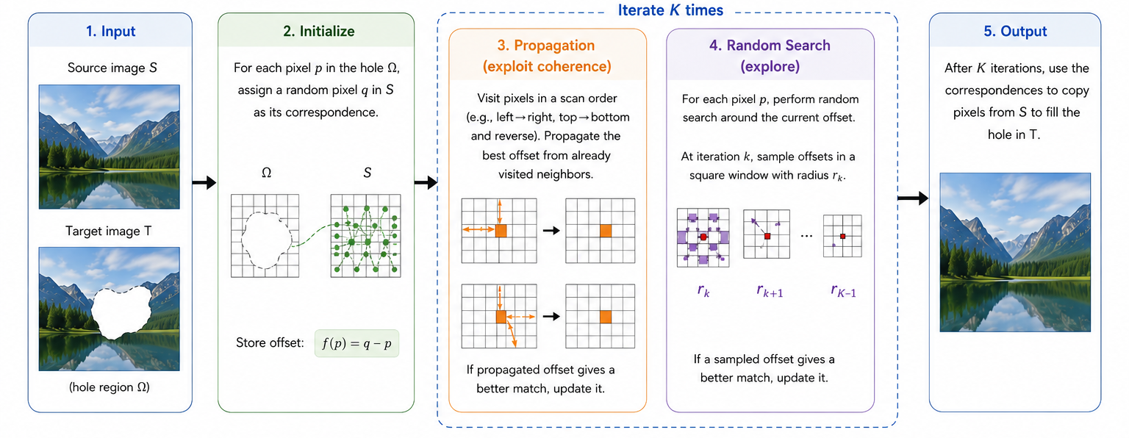
02 RELATED WORK ▸ PatchMatch (ACM SIGGRAPH 2009)
PatchMatch: Randomized Patch-Based Synthesis
Strengths
Why NOT for Here?
Excellent for large object removal
Preserves complex textures (grass, brick)
20-100x faster than prior NNF methods
Full-image search for small hole = waste
May copy unrelated distant textures
Designed for macro, not micro repair
Notes:
第二個方法是PatchMatch
該方法首先用slide window覆蓋待修補區，取與widow相同大小的patch，並隨機取source image中同樣大小的patch配對在一起
接著進入迭代優化的階段，
首先，待修補區的每一個patch，會檢查其鄰居patch的配對，如果鄰居的結果更好，就直接複製它的Offset
接著，每個待修補區patch以配對到的patch位置為中心的一定範圍進行隨機抽樣，這個範圍會逐漸縮小直到找到局部最佳解
不斷重複上述步驟，直到達到iteration次數或者完全收斂(結果完前相同)
最後，會得到一個待修補區域的每個patch與source image中patch的對照表
每個待修補區域的pixel會有多個patch重疊在上面，會依據每個patch對應到的source match上對應位置的pixel進行投票，選出最合適的顏色
這種方法很適合用於大面積物件移除、複雜紋理重建，並且速度相較於前一種方法快了非常多。
但如先前所述，這種方法更適合大面積的修補，針對為小瑕疵的修補就進行全圖的搜索除了太浪費外，亦可能引入不相關的紋理
"The second method we will be looking at today is PatchMatch."
"To begin, the algorithm covers the target area—the region we want to inpaint—using a sliding window to extract patches of a specific size. Initially, these patches are randomly paired with patches of the exact same size from the available source image.
Next, we enter the iterative optimization phase, which is the core of this algorithm. This phase consists of two alternating steps:
First, Propagation: For every patch in the target area, the algorithm checks the matching results of its immediate neighbors. If a neighbor's offset provides a better match—meaning the source patch it points to is more similar—the current patch simply adopts, or copies, that neighbor's offset.
Second, Random Search: Taking the currently matched patch's location in the source image as a center point, the algorithm performs random sampling within a specific radius. This search radius gradually shrinks, allowing the algorithm to fine-tune and find the best local optimum.
These two steps—propagation and random search—are continuously repeated. The loop stops either when it reaches a predefined maximum number of iterations, or when it fully converges, meaning the matching results stop changing.
Ultimately, this iterative process generates a complete lookup table, mapping every single patch in the target area to its best matching patch in the source image.
Now, for the final reconstruction. Because the sliding windows overlap, each individual pixel in the target area will have multiple patches overlapping it. To resolve this, the algorithm uses a voting mechanism. It looks at the corresponding pixels from all the matched source patches and essentially 'votes' or averages them out to determine the most appropriate final color for that specific pixel.
To summarize its applications: This method is incredibly well-suited for large-scale object removal and complex texture reconstruction. Moreover, its speed is significantly faster compared to the previous method we discussed.
However, there is a catch. As I mentioned earlier, PatchMatch is primarily designed for large-area inpainting. If we are only trying to fix minor, microscopic blemishes, running a full-image search using this method is not only a waste of computational resources, but it also risks pulling in irrelevant textures from other parts of the image."

Slide 6
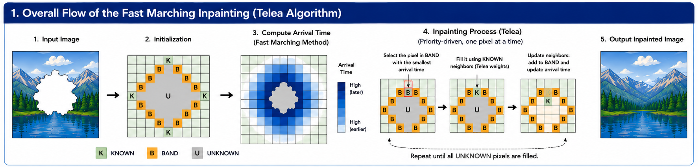
02 RELATED WORK ▸ Telea FMM (JGT 2004)
Telea FMM: Fast Marching Boundary Diffusion
PERFECT for Our Problem
Notes:
第三個方法是Telea FMM
算法首先依據使用者提供的遮罩將圖片分成三個區塊
灰色的已知區域、白色的未知區域，以及分隔兩者的紅色邊界
接著，算法會沿著邊界找到破洞內最外圈的像素，稱為band 0，這也是最先要被修補的地方
接著，算法從band 0開始走往內走訪每個像素，並記錄對應的抵達時間，作為修補順序的參考
在為每個像素算出順序後，從最先、最早抵達的band0開始，進行修補
理論上每完成一個像素的修補，就會更新其鄰居的抵達時間，後再選擇抵達時間最早的pixel進行下一輪修補
但實作上會先計算完所有pixel的抵達時間後依序進行修補
The third method is the Telea FMM.
First, the algorithm divides the image into three regions based on the mask provided by the user: the gray known region, the white unknown region, and the red boundary separating the two.
Next, the algorithm traces along the boundary to find the outermost ring of pixels inside the hole. This is called "band 0," and it is the very first area to be inpainted.
Starting from band 0, the algorithm traverses inward, visiting each pixel and recording its corresponding "arrival time." This time serves as a reference for the inpainting sequence. After calculating the order for every pixel, the inpainting process begins from band 0, which has the earliest arrival time.
Theoretically, every time a pixel is inpainted, its neighbors' arrival times are updated, and the pixel with the next earliest arrival time is chosen for the next round. In actual implementation, however, the algorithm first computes the arrival times for all pixels and then carries out the inpainting sequentially.

Slide 7
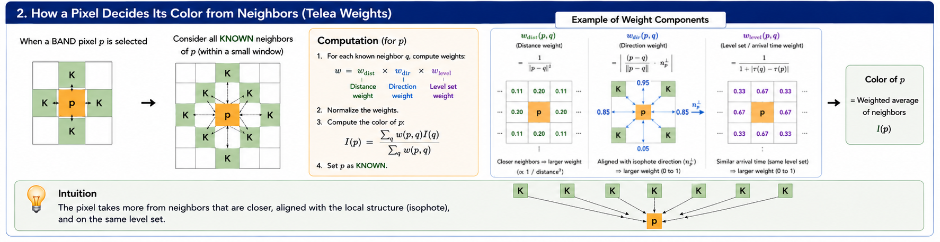
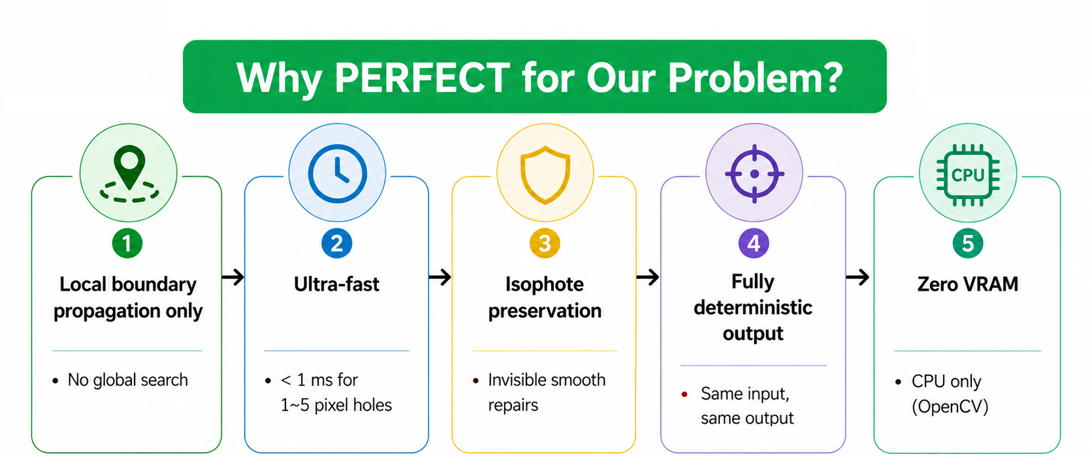
02 RELATED WORK ▸ Telea FMM — Algorithm Detail
Telea FMM: Fast Marching Boundary Diffusion
Why PERFECT for Our Problem?
Notes:
對於要修補的點P，會參考半徑範圍內的所有已知鄰居點q
對於每個鄰居點q，會用一階近似推測由q往p處延伸，p點應該要是什麼顏色
接著，會依據q指向p的方向性、距離以及q抵達p的時間對應的輪廓層次計算出權重w
完成所有q點對p點顏色的預測及權重後，將所有預測進行加權得到要填入p點的顏色
當所有像素都按照順序完成修補，就能得到完成修復的圖片
由於演算法不會去整張圖搜尋，只會看破洞附近的像素並用周圍顏色往內填補
速度快且適合填補小空缺，非常適合我們此刻的問題
For a target point P to be inpainted, the algorithm looks at all known neighboring points q within a specific radius. For each neighbor q, it uses a first-order approximation to estimate what color point P should be, as if extending from q to P.
Then, a weight is calculated based on three factors: the direction from q to P, the geometric distance, and the level set corresponding to the arrival time. Once the color predictions and weights from all points q are calculated, they are combined using a weighted average to get the final color to fill into point P.
When all pixels are inpainted in this calculated order, we get the fully restored image.
Because this algorithm doesn't search through the entire image, but instead only looks at the pixels near the hole and fills inward using surrounding colors, it is very fast and highly suitable for filling small gaps. This makes it a perfect fit for the problem we are trying to solve right now.

Slide 8
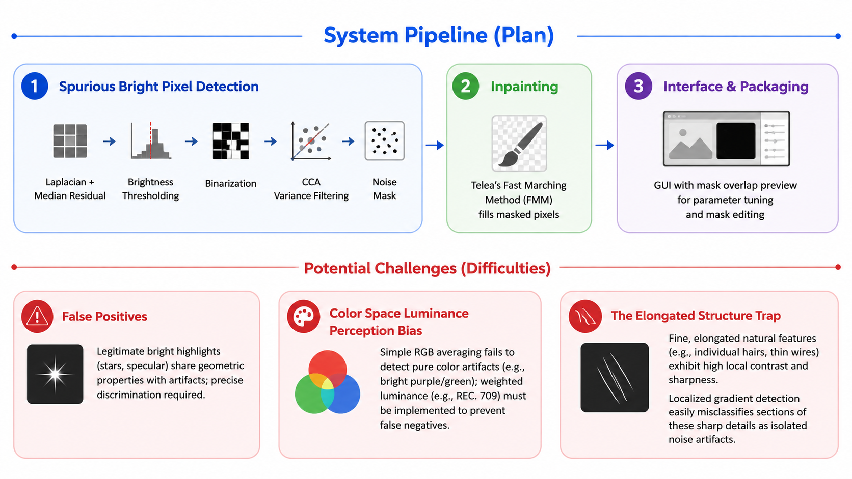
03 MY PLAN
Plan & Potential Challenges
Notes:
接下來介紹我的計畫。
系統分四個步驟：
一、用拉普拉斯加Median Residual以亮度作為閾值找出候選像素，再透過CCA與方差過濾去除誤報，得到精準遮罩；
二、交給Telea FMM進行修補；
三、提供帶紅色遮罩預覽的GUI供即時參數調整甚至讓使用者對遮罩進行編輯；
此計畫的難點在於：
一 、合法亮點與artifact有時候非常相似，難以區分他們
二、有時候噪點並非表現為亮度非常凸顯，而是呈現微與周圍格格不入的純色塊
三、細長自然結構（如髮絲、細線）具有極高的局部對比與銳利度。局部梯度偵測很容易將這些銳利細節的片段誤判為孤立的噪點。

Slide 9
REFERENCES
References & Open-Source Libraries
Papers
[1] Telea, A. “An Image Inpainting Technique Based on the Fast Marching Method.” Journal of Graphics Tools, 2004.
[2] Barnes, C. et al. “PatchMatch: A Randomized Correspondence Algorithm for Structural Image Editing.” ACM SIGGRAPH, 2009.
[3] Lugmayr, A. et al. “RePaint: Inpainting using Denoising Diffusion Probabilistic Models.” CVPR, 2022.
Open-Source Libraries
OpenCV — cv2.inpaint (Telea FMM implementation) + image I/O
NumPy — array operations, mask generation
ComfyUI — custom node framework for Stable Diffusion workflow integration
Pillow (PIL) — image format conversion and preprocessing
Notes:
最後是參考資料。論文部分引用三篇：Telea 2004年的FMM inpainting原始論文、Barnes 2009年的PatchMatch，以及Lugmayr 2022年的RePaint。開源函式庫使用OpenCV的cv2.inpaint做FMM修補、NumPy做遮罩計算、ComfyUI做節點打包、Pillow做圖片格式轉換。以上是我的報告，謝謝大家。

