Slide 1
IMAGE MANIPULATION TECHNIQUES & VISUAL EFFECTS · FINAL PRESENTATION
Fixing SDXL VAE
Spurious Bright Pixels
A Lightweight Traditional Computer-Vision ComfyUI Node
314551028 范家齊
Laplacian + Median Residual › CCA › LAB-Cliff Verification › Telea FMM Inpainting

Slide 2
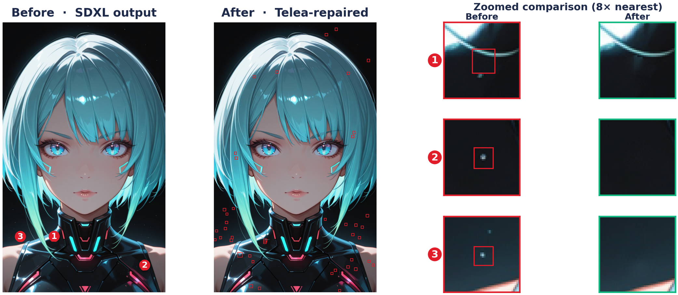
01 · PROBLEM & MOTIVATION
What Are VAE Spurious Bright Pixels?
Project goal: Locate and repair these pixels using traditional algorithms without relying on any models, solving the issue at a much lower cost.
SDXL VAE Noise-Fix · Traditional-CV ComfyUI Node
2
Notes:
The problem I’m solving is a specific SDXL artifact.
The root cause is a bandwidth bottleneck.
The VAE has to squeeze latents through an 8 times compression with just four channels.
When use a high CFG scale, it pushes latents out of distribution, causing the final layers to clip them.
These isolated dead pixels appear as white, black, or pure color dots, and they are especially noticeable in dark areas.
Although these pixels cover less than one percent of the image, fixing them manually is incredibly tedious, and using a model to repair them is far too computationally expensive.
The goal of this project is to locate and repair these pixels using traditional algorithms without relying on any models, solving the issue at a much lower cost.

Slide 3
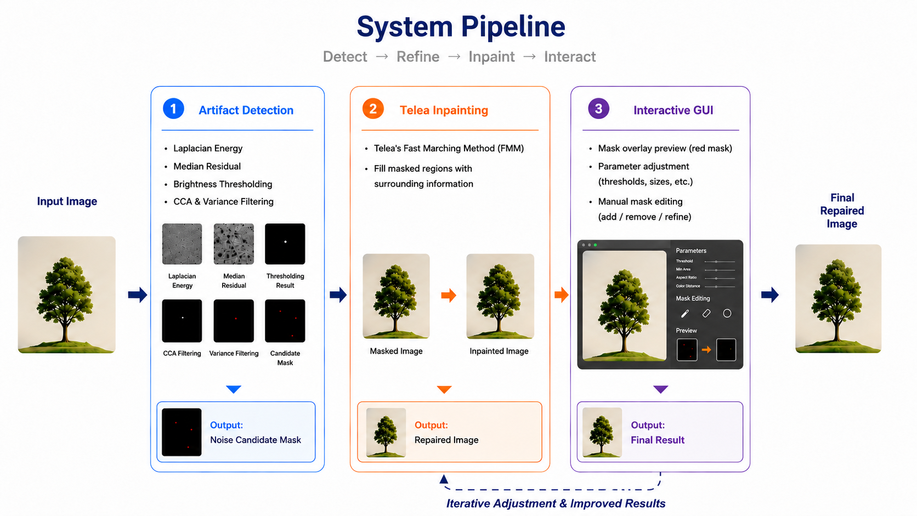
02 · SYSTEM & METHODS
System Overview
Telea FMM chosen for micro-scale repair · full survey covered in our proposal.
SDXL VAE Noise-Fix · Traditional-CV ComfyUI Node
3
Notes:
整個系統分成三個步驟
一、用拉普拉斯加Median Residual以亮度作為閾值找出候選像素，再透過CCA與方差過濾去除誤報，得到精準遮罩；
二、交給Telea FMM進行修補 Telea FMM is a method that Repair from the edge；
三、提供帶紅色遮罩預覽的GUI供即時參數調整甚至讓使用者對遮罩進行編輯；
The whole system breaks down into three steps.
First, artifact detection. We use the Laplacian and the median residual together, with a brightness threshold, to find the candidate pixels.
Second, repair. We hand that mask to Telea's Fast Marching Method, which fills the masked regions using the surrounding information.
Third, an interactive GUI. It offer a red mask overlay preview so we can edit the mask by hand to add, remove, or refine regions to avoid omissions or false positives.
Since most of this builds on the related work we already covered, I will keep it brief and move on to how the detection actually works.
For example, what would be the size of these noises in the image, or what area would be used to cover them after their location is found?
調整：adjust

Slide 4
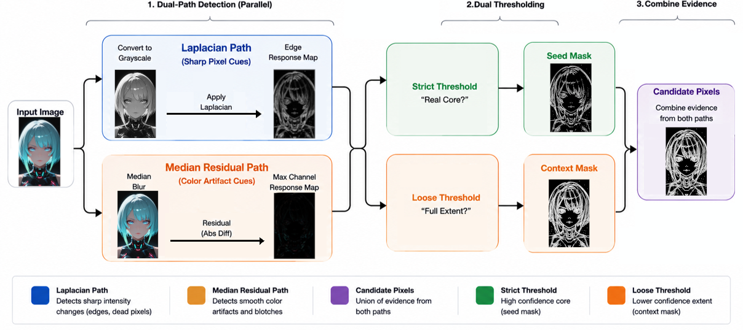
02 · SYSTEM & METHODS
Detection Methodology I — Dual-Path Detection
SDXL VAE Noise-Fix · Traditional-CV ComfyUI Node
4
Notes:
Next, let me explain the detection logic in this project.
We start from the input image on the far left, and it enters two paths at the same time.
The top one is the Laplacian path, which looks for sharp pixel cues. We first convert the image to grayscale, apply a Laplacian filter, and get an edge energy map. The Laplacian reacts to how sharply the brightness changes, so it fires strongly wherever a pixel differs greatly in luminance from its neighbors.
That is exactly why it is good at catching the hard, sharp dead pixels, whether they are pure white on a dark area or pure black on a bright one, because both are a steep brightness jump.
The bottom one is the median residual path, which looks for color cues.
We first apply a median blur, then subtract it from the original to get the residual, and finally keep the strongest color channel.
Because a median blur ignores lone extreme pixels, this path responds to the smooth blotches that simply do not match the background color, such as the purple and green bleed, and that is the kind of artifact the Laplacian path tends to miss.
The results from both paths are then merged into a single set of candidate pixels.
After that, we use two different thresholds to obtain two things.
The strict threshold asks whether there is a real high energy core here, which lets us pinpoint the precise location of the noise.
The loose threshold asks how far the noise actually extends, which lets us define the extent of the repair mask.
劇烈的：drastic
被認為：be considered as
接下來說明專案中的偵測邏輯。
從最左邊的輸入影像開始，它會同時進入兩條路徑。
上面的是 Laplacian 路徑，負責抓「銳利的像素線索」。
先把影像轉成灰階，套用 Laplacian 濾鏡，得到一張邊緣能量圖。這條路徑會在某個像素跟周圍鄰居差異很大的地方產生強烈反應，所以它特別擅長抓那種又硬又銳利的死點。
下面這條是中值殘差路徑，負責抓「顏色線索」。先做中值模糊，再用原圖減掉它得到殘差，然後取反應最強的色彩通道。
因為中值模糊會忽略掉單一的極端像素，所以這條路徑會在那種平滑、跟背景顏色格格不入的色塊上有反應，例如紫色、綠色的溢色，而這正是 Laplacian 容易漏掉的部分。
兩條路徑的結果會合併成一組候選像素。
接著在用兩個不同的門檻得到兩個要件。
嚴格門檻問的是：這裡有沒有一個真正的高能量核心？這能用來定位noise的精確位置。
寬鬆門檻問的是：這個噪點實際上延伸到多大範圍？這能用來定位遮罩的範圍。

Slide 5
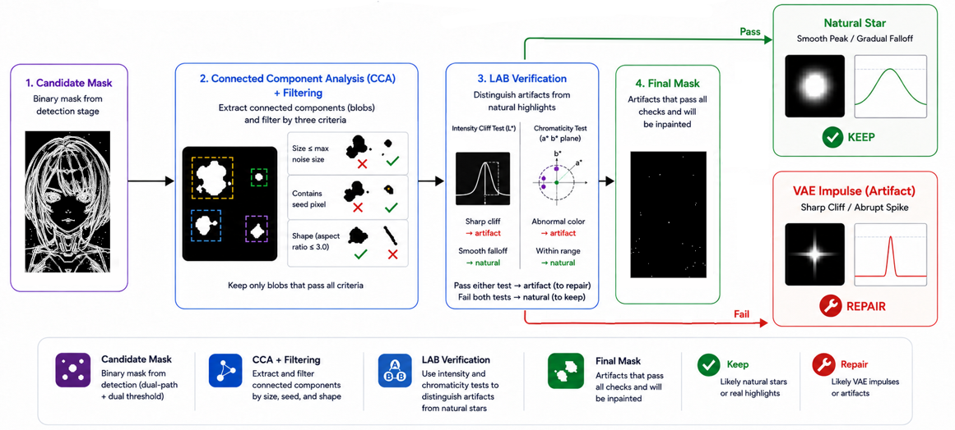
02 · SYSTEM & METHODS
Detection Methodology II — Structural & LAB Verification
SDXL VAE Noise-Fix · Traditional-CV ComfyUI Node
5
Notes:
到這一步，輪廓遮罩已經把所有可疑區域都標出來了，但裡面難免混入「不是異常像素但長得有點像」的東西，例如：頭髮中的一根、衣服上的細格紋、極小的反光高光等。
這一步用**連通域分析 (Connected Component Analysis, CCA)**
這是一種把「相鄰相連的同色像素」歸為同一群（稱為一個 *blob*）的演算法，把每個 blob 拆出來，然後逐一檢查三道條件：
1. **大小檢查**：候選 blob 的尺寸不能比使用者設定的最大噪點尺寸大太多；明顯比設定值大的視為大物件，不符合噪點特性。
2. **核心檢查**：blob 內部必須含有「核心遮罩」中的種子像素（也就是真的存在強烈異常的核心），否則只是個低能量的微小區塊，不算真噪點。
3. **形狀檢查**：對 blob 計算最小外接旋轉矩形，量它的長寬比；若長寬比過於懸殊（例如 3:1 以上），表示它是頭髮、細線、刮痕這類**細長結構**，而不是緊湊的小點，捨棄。
長寬比：aspect ratio
錯認：misidentification
亮度：brightness
細長結構：Slender structure
滿足：satisfy
表現為：shown as
變化率：rate of change
主觀因素：Subjective factors
分開：seperate
接下來，會利用 LAB 色彩空間區分異常像素與自然亮點或色塊
兩者間最可能的區別是後者從中心到外圍過渡是平滑的；異常像素則是斷崖式的脈衝，幾乎沒有過渡。
此處會同時進行亮度、色彩兩道檢查
只要其中一者與周圍的落差過大、沒有過度就判定為異常像素，需要修補
Is the rate of change in brightness or color in the candidate region abrupt or gradual?
候選區域的亮度或色彩變化率是劇烈的還是漸進的

Slide 6
03 · RESULTS
Results — Before & After Repair
Image Prompt:
A close up portrait of a cyberpunk girl, pure black background, cinematic rim lighting, highly detailed, 8k resolution, sharp focus
SDXL VAE Noise-Fix · Traditional-CV ComfyUI Node
6
Notes:
消失：disappear

Slide 7
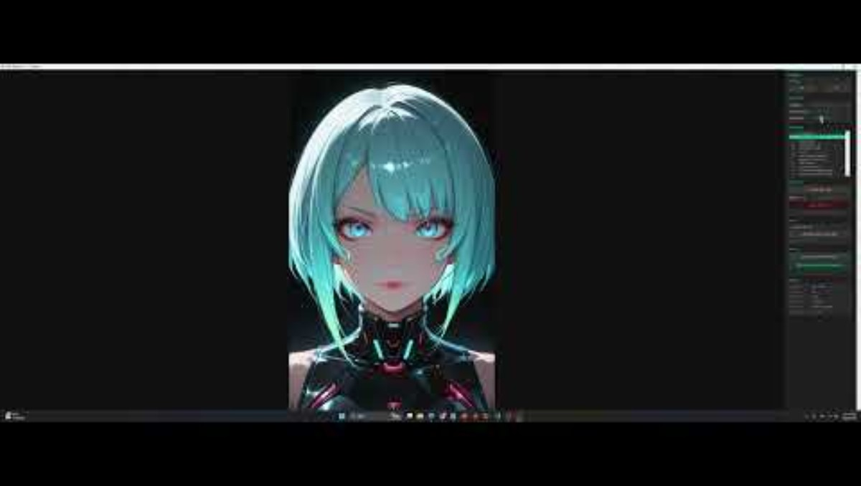
03 · DEMO
Live Demo
SDXL VAE Noise-Fix · Traditional-CV ComfyUI Node
7
Notes:
主觀因素：Subjective factors

Slide 8
04 · CONCLUSION
A purpose-built classical-CV pipeline removes SDXL VAE spurious bright pixels in milliseconds, on the CPU, with zero model weights — preserving the detail a full diffusion repaint would erase.
FUTURE WORK
FUTURE WORK
Adaptive sensitivity
Temporal consistency
Per-region thresholds so star fields and dark portraits coexist in one pass.
Frame-to-frame coherence for video / animation sequences.
Thank you · Questions?
范家齊 · NYCU · Spring 2026

