Slide 1
Android GUI
Project #4
Russell Shanahan

Slide 2
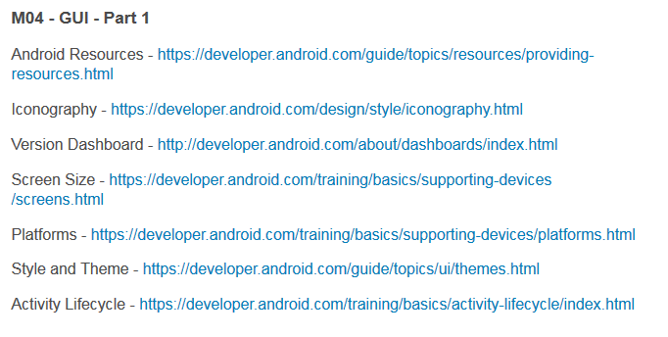
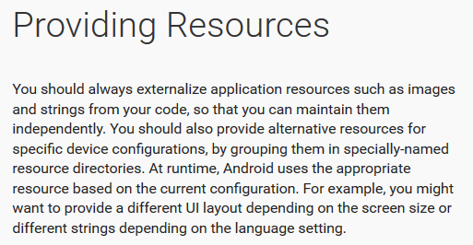
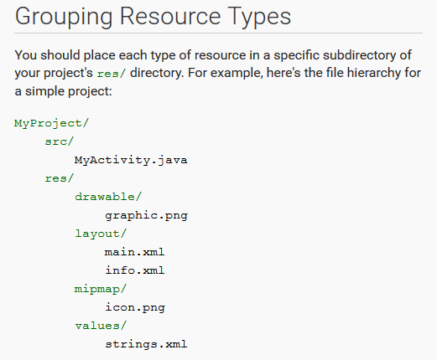
Android Developer Site:
…good reading…it’s the “Book”

Slide 3
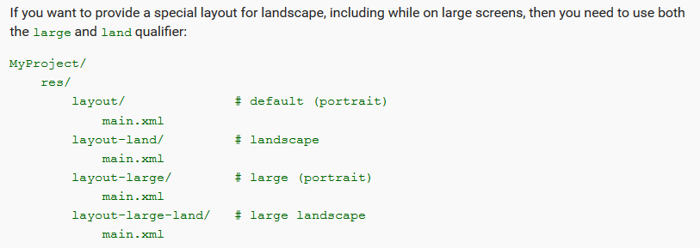
Screen Size processing described:
same filename
different directory (special name)
Android auto-uses correct xml for the device

Slide 4
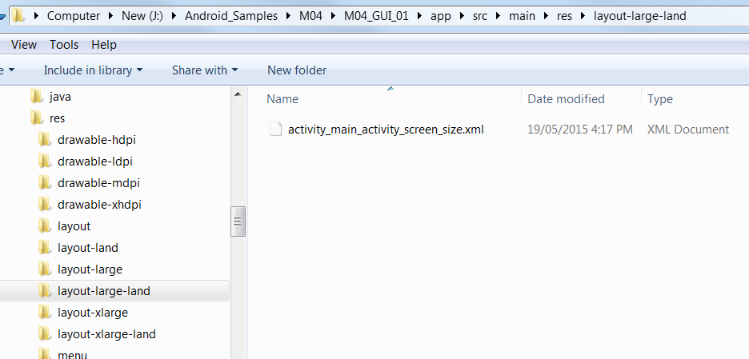
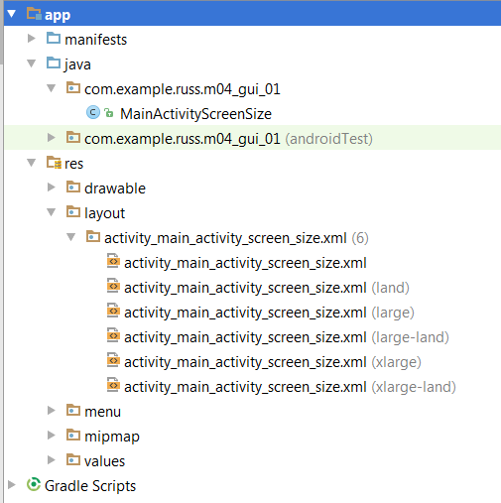
M04 project:
Has several “layout” directories
Each has same filename xml

Slide 5
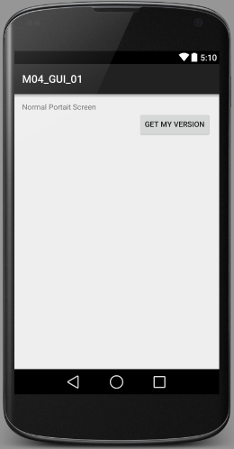
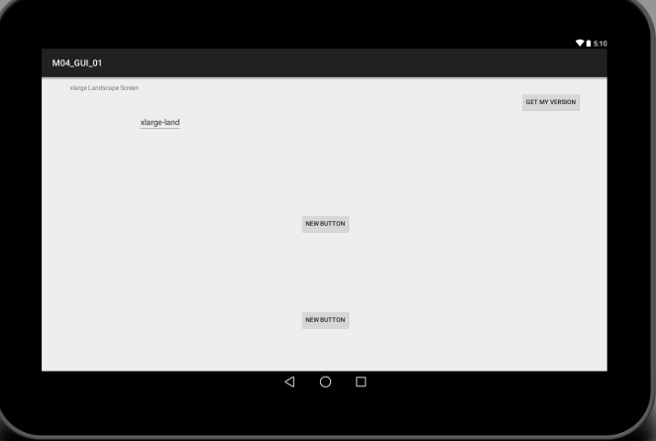
Different files can be the same (if possible),
Or completely different.

Slide 6
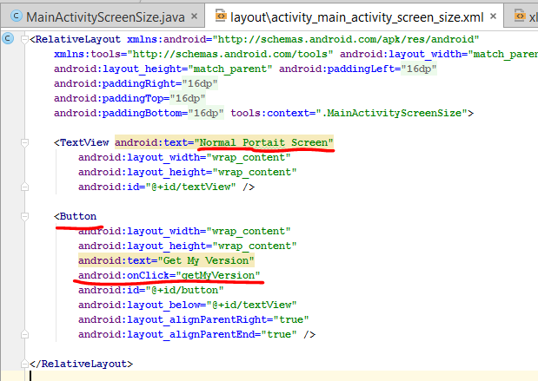
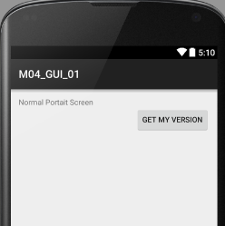
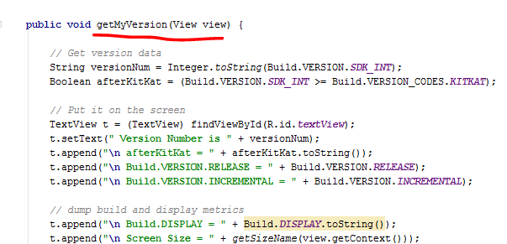
M01 project: All xml files have “Get My Version” button,
Which runs the getMyVersion() method.

Slide 7
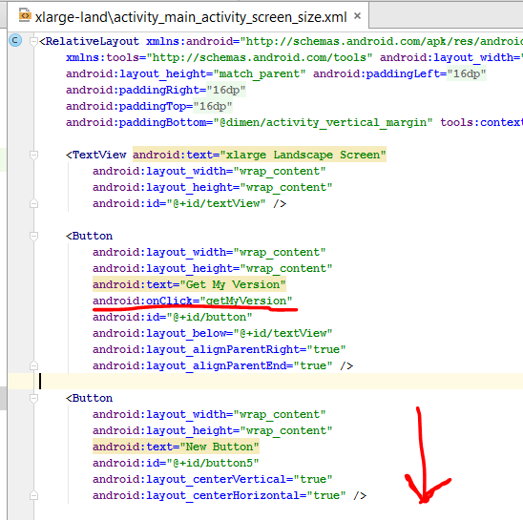
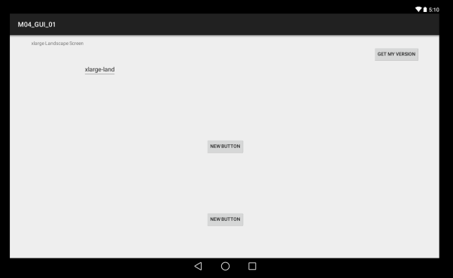
M01 Project: May be too small to see here,
But check for it in the project.

Slide 8
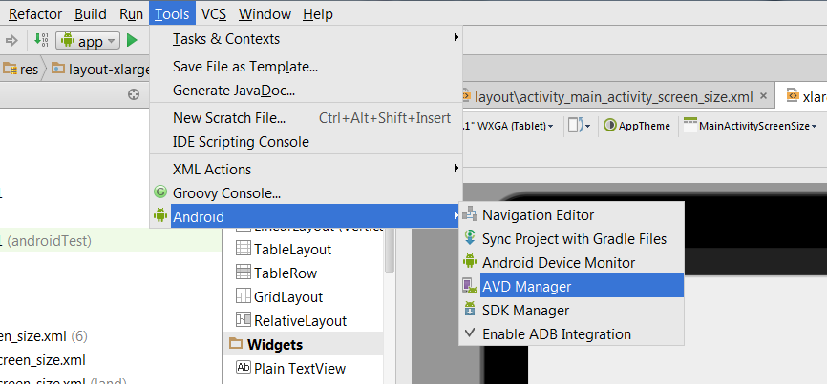
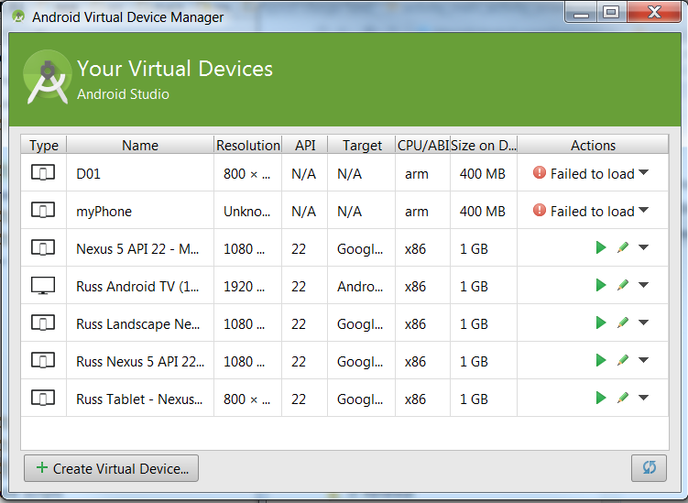
Make new emulators to test the different size/orientation/platform/API

Slide 9
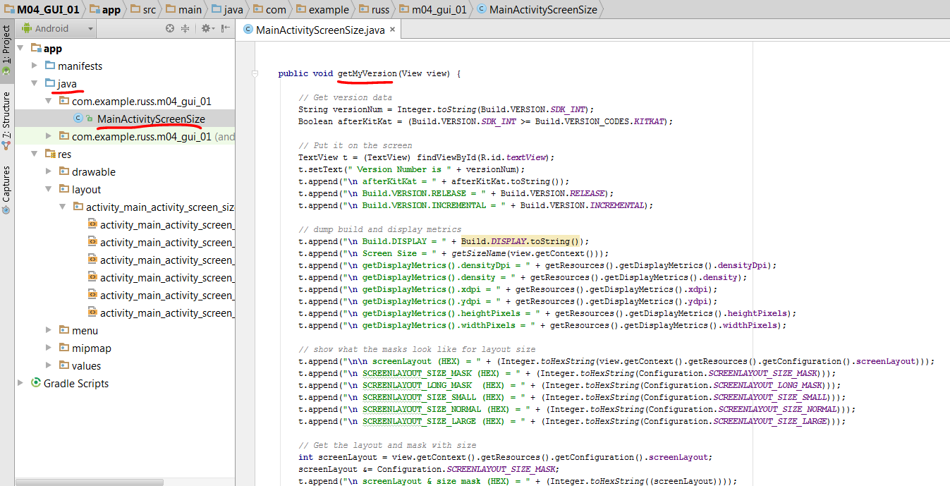
getMyVersion() code: display build parameters

Slide 10
…unmask and find screen layout size.

Slide 11
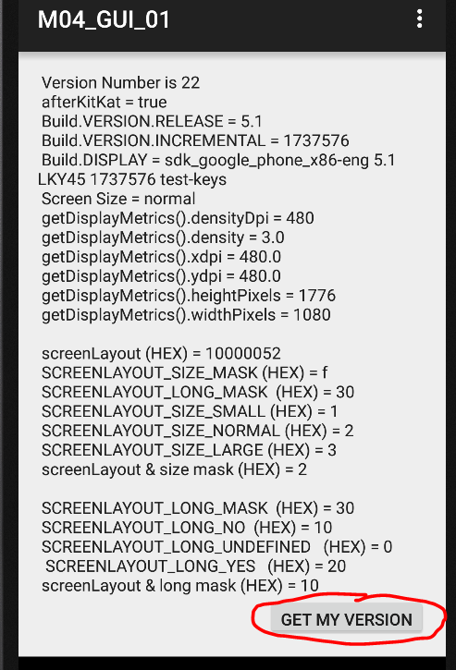
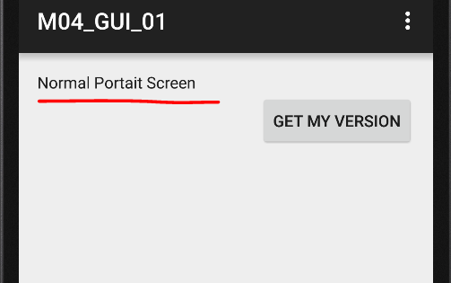
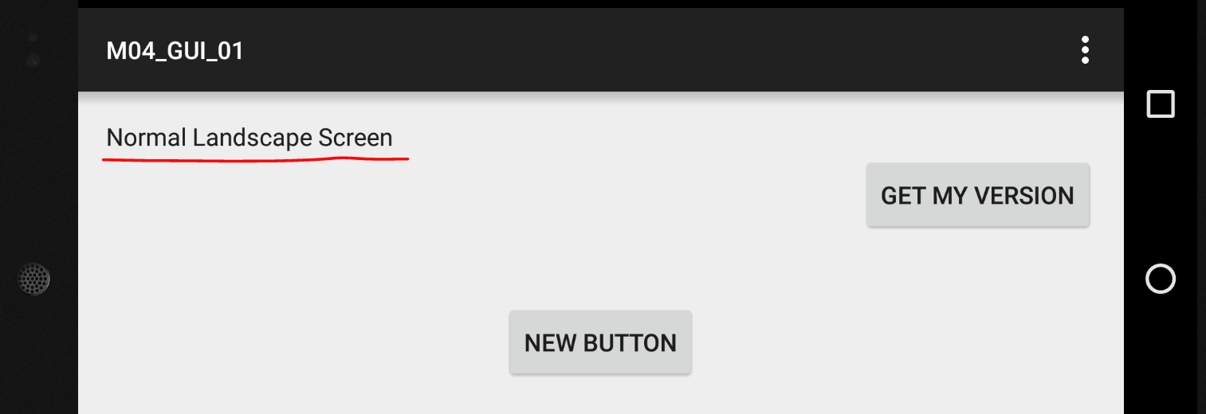
M01 Project: running on different emulators

Slide 12
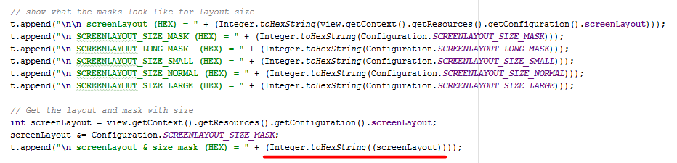

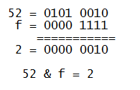
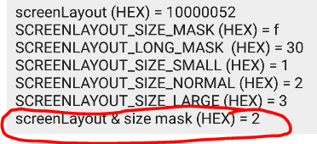
Unmasking the layout size
In this case, Layout Size = Normal
52&f = 2 and Normal=2

Slide 13
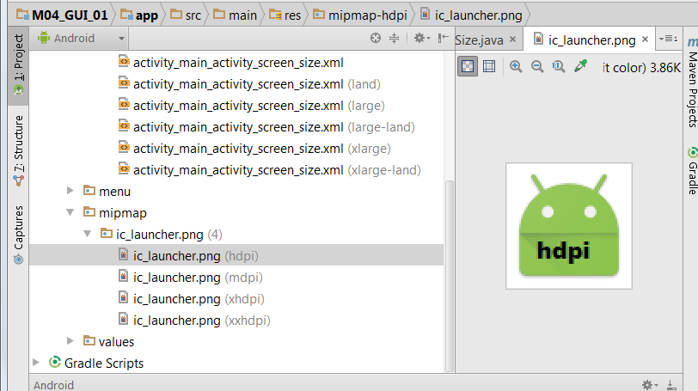
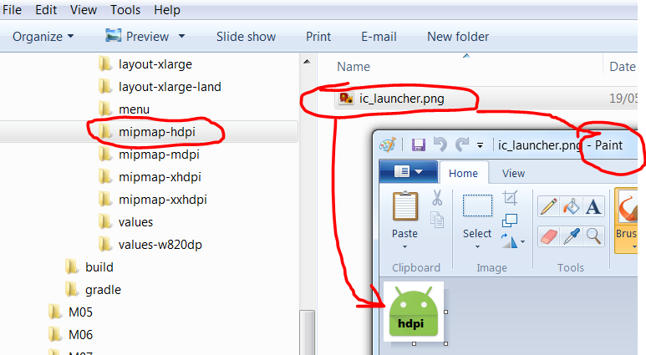

Launcer Icon: same deal, same name, different directories
Use paint to change them

Slide 14
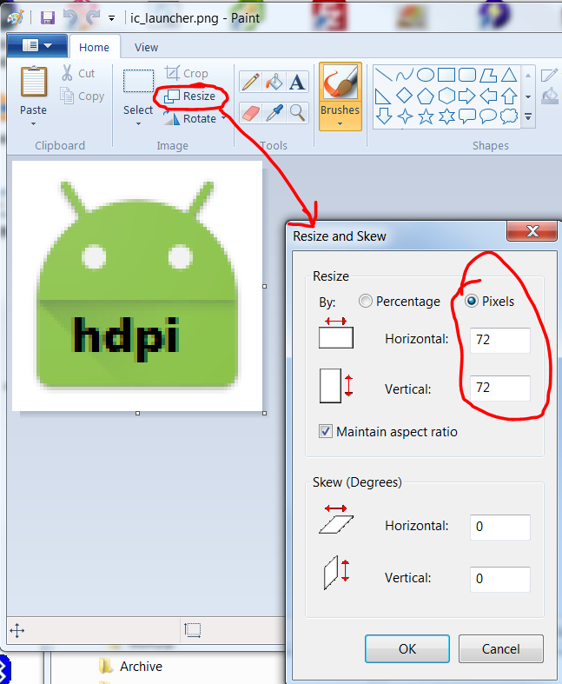

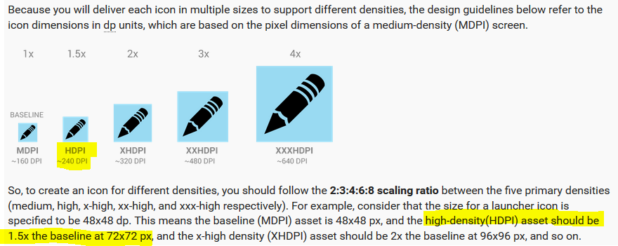
Paint shows pixels used
Same as stated on Android Developer Website

Slide 15
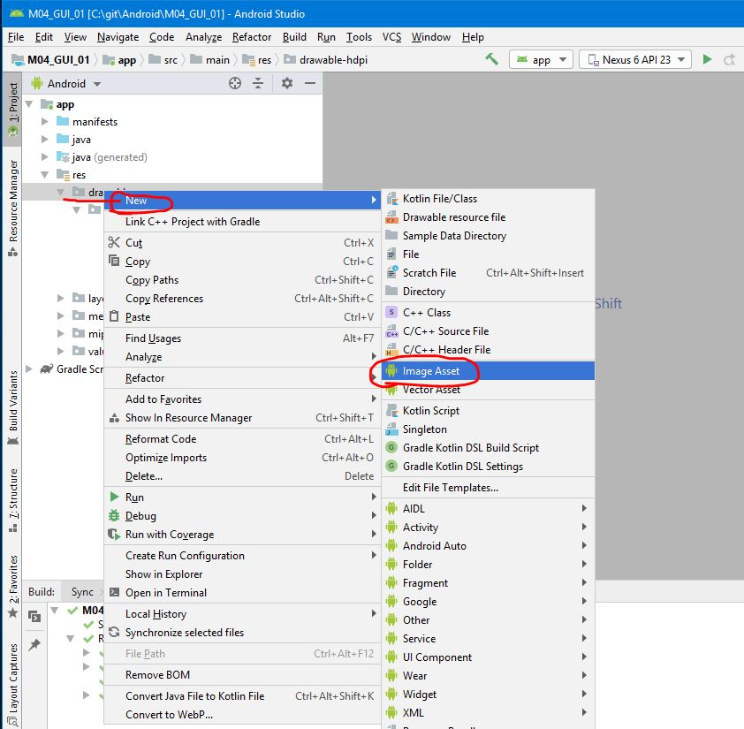
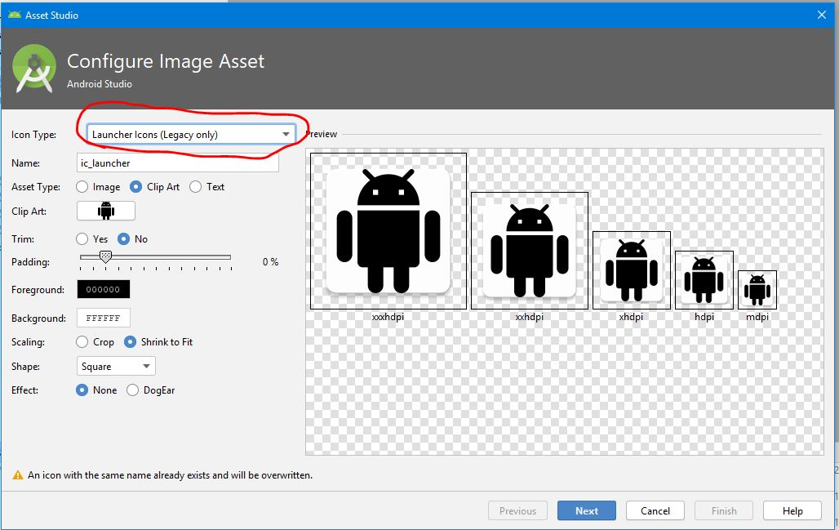
Android Studio
Includes Image Asset Utility

Slide 16
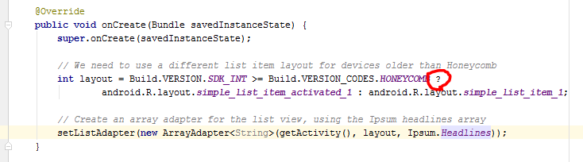
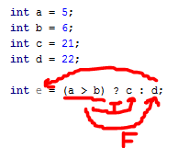
Java Ternary Operator
https://docs.oracle.com/javase/tutorial/java/nutsandbolts/operators.html

