Slide 1
Android Intents #1
Communication
between
Activities & Apps
Russell Shanahan

Slide 2
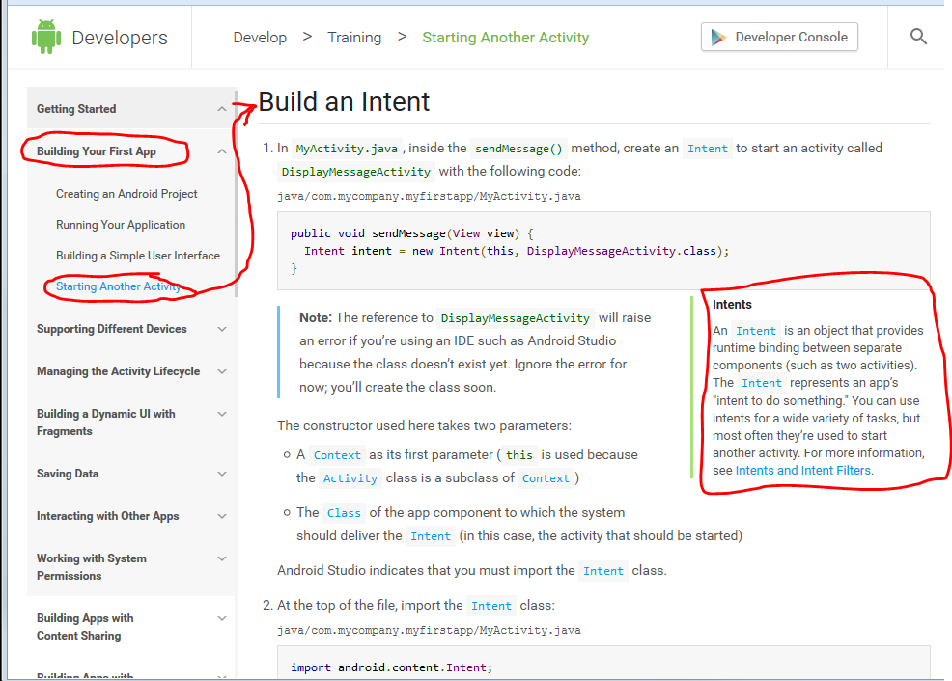
Android Developer Site:
…good reading…it’s the “Book”

Slide 3
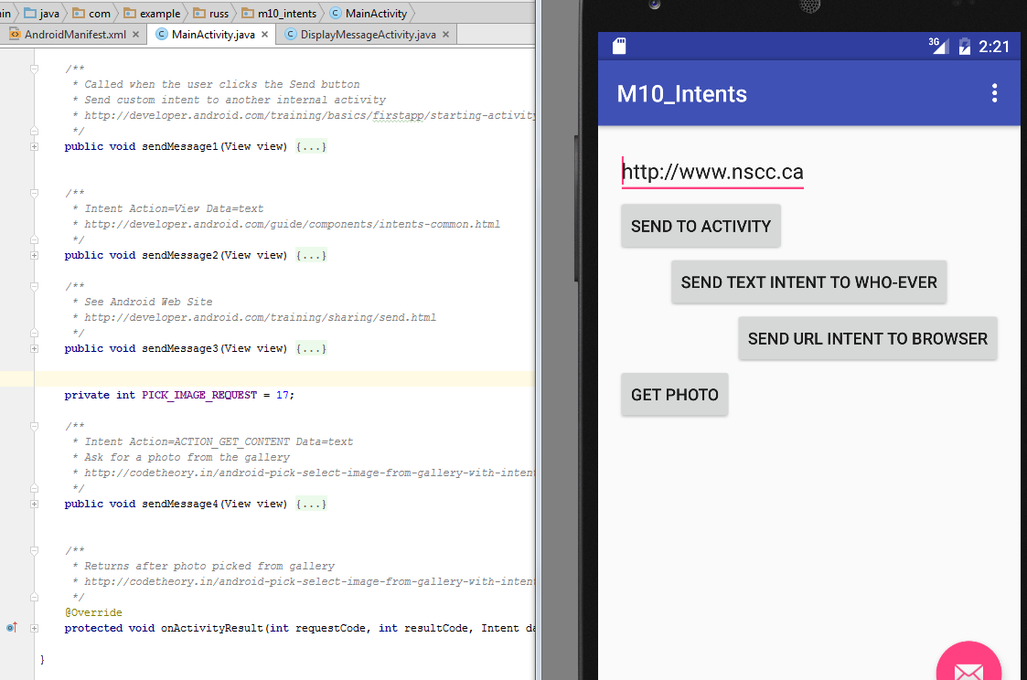
4 Sample programs in 1

Slide 4
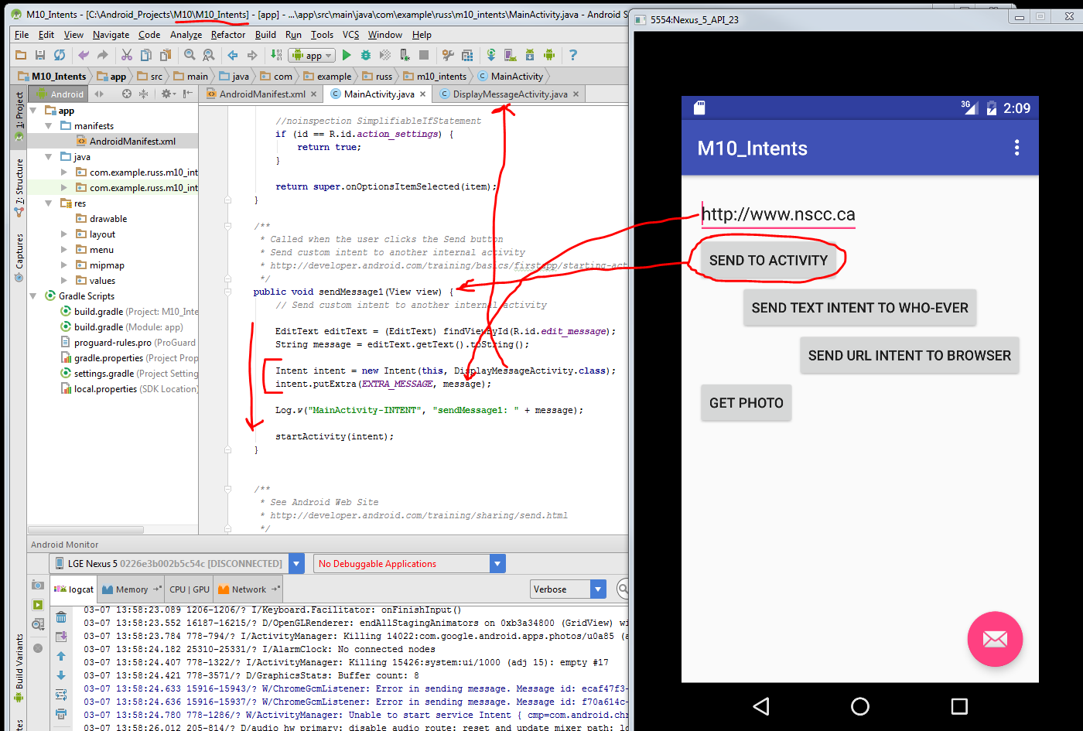
#1 Intent sent to Another Activity

Slide 5
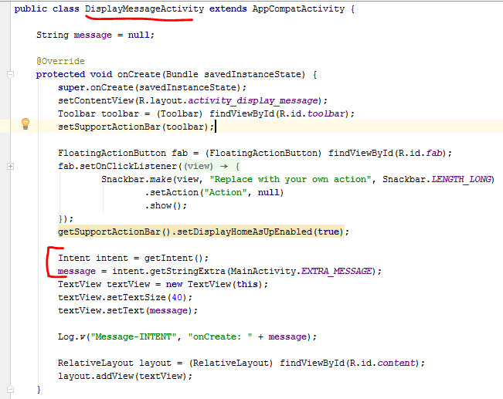
DisplayMessageActivity
Unpacks message from Intent

Slide 6
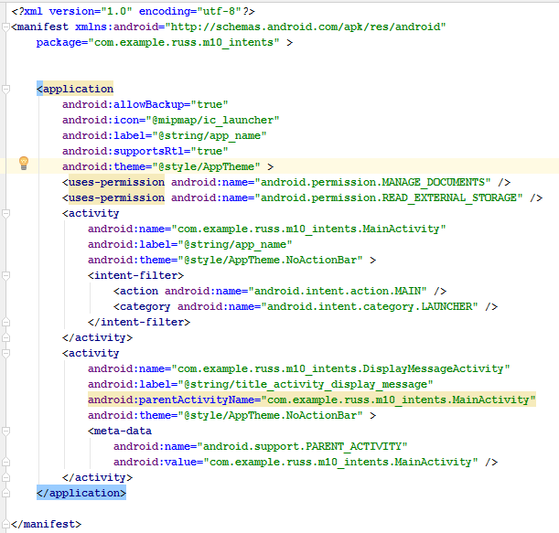
Added section in Manifest.xml
(Used later, External Intent with reply)

Slide 7
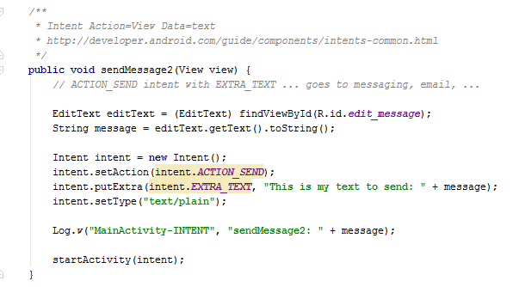
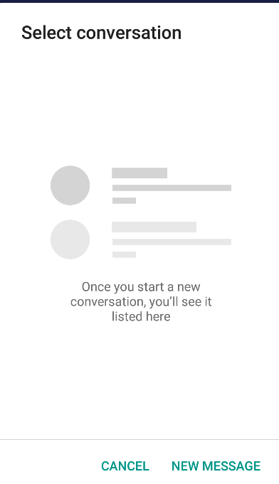
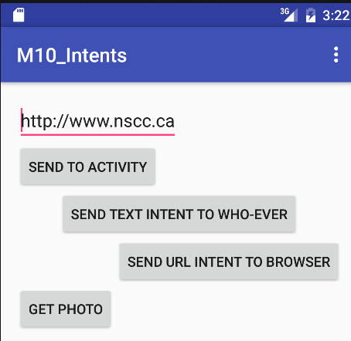
Send Text Intend…Android show pick tool to select what you want to do

Slide 8
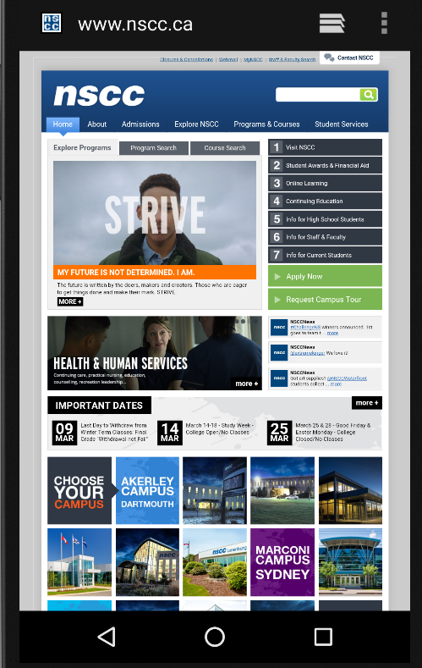
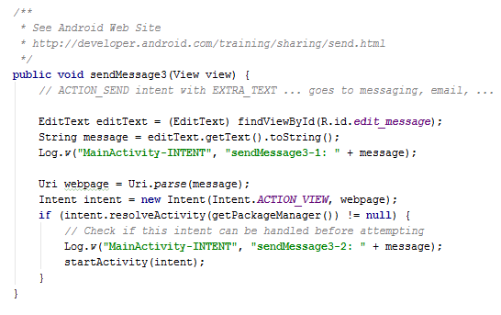
Launch Web Page

Slide 9
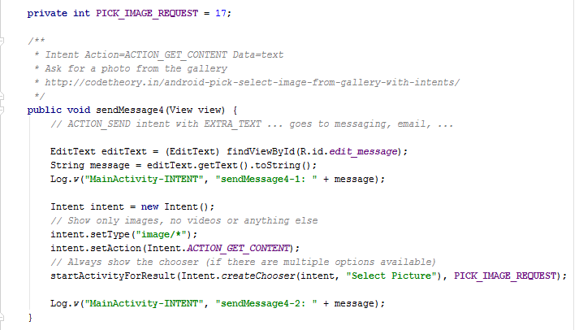
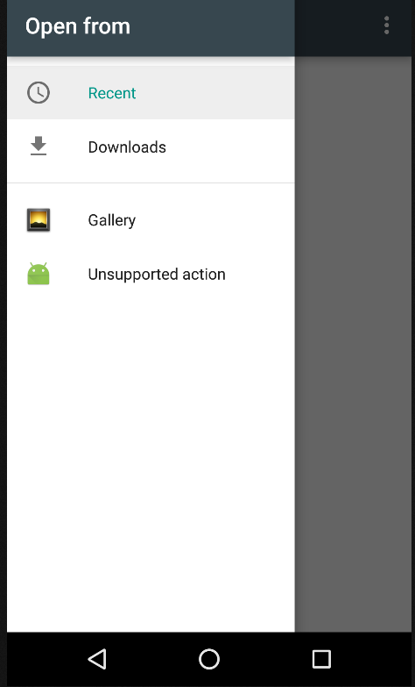
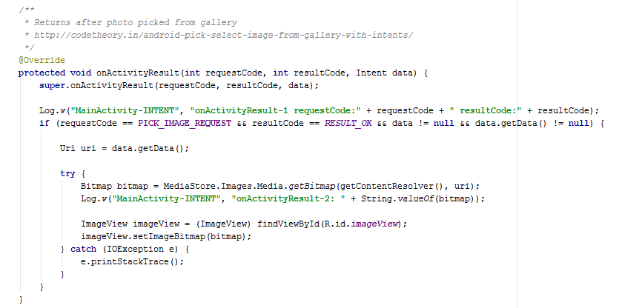
Launch Photo-picker…returns Bitmap
Returns request code that was sent

Slide 10
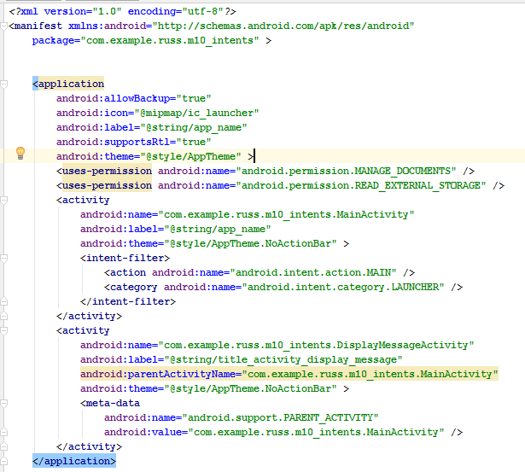
Manifest: Permission, Filter

