Slide 1
Android Fragments #1
Project #5
Russell Shanahan

Slide 2

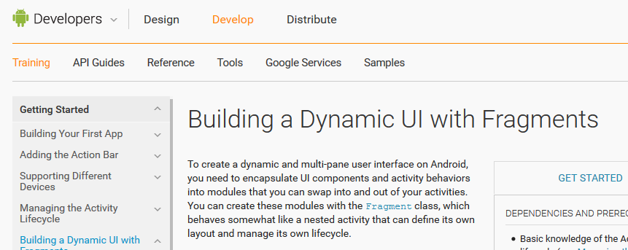
Android Developer Site:
…good reading…it’s the “Book”

Slide 3
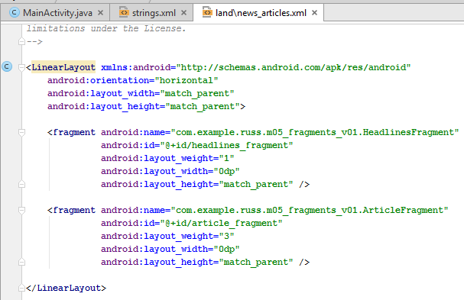
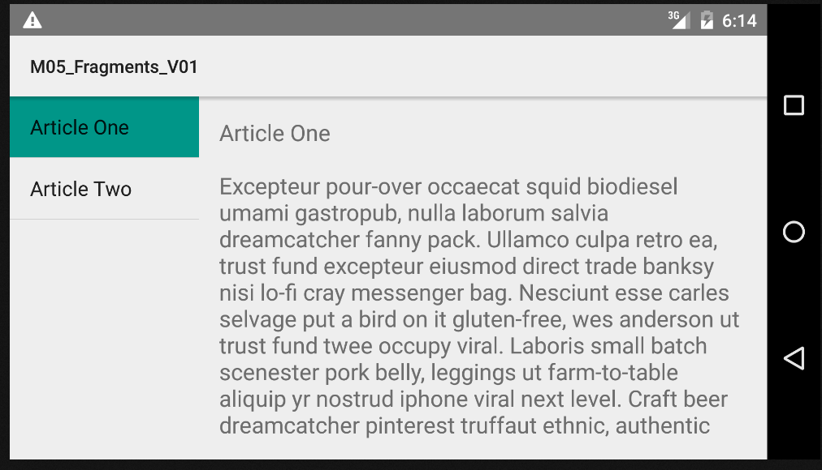
Linear Layout, headlines_fragment

Slide 4
Article_fragment next in the layout

Slide 5
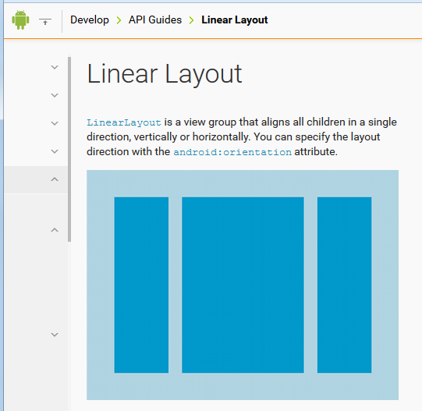
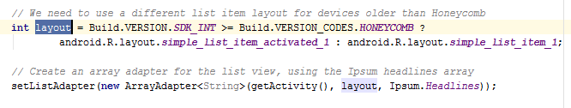
Linear Layout + List Layout
= list of headlines

Slide 6
Article_fragment

Slide 7
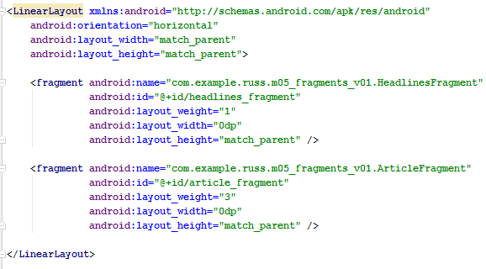
LinearLayout, with 2 fragments
Note the layout_weight

Slide 8
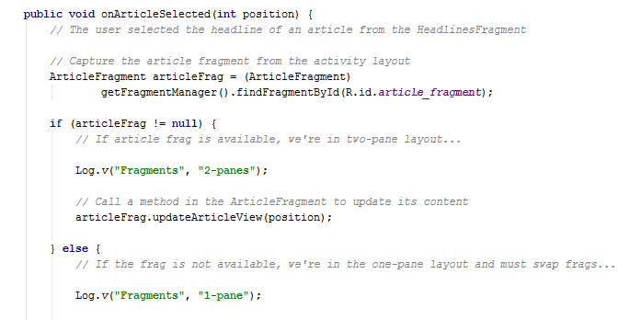
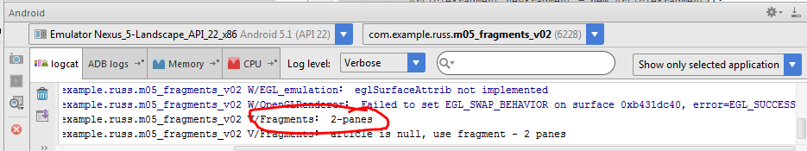
Log output to track code

Slide 9
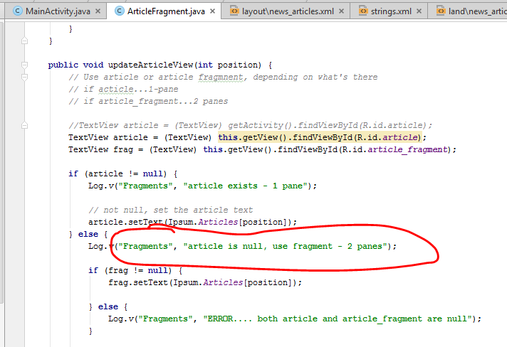
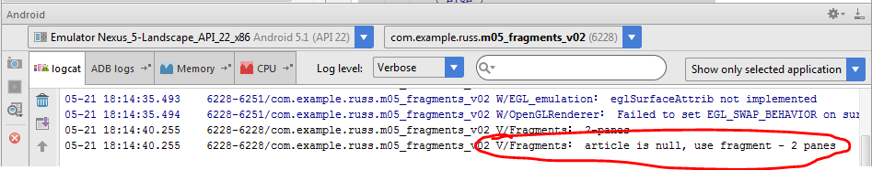
Does Screen have 1 pane or 2?

Slide 10
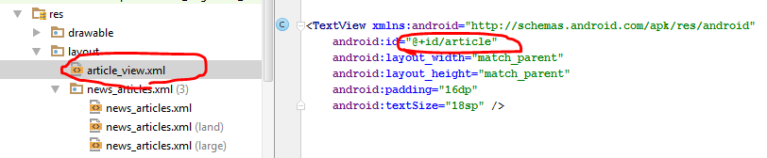
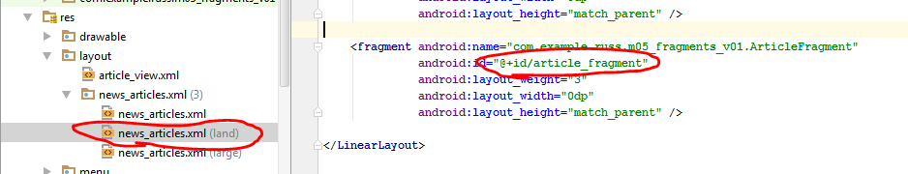
Depends which resource exists

Slide 11
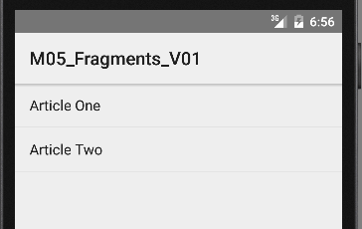
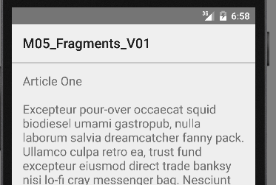
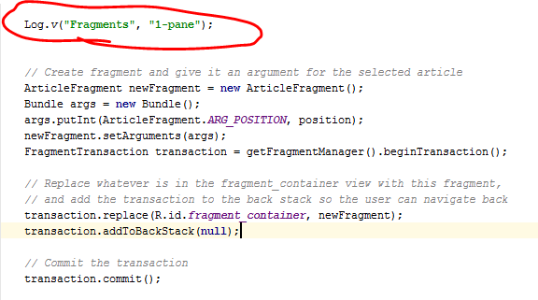

Small Screen, 1 pane
Use FragmentTransaction to swap fragments

Slide 12
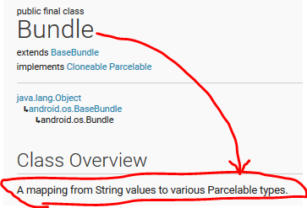
Small Screen, 1 pane
Use FragmentTransaction to swap fragments

Slide 13
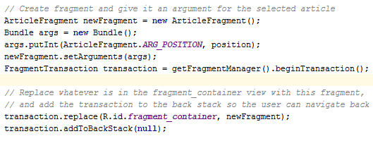
Make the fragment,
Set the arguments (just position),
Replace old fragment with new

