Slide 1
Android Fragments #2
Project #5
Russell Shanahan

Slide 2

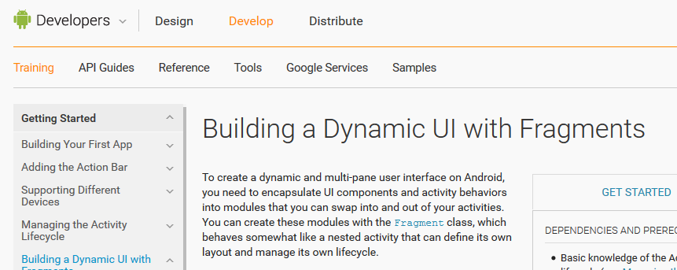
Android Developer Site:
…good reading…it’s the “Book”

Slide 3
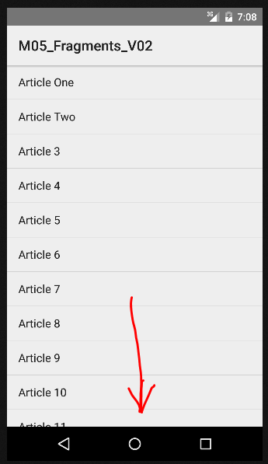
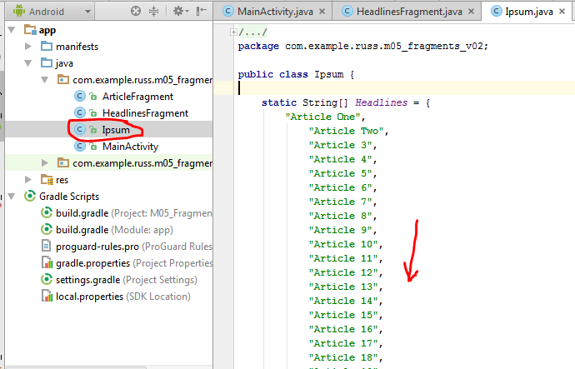
List of Headlines

Slide 4
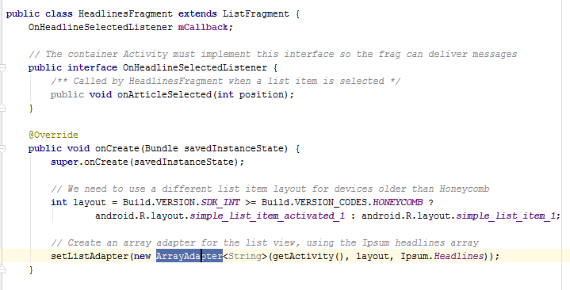
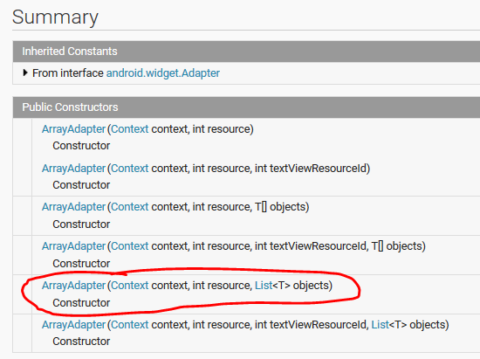
setListAdapter set up list of headlines

Slide 5
Use interface to send message
to MainActivity

Slide 6
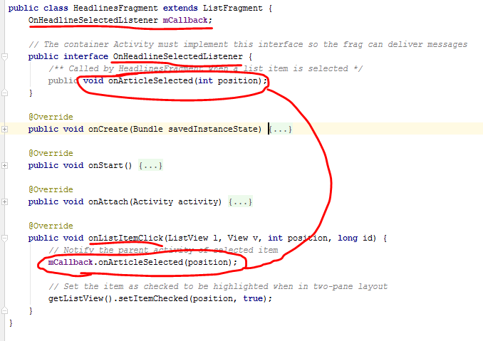
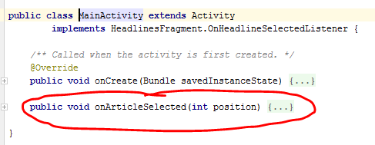
Fragment notifies MainActivity of selection
By calling back

Slide 7
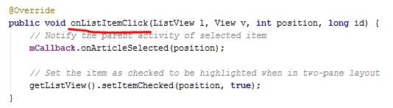
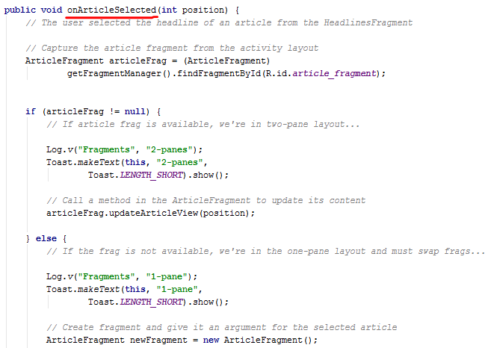
Fragment’s “onListItemClick()” called when user
Selects from the list…supplies position selected
To MainActivity via callback

