Slide 1
Android Fragments #3
Project #5
Russell Shanahan

Slide 2
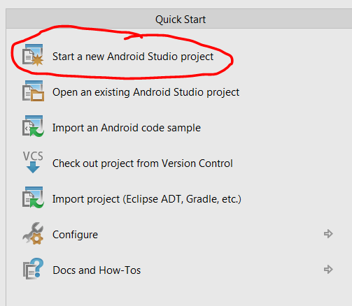
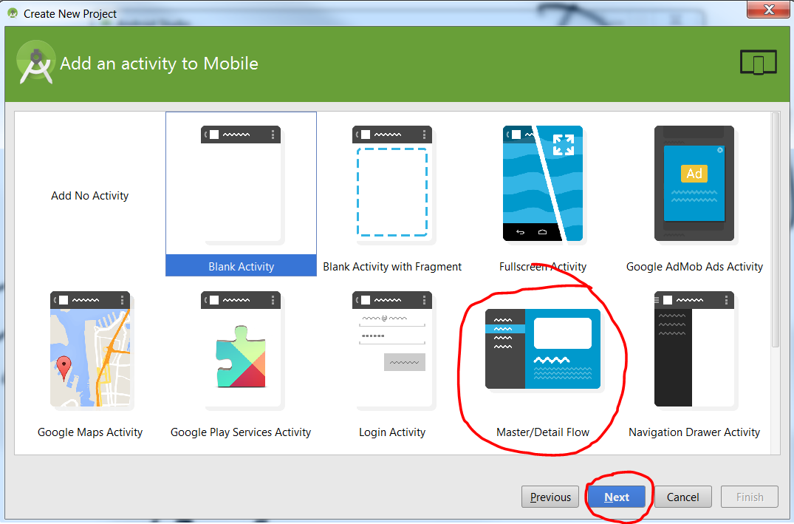
Android Studio:
New Master/Detail Flow Project

Slide 3
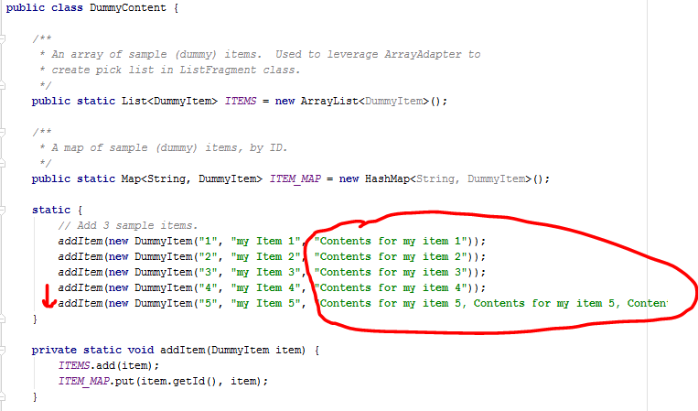
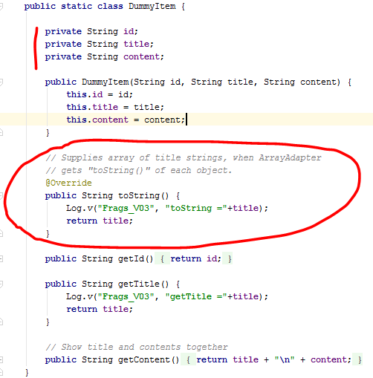
Content class needs a title and content
+ Encapsulate fields

Slide 4

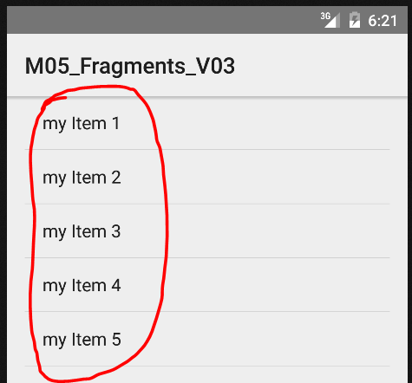
ArrayAdapter creates list of items
...using “toString()” overload from content class.

Slide 5

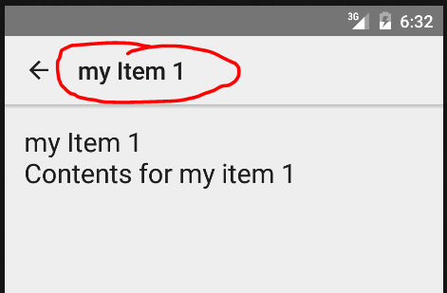
I changed the Title Bar to state the Title from Content

Slide 6
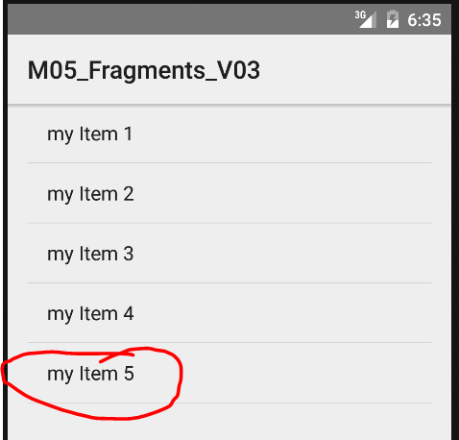
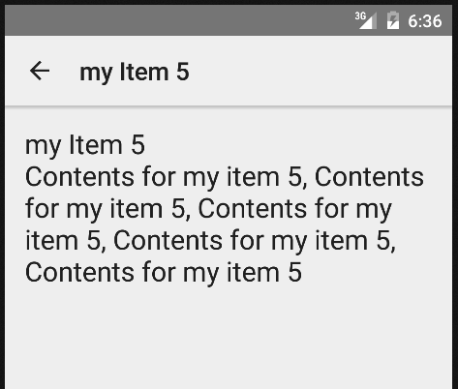

Android Phone vs. TV

