Slide 1
Android Sensors #1
Accelerometer:
Bouncing Balls react to gravity
Russell Shanahan

Slide 2
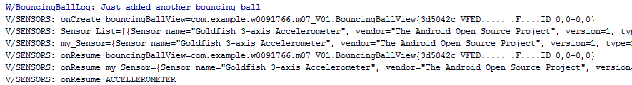
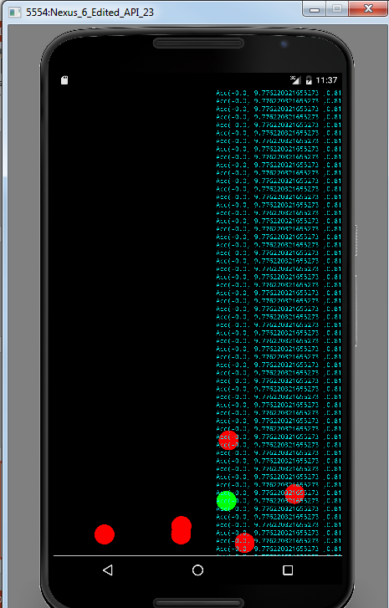
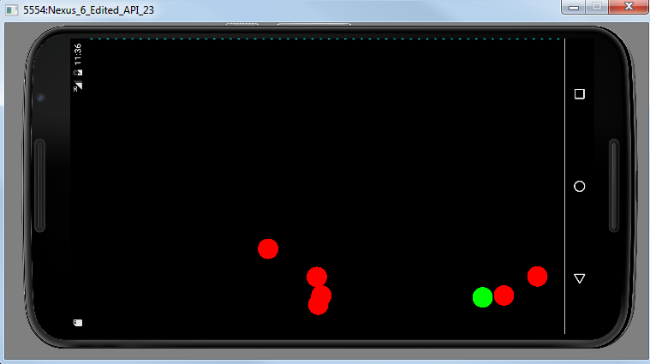
Bouncing Balls “fall”
…Let’s see how to do it…

Slide 3
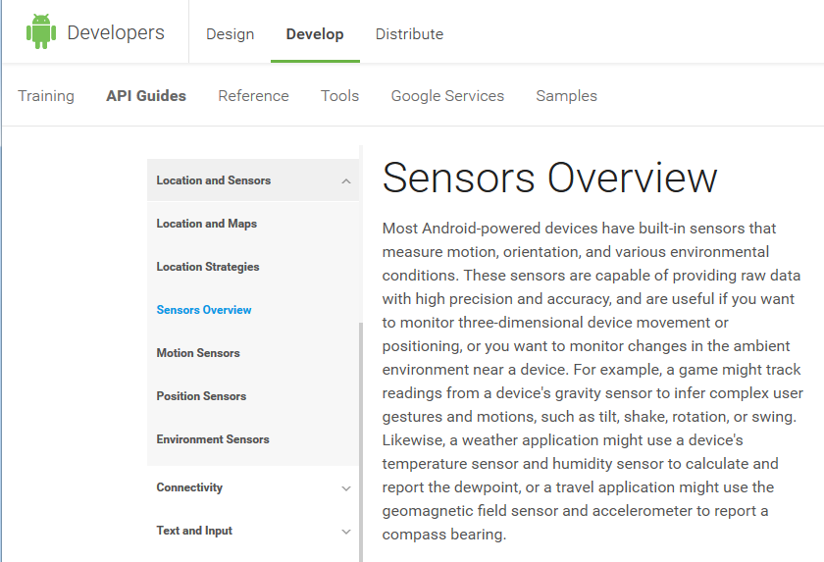
Android Developer Site:
…good reading…it’s the “Book”

Slide 4
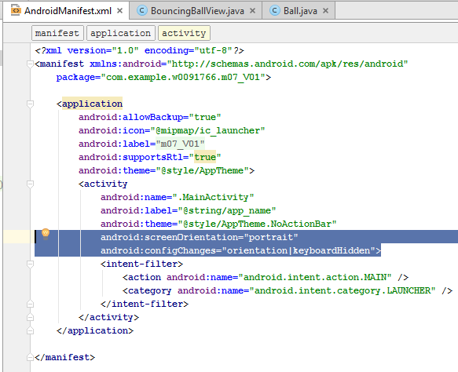
Manifest file…
Force Portrait Mode

Slide 5
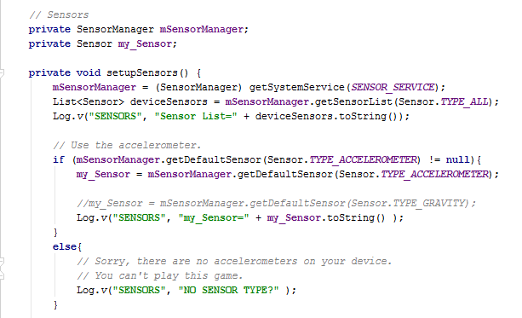
MainActivity…
Use SensorManager…get Sensor access

Slide 6
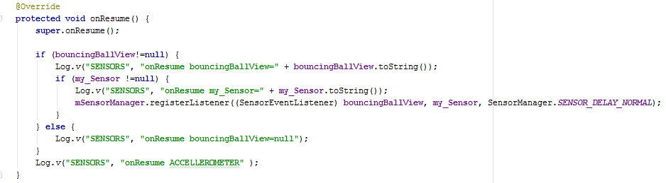
MainActivity…
Register for Events

Slide 7
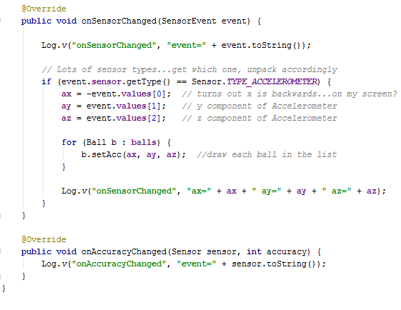
BouncingBallView…
Use SensorManager…get Sensor access

Slide 8
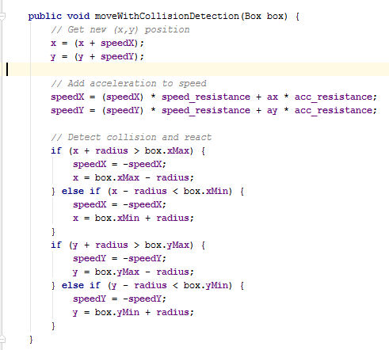
Move Balls per
Acceleration of x, y, z (z ignored)

Slide 9
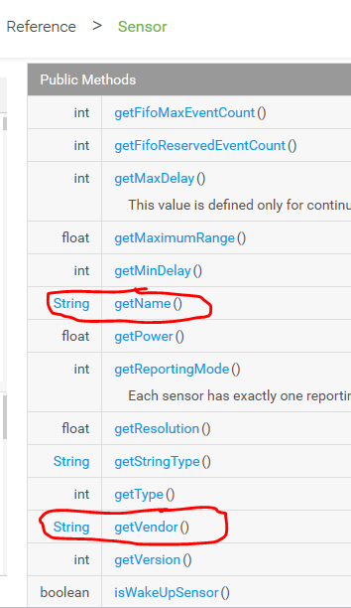
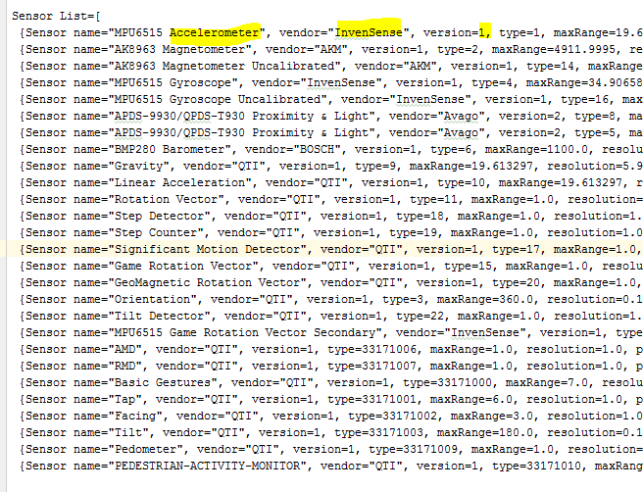
My Sensor List
(call direct or parse this list)

Slide 10
Emulator (Shift-F12 to turn)

Slide 11
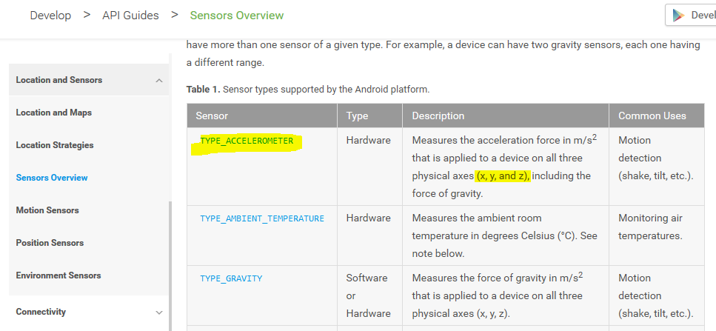
Accelerometer
…on the table of sensors.

Slide 12
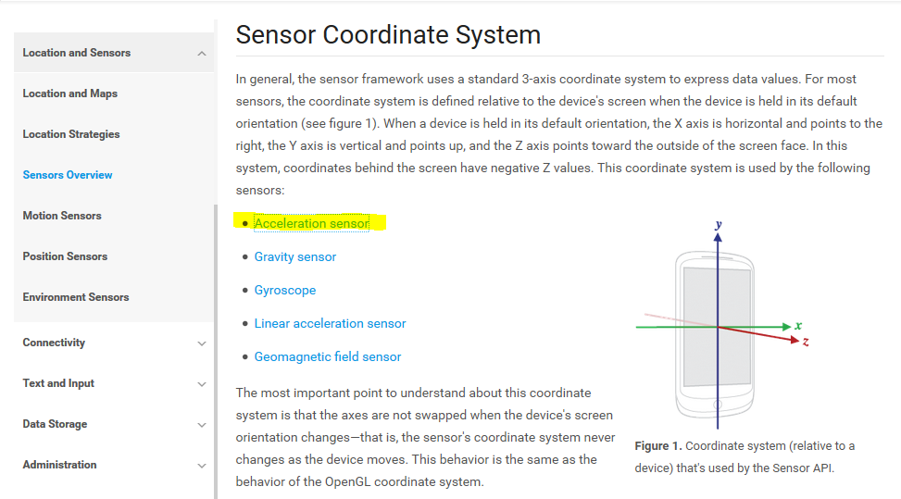
The Reading…
…Coordinates, Math…

Slide 13
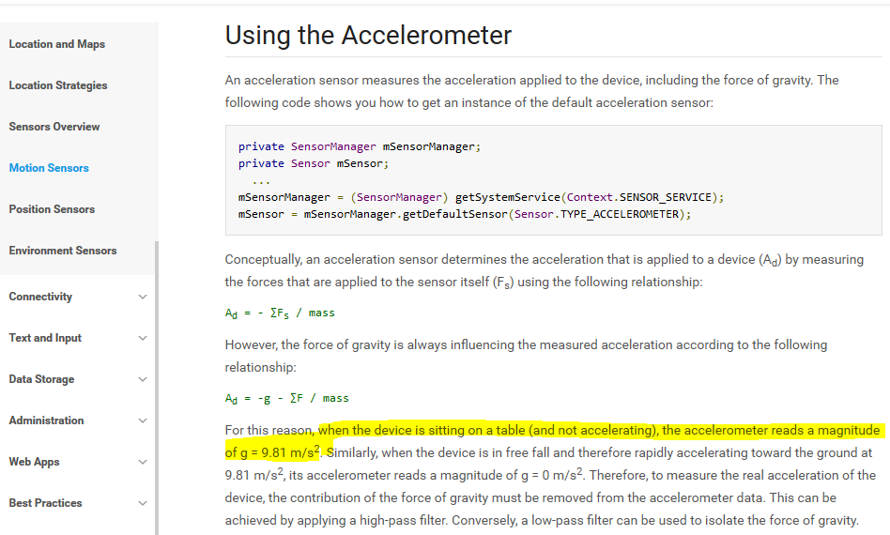
Gravity at work when
device is stationary.

Slide 14
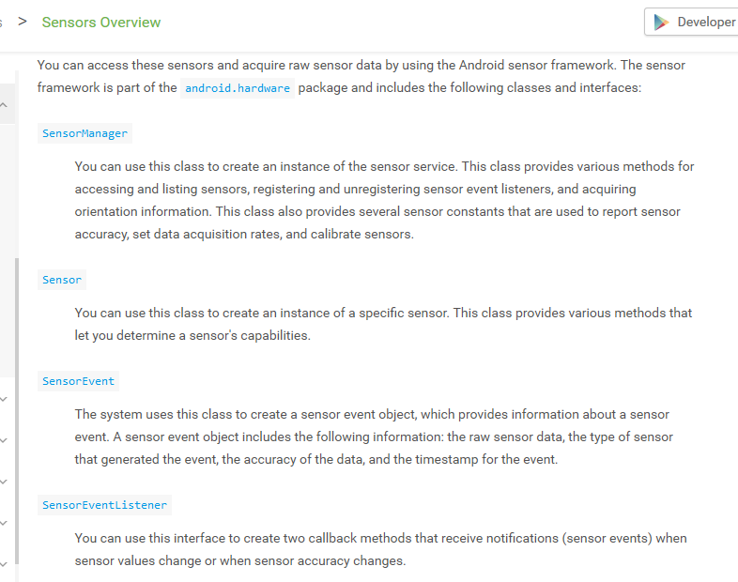
Any Sensor…
Use SensorManager, Register for Events

