Slide 1
Nomad
Use Case #3
Group 3

Slide 2
Use Case Breakdown
Calculate best route from source to destination
Display weather conditions during route and at destination
Display places to visit upon arrival to destination
Store user history
Notes:
Joshua

Slide 3
Application Operations
user will create an account/log in to account
system will have authentication
user will enter source and destination
system will calculate shortest path to destination, using google geo location api
user will proceed to route
system will ensure user stays on route, using location services
system will display weather during journey, using weather api
user will reach destination
system will store route in user history
system will display places to visit, using google places api
user will be able to access its route history and reselect old routes
Notes:
Adam

Slide 4
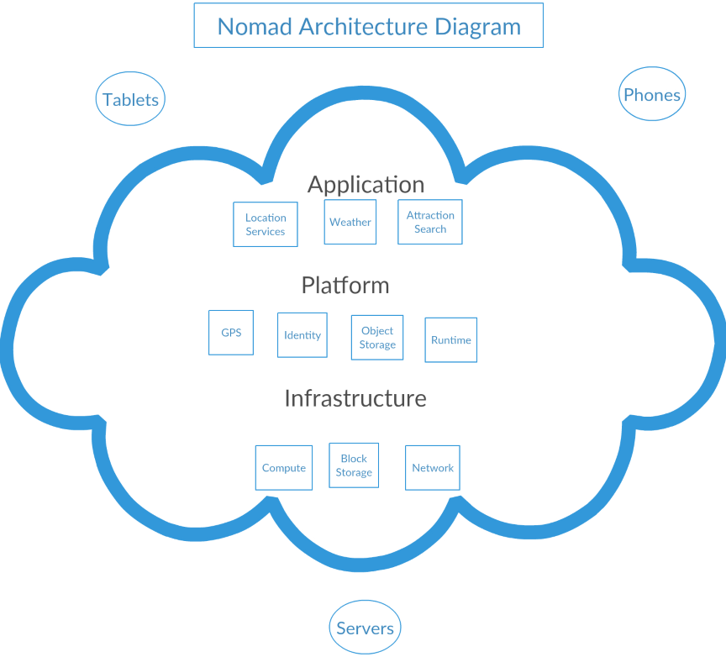
Architecture
Notes:
Nick
Chose to base our architecture off of the Cloud Computing Architecture
Advantages of this architecture…our application can benefit from its reliability, manageability, scalability, storage for data, device independence and location independence…these are reasons for choosing this architecture
Component breakdown:
Servers: hold data needed for application, servers will include our own application server used for user data and will bring data from the other servers into it for access in the application. Other servers needed will include google geo location, google places, and weather. These servers will be used for accessing google maps/locations, attractions near the destination, and weather conditions at the destination, respectively.
Tablets and Phones: represent the devices the application will be used on
Location Services: will use Google Geo Location API, will hold the libraries that are able to access the GPS to determine the devices current location
Attraction Search: will use Google Places API, will have information regarding what attractions are near the destination location
Weather: will use Weather API, will have information regarding weather conditions at the destination location
GPS: hardware of the operating system for GPS application, location services will access
Identity: used for user authentication and identity to track user information and storage
Object Storage: server side storage, stores user data, tokens, history of user searching, will hold all user data in the database
Runtime: runtime will include application launches, service calls, such as authentication, location, weather, attractions to find results, accessing storage, display results to user
Compute: not all hardware and software application will use will be on device or in device’s network, will be provided as a service by application and accessed over the internet in a seamless way
Block Storage: local caching, keeps track of session tokens, will cache server data in case user closes application, the application will not have to recall server when user opens application again
Network: calls to servers on other networks, used to transfer data to and from application
Using APIs and the cloud:
-google geo location: would interact with cloud to provide location of the device for the application
-google places: would interact with cloud to provide places nearby the location of the device for the application
-weather: would interact with cloud to provide weather of current location of the device for the application

Slide 5
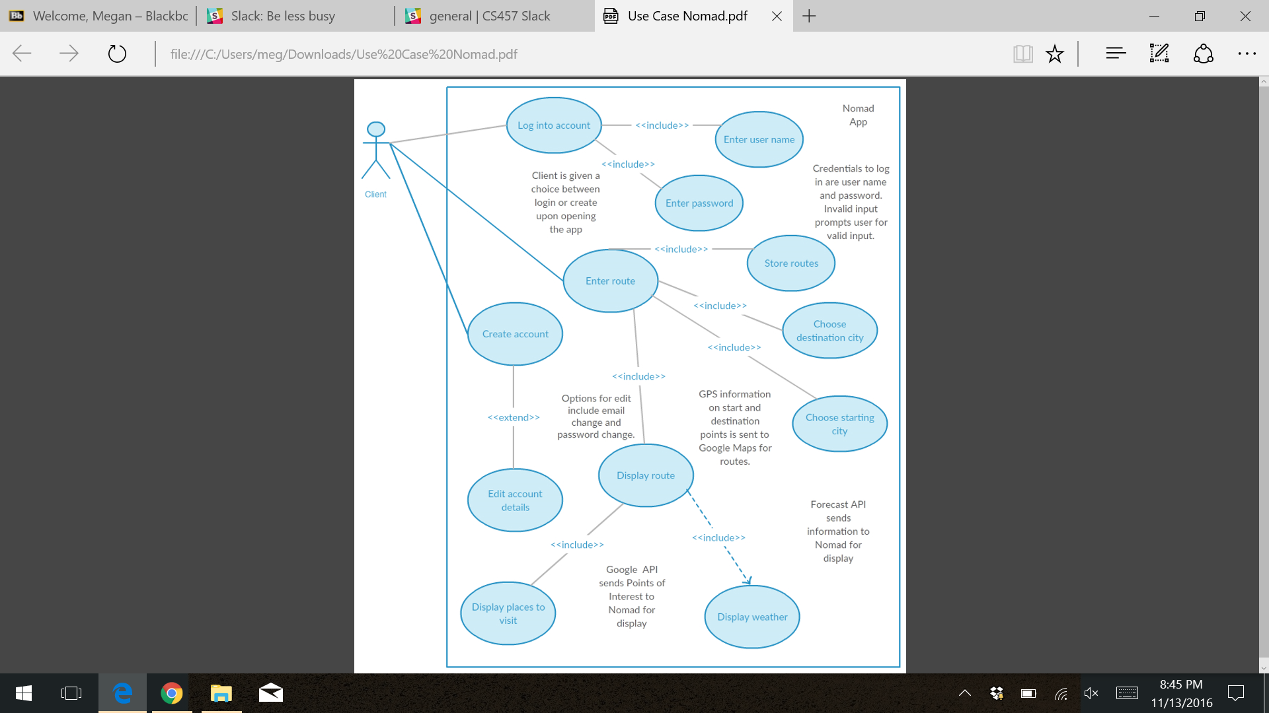
Use Case Diagram
Notes:
Adam

Slide 6
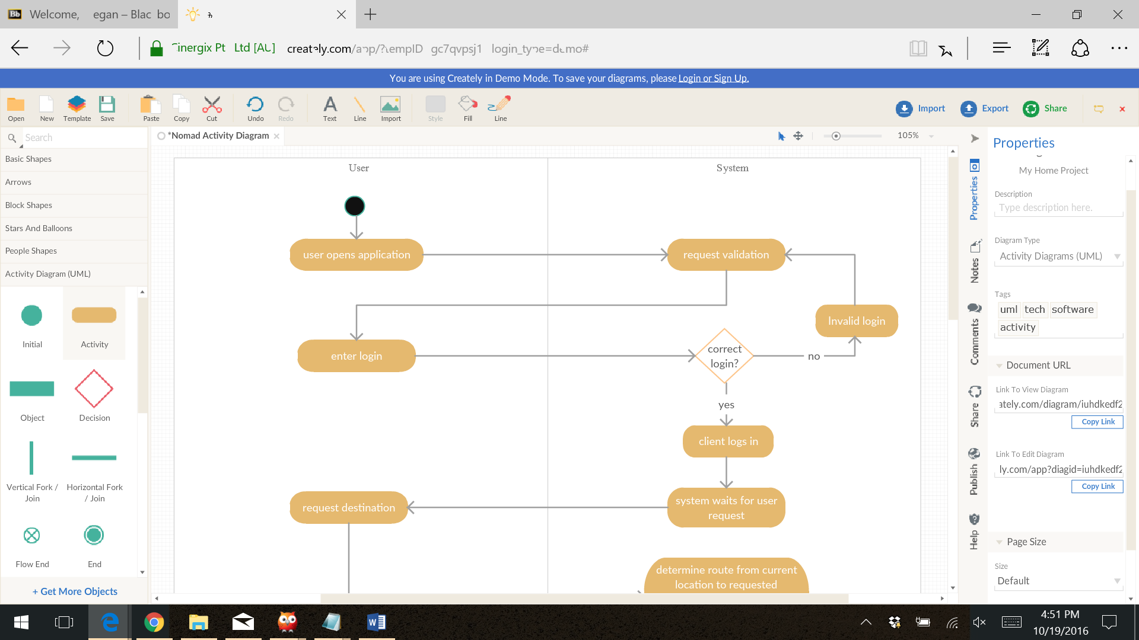
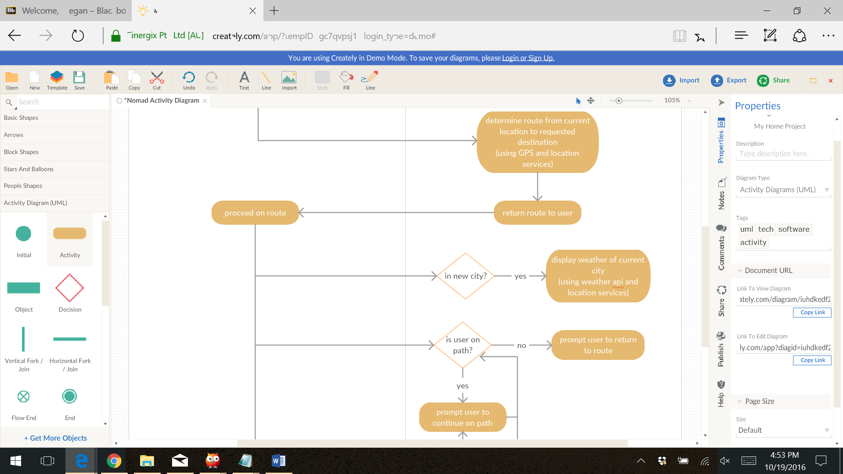
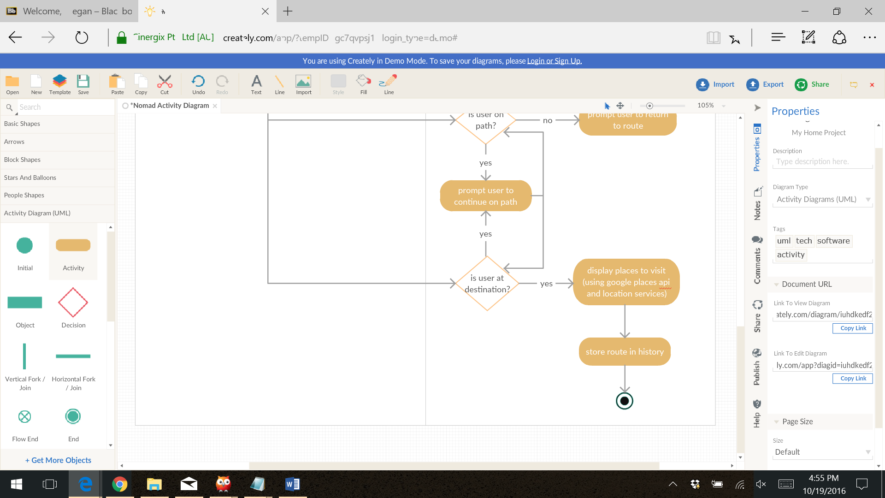
Activity Diagram
no
Notes:
Megan
User opens application -> system requests validation -> enter login -> correct login?
Login -> system waits for user request -> request route -> determine route -> return route to user
User proceed to route -> in new city? -> display weather update
-> is user staying on path? -> if not prompt user to get back on path
-> is user at destination? -> if so display places to visit and save route in history
things to note: update weather when entering new cities…instead of every so many minutes, just doing it every new city like a weather station would do

Slide 7
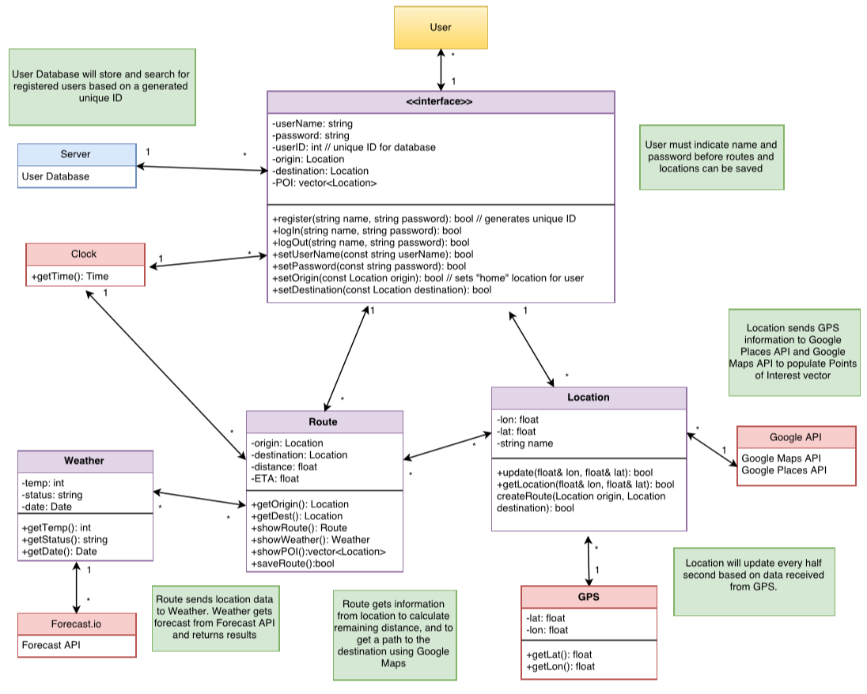
Class Diagram
Notes:
Joshua

Slide 8
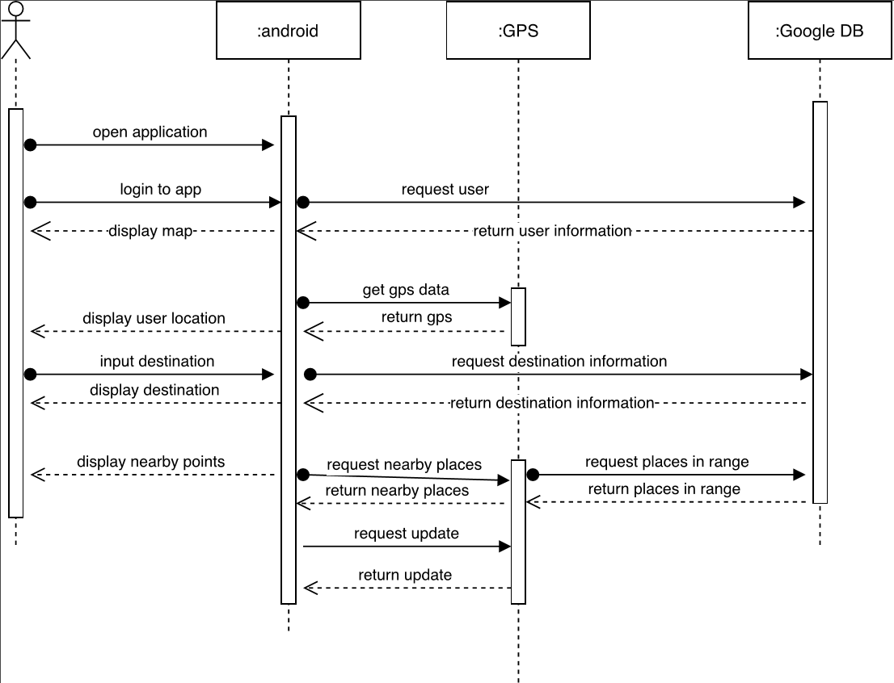
Sequence Diagram
Notes:
Nick
Basic use case to get route to destination, including displaying places to visit upon arrival
Use cases:
Route to destination
Display weather along route (on next page diagram)
Display places to visit upon arrival of destination
Prompt user to return to route if off route (on next page diagram)

Slide 9
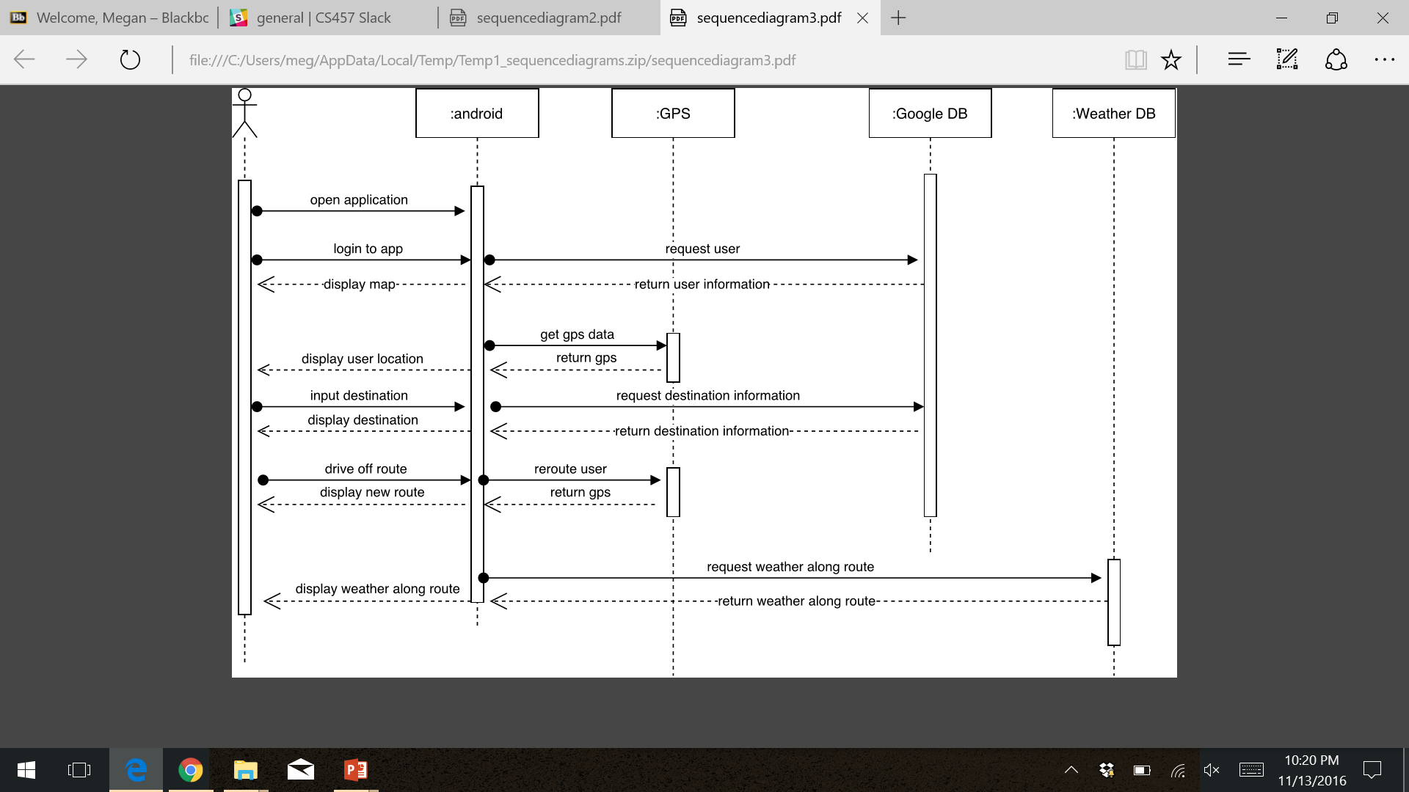
Sequence Diagram
Notes:
Nick
Basic use case to determine route to destination, include displaying weather along the way and rerouting if user goes off route

Slide 10
Design Pattern
Observer Pattern
Chose this pattern because system and user will need to notified when certain event occur during application execution
Events such as:
user veers off route and needs to return to correct path
user enters new city and current weather needs to be updated
user reaches destination and places to visit need to be displayed
When looking at the class diagram, the Route class will be the ‘observer’ when implementing this pattern
Notes:
Megan

Slide 11
Questions?

