Slide 1
Accounting System
MEGHA MAGADUMAKAR-2GI19IS024
UNDER THE GUIDENCE OF
DURGA LAKSHMI

Slide 2
About Company
Things Learned During Internship
Project Specification
Table Of Content
Objective
Project Overview
Conclusion

Slide 3

About Comapany
Company Name : Milestone-First step to a job
Founded in 2018 Industry : Professional Training and Coaching
Headquarters : Bangalore, Karnataka Website : https://www.milestonefstjob.com

Slide 4
Things Learned During Internship
It provided me opprtunity work on different tools like Eclipse IDE, MySQL database, Tomcat server
Software Development
Database Management
Java Web application Development

Slide 5
Project Specification
This problem is assigned to me during my core java training to design an software on “Accounting System” for the internal use at accounting department of organization using Java and Oracle database.

Slide 6
Automate internal operations in organization.
Objectives
Time Saving with Minimize The Risk Of Human Error.
Secured Data Storage

Slide 7
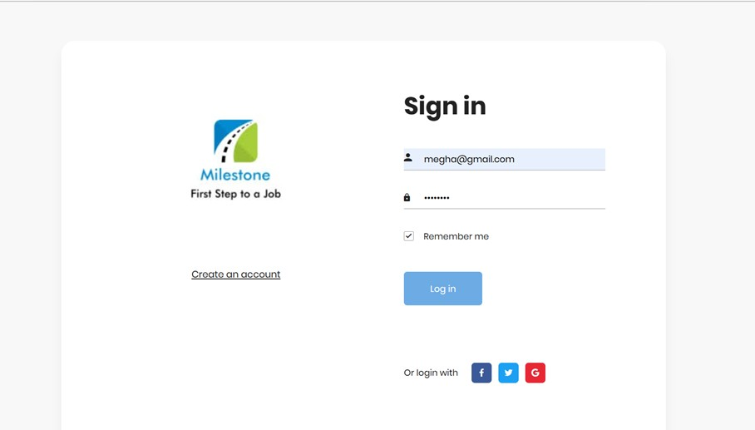
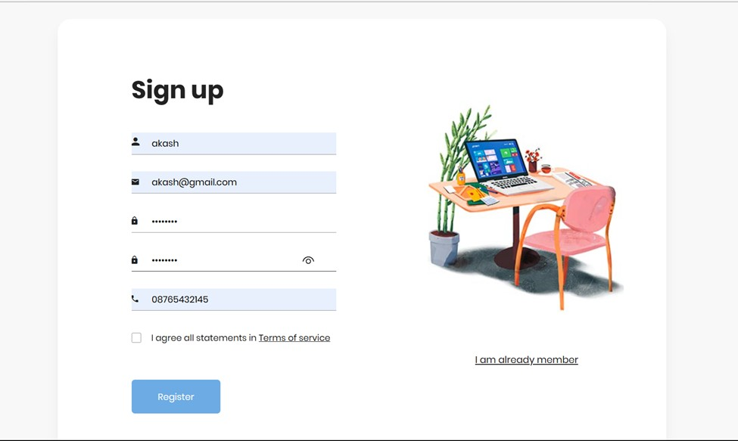
Secured Sign In and Sign Up

Slide 8
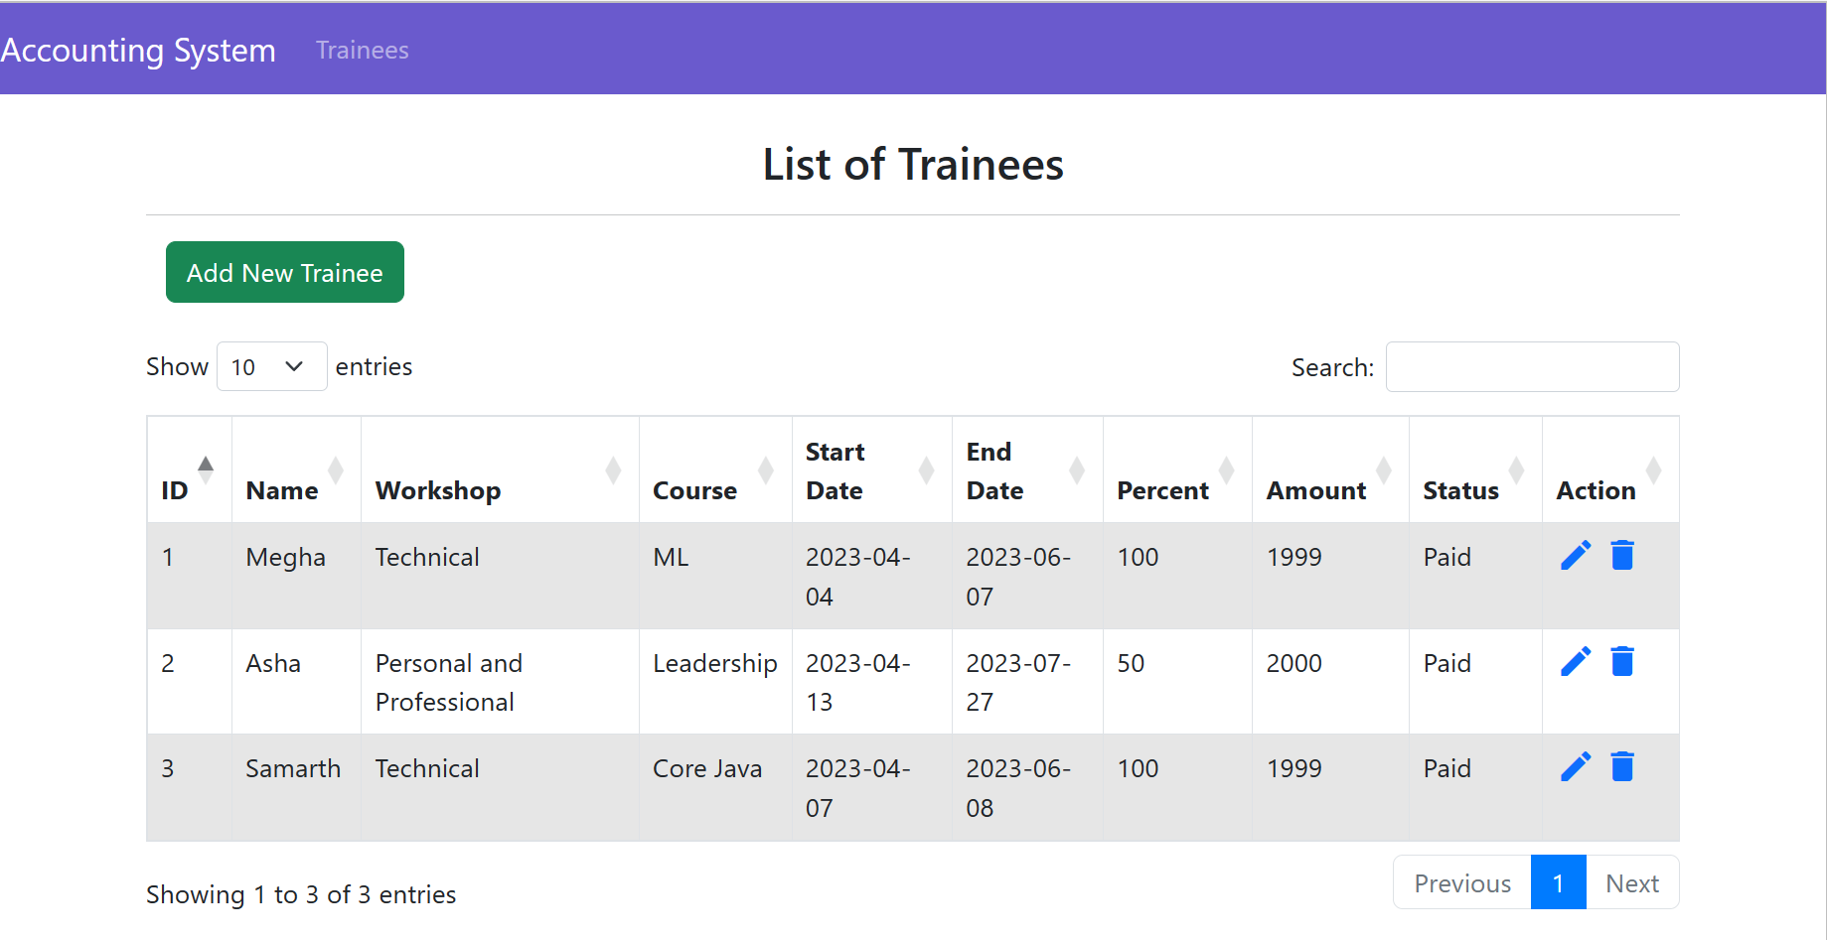
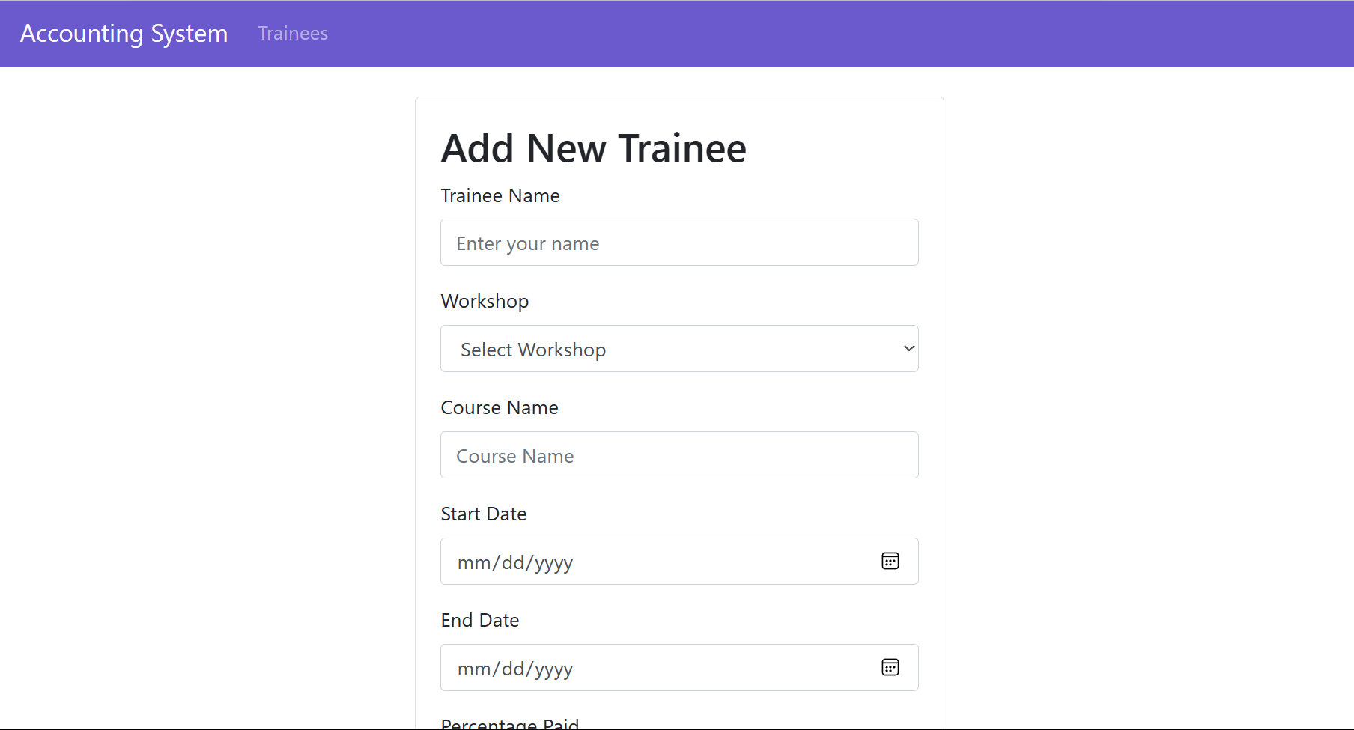
Trainee Payment Form

Slide 9
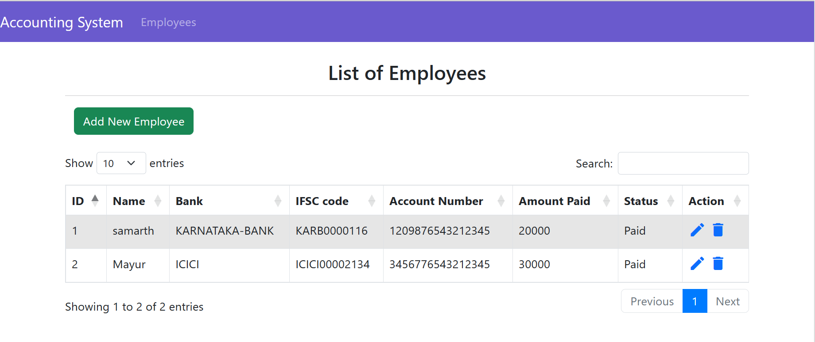
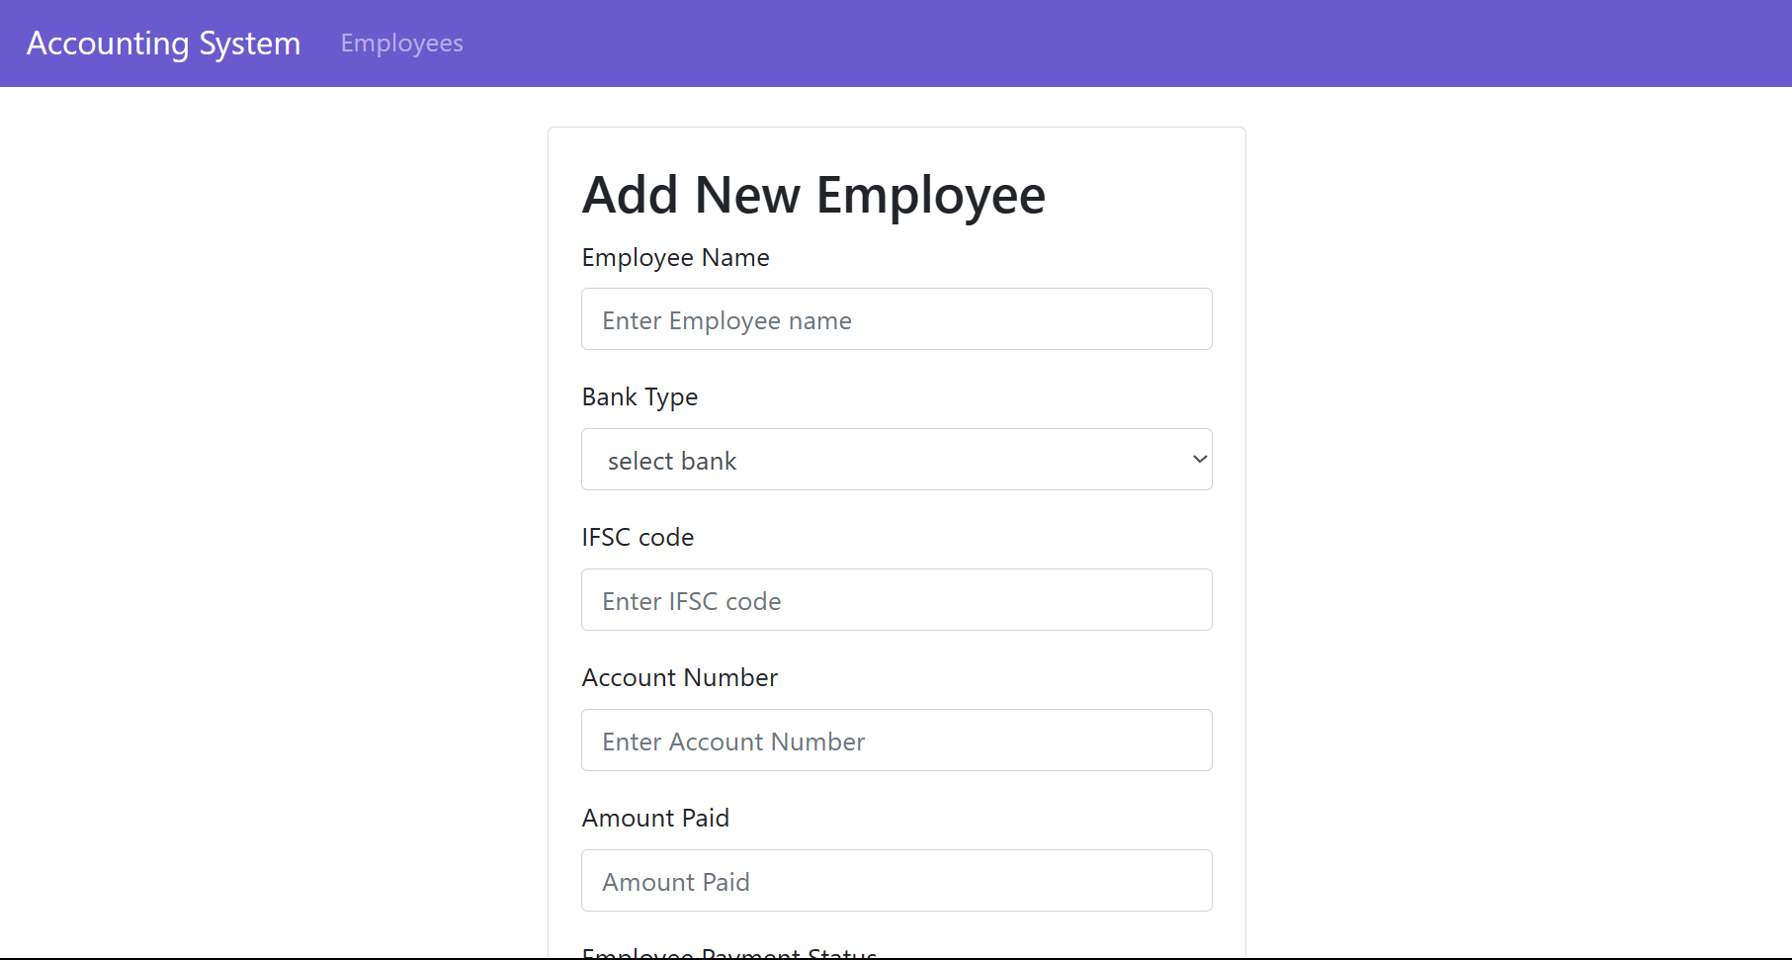
Employee Payment Form

Slide 10
Conclusion
This Internship provide me an opportunity to work for real time project. This helped me to sharpen my skills. This provided me exploser to different tools and technologies. It is indeed greate experience.

Slide 11
THANK YOU

