Slide 1

Library management system
Prepared by:
MEGHA MAGADUMAKAR – 2GI19IS024
SANJANA SUNADHOLI - 2GI19IS047
SHWETA NAIK – 2GI19IS050
TEJASHWINI NAGANOOR – 2GI19IS055

Slide 2
introduction
The project “Library management System” is developed with using python as front-end and MySQL as back-end.
This system mainly focuses on basic operations of library like login, register, adding and deleting new member, new book, updating new information, searching books and members to issue and return book.

Slide 3
objectives
The main objective of the Library Management System is to handle the entire activity of a library.
The software keeps track of all the information about the books and their complete details.
The system contain database where all the information will be stored safely.
Use of “MySQL connector” to connect MySQL with Python so that we can retrieve the data from Python.

Slide 4
purpose
It provide “better and efficient” service to members.
Reduce the workload of librarian.
Faster retrieval of information about the desired book.
Provide facility for proper monitoring reduce paper work and provide data security.
All details will be available on a click for both user and librarian.

Slide 5
Product scope
Any education institute & government office’s can make use of it for providing information about author, content of the available books etc.
This project application will keep track of all the books and library information.
The software will be able to handle all the necessary information.

Slide 6
basic functions
The functions of the software include the system providing different type services based on the requirements.
Like,
Librarian accounts with login facilities.
Provide updated information about books and member.
List will be automatically updated.
Librarian can get the information about the members, books and all transactions.

Slide 7
technical requirements
Hardware Requirements:
Processor : Pentium 3.0 GHz or higher
Ram : 512 Mb or more
Hard Drive : 10 GB or more
Software Requirements:
operating System : Windows 10
Front End : Python
Back End : MySQL + Python

Slide 8
advantages
User friendly
Complete reports
Highly flexible
Highly reliable
Secure data management

Slide 9
modules
Register : with this feature we can add staff details Staff name, Staff ID, Date of Birth, Mobile Number, Email Address and Address of the staff.
Login : with this staff/ librarian enters to the main menu, if and only if username and passwords are correct. We have used username as staff email address and password as staff ID.
Add member : with this feature we can add member details member name, member ID, Date of Birth, Mobile Number, Email Address and Address of the Member.
Add book : with this feature we can add books in LMS system with book details like Title, Book ID Author, Publisher, Price, and for each entry status is automatically updated to “available”.

Slide 10
modules
Update Book : Update the previous entered Book details
Update Member : Update the Member details.
Issue Book: This will record the details on the Book issued to whom. This Feature stores the details of Book ID, Member ID , Issue Date and Return Date of book. After issue book status is automatically updated as “issued”.
Return Book : Update the Book Transactions on returned by the member.
Search Menu: Search The Books which are available in the System.
Report Menu: Return the Reports based on Books, Publisher, Member search

Slide 11
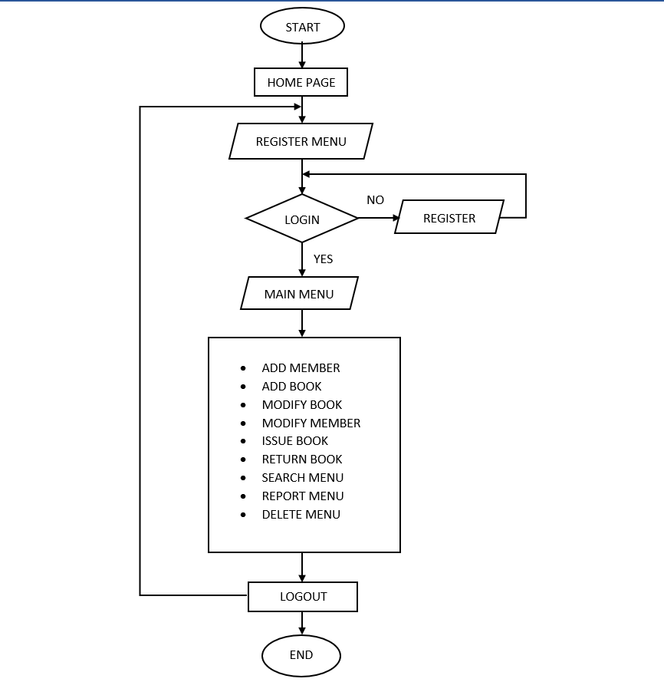
System flow

Slide 12
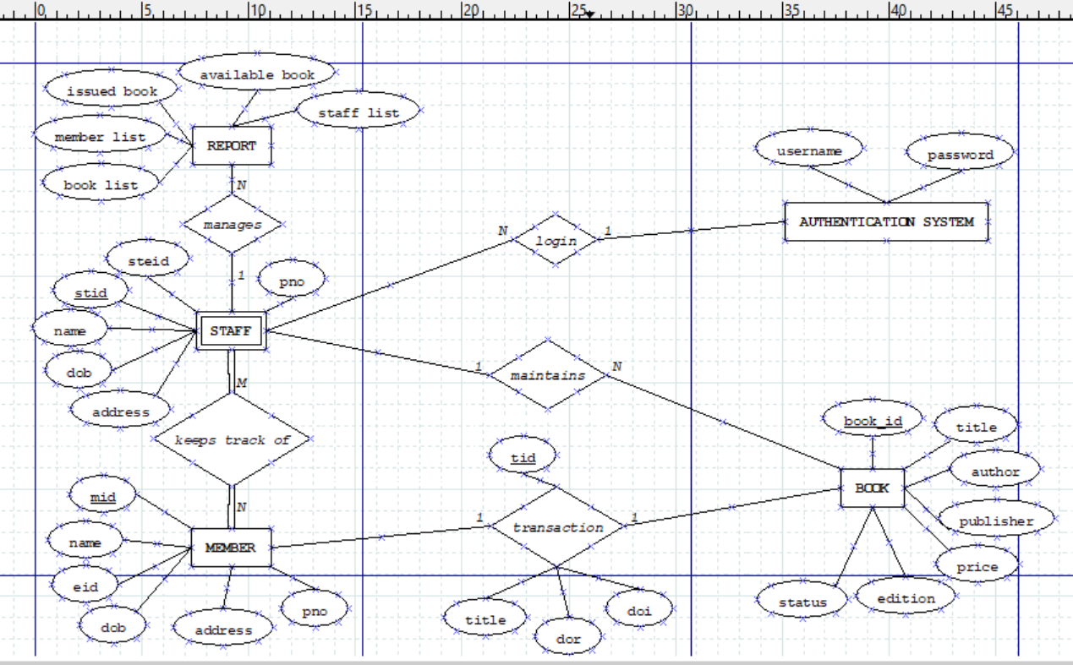
E-R diagram

Slide 13
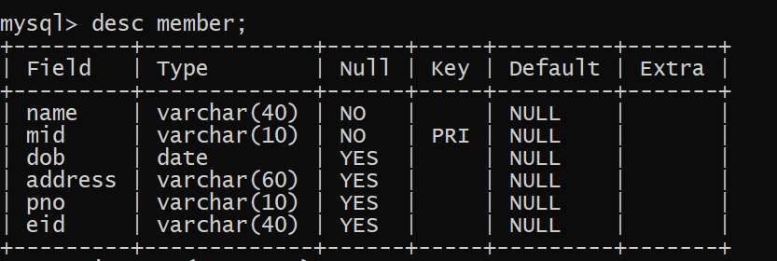
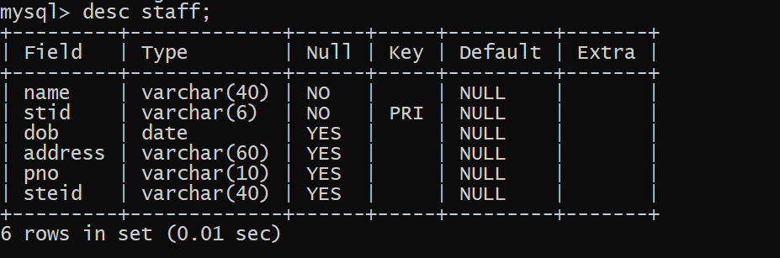
MYSQL DATABASE TABLES
1. MEMBER TABLE :
1. STAFF TABLE :

Slide 14
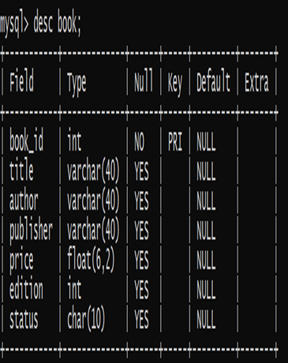
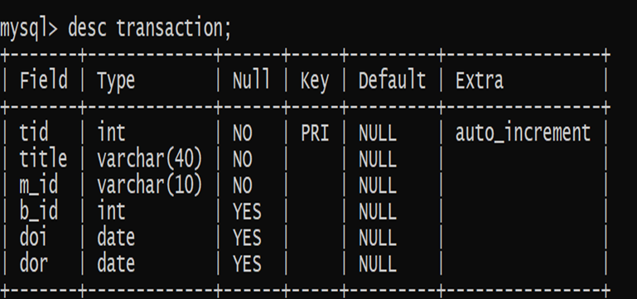
2. BOOK TABLE :
3. TRANSACTION TABLE :

Slide 15
Lets execute the code

Slide 16
conclusion
The Library management System allows the user to store the book details and the member’s details.
This system allows storing the details of all the data related to library.
The implementation of the system will reduce data entry time and provide readily calculated reports.

Slide 17


Thank you

