Slide 1
TEAM grover : audit 1

Slide 2
TEAM ROLES
VIKALP SHENDEKAR (DRIVE TRAIN TEAM)
ABHISHEK CHOZHIYATTIL (DRIVE TRAIN TEAM)
ADNAN AZMIE (AUTONOMOUS TEAM)
RUSSELL REHIM (DRIVE TRAIN)
VISWADEEP KOPALLI (AUTONOMOUS TEAM)

Slide 3
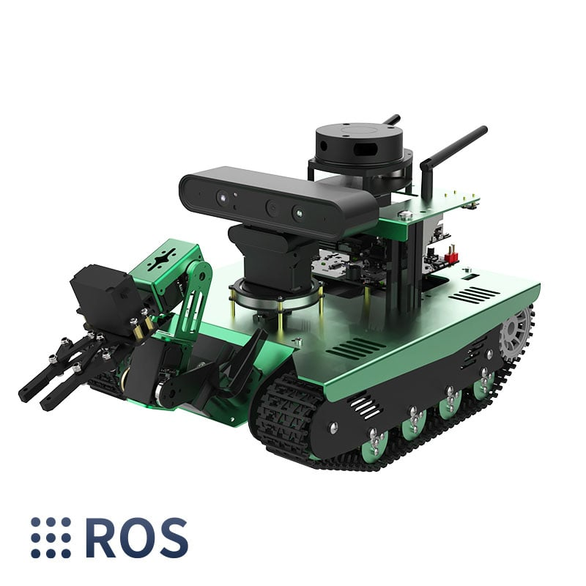
PROJECT setup

Slide 4
PROJECT STATUS
CAD design of the line drawing machine done 60%.
Touch screen setup on raspberry pi and ROS installation done.
Tested the hardware of the grover.
Repository and website up and running.
ConOps and other coursework related documentation created.
A workshop space has been acquired.

Slide 5
PROJECT DISTRIBUTION and future
TEAM DRIVE TRAIN
TEAM AUTONOMOUS
LINE DRAWING MACHINE
DEVELOP DRIVETRAIN
SELECT AND FINALISE THE REQUIRED PARTS
DRAW UP CAD DESIGNS
TEST BED : YAHBOOM TRANSBOT
IMPLEMENT AUTONOMOUS STACK
TEST THE GROVER PLOTTER SOFTWARE
IMPLEMENT ROS 2 AND INTEGRATE WITH EXISTING HARDWARE.
GPS TESTING

Slide 6
Client comms

Slide 7
Client comms
A budget estimate has been communicated
System distribution, project setup and plan have been communicated.
Hardware has been acquired from the client for testing.
Communication established with the software team that’s also working on the rover.

Slide 8
THANK YOU

