Slide 1
L E C T U R E
7&8
SYSTEMS ANALYSIS & REQUIREMENTSDISCOVERY
Notes:
This repository of slides is intended to support the named chapter. The slide repository should be used as follows:
Copy the file to a unique name for your course and unit.
Edit the file by deleting those slides you don’t want to cover, editing other slides as appropriate to your course, and adding slides as desired.
Print the slides to produce transparency masters or print directly to film or present the slides using a computer image projector.
Each slide includes instructor notes. To view those notes in PowerPoint, click-left on the View Menu; then click left on Notes View sub-menu. You may need to scroll down to see the instructor notes.
The instructor notes are also available in hardcopy as the Instructor Guide to Accompany Systems Analysis and Design Methods, 5/ed.

Slide 2
Systems Analysis Phases
Preliminary Investigation Phase
Problem Analysis Phase
Requirements Analysis Phase
Decision Analysis Phase
Notes:
Conversion Notes
The phases correspond to the following fourth edition terms:
Preliminary investigation = former survey phase
Problem analysis = former study phase
Requirements analysis = former definition phase
Decision analysis = former configuration phase

Slide 3
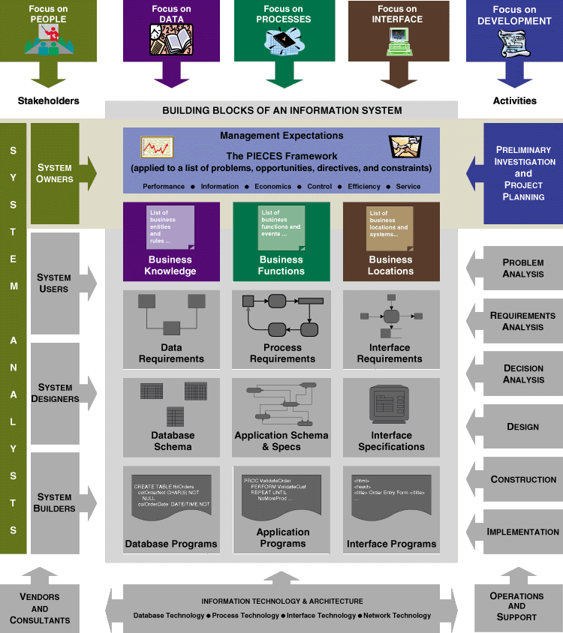
Preliminary Investigation Phase Context
Notes:
Conversion Notes
In this edition we are trying hard to reinforce the building blocks.
Teaching Notes
The focus system owner perspectives.

Slide 4
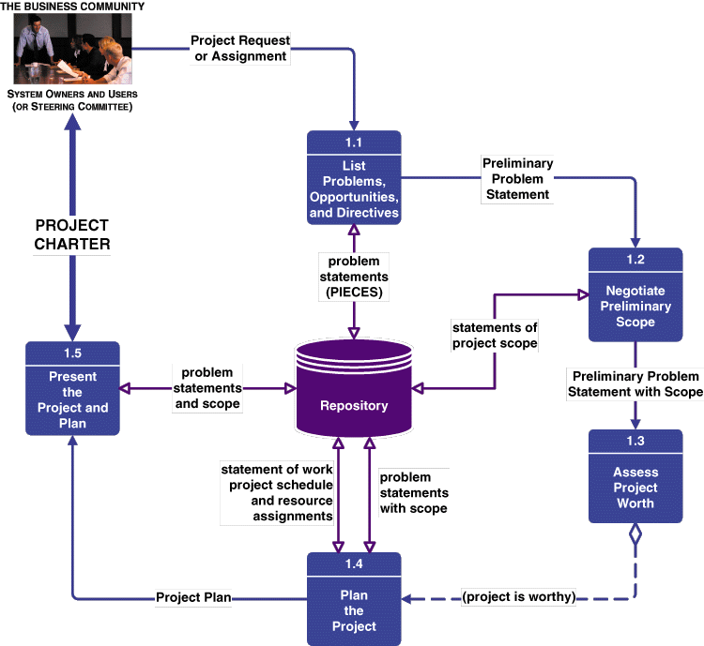
Preliminary Investigation Phase Tasks
Notes:
Teaching Notes
This is called a task diagram for a phase.
It is only a guideline. Each project will adapt these tasks to the project at hard. Tasks may be added, split, or deleted according to the methodology and route used.
The dashed line is a control flow (as contrasted to a solid data flow). In this case, it represents a decision that determines whether the next task is necessary.

Slide 5
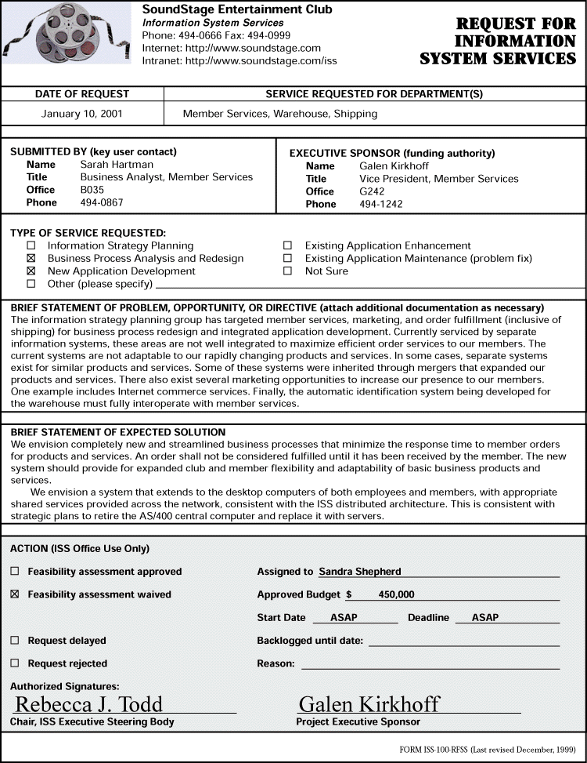
Sample Request for System Services
Notes:
Teaching Notes
Not all businesses have a formal document to initiate projects.

Slide 6
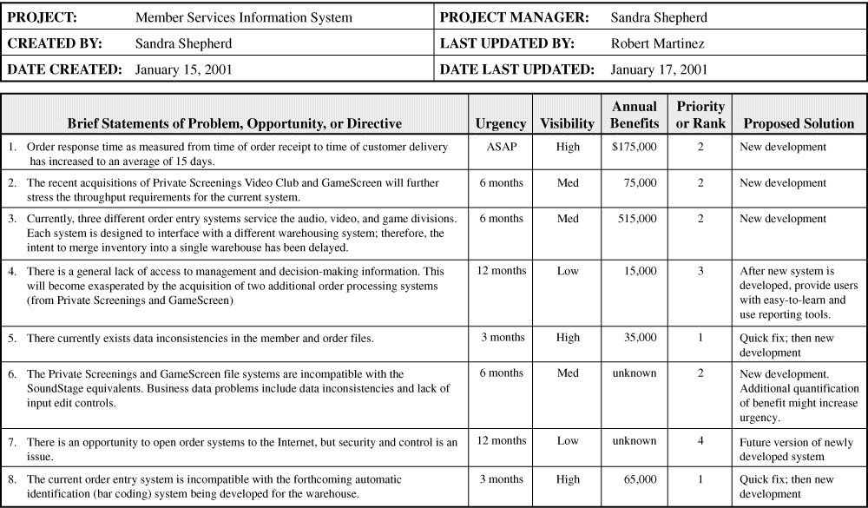
Problem Statements
Notes:
Teaching Notes
Alternatively, this information could be documented in a business memo or report.

Slide 7
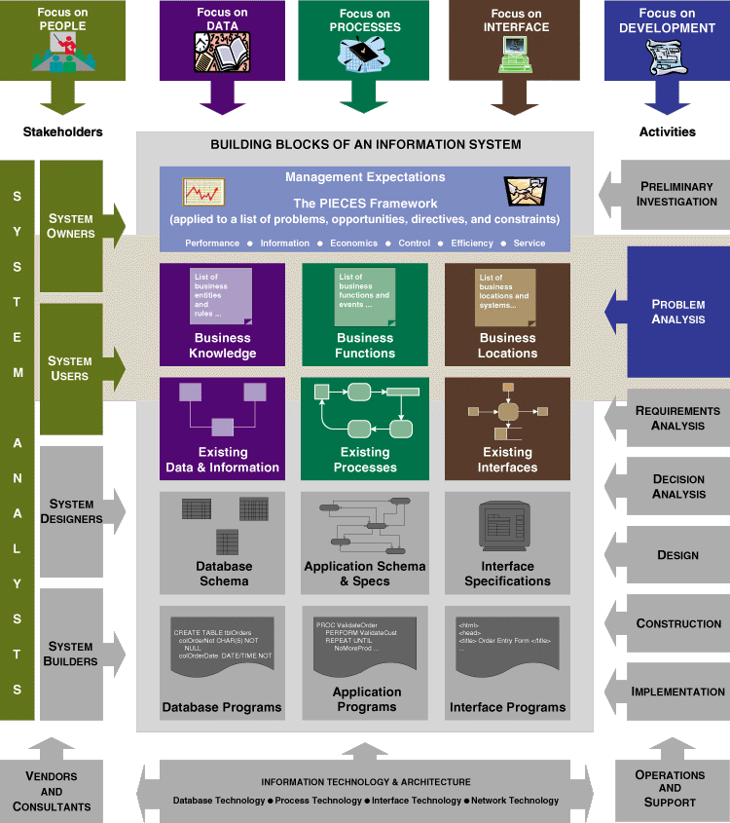
Problem Analysis Phase Context
Notes:
Conversion Notes
In this edition we are trying hard to reinforce the building blocks.
Teaching Notes
The focus is on both system owner and system user perspectives.
We are looking at the building blocks of the existing system.

Slide 8
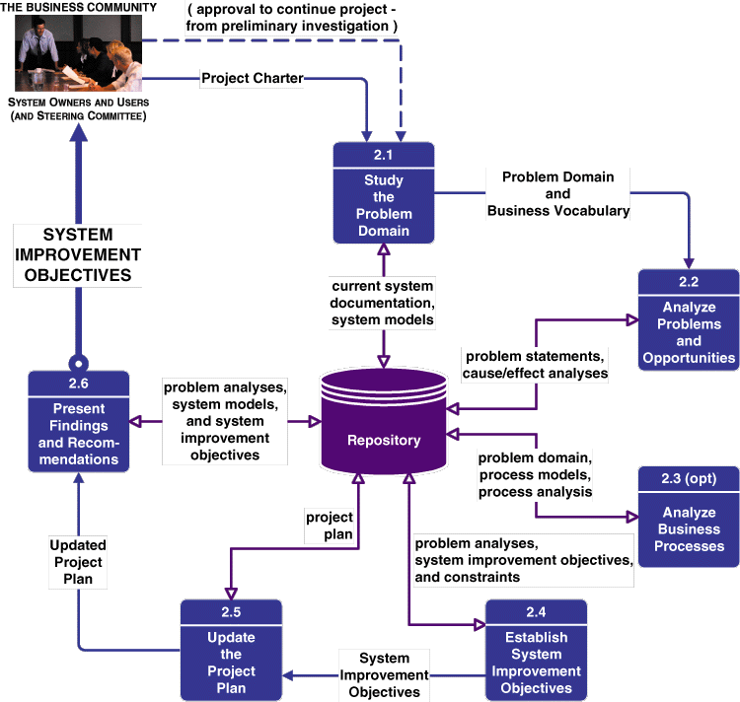
Problem Analysis Phase Context
Notes:
No additional notes

Slide 9
Cause-and-Effect Analysis
  Cause-and-effect analysis is a technique in which problems are studied to determine their causes and effects.
  In practice, effects can be symptomatic of more deeply rooted or basic problems which, in turn, must be analyzed for causes and effects until such a time as the causes and effects do not yield symptoms of other problems.
Notes:
Teaching Tip
Analyze a problem using cause-and-effect analysis.
If you know “fishbone diagrams”, demonstrate cause-and-effect analysis using the diagrams.

Slide 10
System Improvement Objectives
  An objective is a measure of success. It is something that you expect to achieve, if given sufficient resources.
    Reduce the number of uncollectible customer accounts by 50 percent within the next year.
    Increase by 25 percent the number of loan applications that can be processed during an eight-hour shift.
    Decrease by 50 percent the time required to reschedule a production lot when a workstation malfunctions.
  A constraint is something that will limit your flexibility in defining a solution to your objectives. Essentially, constraints cannot be changed.
Notes:
Teaching Tips
Formulate objectives as an in-class exercise.

Slide 11
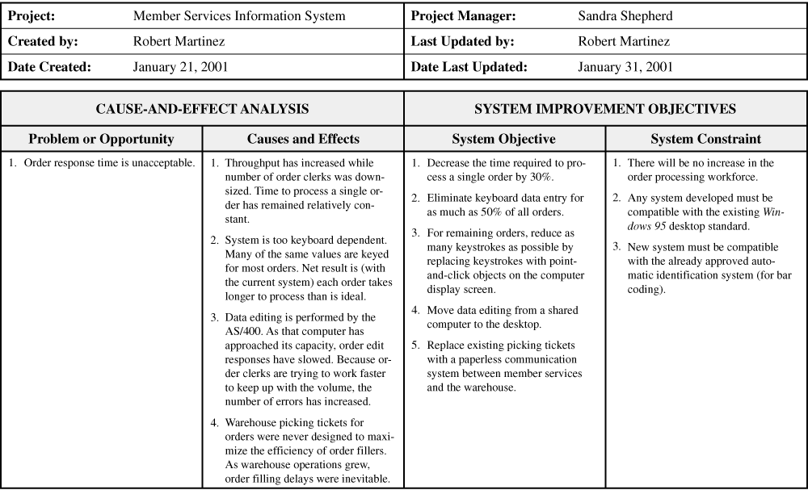
Cause-and-Effect / System Improvement Objectives
PROBLEMS, OPPORTUNITIES, OBJECTIVES, AND CONSTRAINTS MATRIX
Notes:
No additional notes

Slide 12
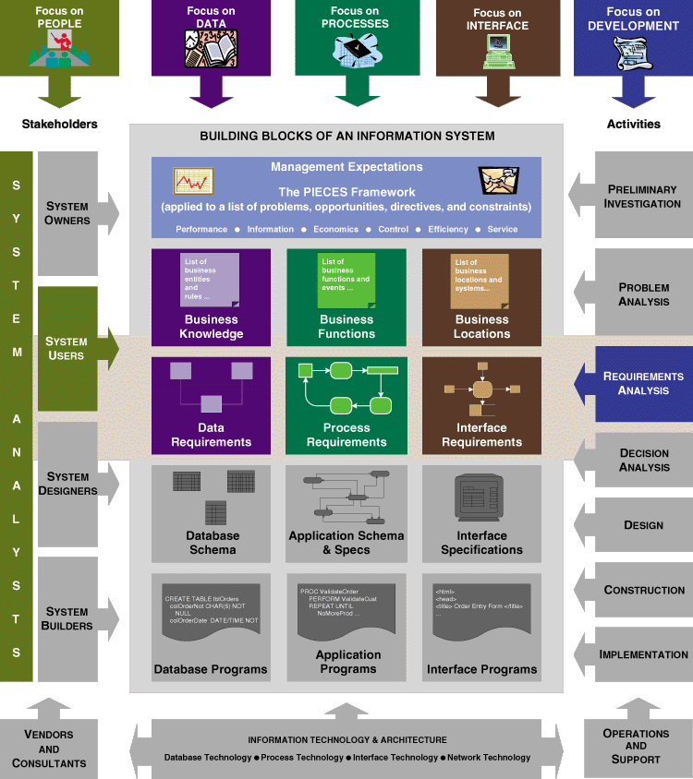
Requirements Analysis Phase Context
Notes:
Conversion Notes
In this edition we are trying hard to reinforce the building blocks.
Teaching Notes
The focus is on system user perspectives.
Requirements can be expressed in narrative, model, and prototype forms, or any combination thereof.

Slide 13
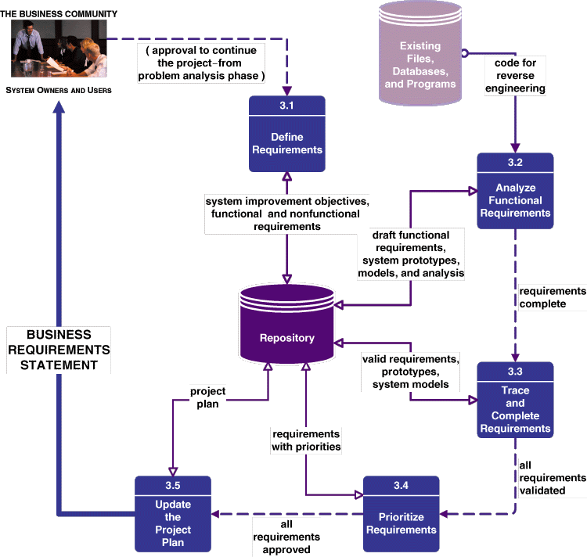
Requirements Analysis Phase Tasks
Notes:
Teaching Notes
Some of the tasks are completed in parallel.

Slide 14
Logical System Models
  Logical system models depict what a system is or what a system must do—not how the system will be implemented. Because logical models depict the essential requirements of a system, they are sometimes called essential system models.
    Process models (e.g., data flow diagrams)
    Data models (e.g., entity relationship diagrams)
    Interface models (e.g., context diagrams)
    Object models (e.g., Uniform Modeling Language diagrams)
Notes:
Teaching Notes
The opposite is physical system models, which will be introduced in the systems design chapter.

Slide 15
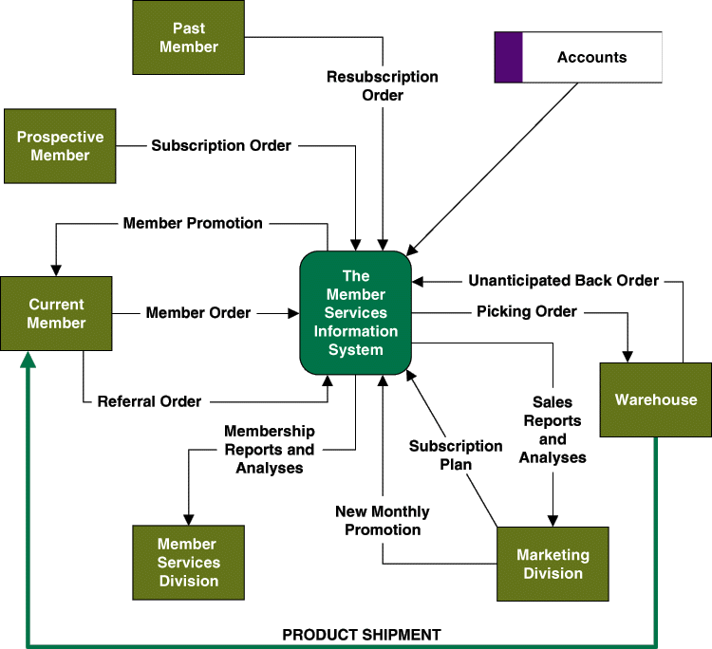
A Simple Interface Model
Notes:
No additional notes

Slide 16
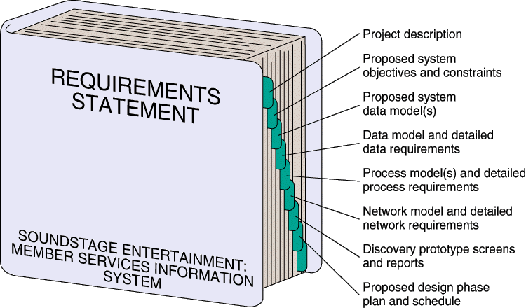
Requirements Statement
Notes:
No additional notes

Slide 17
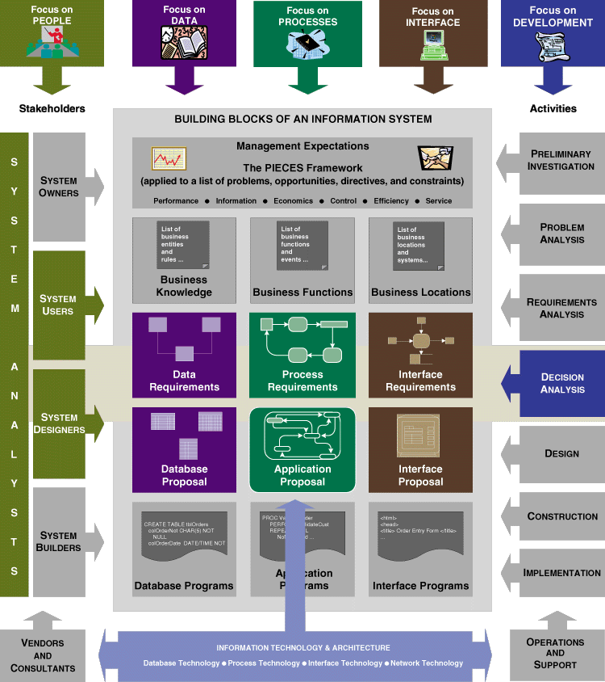
Decision Analysis Phase Context
Notes:
Conversion Notes
In this edition we are trying hard to reinforce the building blocks.
Teaching Notes
The focus is on system user and system designer perspectives.
Notice the transition to technical concerns leading to a system proposal that includes data, process, and interface elements.

Slide 18
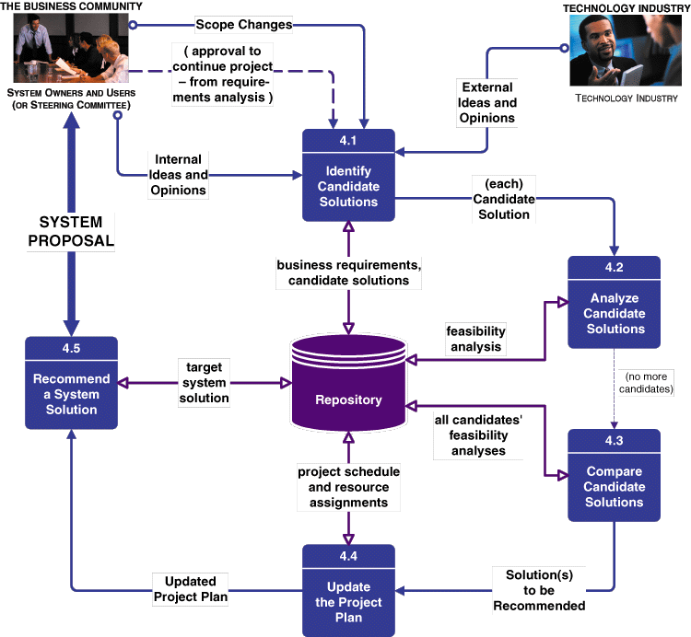
Decision Analysis Phase Tasks
Notes:
No additional notes

Slide 19
Feasibility Analyses
Technical feasibility. Is the solution technically practical? Does our staff have the technical expertise to design and build this solution?
Operational feasibility. Will the solution fulfill the users’ requirements? To what degree? How will the solution change the users’ work environment? How do users feel about such a solution?
Economic feasibility. Is the solution cost-effective?
Schedule feasibility. Can the solution be designed and implemented within an acceptable time period?
Notes:
No additional notes

Slide 20
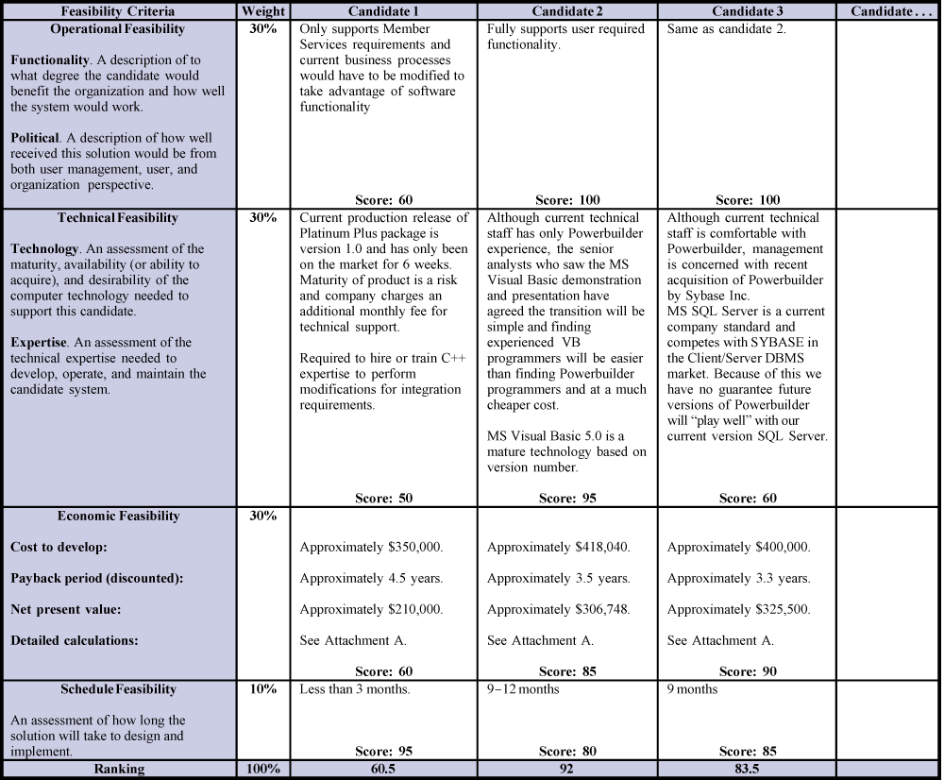
Feasibility Matrix
Notes:
No additional notes

Slide 21
REQUIREMENTSDISCOVERY
Notes:
This repository of slides is intended to support the named chapter. The slide repository should be used as follows:
Copy the file to a unique name for your course and unit.
Edit the file by deleting those slides you don’t want to cover, editing other slides as appropriate to your course, and adding slides as desired.
Print the slides to produce transparency masters or print directly to film or present the slides using a computer image projector.
Each slide includes instructor notes. To view those notes in PowerPoint, click-left on the View Menu; then click left on Notes View sub-menu. You may need to scroll down to see the instructor notes.
The instructor notes are also available in hardcopy as the Instructor Guide to Accompany Systems Analysis and Design Methods, 5/ed.

Slide 22
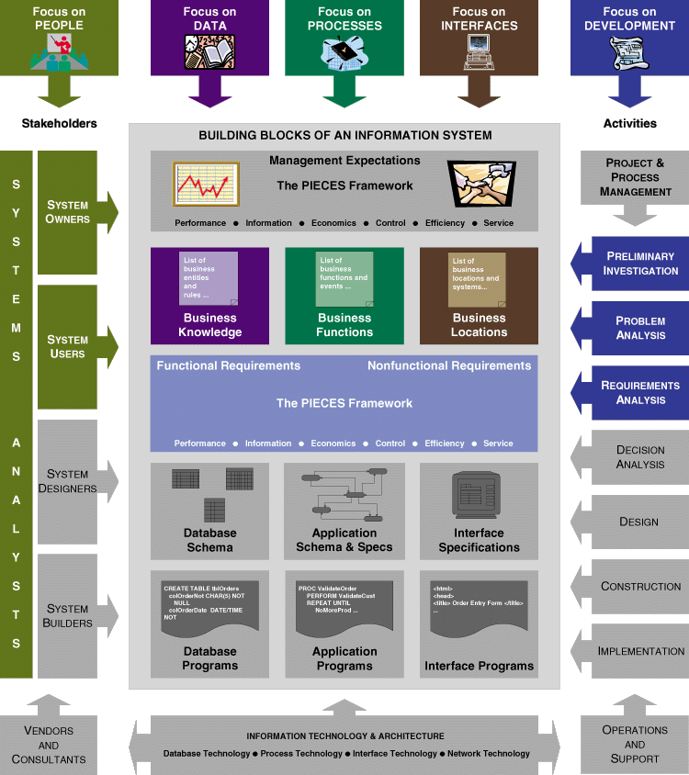
Lesson Map
Notes:
No additional notes

Slide 23
Introduction to Requirements Discovery
Requirements discovery includes those techniques to be used by systems analysts to identify or extract system problems and solution requirements from the user community.
Problem analysis is the activity of identifying the problem, understanding the problem (including causes and effects), and understanding any constraints that may limit the solution.
Notes:
Teaching Notes
This chapter focuses on the techniques and activities for eliciting system requirements as well as how to properly validate and document requirements. The authors have placed an emphasis on this chapter because recent studies have shown that as many as 80% of all system development failures can be traced back to problems with requirements.

Slide 24
Introduction to Requirements Discovery
A system requirement (also called a business requirement) is a description of the needs and desires for an information system. A requirement may describe functions, features (attributes), and constraints.
Notes:
No additional notes.

Slide 25
Types of Requirements
A functional requirement is a function or feature that must be included in an information system in order to satisfy the business need and be acceptable to the users.
A nonfunctional requirement is a description of the features, characteristics, and attributes of the system as well as any constraints that may limit the boundaries of the proposed solution.
Notes:
Teaching Notes
A functional requirement is an action of the system and usually is written using an action verb phrase. For example:
· The system should process a checking account deposit
· The system should calculate the GPA for a student
· The system should capture the account holder identification information
Examples of nonfunctional requirements.
· be user friendly
· be able to accommodate users at different physical locations
Teaching Tips
Have students give examples of different types of requirements and classify this as functional versus nonfunctional.

Slide 26
Types of Nonfunctional Requirements
Requirement Type
Explanation
Performance
Performance requirements represent the performance the system is required
to exhibit to meet the needs of users.
·
What is the acceptable throughput rate?
·
What is the acceptable response time?
Informatio
n requirements represent the information that is pertinent to the
users in terms of content, timeliness, accuracy, and format.
Information
·
What are the necessary inputs and outputs? When must they
happen?
·
What is the required data to be stored?
·
How current must the information be?
·
What are the interfaces to external systems?
Economy requirements represent the need for the system to reduce costs or
increase profits.
Economy
·
What are the areas of the system where costs must be reduced?
·
How much should costs be reduced or profits be increased?
·
What are the budgetary limits?
·
What is the timetable for development?
Control
(and Security)
Control requirements represent the environment in which the system must
operate, as well as the type and degree of security that must be provided.
·
Must access to the system or information be controlled?
·
What are the privacy requirements?
·
Does the criticality of the data necessitate the need for special
handling (backups, offsite storage, etc.) of the data?
Notes:
Teaching Tips
Review each category and have the students give additional examples.
Teaching Notes
Other classifications of requirements exist and are published by IEEE and in Military standards. We chose to use PIECES to be consistent and reinforce the theme of the textbook.

Slide 27
Types of Nonfunctional Requirements (concluded)
Requirement Type
Explanation
Efficiency
Efficiency requirements represent the systems ability to produce outputs
with minimal waste.
·
Are there duplicate steps in the process that must be eliminated?
·
Are there ways to reduce waste in the way the system uses it
resources?
Service
Service requirements represent needs in order for the system to be
reliable, flexible, and expandable.
·
Who will use the system and where are they located?
·
Will there be different types of users?
·
What are the appropriate human factors?
·
What training devices and training materials are to be included in
the system?
·
What training devices and training materials are to be developed
and maintained separately from the system, such as stand- alone
computer based training (CBT) programs or databases?
·
What are the reliability/availability requirements?
·
Ho
w should the system be packaged and distributed?
·
What documentation is required?
Notes:
No additional notes.

Slide 28
An Ambiguous Requirements Statement
Requirement:
Create a means to transport a single
individual from home to place of work.
Management
I T
User
Interpretation
Interpretation
Interpretation
Notes:
Teaching Tips
Try to give other examples of a requirements statement that can be interpreted many ways. These can relate to homework assignments, current events, or normal household chores.

Slide 29
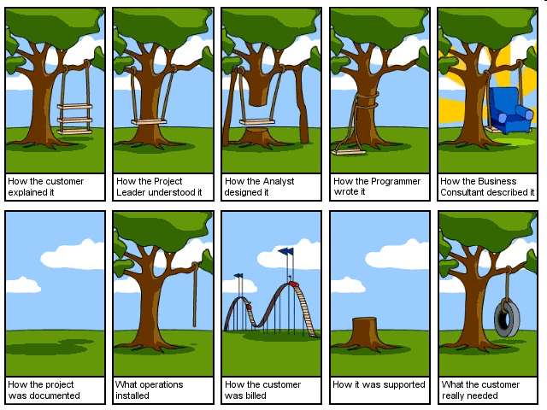

Slide 30
Results of Incorrect Requirements
The system may cost more than projected.
The system may be delivered later than promised.
The system may not meet the users’ expectations and that dissatisfaction may cause them not to use it.
Once in production, the costs of maintaining and enhancing the system may be excessively high.
The system may be unreliable and prone to errors and downtime.
The reputation of the IT staff on the team is tarnished because any failure, regardless of who is at fault, will be perceived as a mistake by the team.
Notes:
No additional notes.

Slide 31
Criteria to Define System Requirements
Consistent-not conflicting or ambiguous
Complete –describe all possible system inputs and responses.
Feasible-satisfied based on the available resources and constraints
Required-the requirements are truly needed
Accurate-the requirements are stated correctly.
Traceable-
Verifiable -
Notes:
Teaching Notes
The goal of the systems analyst is to define system requirements that meet the following criteria:
· Consistent ⎯ the requirements are not conflicting or ambiguous.
· Complete ⎯ the requirements describe all possible system inputs and responses.
· Feasible ⎯ the requirements can be satisfied based on the available resources and constraints (feasibility analysis is covered in Chapter 9).
· Required ⎯ the requirements are truly needed and fulfill the purpose of the system.
· Accurate ⎯ the requirements are stated correctly.
· Traceable ⎯ the requirements directly map to the functions and features of the system.
· Verifiable ⎯ the requirements are defined so they can be demonstrated during testing.

Slide 32
The Process of Requirements Discovery
Problem discovery and analysis
Requirements discovery
Documenting and analyzing requirements
Requirements management
Notes:
Teaching notes
The process of requirements discovery consists of four activities.

Slide 33
Requirements Discovery
Fact-finding is the formal process of using research, interviews, questionnaires, sampling, and other techniques to collect information about problems, requirements, and preferences. It is also called information gathering.
Notes:
Teaching Notes
Stress that fact-finding is a technique that is used across the entire development cycle but it is extremely critical in the requirements analysis phase.
Teaching Tips
Be sure to discuss the role of ethics during the fact-finding activity.

Slide 34
Seven Fact-Finding Methods
Sampling of existing documentation, forms, and databases.
Research and site visits.
Observation of the work environment.
Questionnaires.
Interviews.
Prototyping.
Joint requirements planning (JRP).
Notes:
No additional notes.

Slide 35


