Slide 1
Quiz time: 17:40-18:15
Please also turn in the early feed back form (ignore the back)
My name is Oscar Chang

Slide 2
Hypothesis Testing
Lecture 5
NRE 538

Slide 3
Outline
Null VS Alternative Hypothesis
One- VS two Tail Hypothesis Test
Type I VS Type II Error
Hands-on example

Slide 4
What is a “Hypothesis” ?
Notes:
Ask students here

Slide 5
What is a “Hypothesis” ?
An assumption about a parameter

Slide 6
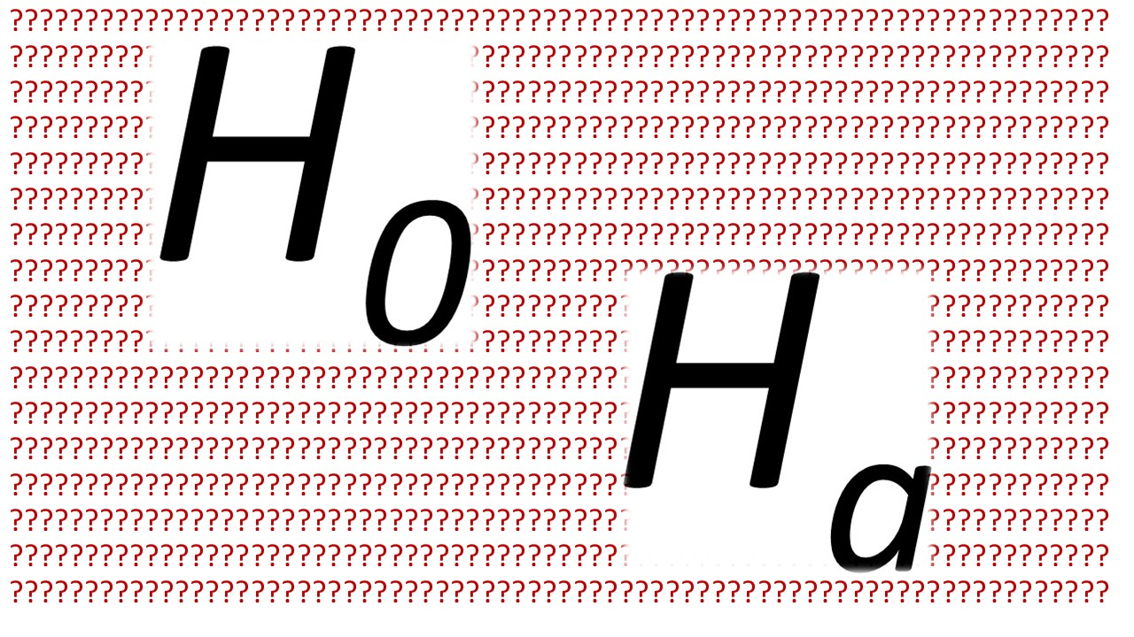
Null VS Alternative Hypothesis

Slide 7
Null VS Alternative Hypothesis
Null Hypothesis (H₀) :
The belief that the parameter is ≥, =, or ≤ than a specific value
A general statement or default position that there is no relationship between two measured phenomena, or no association among groups

Slide 8
Null VS Alternative Hypothesis
Null Hypothesis (H₀) :
The belief that the parameter is ≥, =, or ≤ than a specific value
A general statement or default position that there is no relationship between two measured phenomena, or no association among groups
Alternative Hypothesis (H_{a})
The opposite of H₀

Slide 9
Null VS Alternative Hypothesis…examples
Null Hypothesis (H₀) :
My average 10K running time (50 min; μ₁) is not different from 55 min 52s (μ₂).
OR more statistically,
μ₁ = μ₂
, where μ₁ mean of population 1 and μ₂ mean of population 2
Alternative Hypothesis (H_{a}) :
My average 10K running time (50 min; μ₁) is different from 55 min 52s (μ₂).
OR more statistically,
μ₁ ≠ μ₂
, where μ₁ mean of population 1 and μ₂ mean of population 2

Slide 10
Null VS Alternative Hypothesis…examples
Null Hypothesis (H₀) :
My average 10K running time (50 min; μ₁) is not different from 55 min 52 s (μ₂).
OR more statistically,
μ₁ = μ₂
, where μ₁ mean of population 1 and μ₂ mean of population 2
Alternative Hypothesis (H_{a}) :
My average 10K running time (50 min; μ₁) is different from 55 min 52s (μ₂).
OR more statistically,
μ₁ ≠ μ₂
, where μ₁ mean of population 1 and μ₂ mean of population 2

Slide 11
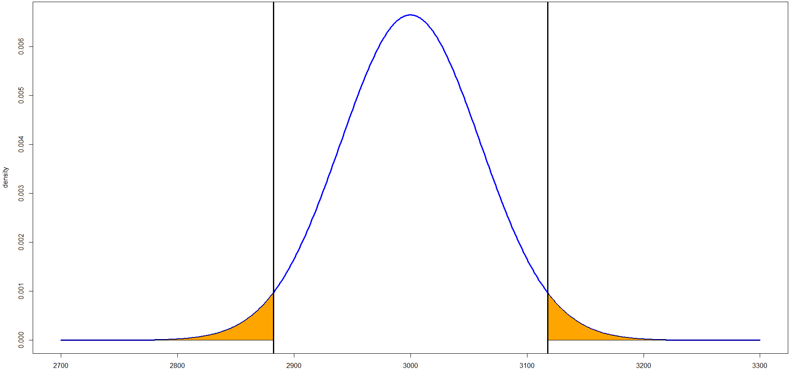
Two Tail Hypothesis Test
H₀: μ₁ = μ₂
H_{a}: μ₁ ≠ μ₂
Critical value to reject H₀
Critical value to reject H₀
Distribution of Oscar’s 10K running time
Oscar’s avg. time (μ₁) = 3000s
Seconds / 10K

Slide 12
Null VS Alternative Hypothesis…examples
Null Hypothesis (H₀) :
My average 10K running time (50 min; μ₁) is shorter than 55 min 52 s (μ₂).
OR more statistically,
μ₁ ≤ μ₂
, where μ₁ mean of population 1 and μ₂ mean of population 2
Alternative Hypothesis (H_{a}) :
My average 10K running time (50 min; μ₁) is longer than 55 min 52s (μ₂).
OR more statistically,
μ₁ > μ₂
, where μ₁ mean of population 1 and μ₂ mean of population 2

Slide 13
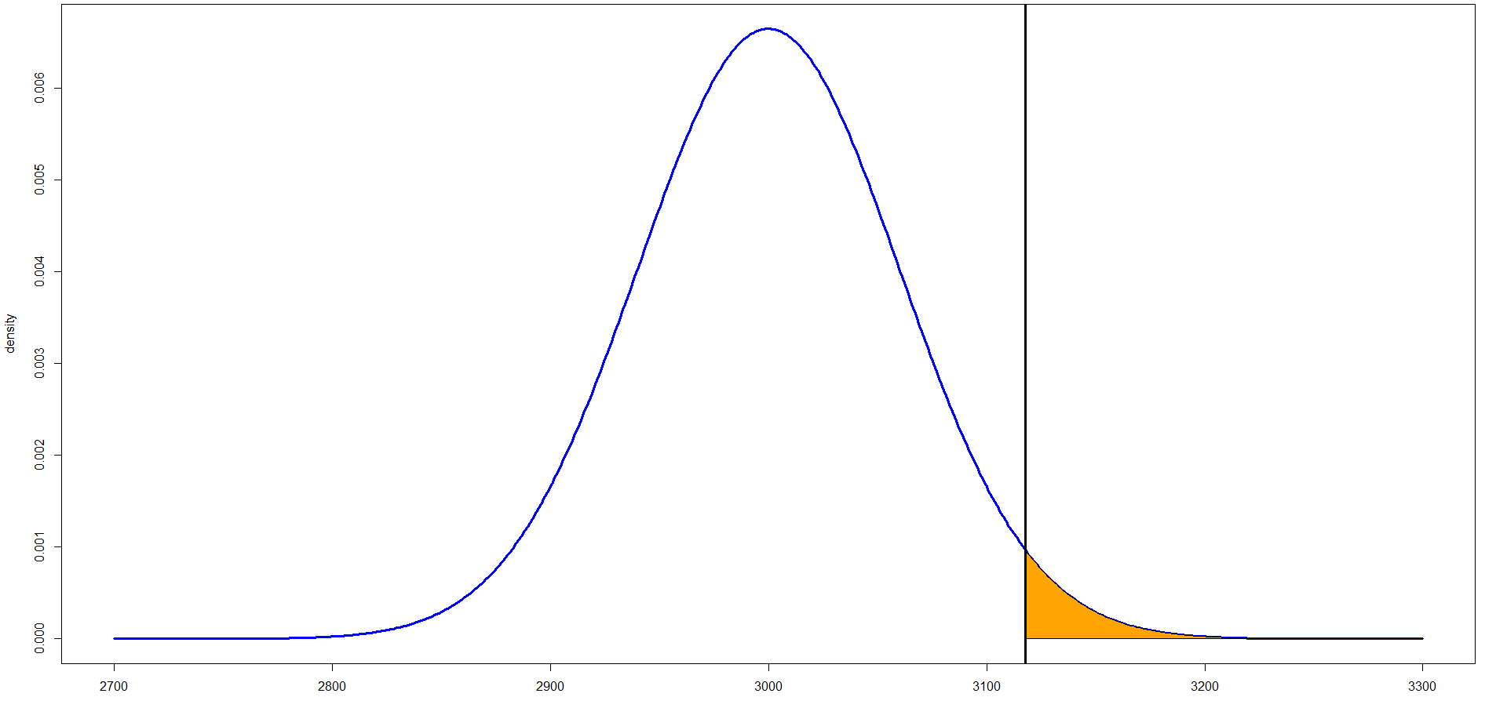
One Tail Hypothesis Test
H₀: μ₁ ≤ μ₂
H_{a}: μ₁ > μ₂
Critical value to reject H₀
Distribution of Oscar’s 10K running time
Oscar’s avg. time (μ₁) = 3000s
Seconds / 10K

Slide 14
Type I VS Type II Error
 |  | H₀ is…
 |  | True | False
Judgement of H₀ | Reject | Type I Error (probability=α) | True positive
 | Fail to reject | True Negative | Type II Error (probability=β)

Slide 15
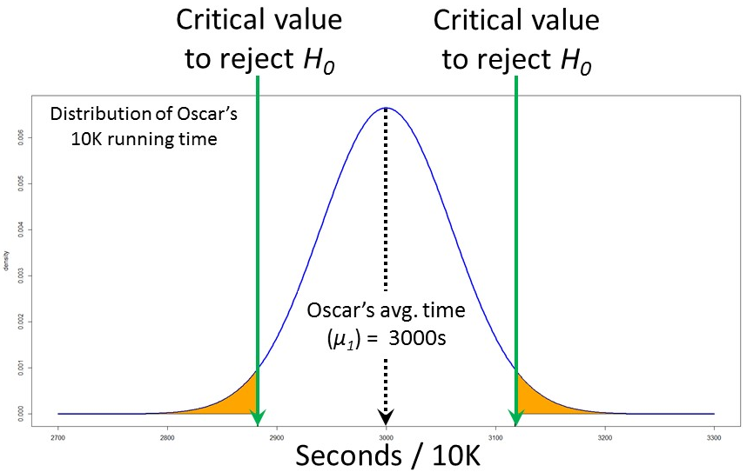
Type I VS Type II Error
 |  | H₀ is…
 |  | True | False
Judgement of H₀ | Reject | Type I Error (probability=α) | True positive
 | Fail to reject | True Negative | Type II Error (probability=β)
H₀: μ₁ = μ₂
H_{a}: μ₁ ≠ μ₂
μ₂

Slide 16
Type I VS Type II Error
 |  | H₀ is…
 |  | True | False
Judgement of H₀ | Reject | Type I Error (probability=α) | True positive
 | Fail to reject | True Negative | Type II Error (probability=β)
H₀: μ₁ = μ₂
H_{a}: μ₁ ≠ μ₂
What if μ₂ is really one of my records?
μ₂
μ₂

Slide 17
Type I VS Type II Error
 |  | H₀ is…
 |  | True | False
Judgement of H₀ | Reject | Type I Error (probability=α) | True positive
 | Fail to reject | True Negative | Type II Error (probability=β)
H₀: μ₁ = μ₂
H_{a}: μ₁ ≠ μ₂
What if μ₂ is really one of my records?
=> Type I Error
μ₂
μ₂

Slide 18
Type I VS Type II Error
 |  | H₀ is…
 |  | True | False
Judgement of H₀ | Reject | Type I Error (probability=α) | True positive
 | Fail to reject | True Negative | Type II Error (probability=β)
H₀: μ₁ = μ₂
H_{a}: μ₁ ≠ μ₂
What if μ₂ is really one of my records?
=> Orange area
μ₂
μ₂

Slide 19
Type I VS Type II Error
 |  | H₀ is…
 |  | True | False
Judgement of H₀ | Reject | Type I Error (probability=α) | True positive
 | Fail to reject | True Negative | Type II Error (probability=β)
H₀: μ₁ = μ₂
H_{a}: μ₁ ≠ μ₂
μ₂

Slide 20

Type I VS Type II Error
 |  | H₀ is…
 |  | True | False
Judgement of H₀ | Reject | Type I Error (probability=α) | True positive
 | Fail to reject | True Negative | Type II Error (probability=β)
H₀: μ₁ = μ₂
H_{a}: μ₁ ≠ μ₂
What if μ₂ is actually one of Usain Bolt’s records?
μ₂

Slide 21
Type I VS Type II Error
 |  | H₀ is…
 |  | True | False
Judgement of H₀ | Reject | Type I Error (probability=α) | True positive
 | Fail to reject | True Negative | Type II Error (probability=β)
H₀: μ₁ = μ₂
H_{a}: μ₁ ≠ μ₂
What if μ₂ is actually one of Usain Bolt’s record?
=> Type II Error
μ₂

Slide 22
Type I VS Type II Error
 |  | H₀ is…
 |  | True | False
Judgement of H₀ | Reject | Type I Error (probability=α) | True positive
 | Fail to reject | True Negative | Type II Error (probability=β)
H₀: μ₁ = μ₂
H_{a}: μ₁ ≠ μ₂
What is the probability of committing Type II Error?
=> 1 - Orange area
μ₂

Slide 23
Type I VS Type II Error
 |  | H₀ is…
 |  | True | False
Judgement of H₀ | Reject | Type I Error (probability=α) | True positive
 | Fail to reject | True Negative | Type II Error (probability=β)
- There is trade-off between α and β
α is typically set to be 0.1-0.01 (1% - 10%)
If α is set to be 0.05, the critical value to reject the H₀ is the 95% CI.

Slide 24
Hands-on exercise Am I really faster than average US men?
Null Hypothesis (H₀) :
μ₁ = μ₂
, μ₁= 2990.641 (s) and μ₂ = 3352 (s)
Alternative Hypothesis (H_{a}) :
μ₁ ≠ μ₂
*Set α to be 0.05.
Should we Reject or NOT Reject the null hypothesis (H₀)?
What is the probability of committing Type I error?

