Slide 1
NRE 538_Lab section 1
Feng-Hsun (Oscar) Chang @ Bradley Cardinale’s lab
fhchang@umich.edu
Office hour: Th/F 4:00-5:00 PM; 3325 Dana

Slide 2
General questions about the class…?
Syllabus
…?

Slide 3
Some notes
Public PC or your own laptop are good
R and Rstudio
Question posting/discussion on Piazza
Assignment rules

Slide 4
Piazza blog
You can ask questions anonymously if you’d like – asking questions doesn’t count as participation. It is your benefit to ask questions if you’re confused about something!
You should always post making sure that your name is visible. We will count answering questions as your 10% participation grade.

Slide 5
Folders – post questions in the right place!
Lab 1-13. NOTE: These numbers match the week number in the syllabus, and not the Assignment number.
Lectures 1-13. NOTE: These numbers match the week number in the syllabus, and not the actual lecture number. There may be 2 lectures that fall within a given week.
Quiz 1-5
Project – Group project
Final Exam

Slide 6
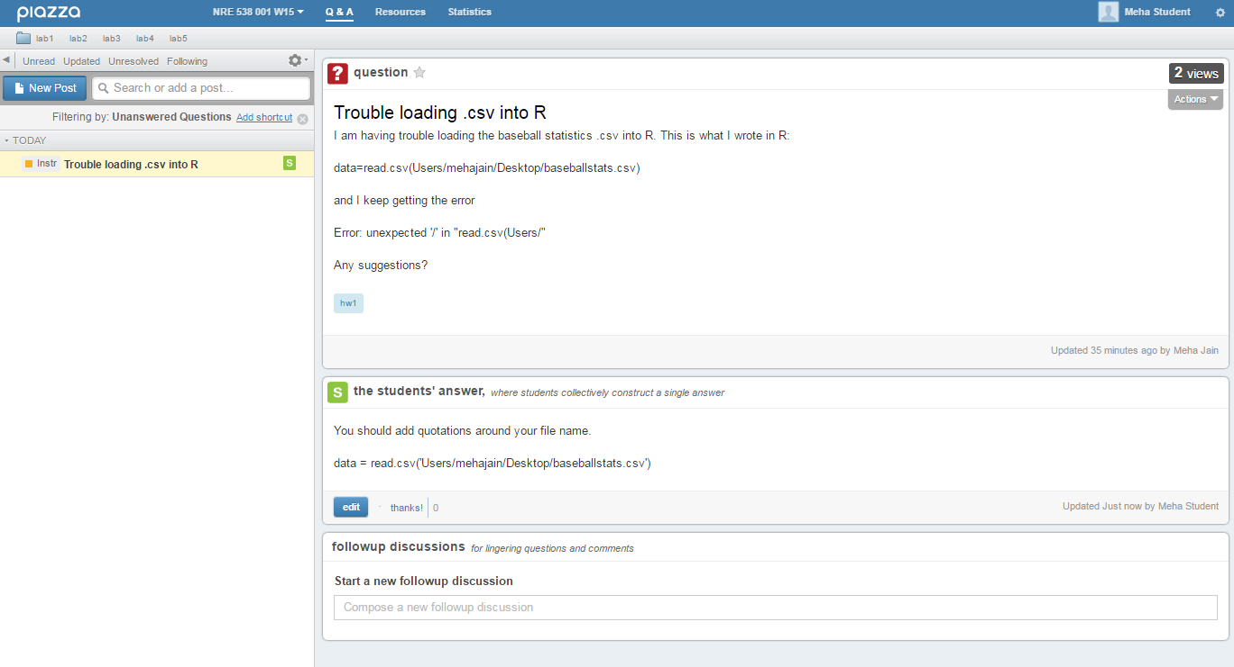

Slide 7
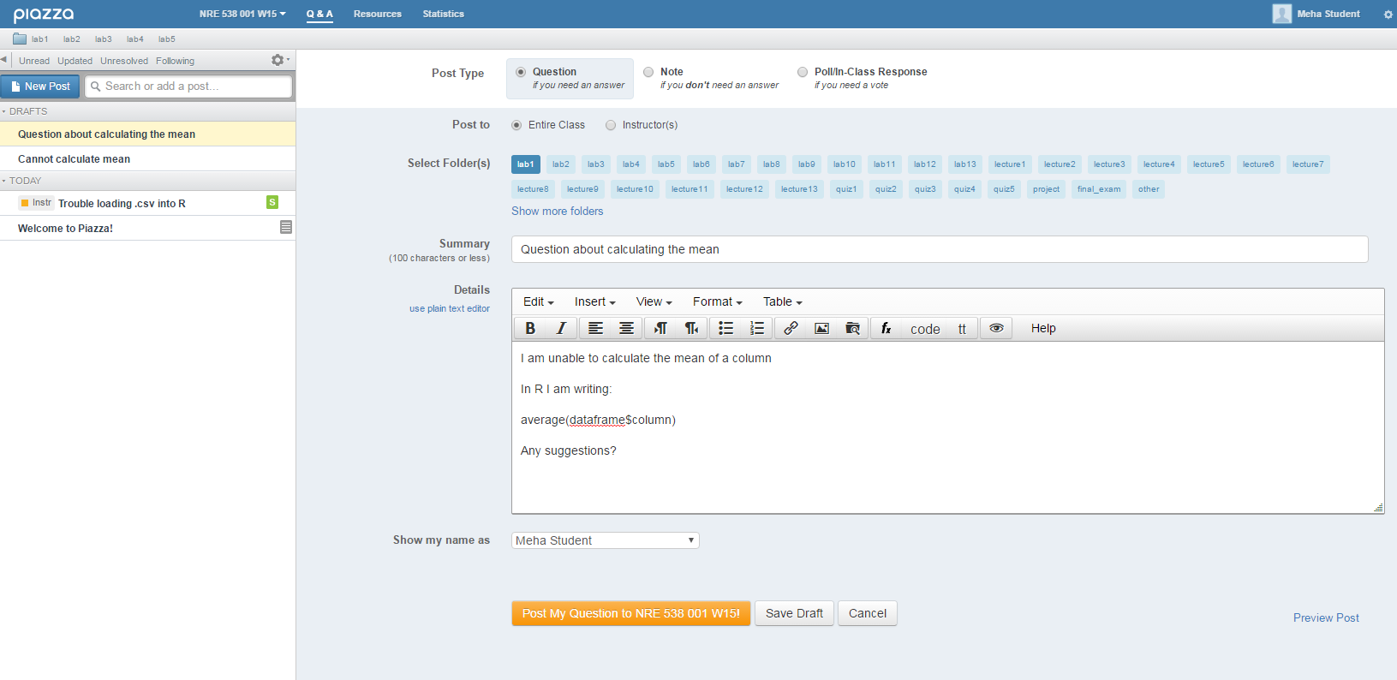
Notes:
Click on folder associated with your question (lab/lecture etc)
Can choose to ask question anonymously (show my name as)

Slide 8
Posting Protocol
Posted question
  Conceptual – simply ask your question
  Coding – provide the line of code you are having problems with, and the error that you are getting.
Posted answer
  Post an answer – do NOT do this anonymously (you want credit!)
  You can edit an existing answer if you feel like it is not correct or can be improved (you will also get credit for this). Wikipedia style editing results in better answers!
  We can see the history of answers, so make sure you are making substantive contributions and non only non-substantive edits (e.g. fixing grammar)
If you still have questions after the original question has been answered, add a follow up question

Slide 9
Participation statistics
http://support.piazza.com/customer/portal/articles/1564015-class-statistics-
  We can see # of questions asked (your benefit, can do anonymously), # of questions answered (participation credit, make sure you are not doing this anonymously)

Slide 10
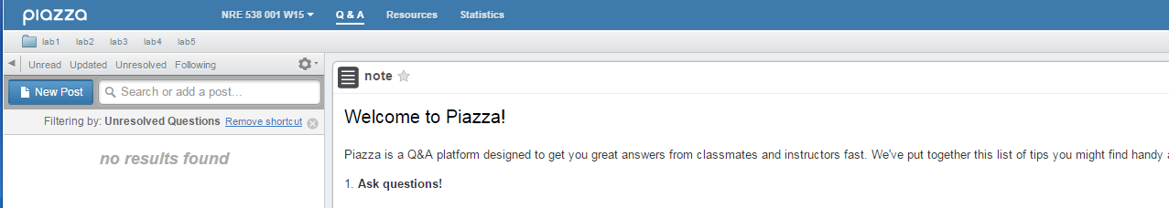
Folders
You can look at unread questions ready to be answered, posts that have been recently updated, unresolved questions that still need a better answer, and you can follow questions if you have the same question and are waiting for an answer

Slide 11
Enrolling in Piazza
Oscar will add your email address to Piazza and you can enroll. We will only use Piazza for Q + A blog. All labs, lecture notes, readings, etc will still be posted on Canvas.

Slide 12
Assignment Rules
ONLY .R, .rmd, .html files are accepted!
File name: your uniquename_assignment number
e.g. fhchang_1

Slide 13
Swirl
Familiar yourself with basic R commends and data type in R
http://www.r-tutor.com/r-introduction
Work on sections: 1, 4, 5, 6, 7

