Slide 1
Advance Programming Concepts
Project
CLINIC APPOINTMENT
Maridul Walia, 2310991897
Mehak Walia, 2310991901
Michael, 2310991902
Ramya,2310992587
Class Group: G-21
Submitted To : Faculty:
Mr. Samarth Dr. Amandeep Kaur
Designation
Department of Computer Science Engineering

Slide 2
Problem Statement
Clinics face multiple operational challenges:
Appointment Scheduling Issues: Manual tracking often results in double-bookings and missed appointments.
Prescription Mismanagement: Handwritten or disconnected systems can cause medication errors and loss of records.
Limited Administrative Oversight: Admins struggle with manual reporting and monitoring staff performance.
Data Security & Accessibility: Ensuring data privacy and accessibility in manual or semi-digital systems is difficult.
CAPMS addresses these issues by providing a secure, scalable, and fully automated system. It improves scheduling accuracy, prescription tracking, administrative control, and overall operational efficiency

Slide 3
Introduction
Clinic Appointment and Prescription Management System (CAPMS) is a modern healthcare management web application designed using a microservices architecture with the Spring Boot framework. The platform connects patients, doctors, and administrators through an intuitive interface for scheduling appointments, issuing prescriptions, and managing clinical operations. The system is composed of three core microservices: Authentication Service for user registration and secure role-based login, Appointment Service for managing doctor-patient scheduling, and Prescription Service for digital prescription handling and patient health tracking. MySQL serves as the primary database, chosen for its relational integrity and strong query optimization. The frontend is developed with Thymeleaf templates and Tailwind for responsive, cross-platform user experiences.
The platform allows patients to register, view doctor profiles, book appointments, and access prescriptions digitally. Doctors can manage their availability, confirm appointments, generate prescriptions, and review patient medical histories. Administrators oversee user management, monitor appointments, and generate reports via a dedicated dashboard. Security is enforced using JWT-based & Session-based authentication, BCrypt password encryption, and role-based access control.

Slide 4
Features
Backend: Spring Boot, JPA/Hibernate, REST APIs, Spring Security
Frontend: Thymeleaf, HTML5, Tailwind, JavaScript, AJAX
Database: MySQL (relational), MongoDB (for some services), HikariCP pooling
Architecture: Microservices, API Gateway, Eureka (service discovery)
Security: JWT authentication, BCrypt encryption, role-based access
Testing: JUnit, Mockito, Spring Boot Test, Postman
Dev Tools: Maven, Git, VSCode, Postman
Logging & Error Handling: Logback, global exception handling

Slide 5
Features
Authentication & Security – JWT login and Session-based authentication, BCrypt password encryption, role-based access.
User Management – CRUD for doctors/patients, dashboards, profiles.
Appointments & Prescriptions – Scheduling, status updates, prescription tracking/history.
Frontend – Responsive UI with Thymeleaf + Tailwind
Backend (Microservices) – Prescrption-History
Database – MySQL, optimized with indexing and relationships.
Error Handling & Logging – Global exception handling, custom errors, standardized responses.

Slide 6
Tech stack
Backend: Java, Spring Boot, Spring Security, JWT
Frontend: HTML5, Tailwind, JS, Ajax
Database: MySQL
Build Tools: Maven

Slide 7
Future Enhancements
Mobile Apps – Android & iOS apps with notifications, GPS, biometric login.
Payment Integration – Razorpay/Stripe/PayPal, UPI, digital wallets, auto-billing.
Real-Time Features – WebSockets/Firebase for instant updates, live chat, video consults.
AI/ML Features – Predictive scheduling, reminders, chatbots, analytics, smart triaging.
Advanced Clinic/Admin Tools – Multi-department management, staff & inventory
tracking, advanced dashboards.
Telemedicine – Video consultations, remote monitoring, wearable integration.
Subscriptions & Loyalty – Premium packages, health checkup plans, reward points.
Infrastructure & DevOps – Cloud-native (Kubernetes, CI/CD, auto-scaling, monitoring).

Slide 8
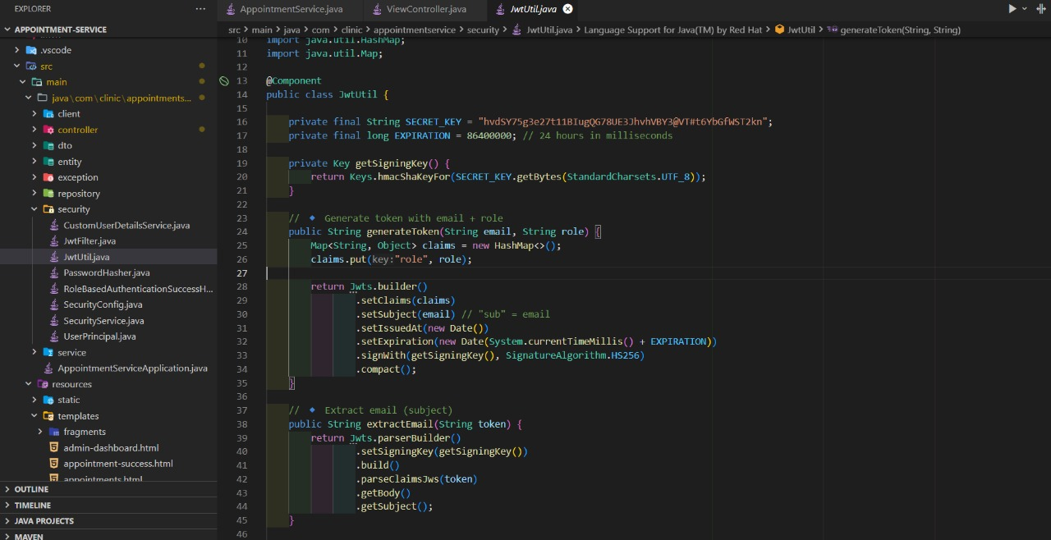
Code Snippets

Slide 9
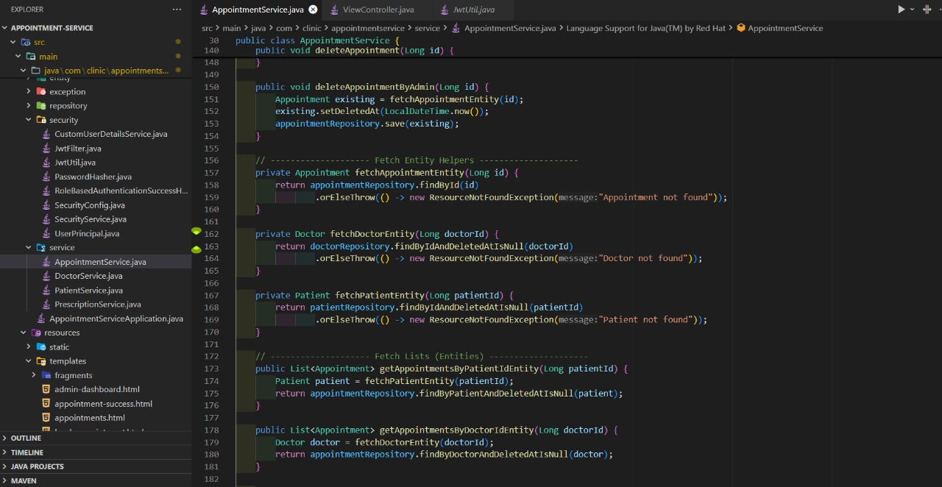
Code Snippets

Slide 10
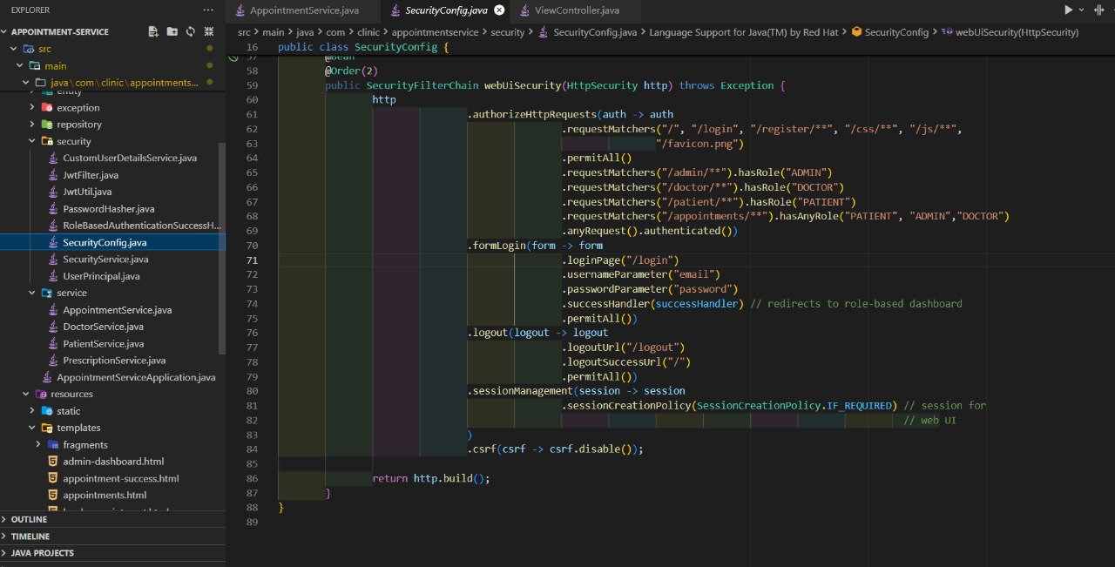
Code Snippets

Slide 11
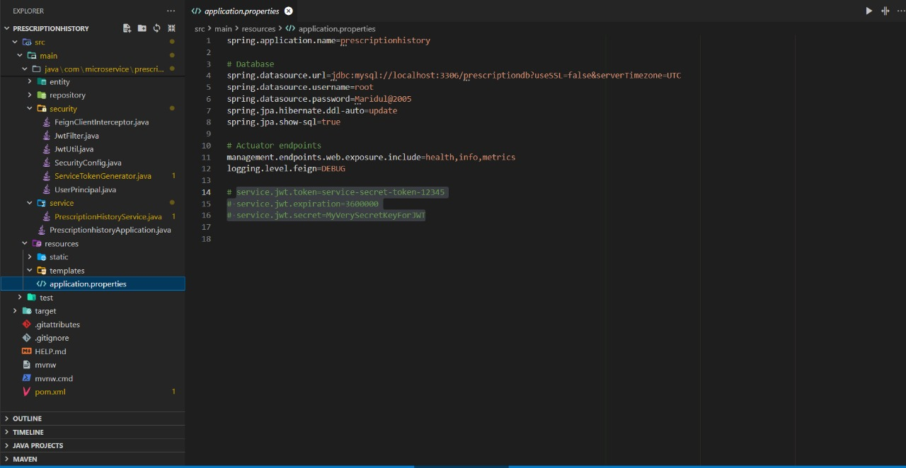

Slide 12
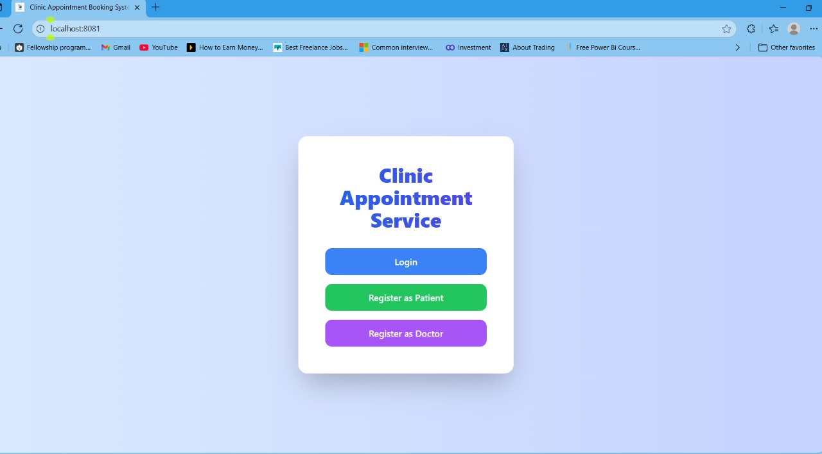
OUTPUT

Slide 13
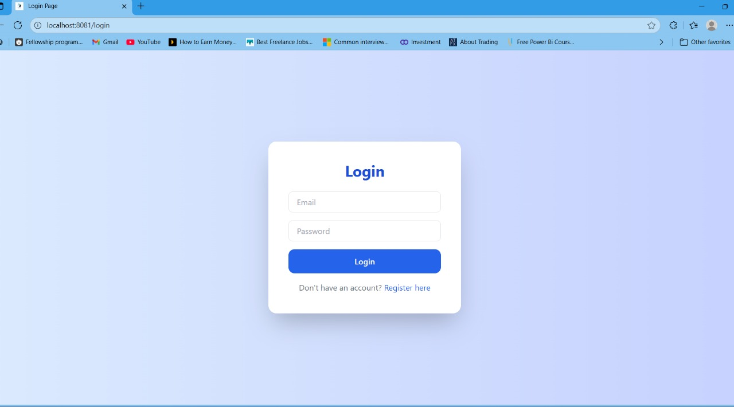

Slide 14
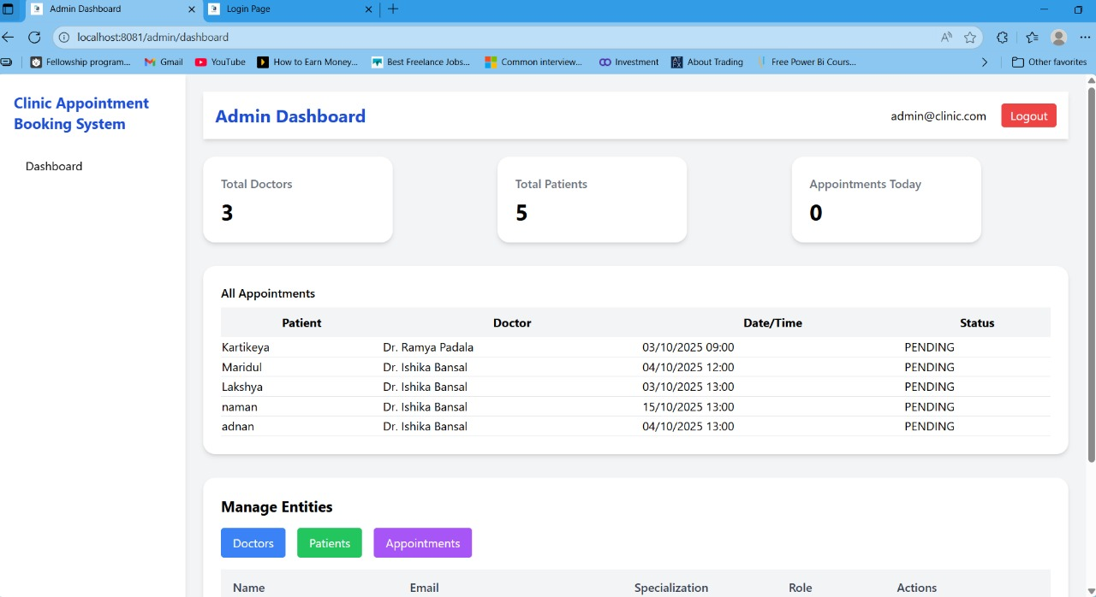

Slide 15
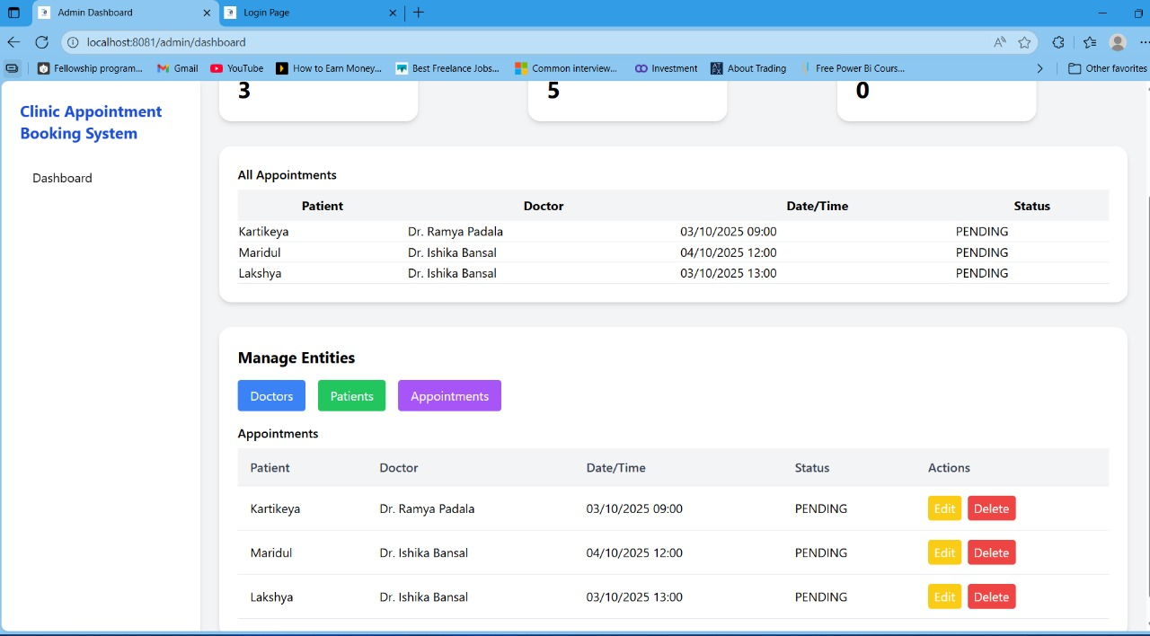

Slide 16
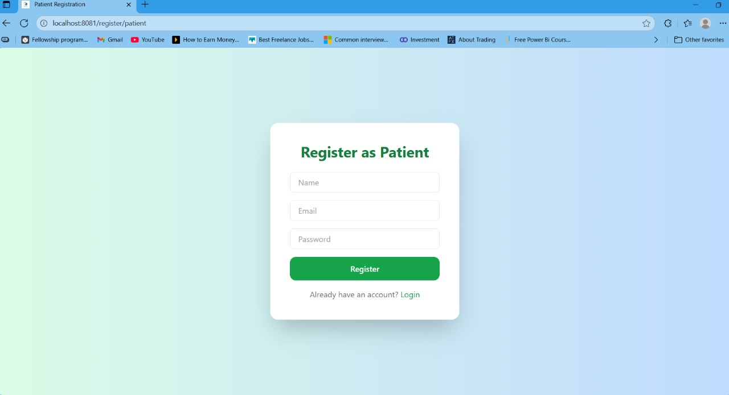

Slide 17
Thank You

