Slide 1
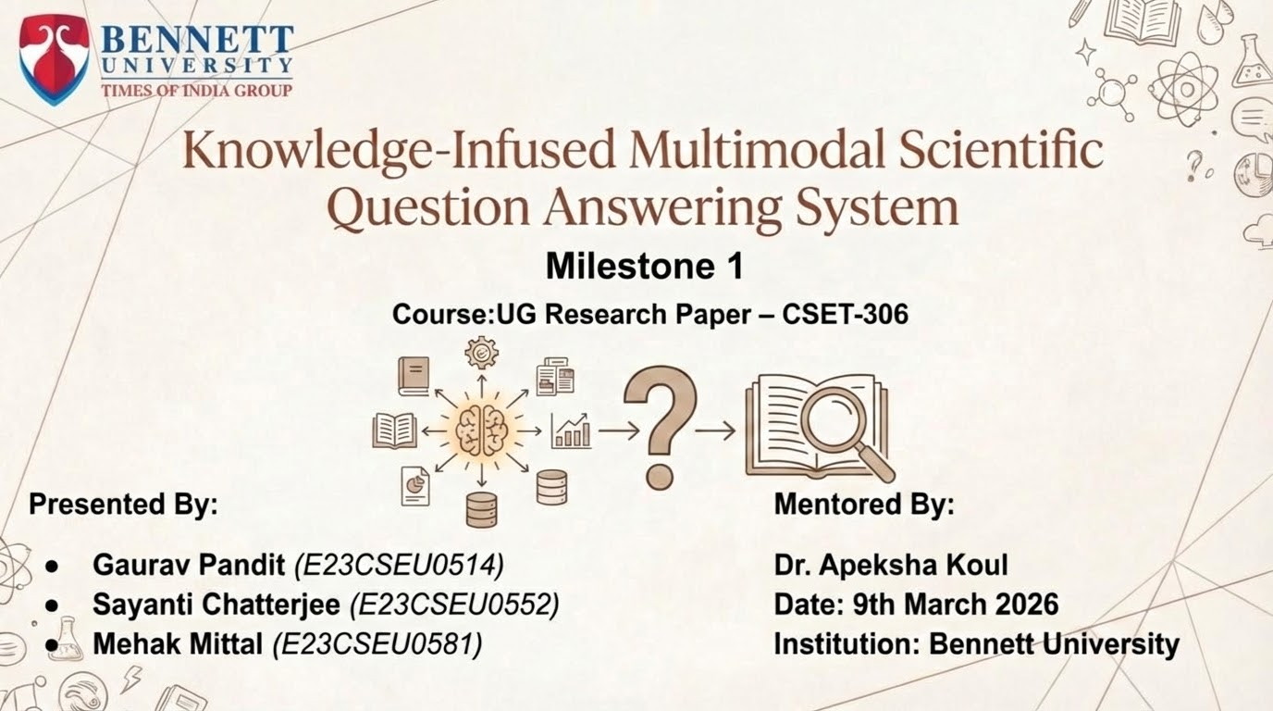

Slide 2
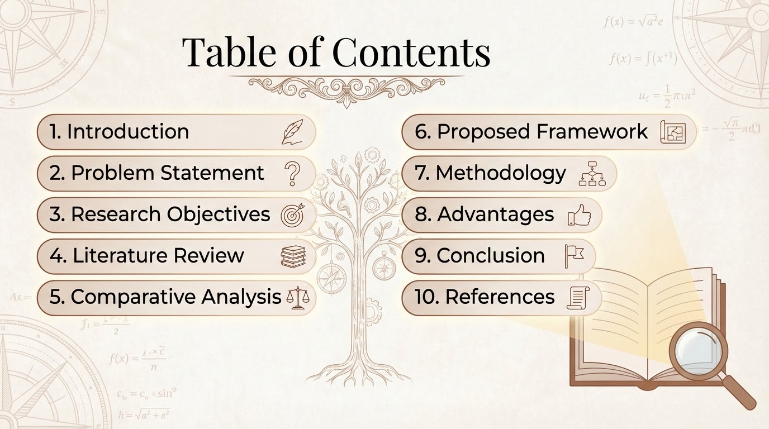

Slide 3
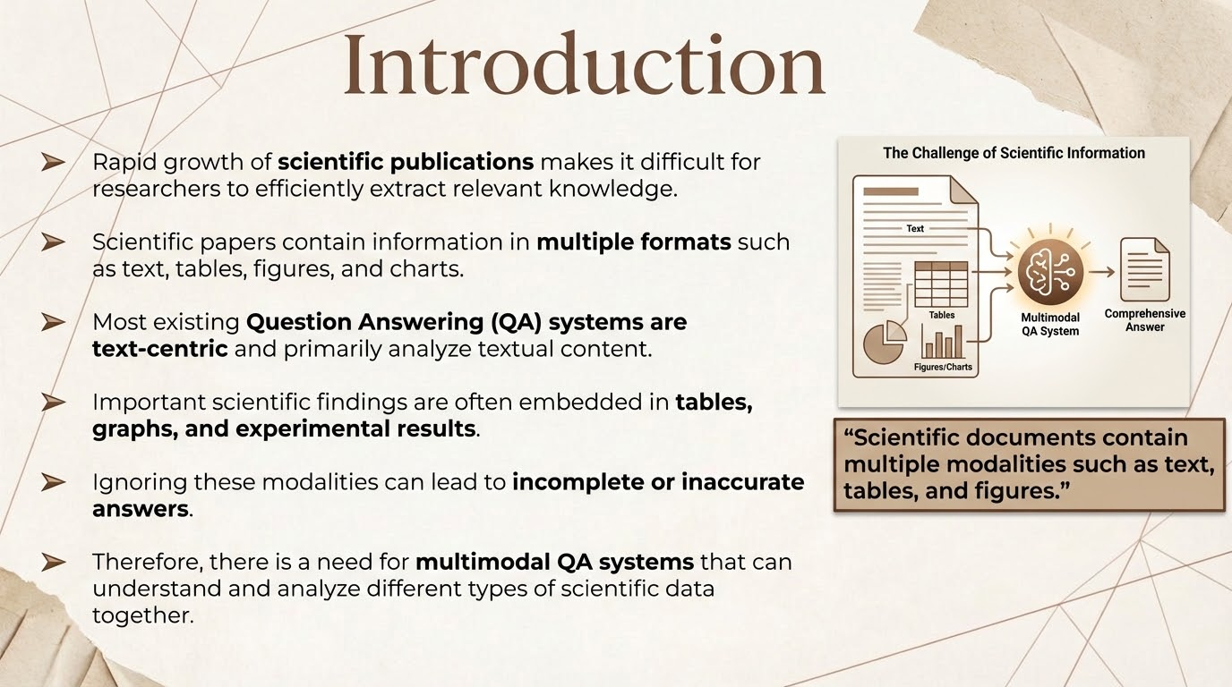

Slide 4
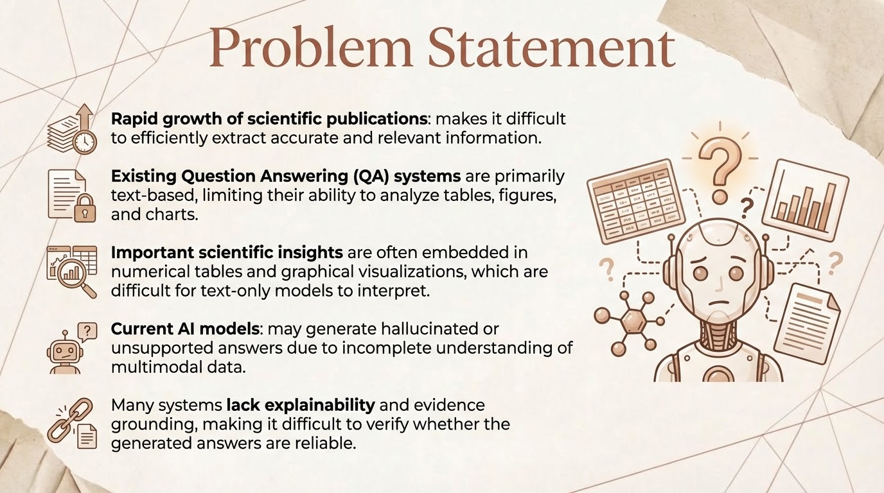

Slide 5
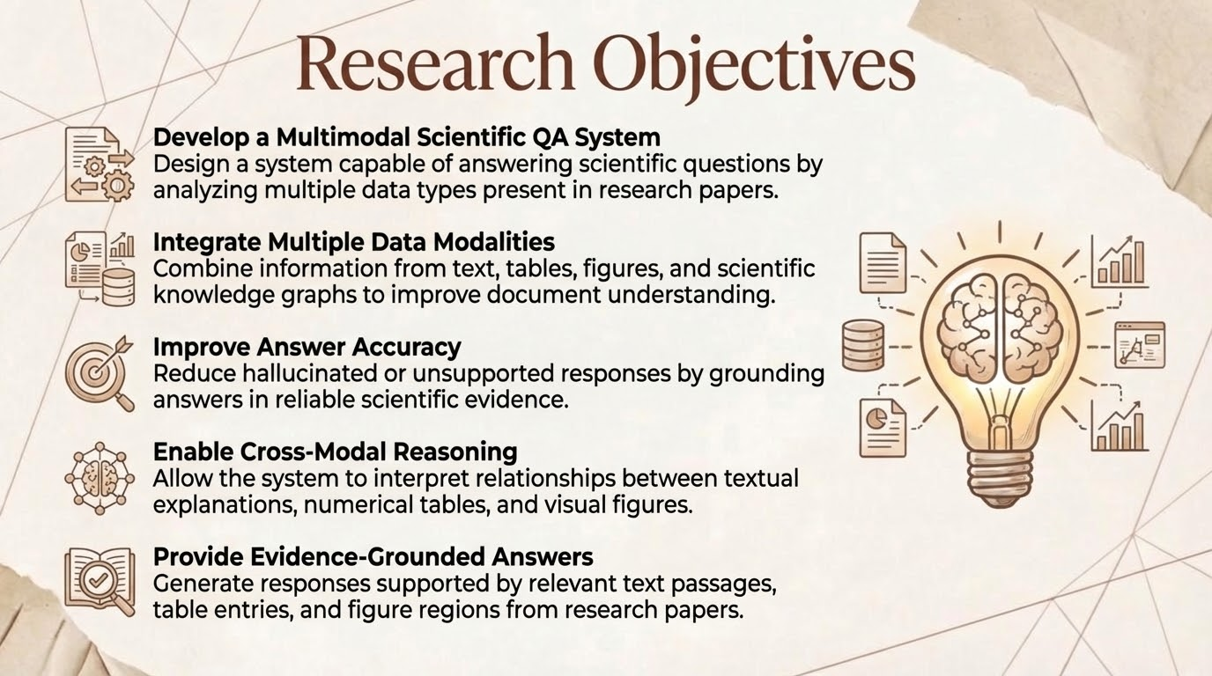


Slide 6
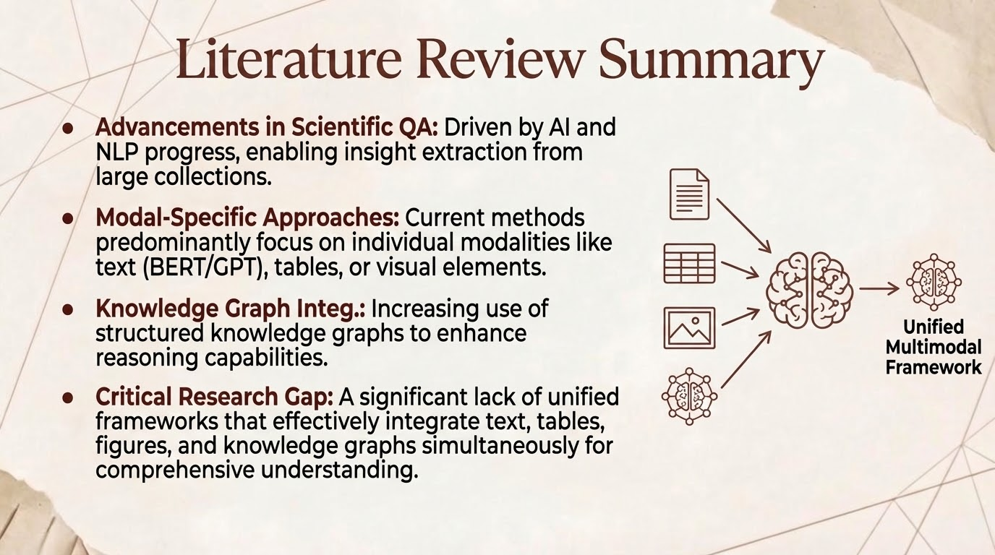

Slide 7
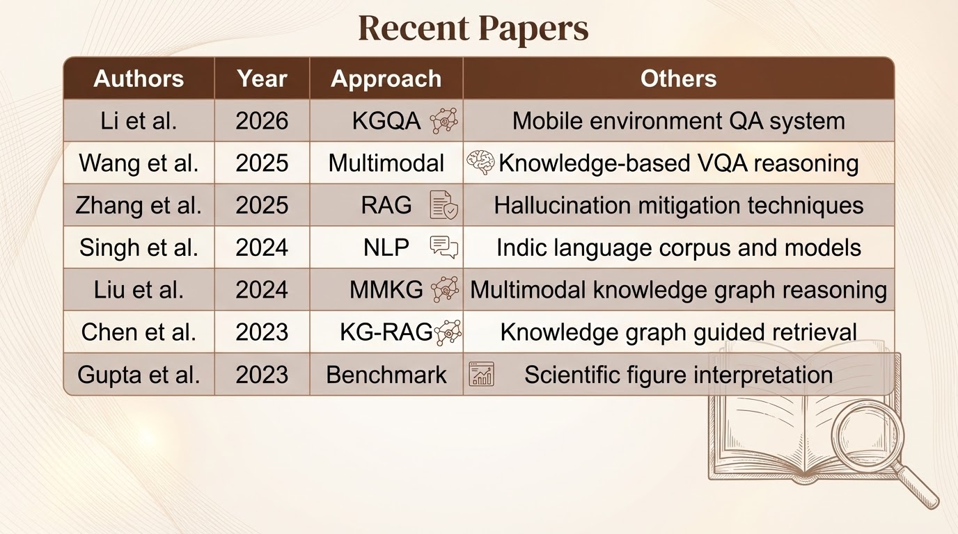

Slide 8
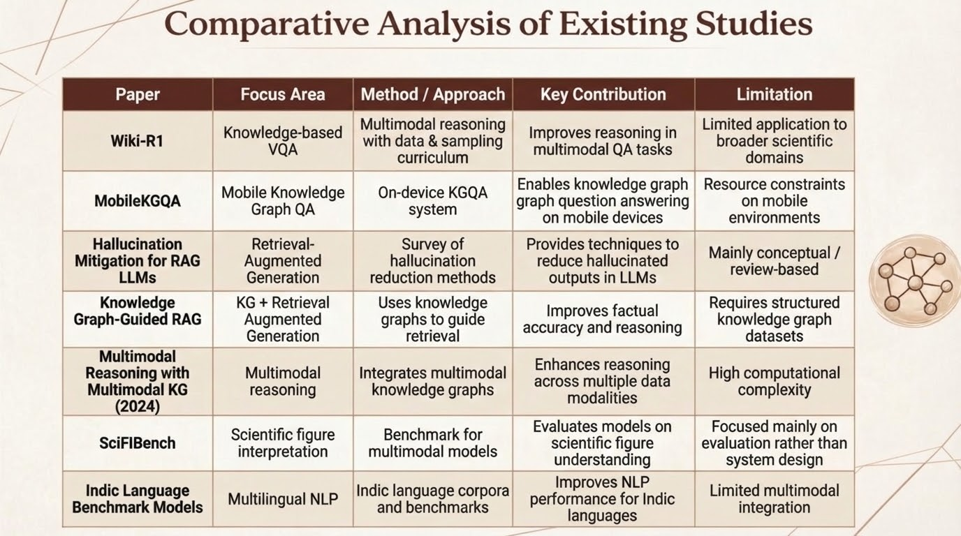

Slide 9
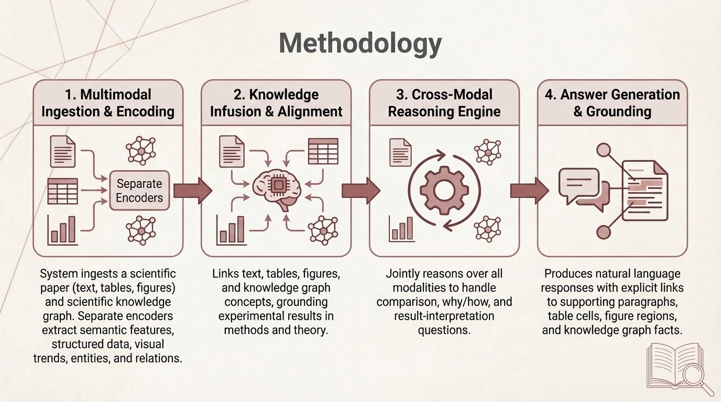

Slide 10
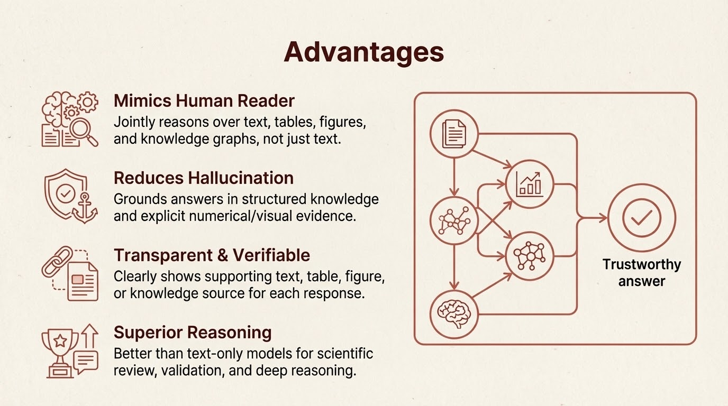

Slide 11
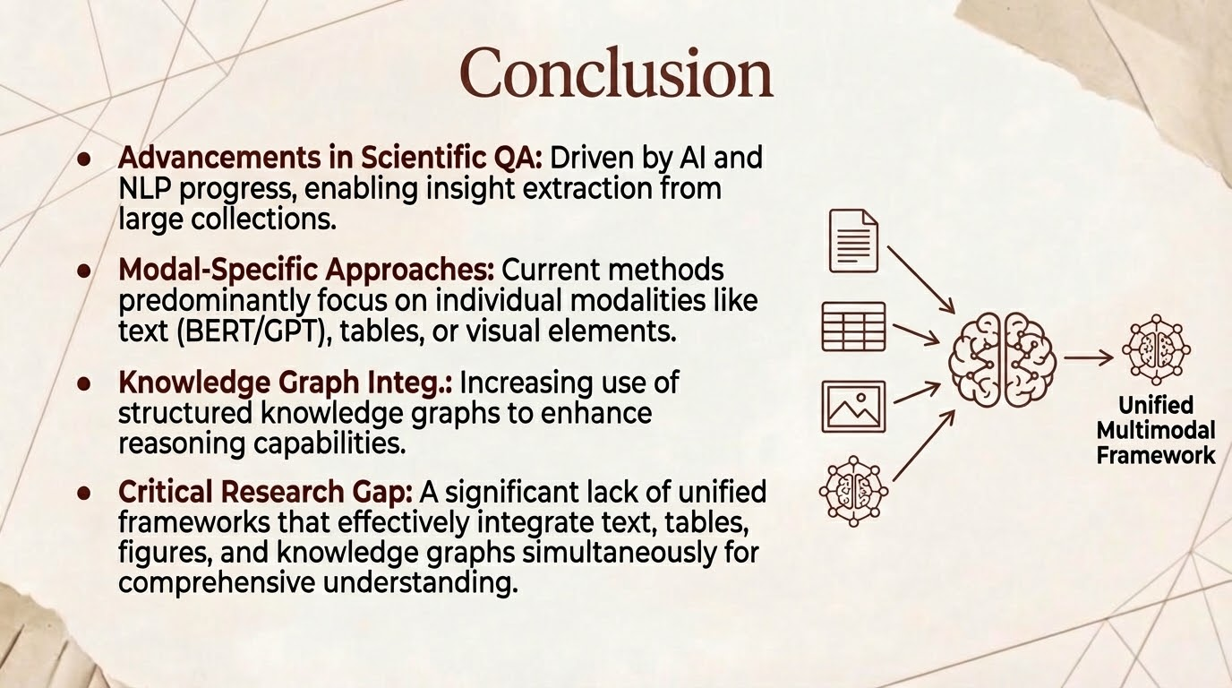

Slide 12


Slide 13
•Multimodal Reasoning with Multimodal Knowledge Graph. ACL 2024. https://aclanthology.org/2024.acl-long.579/
•NeurIPS 2024 Datasets & Benchmarks Track paper (PDF). https://proceedings.neurips.cc/paper_files/paper/2024/file/217bb44ab14621754db8a392163e6b07-Paper-Datasets_and_Benchmarks_Track.pdf
•SPIQA: Scientific Paper Information and Question Answering. GitHub. https://github.com/google/spiqa
•Knowledge-Graph Augmented Multi-hop Question Answering using Large Language Models. METU Thesis & Project. https://open.metu.edu.tr/bitstream/handle/11511/111317/knowledge-graph-augmented-multi-hop-question-answering-using-large-language-models.pdf
•GRAM: Global Reasoning for Multi-Page VQA. CVPR 2024. https://openaccess.thecvf.com/content/CVPR2024/html/Blau_GRAM_Global_Reasoning_for_Multi-Page_VQA_CVPR_2024_paper.html
•ACL Findings 2024 paper. https://aclanthology.org/2024.findings-acl.48/
•ACL Findings 2024 paper. https://aclanthology.org/2024.findings-acl.619/

Slide 14
•LLaVA: Large Language and Vision Assistant. CVPR 2023. https://openaccess.thecvf.com/content/CVPR2023/html/Liu_LLaVA_Large_Language_and_Vision_Assistant_CVPR_2023_paper.html
•VisProg: Programmatic Visual Reasoning with Large Language Models. CVPR 2023. https://openaccess.thecvf.com/content/CVPR2023/html/Gupta_VisProg_Programmatic_Visual_Reasoning_With_Large_Language_Models_CVPR_2023_paper.html
•Masry et al., ACL 2023 Long Paper. https://aclanthology.org/2023.acl-long.693/
•Zhang et al., ACL 2023 Long Paper. https://aclanthology.org/2023.acl-long.656/
•Liu et al., ACL 2023 Long Paper. https://aclanthology.org/2023.acl-long.315/
•Peng et al., NeurIPS 2023. https://papers.nips.cc/paper_files/paper/2023/hash/f3b9c98b5d5d8e6f98c2f8adf0c0e5a7-Abstract-Conference.html
•Dai et al., NeurIPS 2023. https://papers.nips.cc/paper_files/paper/2023/hash/7c6e6f9b0e9e3a2fbbf5e91d3b3a9c72-Abstract-Conference.html

Slide 15


