Slide 1


Call Center Performance Analysis
29 March 2026
Presented by
Mehak Aggarwal

Slide 2

AstroSage has received a 1 crore investment and aims to optimize its call center operations. The goal is to determine how to allocate this investment to maximize operational efficiency, customer satisfaction, and profitability. The analysis will consider historical call data, performance metrics, and market trends to make informed decisions.
Problem
Statement

Slide 3

Analyze call center data to identify key operational inefficiencies and performance gaps
Evaluate customer satisfaction drivers across channels and time periods
Assess agent workload distribution and resource utilization
Provide data-driven recommendations to improve:
Operational efficiency
Customer experience
Revenue growth
Project
Objective

Slide 4
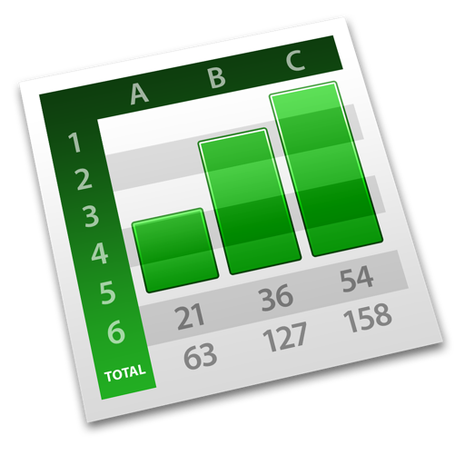
Data
Overview
Dataset Summary
Data Cleaning & Preparation
Why This Data Matters
Dataset contains 28,027 customer interaction records
Includes calls, chats, ratings, revenue, and agents information
Covers platform usage and time-based activity
Provides performance and service quality indicators
Enables detailed operational trend analysis
Removed duplicates and handled missing/inconsistent values
Standardized key fields:
Status fields (call/chat → “Unknown”, “No Status”)
Earnings/duration fields → replaced blanks with 0 / N/A
Cleaned text fields using TRIM()
Created derived features:
Hour, Month-Year, Peak vs Non-Peak
Workload category (Overloaded / Balanced / Underutilized)
Removed irrelevant columns
Enables analysis across operational efficiency, customer experience, and revenue
Provides agent-level and time-based insights
Forms the foundation for data-driven decision-making and investment strategy

Slide 5
Analytical Approach
Key Analysis Performed
Tools & Functions Used
Followed a structured approach covering:
Data Cleaning & Preparation
Feature Engineering (derived variables)
Exploratory Data Analysis (EDA)
Insight generation & recommendation building
Operational Analysis: Call/chat status distribution, completion rates, no-answer rates
Customer Experience Analysis: Average ratings by channel and time
Monthly trends in satisfaction
Workforce Analysis: Agent workload distribution (Overloaded vs Underutilized)
Revenue Analysis: Revenue by channel and platform
Pivot Tables & Charts → for aggregation and visualization
Excel Functions: IF(), IFERROR() → data cleaning & classification
COUNTIFS(), AVERAGEIFS() → metric calculations
HOUR(), TEXT() → time-based feature creation
TRIM() → text cleaning
Slicers & Dashboarding → interactive analysis
Methodology

Slide 6
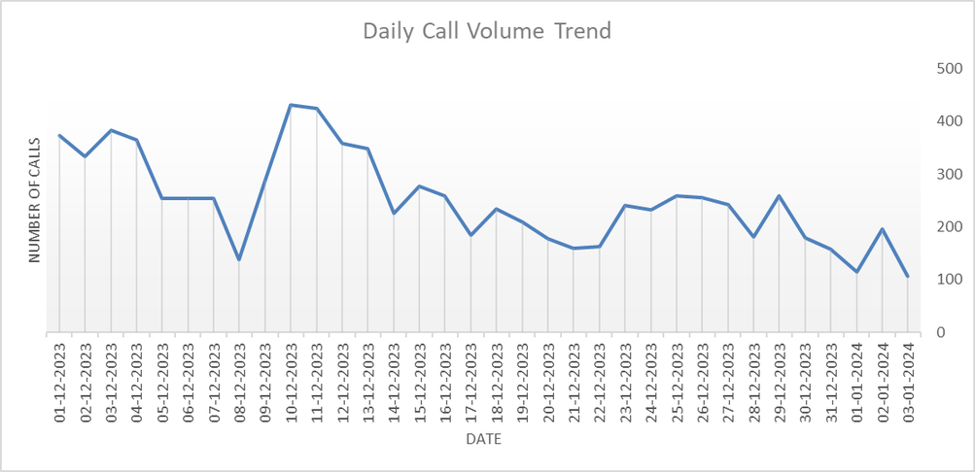
Call Volume Trends
Key Takeaways:
Call demand shows high day-to-day volatility, indicating unpredictable workload
~95% volume concentrated in December → strong demand skew / possible data limitation
Sharp drop in January suggests seasonality or incomplete data capture
Implication: Workforce planning must be flexible to handle demand spikes

Slide 7
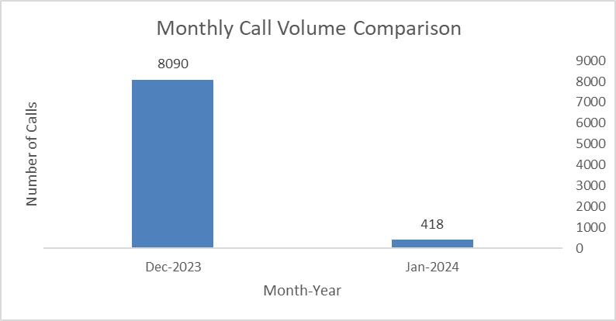
Call Volume Trends
Key Takeaways:
Call demand shows high day-to-day volatility, indicating unpredictable workload
~95% volume concentrated in December → strong demand skew / possible data limitation
Sharp drop in January suggests seasonality or incomplete data capture
Implication: Workforce planning must be flexible to handle demand spikes

Slide 8
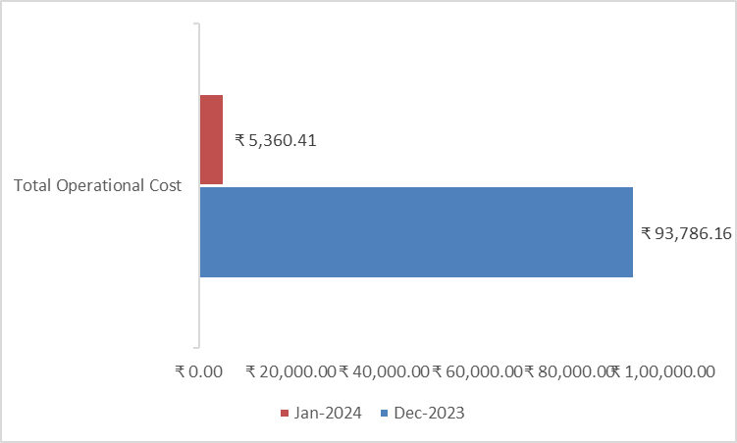
Revenue Analysis
Key Takeaways:
Revenue is heavily skewed toward call-based consultations (~79%)
Chat contributes only ~21% → under-monetized channel
Significant drop in January revenue mirrors demand decline
Implication: Business is over-dependent on one channel → diversification needed

Slide 9
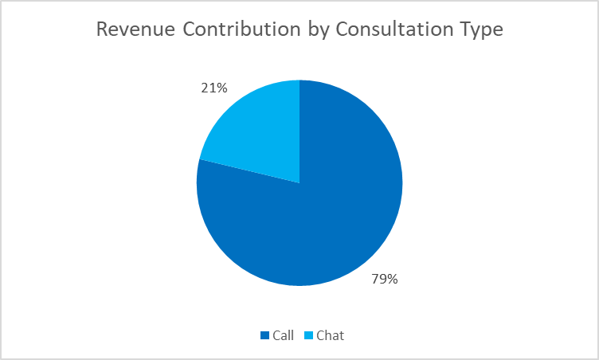
Revenue Analysis
Key Takeaways:
Revenue is heavily skewed toward call-based consultations (~79%)
Chat contributes only ~21% → under-monetized channel
Significant drop in January revenue mirrors demand decline
Implication: Business is over-dependent on one channel → diversification needed

Slide 10
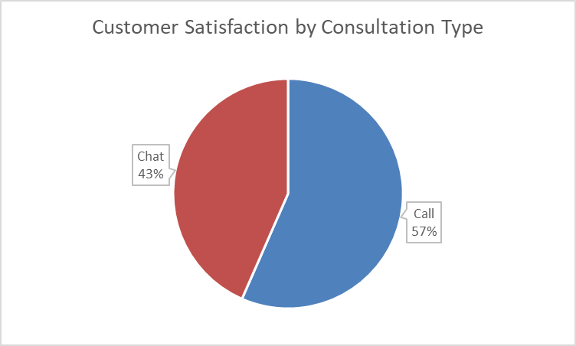
Customer Satisfaction Analysis
Key Takeaways:
Calls deliver higher satisfaction (~3.5) vs chats (~2.7)
Overall rating (~2.9) indicates moderate customer experience
Decline in satisfaction from Dec → Jan signals service inconsistency
Implication: Experience gaps in chat and low-demand periods need attention

Slide 11
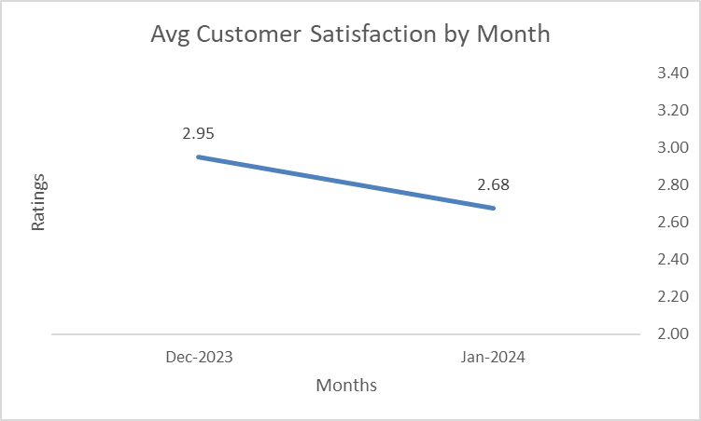
Customer Satisfaction Analysis
Key Takeaways:
Calls deliver higher satisfaction (~3.5) vs chats (~2.7)
Overall rating (~2.9) indicates moderate customer experience
Decline in satisfaction from Dec → Jan signals service inconsistency
Implication: Experience gaps in chat and low-demand periods need attention

Slide 12
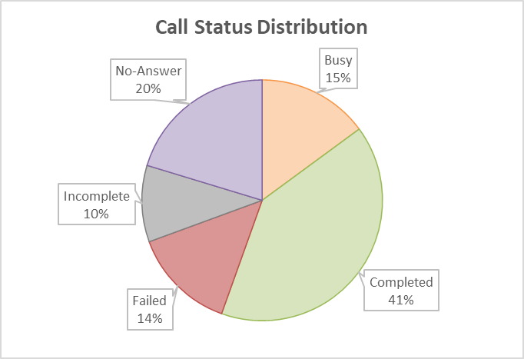
Revenue Efficiency & Channel Optimization
Key Takeaways:
Calls show ~40% completion rate vs ~28% for chat
High % of failed + incomplete chats (~60%) → major revenue leakage
“No-answer” and drop-offs indicate poor customer journey management
Implication: Improving chat conversion can unlock significant incremental revenue

Slide 13
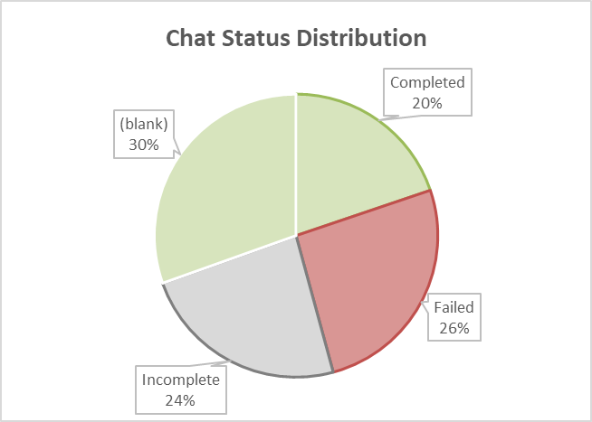
Revenue Efficiency & Channel Optimization
Key Takeaways:
Calls show ~40% completion rate vs ~28% for chat
High % of failed + incomplete chats (~60%) → major revenue leakage
“No-answer” and drop-offs indicate poor customer journey management
Implication: Improving chat conversion can unlock significant incremental revenue

Slide 14
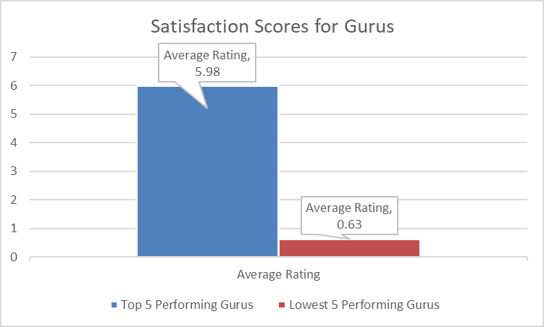
Agent Performance & Quality Gap
Key Takeaways:
Huge performance gap: Top agents (~6 rating) vs bottom (~0.6)
Low-performing agents are handling high call volumes → impacting CX
Lack of quality control leads to inconsistent service delivery
Implication: Upskilling and performance-based allocation is critical

Slide 15
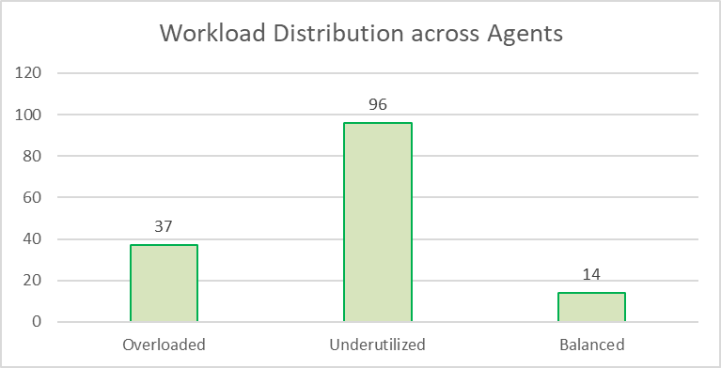
Operational Efficiency & Workload Optimization
Key Takeaways:
~65% agents are underutilized, while ~25% are overloaded
Only ~10% workforce is optimally balanced
Average productivity is low (~1.9 calls/agent/day)
Implication: Significant efficiency gains possible through workload redistribution

Slide 16
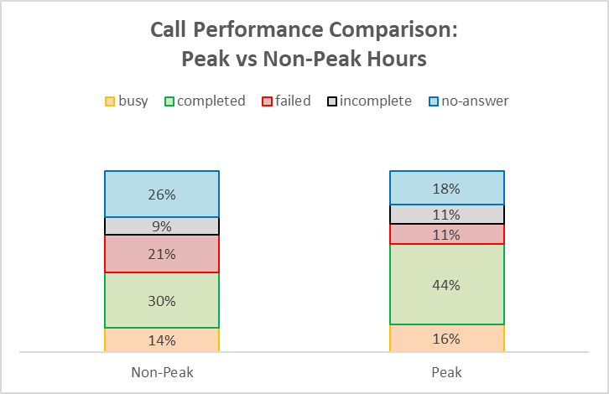
Peak vs Non-Peak Hours
Key Takeaways:
Peak hours show higher completion (~44%) vs non-peak (~30%)
Non-peak hours have higher failure + no-answer rates (~46%)
Demand is concentrated but staffing is not optimized accordingly
Implication: Aligning staffing with demand can improve both efficiency & CX

Slide 17
Strategic
Recommendations
Optimize Call Routing & Reduce Drop-offs
Transform Chat Channel Performance
Rebalance Workforce Allocation
What to do:
Implement intelligent call routing + callback/queue systems
Why:
~45% interactions are failed, no-answer, or incomplete
Indicates poor routing & agent availability mismatch
Impact:
↑ Call completion rate
↑ Revenue per session
↓ Customer frustration
What to do:
Introduce AI-assisted chat + chatbot for basic queries
Train agents for faster, structured responses
Why:
Chat = highest volume (~70%) but lowest satisfaction (~2.7)
~60% chats are failed/incomplete → major leakage
Impact:
↑ Chat conversion & revenue
↑ Customer satisfaction
Unlocks largest growth opportunity
What to do:
Implement load-based agent allocation
Optimize shift scheduling (peak vs non-peak)
Why:
~65% agents underutilized, ~25% overloaded
Avg productivity = 1.9 calls/agent/day (very low)
Impact:
↑ Utilization without hiring
↓ Burnout risk
↑ Operational efficiency

Slide 18
Strategic
Recommendations
Implement Performance-Based Agent Assignment
Improve Non-Peak Hour Performance
Strengthen Customer Retention + New User Acquisition
What to do:
Route high-value users to top-performing agents
Reduce exposure to low-rated agents
Why:
Huge quality gap: Top (~6 rating) vs Bottom (~0.6)
Poor agents handling significant volume → hurting CX
Impact:
↑ Customer satisfaction
↑ Repeat usage & retention
More consistent service quality
What to do:
Adjust staffing for demand-based scheduling
Introduce incentives for off-peak availability
Why:
Non-peak hours have higher failure & no-answer rates (~46%)
Demand-supply mismatch across time slots
Impact:
↑ Service availability
↑ Completion rates
Better demand utilization
What to do:
Launch loyalty programs & repeat-user incentives
Invest in new user acquisition campaigns
Why:
~72% calls are repeat → strong retention but high dependency risk
Low new user contribution limits growth
Impact:
↑ Customer lifetime value (CLTV)
Diversified user base
Sustainable long-term growth

Slide 19
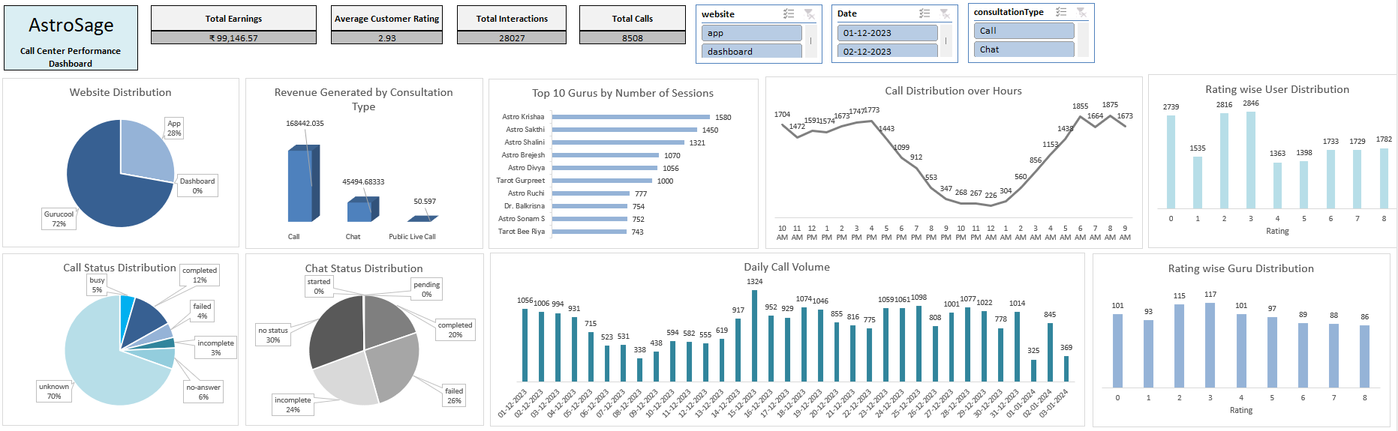

Slide 20

Key Insights
Demand is highly concentrated and volatile, creating planning challenges
Business is over-dependent on call channel for both revenue and satisfaction
Chat channel underperforms despite handling majority of volume
Significant agent inefficiency and quality gaps impact overall performance
Customer base shows strong retention but weak new user growth
Conclusion
Strategic Direction
Improve call completion and reduce drop-offs to unlock immediate revenue
Transform chat experience to convert high volume into high value
Optimize workforce allocation and agent performance
Invest in technology, training, and customer experience improvements
By addressing operational inefficiencies and unlocking underperforming channels, the call center can significantly improve customer satisfaction, increase revenue efficiency, and build a scalable, high-performance service model

Slide 21
Thank
You

