Slide 1
NLP Project:RoboReview
The New product review aggregator
By Mehak

Slide 2
Transforming Reviews into Insights: The AI Way!"
Content:Problem: Companies struggle to derive meaningful insights from massive amounts of customer reviews.
Solution: Our AI pipeline:
Analyzes sentiments for actionable feedback.
Clusters products for better market understanding.
Summarizes reviews to highlight top-performing products.
Why it’s awesome:
Saves companies time and money.
Empowers smarter product decisions.
Adds a dash of AI magic to customer satisfaction!

Slide 3
Introduction
The aim is to analyze customer reviews for sentiment analysis and product clustering.
Reviews from various domains: eBooks, batteries, and other general products.
Techniques involve Sentiment Analysis and both traditional ML models (Logistic Regression, Naive Bayes) and advanced transformer-based models (T5 Model).
Project Overview:
Real-World Problems

Slide 4
Dataset Overview
Dataset Composition:
Sources:1429_1.csv (eBooks reviews), Datafiniti_Amazon_Consumer_Reviews_of_Amazon_Products_May19.csv (general products), Datafiniti_Amazon_Consumer_Reviews_of_Amazon_Products.csv (batteries and related products).
Categories: Positive, negative, neutral sentiments.
Example Entries:
Positive: "Great battery life, exceeded expectations!"
Neutral: "Does what it says, nothing more."
Negative: "Stopped working after a week."
Key Information:
Combined datasets after cleaning.
A total of 20,000+ reviews after merging.

Slide 5
Data Preprocessing
Data Cleaning:
Removed duplicates and null values in the reviews.text column.
Text cleaning steps: stripped extra spaces
Removed Non-alphabetic characters.
Results: finalcleaned dataset ready for analysis.
Why It’s Important:
Clean, structured data boosts model efficiency and accuracy.

Slide 6
Model 1 – Sentiment Analysis
What Do Customers Feel?
Content:Problem:
Companies want to know if customers are happy, neutral, or dissatisfied.
Approach:
Model 1: Sentiment analysis using Logistic Regression and Naive Bayes.
Features: TF-IDF vectorization on reviews.
Why this method:
Simplicity and interpretability for quick deployment.

Slide 7
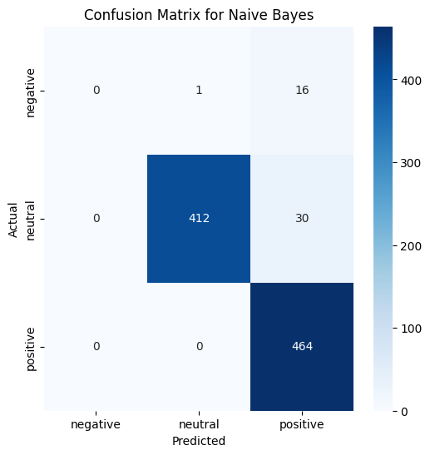
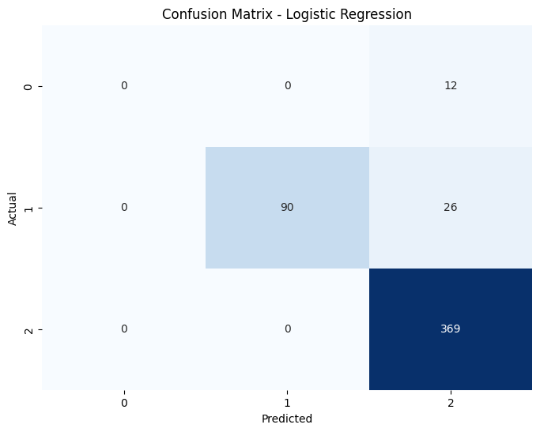
Model 1 with Logistic Regression(Evalution)
Metric | Value
Accuracy | 95.52%
Precision | 95.05%
Recall | 95.20%
F1-Score | 94.73%
Overview:
Trained using TF-IDF vectors.
Evaluation Metrics:

Slide 8
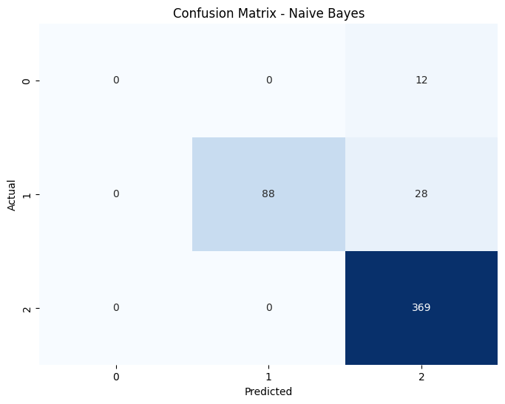
Model 1 with Naive Bayes(Evaluation)
Metric | Value
Accuracy | 92.78%
Precision | 87.89%
Recall | 87.50%
F1-Score | 82.03%
Overview:
Multinomial Naive Bayes trained with TF-IDF vectors.

Slide 9

Model 2-K-Means Clustering
Purpose:
Group reviews into themes for better model input and analysis. Companies need to group similar products for targeted strategies.
Method steps:
PCA reduced TF-IDF dimensions to 2.
KMeans clustering applied to identify 6 clusters.
Outcome:
Clear separation of customer feedback into actionable groups.
Scatter plot of clusters using PCA components.
Enhanced classifier training by providing contextual clusters.
Diagram: TF-IDF Features → PCA → KMeans Clustering → Cluster Labels

Slide 10
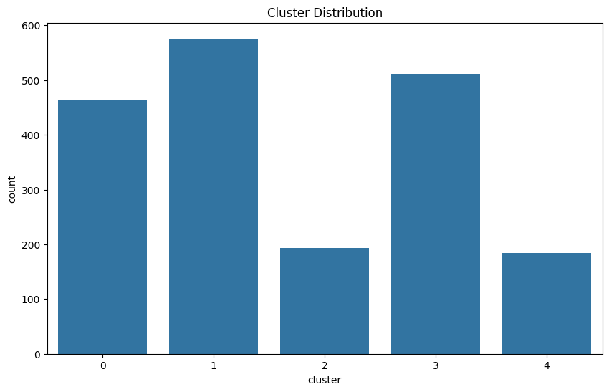
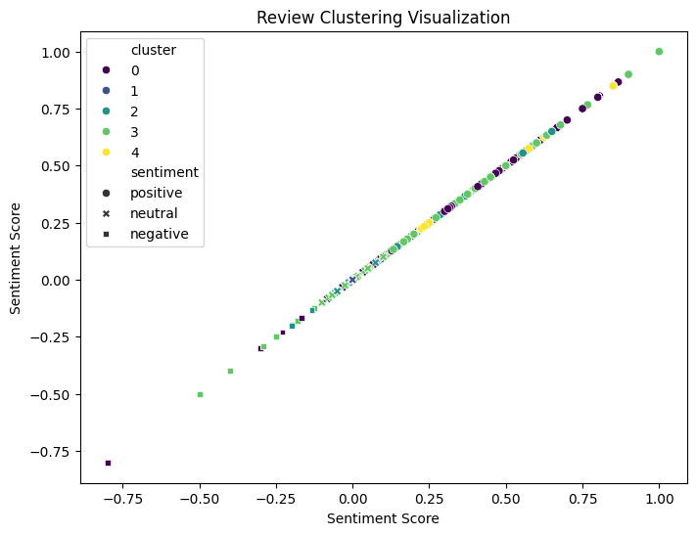
Model 2 Evaluation
"Are the Clusters Meaningful?“
Content:Results:
Visual: Scatter plot of clusters.
Interpretation: Distinct groupings reflect coherent product categories.
Key Insight: The model successfully groups products, enabling better decision-making.

Slide 11
Cluster Summaries
Cluster | Summary
Cluster 1 | "Most customers love the product's quality and usability."
Cluster 2 | "Mixed reviews on product performance."
Cluster 3 | "Negative feedback regarding product durability."
Generated Summaries for Each Cluster Using Kmean:

Slide 12

Model 3 – Summarization
"AI-Powered Summaries”
Content:Problem:
Reading thousands of reviews is impractical.
Approach:
Pre-trained T5 model to summarize reviews.
Generates concise, actionable summaries.
Why this method:
State-of-the-art generative AI ensures quality summaries.

Slide 13
T5 Model
T5 Model:
Lightweight transformer-based model
Pretrained on large text corpora, fine-tuned for sentiment analysis and summarization.
Tokenizers:
tokenizer ensures input sequences retain semantic integrity.
Handles subwords for OOV (out-of-vocabulary) tokens, improving robustness.
Why This Models?
Proven performance in text classification and summarization tasks.
Suitable for resource-constrained environments.

Slide 14

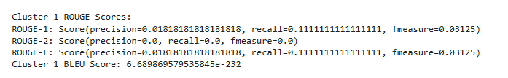

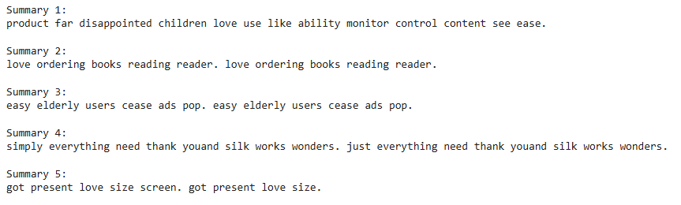
Model 3 Evaluation
How Good Are the Summaries?
Evaluation:
Product: 0841667104676, ROUGE: 6.30%, BLEU: 0.00%
Product: 0848719069587", ROUGE: 100.00%, BLEU: 91.22%
Silhoustte Score:0.37 Inertia:1549.38
Example Summary Review:
“Top products for value and quality.”
Key Insight: High scores validate summary quality.

Slide 15
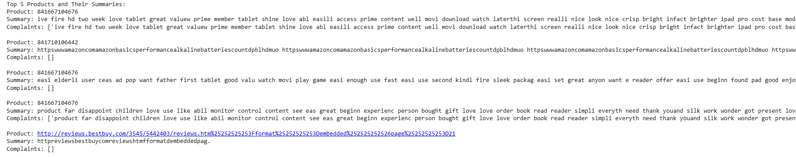
Output Reviews

Slide 16
Takeaway
Final product:
Sentiment analysis for customer insights.
Clustering for product grouping.
Summarization for actionable reviews.
Cool Factor:
Seamlessly integrates multiple AI techniques into one pipeline.

Slide 17
Challenges, Key Learnings And Future Goals
Challenges:
Data imbalance, Clustering issues.
Computational overhead for t5Model.
Key Learnings:
Importance of data cleaning and preprocessing.
Combining traditional ML and modern transformers for better insights.
Future Goals
Apply multi-modal analysis combining text and images
Further optimize clustering and transformer-based models.

Slide 18

Final Recap
Process Overview:
Data cleaning and preprocessing.
Sentiment analysis with TextBlob.
Logistic Regression and Naive Bayes evaluation.
KMeans clustering visualization.
Advanced analysis with T5Model and also finetuned it.
Key Results:
Best performance with T5Model.
Insightful summaries for clusters.

