Slide 1
NLP Project:RoboReview
The New product review aggregator
By Mehak

Slide 2
Introduction
Project Overview:
The aim is to analyze customer reviews for sentiment analysis and product clustering.
Reviews from various domains: eBooks, batteries, and other general products.
Techniques involve both traditional ML models (Logistic Regression, Naive Bayes) and advanced transformer-based models (DistilBERT).

Slide 3
Dataset Overview
Dataset Composition:
Sources:1429_1.csv (eBooks reviews), Datafiniti_Amazon_Consumer_Reviews_of_Amazon_Products_May19.csv (general products), Datafiniti_Amazon_Consumer_Reviews_of_Amazon_Products.csv (batteries and related products).
Categories: Positive, negative, neutral sentiments.
Example Entries:
Positive: "Great battery life, exceeded expectations!"
Neutral: "Does what it says, nothing more."
Negative: "Stopped working after a week."
Key Information:
Combined datasets after cleaning.
A total of 50,000+ reviews after merging.

Slide 4
Data Preprocessing
Data Cleaning:
Removed duplicates and null values in the reviews.text column.
Text cleaning steps: stripped extra spaces
Removed Non-alphabetic characters.
Results: finalcleaned dataset ready for analysis.
Why It’s Important:
Clean, structured data boosts model efficiency and accuracy.

Slide 5
Data Preprocessing(conti)
Steps:
Extracted sentiments using TextBlob.
Positive, Neutral, Negative classification.
Converted textual data to TF-IDF vectors (top 5000 features).
Split data into training (70%) and testing (30%) sets.
Flow Diagram:
Raw Reviews → Data Cleaning → Sentiment Analysis (TextBlob) → TF-IDF Vectorization → Train/Test Split

Slide 6
Sentiment Analysis with TextBlob
Method:
TextBlob for initial sentiment classification based on polarity.
Positive: Polarity > 0
Neutral: Polarity = 0
Negative: Polarity < 0
Example Results:
Review | Sentiment
"Terrible experience!" | Negative
"It works okay but not the best." | Neutral
"The product is amazing!" | Positive

Slide 7
TF-IDF Vectorization
Steps:
Converted text data into numerical vectors.
Features:
Top 5000 words based on importance.
Why TF-IDF?
Measures word importance in relation to the dataset.
Reduces noise by down-weighting commonly occurring words.
Flow Diagram:
Cleaned Reviews → TF-IDF Vectorizer → Numerical Features (5000 dimensions)

Slide 8
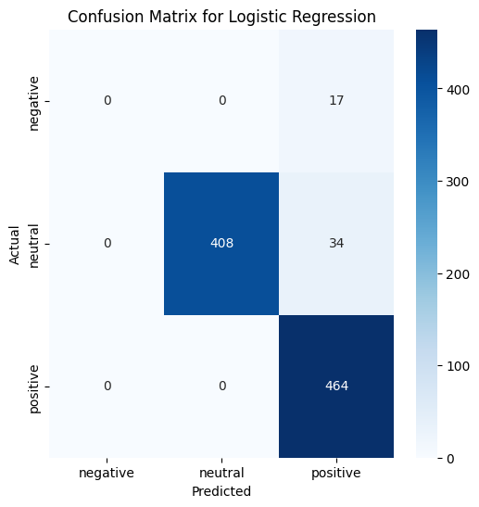
Model 1: Logistic Regression
Metric | Value
Accuracy | 95.20%
Precision | 95.05%
Recall | 95.20%
F1-Score | 94.73%
Overview:
Trained using TF-IDF vectors.
Evaluation Metrics:

Slide 9
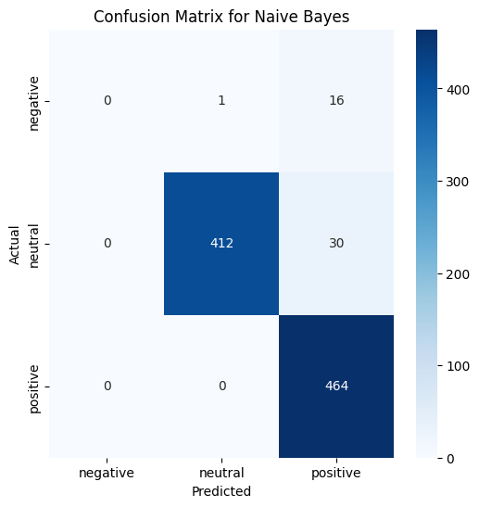
Model 2: Naive Bayes
Metric | Value
Accuracy | 87.50%
Precision | 87.89%
Recall | 87.50%
F1-Score | 82.03%
Overview:
Multinomial Naive Bayes trained with TF-IDF vectors.

Slide 10

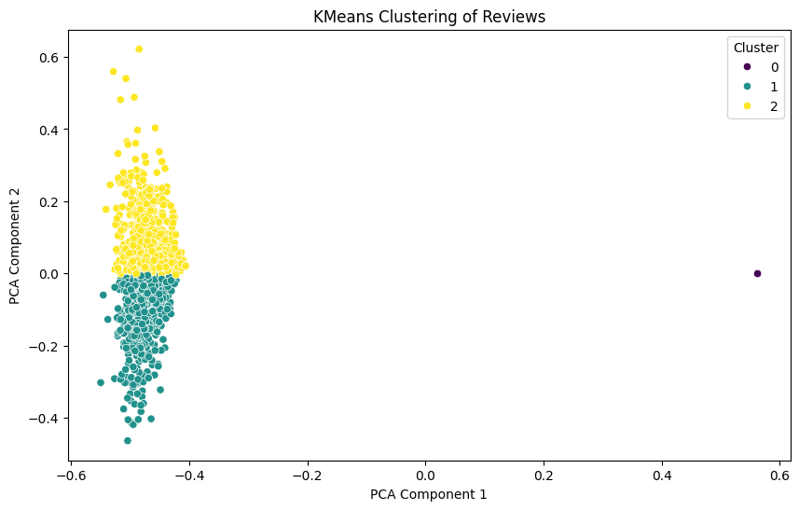
K-Means Clustering
Purpose:
Group reviews into themes for better model input and analysis.
Method steps:
PCA reduced TF-IDF dimensions to 2.
KMeans clustering applied to identify 3 clusters.
Outcome:
Clear separation of customer feedback into actionable groups.
Scatter plot of clusters using PCA components.
Enhanced classifier training by providing contextual clusters.
Diagram: TF-IDF Features → PCA → KMeans Clustering → Cluster Labels

Slide 11
DistilBERT Model
DistilBERT Model:
Lightweight transformer-based model.
Retains most of BERT's performance while being computationally efficient.
Pretrained on large text corpora, fine-tuned for sentiment analysis and summarization.
Tokenizers:
DistilBERT tokenizer ensures input sequences retain semantic integrity.
Handles subwords for OOV (out-of-vocabulary) tokens, improving robustness.
Why These Models?
Proven performance in text classification and summarization tasks.
Suitable for resource-constrained environments.

Slide 12
M-shot Prompting
Overview:
M-shot prompting for few-shot learning.
Used 5 sample prompts to guide DistilBERT.
Example:
Review: "This product is great!" → Sentiment: Positive

Slide 13
DistilBERT (tokenization and Fine-tuning)
Tokenization:
Tokenized reviews using DistilBERT tokenizer.
Outputs:
Input IDs
Attention Masks
Fine-tuning Steps:
Model trained for 3 epochs with AdamW optimizer.
Batch size: 8, Learning rate: 5e-5.

Slide 14
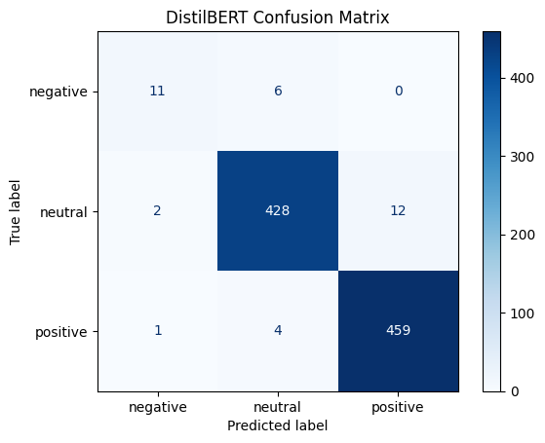
Evaluation of DistilBERT
Evaluation Metrics:
Metric | Value
Accuracy | 98.00%
Precision | 98.00%
Recall | 98.00%
F1-Score | 98.00%

Slide 15
Cluster Summaries
Cluster | Summary
Cluster 1 | "Most customers love the product's quality and usability."
Cluster 2 | "Mixed reviews on product performance."
Cluster 3 | "Negative feedback regarding product durability."
Generated Summaries for Each Cluster Using DistilBERT:

Slide 16
Challenges, Key Learnings And Future Goals
Challenges:
Data imbalance.
Computational overhead for DistilBERT.
Key Learnings:
Importance of data cleaning and preprocessing.
Combining traditional ML and modern transformers for better insights.
Future Goals
Apply multi-modal analysis combining text and images
Further optimize clustering and transformer-based models.
Explore domain-specific fine-tuning for DistilBERT.

Slide 17

Final Recap
Process Overview:
Data cleaning and preprocessing.
Sentiment analysis with TextBlob.
Logistic Regression and Naive Bayes evaluation.
KMeans clustering visualization.
Advanced analysis with DistilBERT.
Key Results:
Best performance with DistilBERT.
Insightful summaries for clusters.

