Slide 1
EduALL
LEARN BEFORE YOU EDUCATE

Slide 2
Mehak Kalra
CREATED BY

Slide 3
Teachers teach the students but who teaches the teachers?
Poverty and education are intertwined. In fact, one of the biggest contributors to global property is lack of access to education.
About 114 million young people, still lack basic reading and writing skills.
WHAT IS THE
PROBLEM

Slide 4
An application to educate teachers about how to educate children.
Bringing ways of teaching in developed countries and rich sectors to
developing countries and the poor population
THE SOLUTION

Slide 5
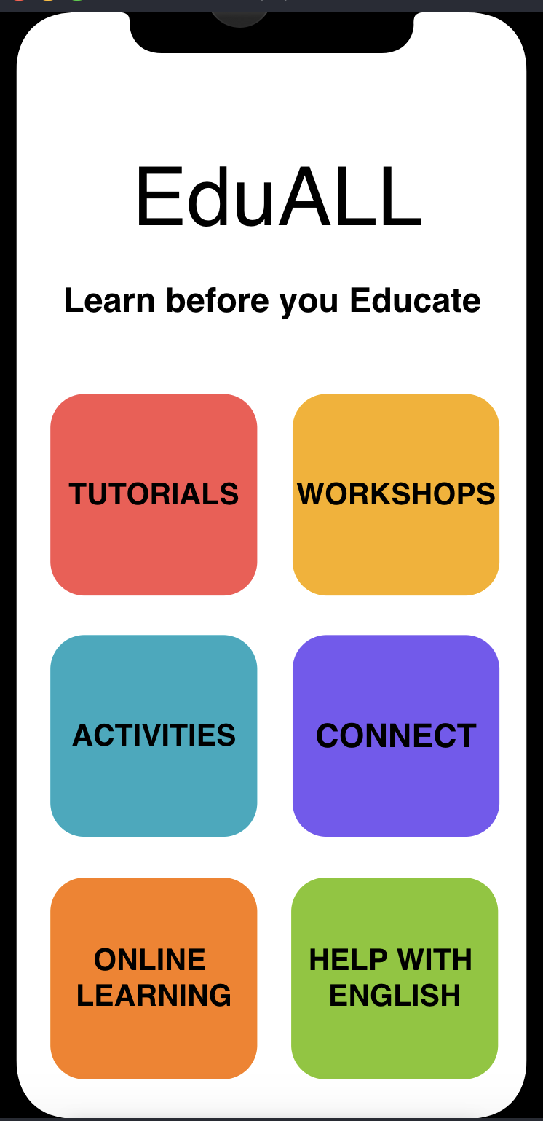
The app includes different tutorials, workshops and activities that will inspire teachers to do innovative learning. The app also connects teachers in developing countries to other educators worldwide. It includes a ‘Help in English’ as well.
PRODUCT

Slide 6
It is estimated that 69 million primary and secondary school teachers need to be recruited by 2030 in order to meet demand. Our ultimate aim is to educate as many of them as possible so that they can pass on the knowledge
TRACTION

Slide 7
1
Educated teachers will be able to pass on their knowledge better to the next generation.
All students will get high level education and will be introduced to recent technologies.
Literacy rate in developing nations will improve.
More students will be able to change their status from poor to successful.
Everyone who uses the app can learn something new.
ADVANTAGES

Slide 8
We aim to start with the rural population in Indian states and then expand to other developing countries like Sub Saharan Africa.
MARKET

Slide 9
The main aim of this application is not earning money but to help others to be successful in life. Some revenue might come through different advertisements.
BUSINESS MODEL

Slide 10
The main product here is an application which I as a computer engineering student is capable of designing.
I have knowledge of UX/UI which will help me in doing the front-end stuff.
So, overall no money will be needed in making the app work.
Finances might be needed to promote the app.
FINANCES

