Slide 1
INTERNSHIP MANAGEMENT SYSTEM
Build, Deploy & Analyze a Containerized Microservice Application Under Varying Workloads
Cloud Computing Laboratory
FastAPI | Docker Compose | Locust | Resource Profiling
PROJECT TEAM MEMBERS
Vageesh Mathad
USN: 01FE24BCI008
Mehak Sayed Yusuf
USN: 01FE24BCI012
Joel Biju
USN: 01FE24BCI021
Akshay Bhat
USN: 01FE24BCI024

Slide 2
CLOUD COMPUTING LABORATORY
Aim & Objectives
Aim
To develop, containerize and deploy an Internship Management System using independent microservices, establish inter-service communication, and evaluate performance under varying workloads.
Objectives
• Develop three independent core microservices.
• Implement REST APIs for student, internship and application management.
• Containerize the services using Docker.
• Establish inter-service communication through Docker Compose networking.
• Test the Application Service with 1, 2, 4, 8 and 16 concurrent users.
• Measure response time, throughput, failed requests, CPU and memory usage.

Slide 3
CLOUD COMPUTING LABORATORY
Core Microservices
Student Service
Port: 8002
Database: students.db
Manages:
• Student profiles
• Student CRUD operations
• Student information validation
Internship Service
Port: 8003
Database: internships.db
Manages:
• Internship postings
• Internship details
• Search/filter operations
Application Service
Port: 8004
Database: applications.db
Manages:
• Internship applications
• Application status
• Inter-service validation
Supporting Service: Authentication Service — Port 8001 (auth.db | User registration & Bcrypt login)

Slide 4
CLOUD COMPUTING LABORATORY
System Architecture
CLIENT (Web Dashboard / Locust)
|
REST Requests
|
┌──────────────────────────────┴──────────────────────────────┐
│ Docker Compose Network │
│ │
│ Application Service (:8000) │
│ / \ │
│ / \ │
│ ↓ ↓ │
│ Student Internship │
│ Service Service │
│ (:8000) (:8000) │
│ │
│ Authentication Service (:8000) │
└─────────────────────────────────────────────────────────────┘
Host Ports: Auth: 8001 | Student: 8002 | Internship: 8003 | Application: 8004 (Internal container port: 8000)
Important: All services communicate through the Docker Compose network via internal service names.

Slide 5
CLOUD COMPUTING LABORATORY
REST API Design
Service | Method | Endpoint | Purpose
Student | POST | /students | Create student
Student | GET | /students | List students
Student | GET | /students/{id} | Get student
Student | PUT | /students/{id} | Update student
Student | DELETE | /students/{id} | Delete student
Internship | POST | /internships | Create internship
Internship | GET | /internships | Search/list
Internship | GET | /internships/{id} | Get internship
Internship | PUT | /internships/{id} | Update internship
Internship | DELETE | /internships/{id} | Delete internship
Application | POST | /applications | Submit application
Application | GET | /applications | List applications
Application | PATCH | /applications/{id}/status | Update status
Application | DELETE | /applications/{id} | Withdraw

Slide 6
CLOUD COMPUTING LABORATORY
Docker Containerization & Deployment
Containerization
• Individual Dockerfile for each service
• Python 3.12-slim base image
• FastAPI + Uvicorn
• Uvicorn listens on container port 8000
• Independent service dependencies
Docker Compose
docker compose up --build -d
↓
Docker Compose
↓
┌──────────┼──────────┐
↓ ↓ ↓
Student Internship Application
:8000 :8000 :8000
Persistence: student_data | internship_data | application_data
Docker named volumes guarantee SQLite data persists safely across container teardowns and restarts.

Slide 7
CLOUD COMPUTING LABORATORY
Inter-Service Communication
Synchronous Validation Protocol
POST /applications
|
↓
Application Service
|
├──→ GET http://student:8000/students/{id}
| ↓
| Student Service
|
└──→ GET http://internship:8000/internships/{id}
↓
Internship Service
|
↓
Application Created
(HTTP 200 OK)
Why student:8000 & internship:8000?
Docker Compose provides internal DNS, so services communicate using service names instead of container IP addresses.
Failure Handling Flow:
Invalid Student
↓
Student Service → 404
↓
Application NOT created
• Successful application creation returns HTTP 200 OK.

Slide 8
CLOUD COMPUTING LABORATORY
Workload Testing Methodology
Tool: Locust | Target: Application Service | Host: localhost:8004
Docker stats was used to monitor container resource utilization during workload testing.
WORKLOAD LEVELS
W1
1 user
W2
2 users
W3
4 users
W4
8 users
W5
16 users
Metrics Recorded
• Average Response Time
• Throughput (RPS)
• Failed Requests
• CPU Utilization
• Memory Usage

Slide 9
CLOUD COMPUTING LABORATORY
Performance Results
Workload | Users | Avg Response Time | Throughput | Failures
W1 | 1 | 10.28 ms | 3.2 RPS | 0
W2 | 2 | — | — | —
W3 | 4 | — | — | —
W4 | 8 | — | — | —
W5 | 16 | — | — | —
* W1 represents actual measured baseline values. Remaining workload rows are populated as evaluations proceed.

Slide 10
CLOUD COMPUTING LABORATORY
Resource Utilization
Service | CPU | Memory
Authentication | 0.26% | 53.77 MiB
Student | 0.31% | 55.21 MiB
Internship | 0.28% | 54.64 MiB
Application | 0.32% | 59.06 MiB
* Measured via docker stats under baseline workload W1 (1 concurrent user). Remaining workload tests W2–W5 follow the same profiling methodology.

Slide 11
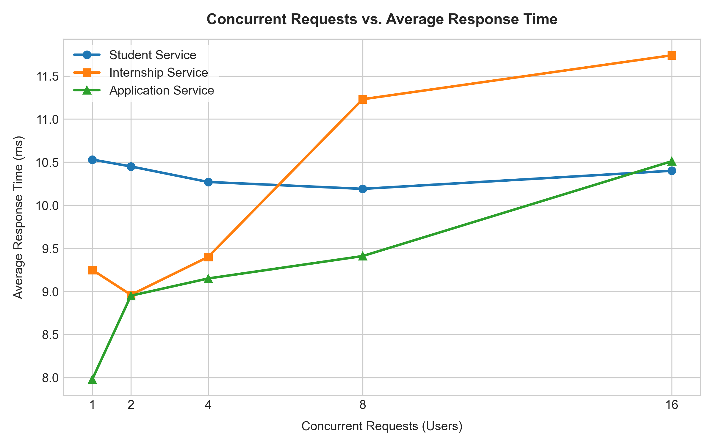
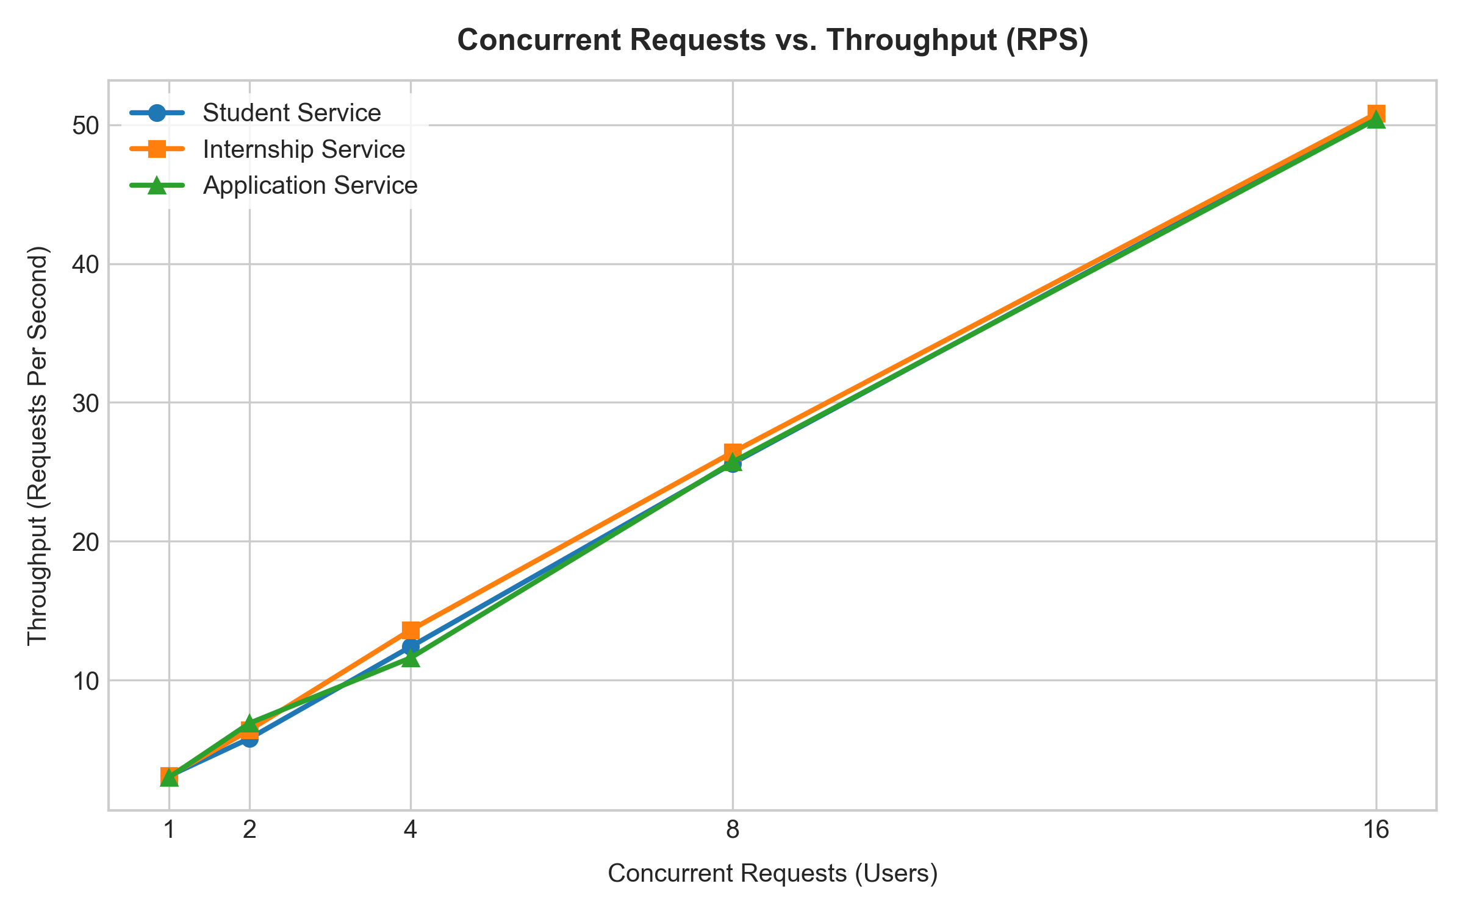
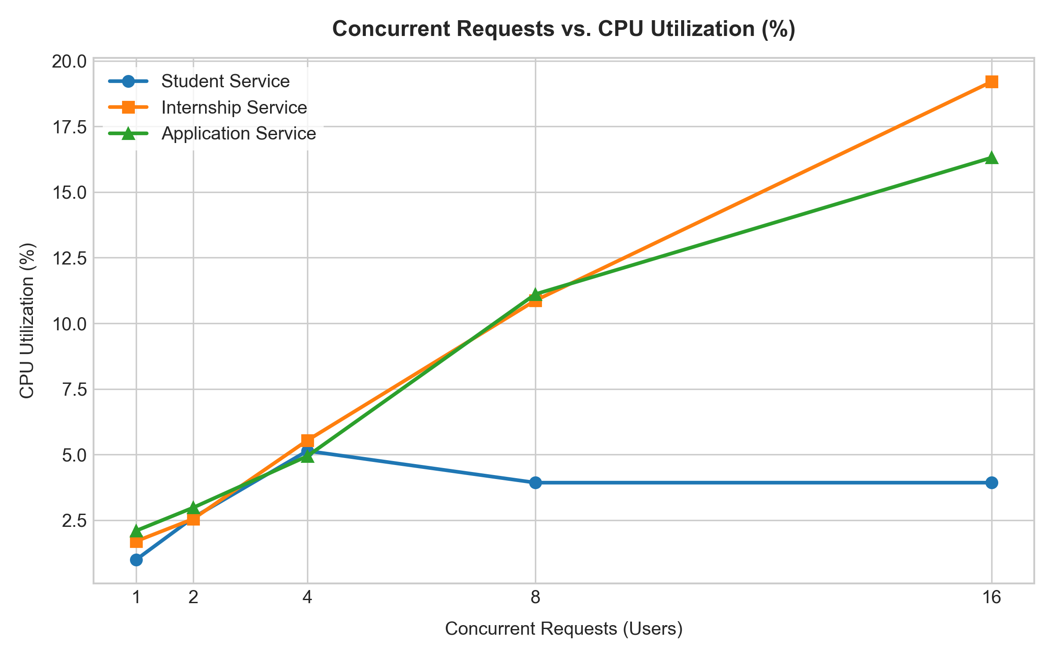
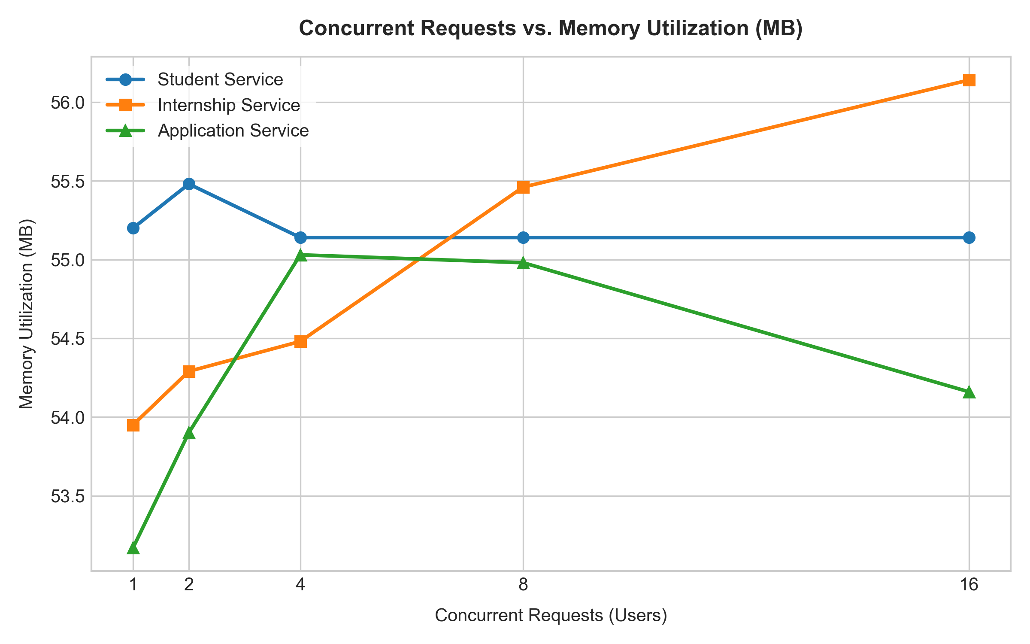
CLOUD COMPUTING LABORATORY
Performance Analysis
Graph 1: Concurrent Users vs Average Response Time
Graph 2: Concurrent Users vs Throughput
Graph 3: Concurrent Users vs CPU Utilization
Graph 4: Concurrent Users vs Memory Usage
Observed Behaviour: Response time, throughput and resource utilization were compared across increasing concurrent workloads.

Slide 12
CLOUD COMPUTING LABORATORY
Conclusion & Demonstration
Project Demonstrates
✔ Independent microservices
✔ RESTful APIs
✔ Docker containerization
✔ Docker Compose orchestration
✔ Docker-network service discovery
✔ Inter-service validation
✔ Locust workload testing
✔ CPU and memory monitoring
Live Demo Flow
Docker Compose
↓
Verify Containers
↓
Verify Docker Network
↓
Create Student
↓
Create Internship
↓
Submit Application
↓
Show Inter-Service Validation
↓
Run Locust
↓
Show Results

