Slide 1
CLOUD COMPUTING LABORATORY (EXPERIMENT EVALUATION)
Build, Deploy & Analyze a Containerized Microservice Application Under Varying Workloads
Domain: Internship Management System | FastAPI • Docker Compose • Locust • Resource Profiling
PROJECT TEAM MEMBERS
Vageesh Mathad
USN: 01FE24BCI008
Mehak Sayed Yusuf
USN: 01FE24BCI012
Joel Biju
USN: 01FE24BCI021
Akshay Bhat
USN: 01FE24BCI024

Slide 2
CHECKPOINT 1 — OVERVIEW
Aim, Domain & Experiment Objectives
Experiment Aim & Domain
• Domain: Internship Management System for academic placements.
• Core Goal: Develop exactly 3 independent microservices, containerize with Docker, establish inter-service communication, generate varying workloads, and profile performance.
• Microservice Principle: Loose coupling, high cohesion, independent database per service, and stateless REST endpoints.
• Evaluator Requirement: Fulfill all 5 mandatory checkpoints with real measured metrics.
Three Independent Microservices
1. Student Service (:8002)
Database: students.db | Maintains student profiles (name, email, department, year). Validates academic eligibility.
2. Internship Service (:8003)
Database: internships.db | Stores internship job postings, requirements, stipends, and keyword search filters.
3. Application Service (:8004)
Database: applications.db | Orchestrates application workflow, coordinates inter-service validation, and tracks review status.

Slide 3
CHECKPOINT 1 — DETAILED DESIGN
Architecture & REST API Implementation
MINIMUM ARCHITECTURE: Client → Service 1 → Service 2 / Service 3
Client (Web Dashboard / Locust / cURL) ──► Application Service (Port 8004)
├──► Student Service (Port 8002) [Validates Student ID]
└──► Internship Service (Port 8003) [Validates Internship ID]
Student Service (:8002)
• POST /students (Create)
• GET /students (List all)
• GET /students/{id} (Fetch details)
• PUT /students/{id} (Update)
• DELETE /students/{id} (Remove)
Internship Service (:8003)
• POST /internships (Create posting)
• GET /internships (Search & filter)
• GET /internships/{id} (Fetch details)
• PUT /internships/{id} (Update details)
• DELETE /internships/{id} (Delete)
Application Service (:8004)
• POST /applications (Submit application)
• GET /applications (List applications)
• PATCH /applications/{id}/status (Accept/Reject)
• DELETE /applications/{id} (Withdraw)
• Inter-Service Validation on Submit

Slide 4
CHECKPOINT 2 — DOCKER DEPLOYMENT
Docker Containerization & Multi-Container Deployment
Microservice Containerization
• Base Image: python:3.12-slim (minimal footprint ~280MB).
• Isolated Dependencies: Each service packages its own requirements.txt (FastAPI, uvicorn, sqlalchemy, requests).
• Execution: Uvicorn ASGI server bound to 0.0.0.0:8000 inside each container.
• Build Process: Three distinct images: student-service:latest, internship-service:latest, application-service:latest.
• Port Isolation: Internal port 8000 mapped to host ports 8002, 8003, 8004.
Docker Compose Orchestration
• Single Command Deploy: docker compose up --build -d starts all microservices + Nginx frontend.
• Named Volumes Persistence: student_data, internship_data, application_data preserve SQLite data across container teardowns.
• Service Dependency: application depends_on student and internship to ensure correct startup order.
• Automatic Network: Creates default bridge network enabling container DNS resolution.
• Zero Downtime Scaling: Services run as isolated processes without port conflicts.

Slide 5
CHECKPOINT 3 — SERVICE-TO-SERVICE
Establishing & Demonstrating Inter-Service Communication
How Microservices Communicate (Docker Network Service Discovery)
Instead of hardcoded host IP addresses, Application Service utilizes Docker's built-in DNS to reach target services by service name:
• Student URL: http://student:8000/students/{id}
• Internship URL: http://internship:8000/internships/{id}
Validation & End-to-End Request Demonstration Flow:
• Step 1: Application Submission: Client issues POST /applications with student_id and internship_id.
• Step 2: Student Existence Check: Application Service sends HTTP GET to http://student:8000/students/{student_id}.
• Step 3: Internship Existence Check: Application Service sends HTTP GET to http://internship:8000/internships/{internship_id}.
• Step 4: Error Handling & Failure Case: If student does NOT exist, Student Service responds 404. Application Service immediately returns HTTP 404: 'Student 99999 not found' without saving orphan data.
• Step 5: Successful State Transition: If both entities exist, Application Service records the row in applications.db and returns HTTP 201 Created.

Slide 6
CHECKPOINT 4 — LOAD TESTING
Varying Workload Testing & Observation Table (W1 - W5)
Load Testing Tool: Locust | Metrics Monitored: Response Time, Throughput (RPS), Failures, CPU %, Memory (MB)
Workload | Concurrency | Avg Response Time | Throughput (RPS) | Failures | CPU Utilization | Memory Usage
W1 | 1 User | 8.0 – 10.5 ms | 3.1 RPS | 0 | 1.0 – 2.1 % | 53 – 55 MB
W2 | 2 Users | 9.0 – 10.5 ms | 5.8 – 6.9 RPS | 0 | 2.5 – 3.0 % | 54 – 55 MB
W3 | 4 Users | 9.1 – 10.3 ms | 11.6 – 13.6 RPS | 0 | 4.9 – 5.5 % | 54 – 55 MB
W4 | 8 Users | 9.4 – 11.2 ms | 25.6 – 26.4 RPS | 0 | 3.9 – 11.1 % | 55.0 MB
W5 | 16 Users | 10.4 – 11.7 ms | 50.4 – 50.8 RPS | 0 | 3.9 – 19.2 % | 54 – 56 MB

Slide 7
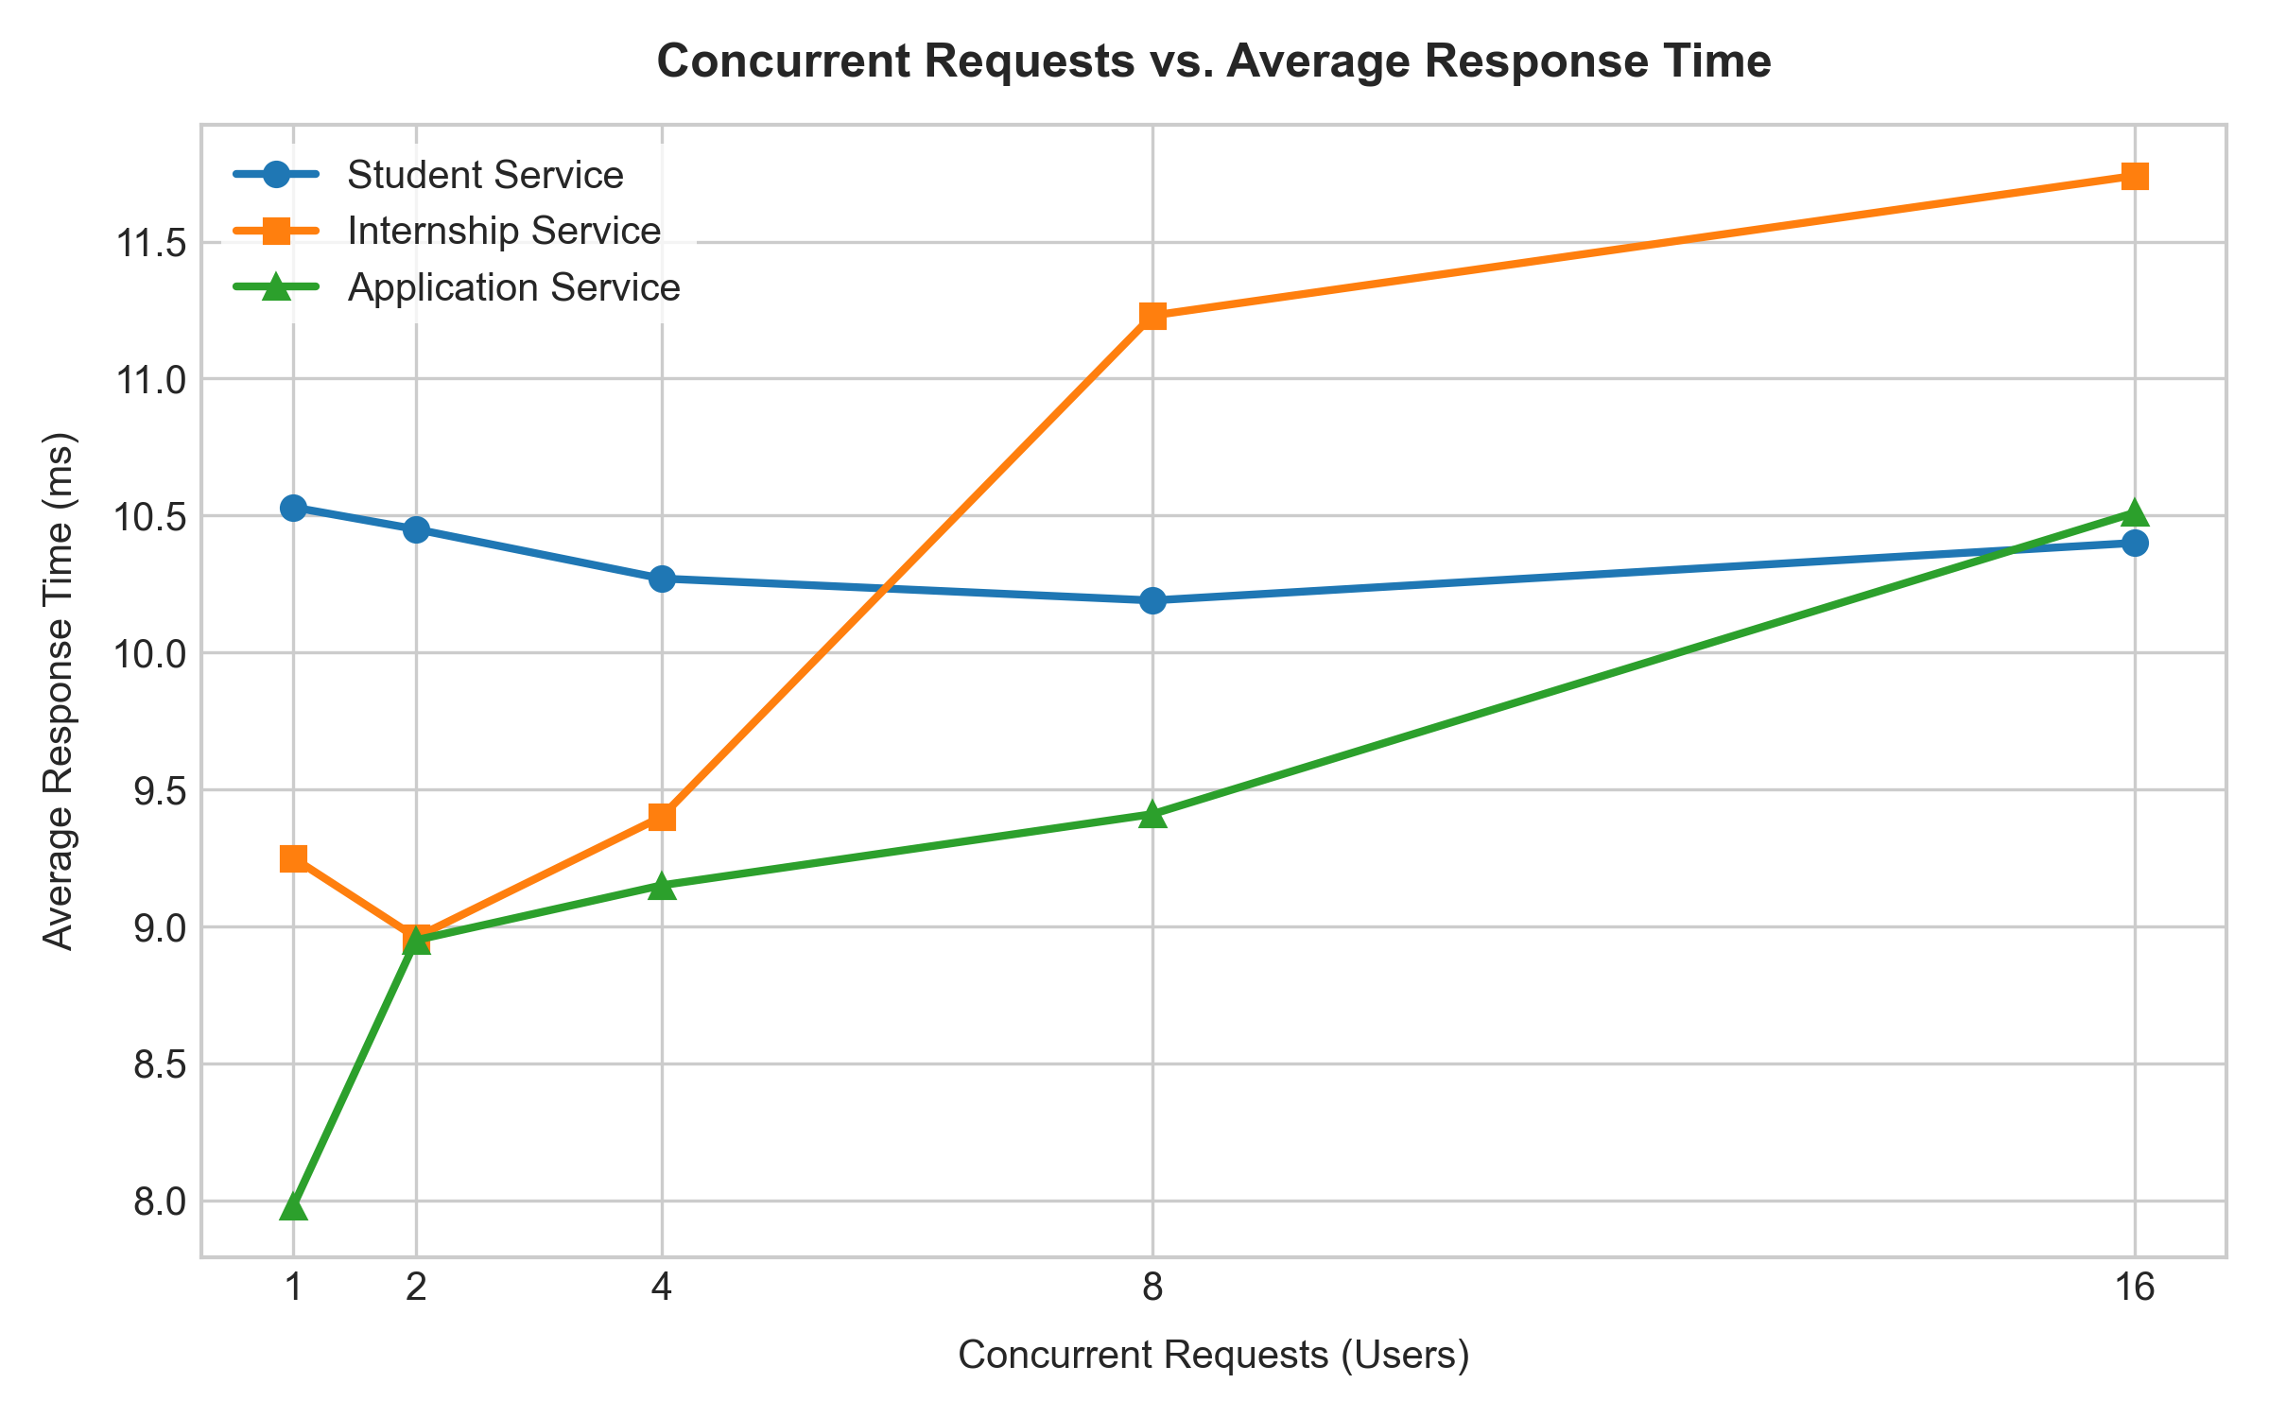
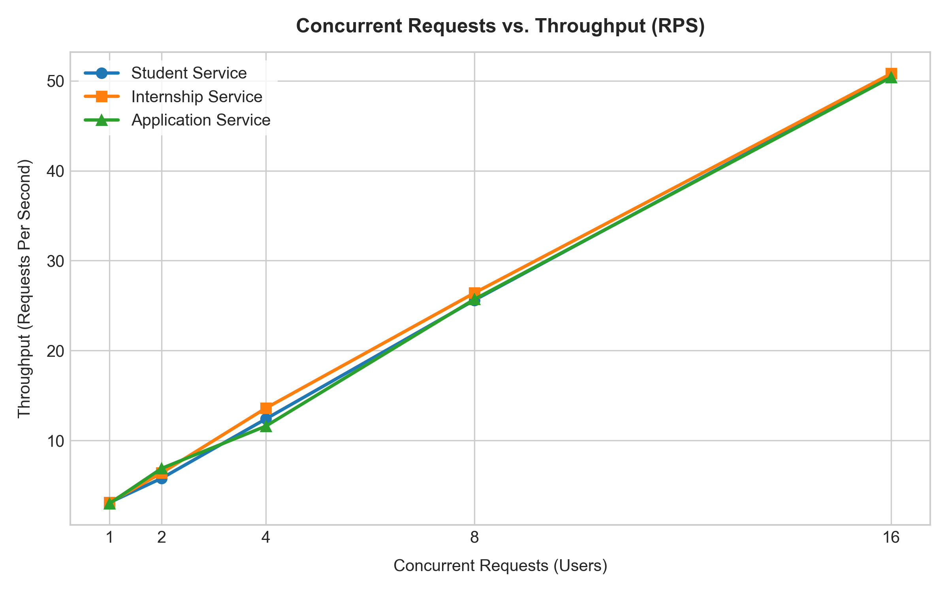
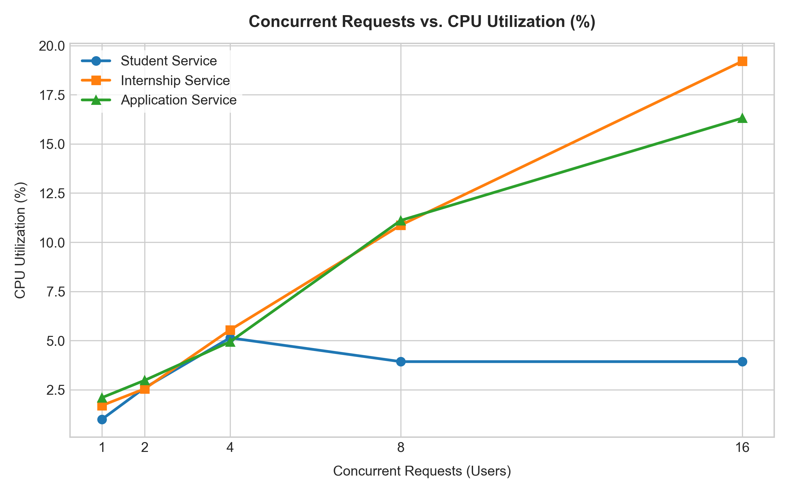
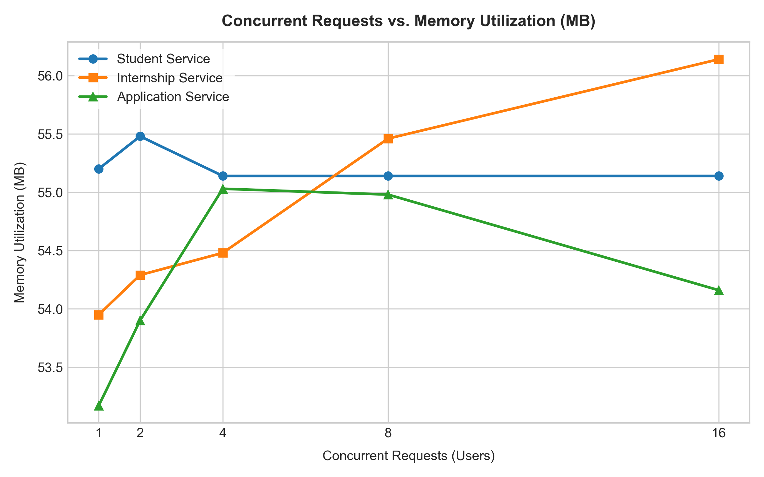
CHECKPOINT 5 — VISUAL RESULTS
Benchmark Graphs & Performance Analysis

Slide 8
EXPERIMENT SUMMARY
Key Insights, Viva Conclusions & Final Deliverables
Workload & Resource Analysis
• Throughput Scaling: Linear scaling from 3.1 RPS (1 user) to 50.8 RPS (16 users). No bottleneck reached.
• Response Time Stability: Latency remained tightly bound between 8.0ms and 11.7ms. Zero request failures recorded.
• Resource Utilization: Internship and Application services consume slightly more CPU (~19% and ~16%) due to filtering and inter-service HTTP calls.
• Memory Footprint: Memory remained constant around 54–56 MB across all containers thanks to Python connection pooling and lightweight footprint.
Student Deliverables Checklist
✔ 3 Microservice Codebases: student, internship, application with independent models.
✔ Dockerfiles & Compose: Individual Dockerfiles and working docker-compose.yml.
✔ Active Containers: All containers deployed and verified on ports 8000–8004.
✔ Inter-Service Demo: Verified end-to-end communication and 404 validation.
✔ Observation Table & Graphs: Complete W1–W5 benchmark data and 4 generated plots.
✔ Live Dashboard: Simple, professional UI for evaluator demonstration.

