Slide 1

Theme 4: Network Systems and Tools
DNS Resolver and Caching Server
Stage S1 — Functional Requirements Engineering & Engine Decomposition
Team No. 11
Guide: Mr. Pavankumar S
Date: 29/09/2026
Sl. No. | SRN | Student Name
1 | 01fe24bci012 | Mehak Sayed Yusuf
2 | 01fe24bci008 | Vageesh Mathad
3 | 01fe24bci021 | Joel Biju
4 | 01fe22bci009 | Ishani G

Slide 2
Use Cases and User Stories (1 of 2)
B · REQUIREMENTS (SRS)
Ten use cases covering normal, boundary, and exception execution paths
ID | Actor | Use Case / User Story | Normal / Main Flow | Boundary & Exception Flow
UC-01 | DNS Client | Resolve Uncached Domain (Cache Miss) | Client sends query for new domain → Resolver checks cache → Cache Miss detected → Resolver forwards query to upstream within 2.0s deadline → Upstream returns answer → Resolver commits to Cache → Transmits answer to Client. | 2.0s upstream deadline expires → Terminate resolution → Return SERVFAIL.
UC-02 | DNS Client | Resolve Cached Domain (Cache Hit) | Client sends query for domain → Resolver checks cache → (TTL_orig - elapsed_time) > 0 → Dynamically assign remaining TTL → Transmit cached response (target: < 1 ms). | (TTL_orig - elapsed_time) ≤ 0 → Evict expired entry → Treat as Cache Miss → Trigger external resolution → Update cache.
UC-03 | DNS Client | Query for Non-Existent Domain (NXDOMAIN) | Client queries non-existent domain → Upstream returns NXDOMAIN (RCODE 3) → Resolver applies RFC 2308 negative caching, with TTL derived from the SOA record → Returns NXDOMAIN to client. | Upstream deadline expires before SOA received → Return SERVFAIL.
UC-04 | DNS Client | Process Malformed / Corrupt Wire Packet | Client transmits datagram ≥ 12 bytes with corrupt syntax → Protocol engine validates header → Extracts Query ID → Emits structured FORMERR response (RCODE 1). | Datagram < 12 bytes (sub-header truncation) → Drop packet silently to prevent UDP amplification.
UC-05 | Cache Subsystem | Proactive TTL Expiration Sweep | Background timer examines root of Min-Heap → Expiration timestamp ≤ Current time → Pop expired entry → Remove from cache hash map and LRU list. | Min-Heap empty → Sleep until next scheduled timer cycle.

Slide 3
Use Cases and User Stories (2 of 2)
B · REQUIREMENTS (SRS)
Ten use cases covering normal, boundary, and exception execution paths
ID | Actor | Use Case / User Story | Normal / Main Flow | Boundary & Exception Flow
UC-06 | Cache Subsystem | Capacity-Based LRU Eviction | New record insertion triggered when cache is at maximum capacity (10,000 entries) → Engine identifies least recently used tail node in doubly linked list → Evicts from list and hash map → Inserts new record. | Incoming record key already exists → In-place update value, reset TTL, and splice node to LRU head.
UC-07 | System Operator | Query Resolution Telemetry & Performance | Operator requests system metrics → Engine queries steady_clock timestamps → Aggregates query count, hit count, miss count, hit ratio %, and latency statistics → Renders real-time dashboard. | No queries received → Output zeroed baseline counters.
UC-08 | System Operator | Graceful Shutdown and Cache Snapshot | Operator sends SIGINT / Ctrl+C → Server halts UDP listener → Dumps active in-memory cache to disk snapshot (dns_cache.db) → Releases socket resources → Clean termination. | Disk write permission denied → Log critical error to stderr and exit safely.
UC-09 | System Operator | Cache Warm-Up on Server Boot | Server launches → Checks for valid disk snapshot file → Loads stored records into cache → Filters out expired records → Reconstructs LRU list and Min-Heap. | Snapshot file missing or corrupted → Initialize fresh empty cache and log warning.
UC-10 | DNS Client | Cyclic Pointer Exploit Detection | Client transmits crafted packet containing recursive pointer loop (0xC0 pointing to self) → Protocol engine dereference counter exceeds limit (16) → Aborts loop → Returns FORMERR. | Invalid pointer offset outside packet boundary → Abort decompression safely; return FORMERR.

Slide 4
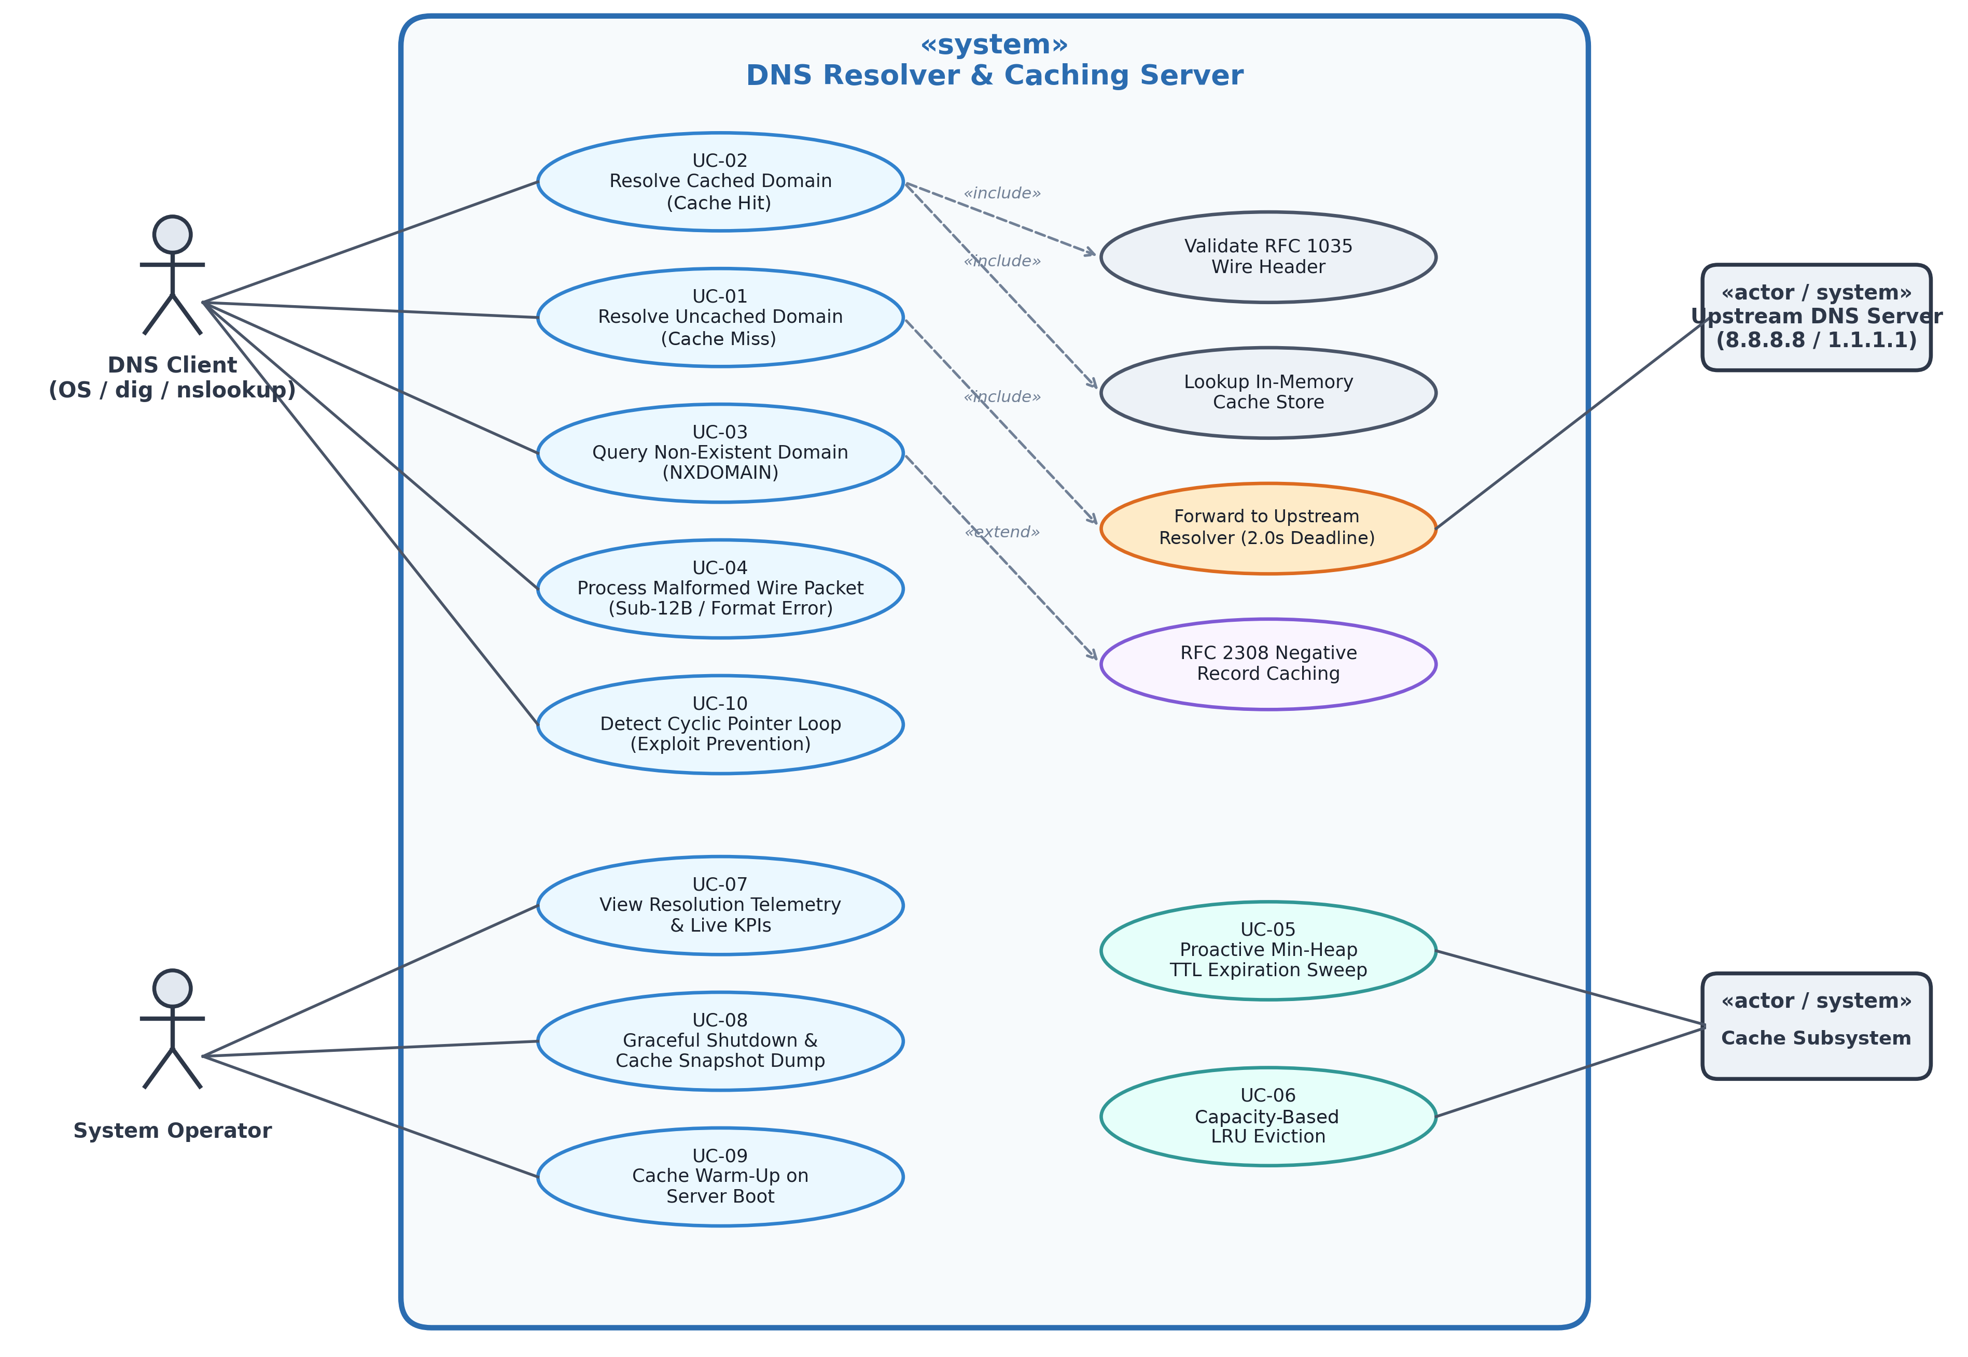
B · REQUIREMENTS (SRS)
Use Case Diagram
Figure S1.1: Complete UML Use Case Model — DNS Resolver & Caching Server (Themes 1–5, Team 11)

Slide 5
Functional Requirements (FR)
B · REQUIREMENTS (SRS)
Nine functional requirements: eight mandatory, one challenge
ID | Functional Requirement | Priority
FR-01 | The server shall ingest incoming client DNS queries over a configurable UDP port, defaulting to port 53, and validate RFC 1035 datagram integrity. | Mandatory
FR-02 | Parse DNS header bitfields, questions, and decompress domain labels (0xC0 pointer offsets) with recursion-depth limit of 16. | Mandatory
FR-03 | Query the in-memory cache using composite key (domain, qtype, qclass) to identify valid cached resource records. | Mandatory
FR-04 | Evaluate cache TTL dynamically: if (TTL_original - elapsed_time) > 0, return remaining TTL; otherwise evict entry and trigger a cache miss. | Mandatory
FR-05 | Evict expired records proactively using a Min-Heap priority queue (O(log N) per entry) and enforce O(1) LRU capacity eviction at cache ceiling. | Mandatory
FR-06 | Forward cache-miss queries to external upstream DNS resolvers within an end-to-end 2.0-second deadline; manage per-attempt timeouts and failover. | Mandatory
FR-07 | Atomically commit valid upstream resolution answers and authority records to the in-memory cache with authoritative TTLs. | Mandatory
FR-08 | Handle edge conditions: cache NXDOMAIN via RFC 2308 negative caching, emit SERVFAIL upon upstream deadline expiry, and emit FORMERR for corrupt packets >= 12B. | Mandatory
FR-09 | Collect and evaluate real-time resolution telemetry using monotonic steady_clock (total queries, hit ratio %, and latency distributions). | Challenge

Slide 6
Non-Functional Requirements (NFR)
B · REQUIREMENTS (SRS)
Seven quality requirements, each with a measurable target to be verified in testing
ID | Non-Functional Requirement | Category | Measurable Target (to be verified)
NFR-01 | Cache-Hit Response Latency: The resolver shall achieve an average cache-hit response latency of less than 1.0 ms under defined local benchmark conditions. | Performance | Average cache-hit latency < 1.0 ms
NFR-02 | Throughput & Concurrency: Sustain ≥ 1,000 queries per second without packet drop via multi-threaded worker dispatch. | Scalability | ≥ 1,000 QPS with 0% socket buffer overrun
NFR-03 | Memory Bound & Safety: Enforce strict bounded memory consumption with configurable upper limit (10,000 records ≤ 30 MB) using O(1) LRU eviction. | Resource Management | Resident set size ≤ 30 MB at full capacity
NFR-04 | Upstream Resolution Deadline: Enforce strict 2.0s end-to-end resolution deadline across all upstream attempts; return SERVFAIL upon expiration. | Reliability | Total resolution deadline ≤ 2.0s; 0 zombie sockets
NFR-05 | Thread Safety & Concurrency Control: Multi-threaded cache reads and writes must guarantee zero race conditions using Reader-Writer lock primitives. | Correctness | 100% thread safety; 0 race conditions under stress
NFR-06 | RFC Compliance & Interoperability: Compatibility with the RFC 1035 UDP wire format for standard client tools (dig, nslookup). | Interoperability | 100% interoperability with dig and nslookup
NFR-07 | Cache Durability: Persist in-memory cache state to disk snapshot on graceful shutdown and reload valid entries on startup. | Durability | Snapshot dump/load time < 100 ms

Slide 7
Requirement Clustering Sheet
C · CLUSTERING, ENGINES AND OWNERSHIP
Requirements grouped into five technical clusters deriving independent, verifiable system engines
C1 Wire Protocol Parsing & Message Serialization
C2 In-Memory Storage & Cache Eviction Lifecycle
C3 Upstream Resolution & Network Forwarding
C4 Query Execution Virtual Machine & Policy Dispatch
C5 Telemetry, Benchmarking & Performance Analytics
FR-01, FR-02
NFR-06
FR-03, FR-04, FR-05
NFR-03, NFR-05, NFR-07
FR-06
NFR-04
FR-07*, FR-08
NFR-02
FR-09
NFR-01
Binary UDP datagram parsing, sub-12B drop, 16-bit header unpacking, label decompression with loop prevention (depth limit 16), response serialization.
Key-value indexing, average O(1) lookup, O(1) LRU eviction, O(log N) Min-Heap TTL sweep, dynamic remaining TTL, snapshot persistence.
Forwarding of cache misses to upstream resolvers, 2.0s deadline, per-attempt timeouts, failover, randomized transaction IDs (spoofing mitigation).
Request pipeline FETCH → DECODE → LOOKUP → RESOLVE → COMMIT → EMIT, edge-condition mapping (NXDOMAIN, SERVFAIL, FORMERR), multi-threaded worker dispatch.
Real-time tracking of hit/miss counts, hit ratio %, and monotonic steady_clock latency distributions; evaluation reporting.
Engine E1: Protocol Parsing
Owner: Vageesh Mathad (01fe24bci008)
Engine E2: In-Memory Cache
Owner: Mehak Sayed Yusuf (01fe24bci012)
Engine E3: Upstream Resolution
Owner: Ishani G (01fe22bci009)
Engine E4: Query Execution VM
Owner: Joel Biju (01fe24bci021)
Engine E4: Telemetry Subsystem
Owner: Joel Biju (01fe24bci021)
Decomposition Flow: Approved S0 Need → SRS Requirement → Functional Cluster → Technical Engine → Primary Owner
* FR-07: the atomic cache commit is performed by E2 (per traceability matrix); E4 sequences the COMMIT pipeline stage.

Slide 8
DETAILED ENGINE SPECIFICATIONS
Responsibility Boundaries, Core Algorithms, Failure Handling, and Foundational Course Integration
S1 baseline: engine designs and performance figures are requirements and targets. Implementation and measured results follow in later stages.

Slide 9
Protocol Parsing & Wire Message Engine
C · ENGINE 01
COMPUTER NETWORKS ENGINE | Owner: Vageesh Mathad (01fe24bci008) | Cluster C1: FR-01, FR-02, NFR-06
RESPONSIBILITY
Parses raw UDP datagrams into structured DNS request messages and serializes DNS response structures into RFC 1035 wire-format datagrams. It owns header and question parsing, domain-name decompression, packet-boundary validation, and response serialization. It does not own the client UDP listener or upstream network communication.
REQUIREMENTS COVERED
FR-01 Datagram validation (the UDP listener is owned by E4)
FR-02 Header parsing and label decompression (depth limit 16)
NFR-06 RFC 1035 UDP wire-format compatibility with dig and nslookup (target)
INPUT
Raw UDP datagram buffer (up to 512 bytes) and its byte length.
OUTPUT
Decoded DNS message (or FORMERR status) for the E4 pipeline; serialized wire-format response for E4 to send.
CORE MECHANISM
RFC 1035 wire parser with bounds checking and depth-bounded label decompression (max jump depth = 16); zero-copy ByteStream marshalling with ntohs/htons byte-order conversion.
IF IT FAILS
• Datagram < 12 B: drop silently
• Malformed ≥ 12 B or cyclic pointer: abort and emit FORMERR
ACADEMIC FOCUS & FOUNDATIONAL LINK — concepts we will use from each course
Computer Networks (Dominant) | RFC 1035 wire format · UDP datagrams (up to 512 bytes) · DNS header bitfields · Name compression (0xC0 prefix, 14-bit offsets) · Endianness (ntohs/htons)
Operating System Principles | Buffer boundary checks · Pointer safety · Avoiding stack overflow during decompression
Design & Analysis of Algorithms | Recursion-depth bounding (limit 16) · Label pointer offset indexing · Stream cursor parsing

Slide 10
In-Memory DNS Storage & Cache Engine
C · ENGINE 02
DAA AND DBMS ENGINE | Owner: Mehak Sayed Yusuf (01fe24bci012) | Cluster C2: FR-03, FR-04, FR-05, NFR-03, NFR-05, NFR-07
RESPONSIBILITY
Maintains the in-memory DNS cache: performs lookups and updates, validates remaining TTLs, removes expired entries, enforces LRU capacity eviction, synchronizes concurrent cache access, and persists cache snapshots. E4 coordinates the query pipeline; E2 performs the cache operations.
REQUIREMENTS COVERED
FR-03 Cache lookup by (domain, qtype, qclass)
FR-04 Dynamic remaining-TTL evaluation
FR-05 Min-Heap TTL sweep and LRU capacity eviction
FR-07 Atomic cache commit (E4 sequences the COMMIT stage)
NFR-03 Memory bound · NFR-05 Thread safety · NFR-07 Durability
INPUT
Query key (domain, query type, class); resolved record set; eviction sweep timer tick.
OUTPUT
Cache verdict: HIT with remaining TTL, or MISS if absent or expired (expired entries are removed, never served).
CORE MECHANISM
Hash table (average O(1) lookup) + doubly-linked list (O(1) LRU update/eviction); Min-Heap (O(log N) insert/remove) for proactive TTL sweep.
IF IT FAILS
• Capacity reached: evict LRU tail
• TTL expired ((TTL − elapsed) ≤ 0): evict entry, return MISS
• Corrupt snapshot file: initialize empty cache
ACADEMIC FOCUS & FOUNDATIONAL LINK — concepts we will use from each course
Design & Analysis of Algorithms | Hash table (average O(1) lookup) · Doubly-linked list (O(1) LRU update/eviction) · Min-Heap (O(log N) insert/remove for TTL sweep)
Database Management Systems | Key-value indexing · Atomic commit of multi-record answers · Snapshot serialization (dns_cache.db) · Data consistency
Operating System Principles | Reader-Writer lock (SharedMutex) · Multi-reader concurrency · Bounded resident memory (target ≤ 30 MB)

Slide 11
Upstream Resolution & Network Forwarding Engine
C · ENGINE 03
COMPUTER NETWORKS / OPERATING SYSTEMS ENGINE | Owner: Ishani G (01fe22bci009) | Cluster C3: FR-06, NFR-04
RESPONSIBILITY
Sends unresolved DNS queries to configured upstream DNS servers. It owns outbound socket communication, timeouts, retry and failover policy, and validation of upstream responses. It does not own the inbound client UDP listener or cache data structures.
REQUIREMENTS COVERED
FR-06 Forward cache misses upstream within the 2.0 s deadline, with timeouts and failover
NFR-04 Upstream resolution deadline
Response validation: transaction ID checked against the pending-query map.
INPUT
Uncached DNS query from the VM pipeline; upstream servers (8.8.8.8, 1.1.1.1).
OUTPUT
Raw upstream response datagram and status (SUCCESS, TIMEOUT, UNREACHABLE).
CORE MECHANISM
Non-blocking UDP socket polling within a 2.0 s deadline budget; sequential failover; randomized 16-bit transaction IDs and ports (spoofing mitigation).
IF IT FAILS
• Primary upstream timeout: fail over to secondary
• Deadline expires: return SERVFAIL, close sockets (target: 0 leaks)
ACADEMIC FOCUS & FOUNDATIONAL LINK — concepts we will use from each course
Computer Networks | Forwarding to recursive upstream resolvers · UDP client sockets · Spoofing mitigation: random 16-bit IDs and port randomization (Kaminsky)
Operating System Principles | Non-blocking socket I/O (poll/select) · 2.0 s deadline budget · Socket cleanup with 0 leaks
Design & Analysis of Algorithms | Timeout retry backoff · Transaction ID verification map lookup

Slide 12
Query Execution VM & Performance Telemetry Engine
C · ENGINE 04
OPERATING SYSTEMS PRINCIPLES AND PROGRAMMING ENGINE | Owner: Joel Biju (01fe24bci021) | Cluster C4, C5: FR-07, FR-08, FR-09, NFR-01, NFR-02
RESPONSIBILITY
Owns the inbound client UDP listener, coordinates the query execution pipeline and worker threads, handles query outcomes, and collects performance telemetry. It coordinates parsing through E1, cache operations through E2, and upstream resolution through E3.
REQUIREMENTS COVERED
FR-07 Sequences the COMMIT stage (E2 performs the cache update)
FR-08 Edge conditions: NXDOMAIN, SERVFAIL, FORMERR
FR-09 Real-time telemetry using steady_clock
NFR-01 Cache-hit latency · NFR-02 Throughput
INPUT
Inbound client datagram on the server port (default 53); periodic telemetry timer tick.
OUTPUT
Final DNS response datagram to the client; live KPI dashboard (1 s timer tick).
CORE MECHANISM
Pipeline state machine: FETCH → DECODE → LOOKUP → RESOLVE → COMMIT → EMIT, with worker pool dispatch and steady_clock telemetry.
IF IT FAILS
• Port unavailable: report startup error (port 5353 only if explicitly configured)
• Queue full: drop datagram
• Deadline expired: return SERVFAIL (RCODE 2)
ACADEMIC FOCUS & FOUNDATIONAL LINK — concepts we will use from each course
Operating System Principles (Dominant) | Thread-pool concurrency · Pipeline VM state machine · Non-blocking I/O · steady_clock monotonic telemetry
Computer Networks | DNS response codes (NOERROR, NXDOMAIN, SERVFAIL, FORMERR) · UDP port binding (port 53)
Design & Analysis of Algorithms | Telemetry metric aggregation · Latency distribution evaluation

Slide 13
KPI and Measurement Sheet
C · CLUSTERING, ENGINES AND OWNERSHIP
Targets and planned verification methods per engine; results to be reported after testing
KPI Name | Type | Owning Engine & Owner | Workload / Test Scenario | Target & Verification Method
Wire Parsing Latency & Interoperability | Mandatory | E1: Vageesh Mathad | Sub-12B, 512B and cyclic-pointer datagrams; dig and nslookup queries. | Targets: parsing < 20 µs; no crash on malformed packets; 100% interoperability with dig and nslookup.
Cache-Hit Latency & Memory Ceiling | Mandatory | E2: Mehak Sayed Yusuf | 1,000 identical queries (mean, p99); cache filled to 10,000 entries. | Targets: mean hit latency < 1.0 ms; lookup < 5 µs; resident set ≤ 30 MB.
Thread Safety & Snapshot Durability | Mandatory (NFR-05, NFR-07) | E2: Mehak Sayed Yusuf | 100 reader and 10 writer threads under ThreadSanitizer; dump and restore of 10,000 records. | Targets: 0 race conditions; snapshot dump/load < 100 ms.
Upstream Deadline & Socket Leaks | Mandatory | E3: Ishani G | Unresponsive primary upstream; simulated packet loss. | Targets: response or SERVFAIL within 2.0 s; 0 leaked sockets; 100% transaction ID verification.
Sustained Throughput Under Load | Challenge | E4: Joel Biju | Load test dispatching 1,000 requests/sec. | Targets: ≥ 1,000 QPS with 0% packet drop.
Telemetry & Condition Accuracy | Mandatory (FR-08) / Challenge (FR-09) | E4: Joel Biju | 100 benchmark queries; NXDOMAIN, SERVFAIL and FORMERR test cases. | Targets: correct RCODEs (3, 2, 1); telemetry matches recorded traffic.

Slide 14
THANK YOU
DNS Resolver and Caching Server — Stage S1: Requirements and Engines
Team 11 | Theme 4: Network Systems and Tools | Guide: Mr. Pavankumar S

