Slide 1
POC · CUSTOMER OPERATIONS
Intelligent Customer Signal Detector
Problem Understanding & Objective
REACTIVE TODAY
PROACTIVE WITH AI
Signals siloed across chat, billing & usage
Unified multi-signal scoring engine
Transcripts reviewed manually, one by one
LLM correlates chat logs with telemetry
Action only after a complaint escalates
Ranked daily action queue for Ops
Intervention lands after churn intent forms
Intervene before the customer decides to leave
OBJECTIVE
TARGET USER
Build a unified multi-signal scoring engine that correlates unstructured chat logs with CSAT, billing and usage telemetry to surface early churn/escalation risk.
Customer Operations & Retention teams needing a prioritized daily action queue.

Slide 2
Solution Architecture & Design Flow
Structured telemetry and unstructured chat converge into one prioritized triage view.
INPUTS
1
Ingestion
Support chat logs
Chat logs + structured usage/billing metrics normalized into one record.
CSAT scores
2
Signal Correlation Engine
Billing disputes
Heuristic weighting blended with LLM contextual reasoning over the transcript.
Login inactivity
3
Risk Scoring Layer
Multi-factor 0–100 score mapped to Critical / High / Medium / Low SLA tiers.
4
Triage UI
Streamlit command center presenting prioritized intervention recommendations.

Slide 3
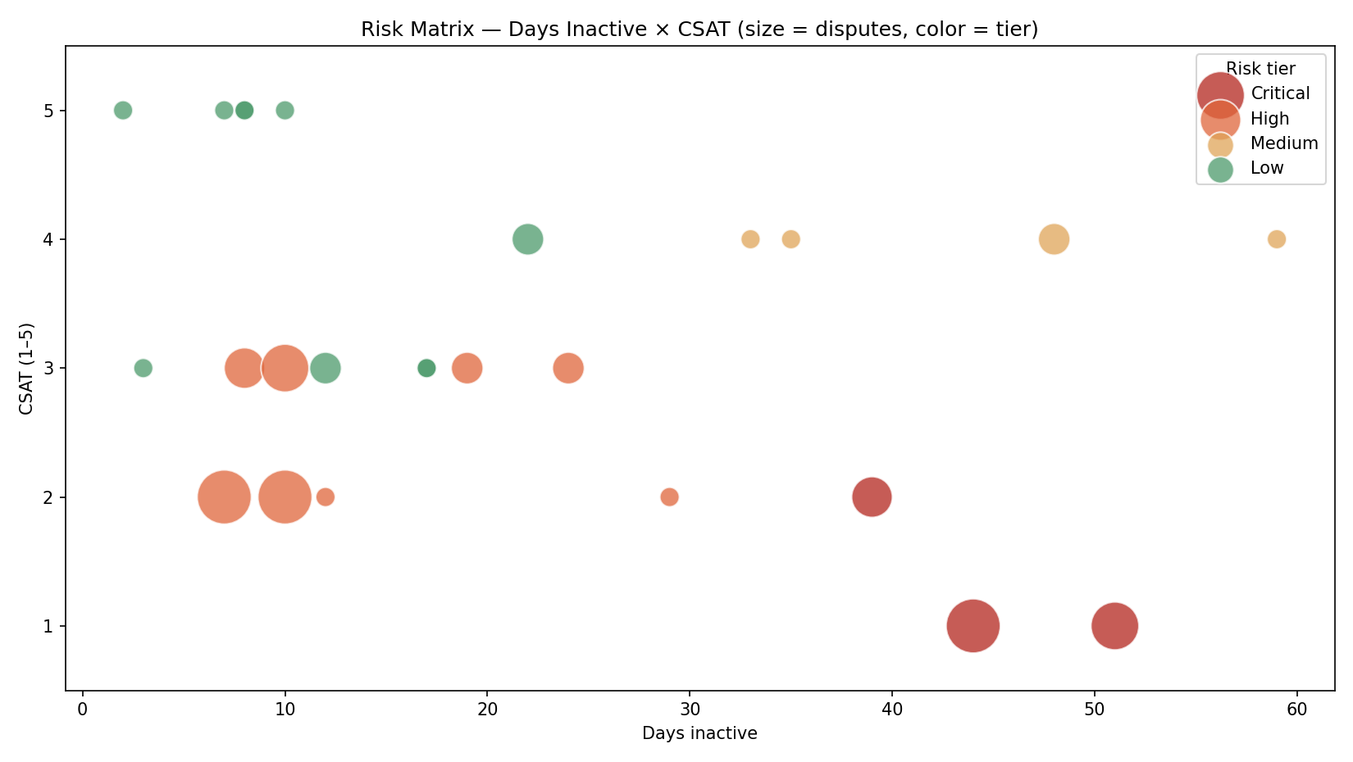
Implementation Highlights
Structured JSON output (zero-shot schema)
{
"churn_intent": 0.0-1.0,
"frustration": 0.0-1.0,
"competitor_mention": bool,
"feature_gap": bool,
"billing_issue": bool,
"passive_dissatisfaction": bool,
"sentiment": -1.0..1.0,
"confidence": 0.0-1.0,
"key_phrases": [string]
}
Enforced JSON → reliable parsing into operational tables.
Live risk matrix from the Streamlit command center.
Hybrid signal analysis
Pydantic-validated output
Confidence + human-in-loop
Hard thresholds (CSAT ≤ 2, high disputes) + soft semantic signals (passive dissatisfaction, competitor mentions).
Zero-shot JSON is schema-validated before scoring — malformed reads are caught and safely handled.
Low-confidence transcript reads are auto-flagged for manual review; every flag cites transcript evidence.

Slide 4
Challenges & Learnings
Every challenge resolved by anchoring AI judgment to hard evidence.
Signal noise & false positives
LLM latency & cost
Challenge A venting-but-happy customer must not top the queue.
Challenge Scoring 100s of transcripts in real time is a bottleneck.
Solution Anchor qualitative sentiment with hard billing/usage metrics; positive-language guard caps churn intent.
Solution Batch transcript analysis asynchronously; deterministic scoring runs instantly on cached signals.
Operational trust
Reliable structured output
Challenge Ops teams reject a raw sentiment score they can't defend.
Challenge Free-form LLM text breaks downstream tables.
Solution Every flag shows its key_signals + transcript evidence — explainable, not black-box.
Solution Zero-shot JSON schema + robust parsing + mock fallback keep the pipeline unbreakable.

Slide 5
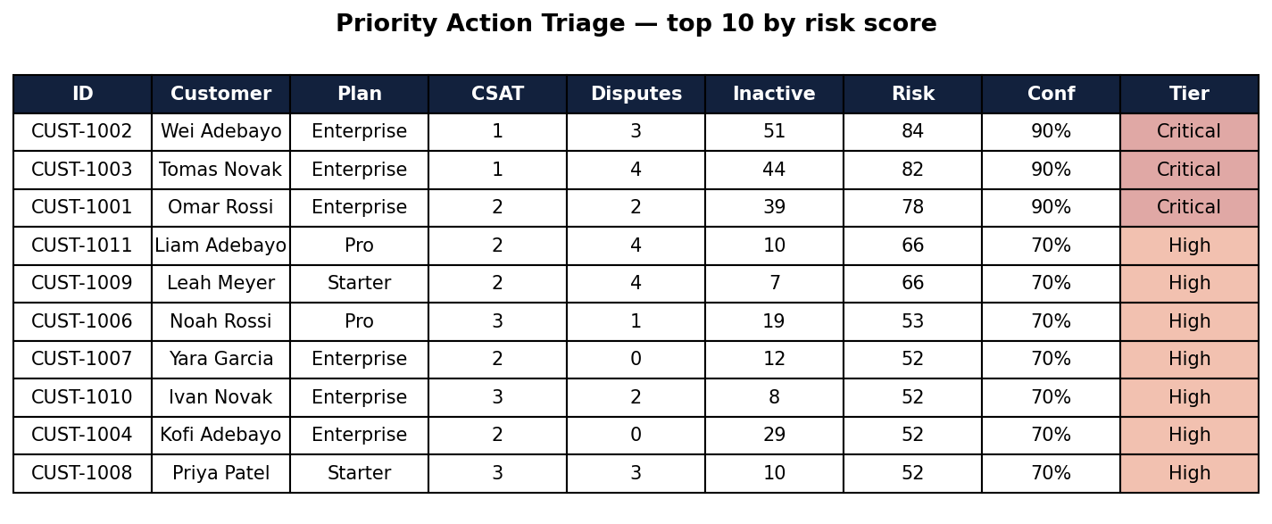
Demo Summary & Next Steps
Demo recap
Production next steps
End-to-end: synthetic chat logs → AI analysis → real-time risk triage queue
1 · Live integrations
KPI cards, risk matrix, triage table, inspector & a persisted action log
Webhooks into Zendesk, Intercom & Stripe for real-time signals.
Each flag ships a risk score, evidence, rationale, and a retention action
2 · Automated alerting
Runs with any LLM (Anthropic/OpenAI/Gemini) or a no-key deterministic fallback
Push Critical-tier flags to Slack / PagerDuty instantly.
3 · Closed-loop learning
Action log ships today; next, correlate outcomes to refine scoring.
Links
GitHub: https://github.com/mehaksomani/Intelligent-Customer-Signal-Detector.git Demo : https://www.loom.com/share/ce65e5cb81c94816bec5d32fbf9def8a
Priority action triage (sample output)

