Slide 1

MACHINE LEARNING INTERNSHIP
Presentation on
“MUTUAL FUNDS INDIA PREDICTION”
Under the guidance of :
PRINSTON SMART ENGINEERS
Presented by : MEHAK TAJ
U18IW23S0111

Slide 2
CONTENTS
Introduction
Problem Statement
Objective
Dataset Description
Data Preprocessing
Exploratory Data Analysis
Machine Learning Models
Model Evaluation
Results
Conclusion
Future Scope

Slide 3
ABSTRACT
The rapid growth of the mutual fund industry has increased the need for intelligent investment decision-making tools. Predicting mutual fund returns is challenging due to market volatility and complex financial factors. This project applies Machine Learning techniques to predict 1-Year mutual fund returns using historical data.
The dataset includes features such as AUM, Expense Ratio, Risk Level, and past returns. After data preprocessing, regression models like Linear Regression and Random Forest were implemented. The models were evaluated using R² Score, MAE, and RMSE, where Linear Regression showed slightly better performance.
This project demonstrates that Machine Learning can assist investors in making data-driven decisions, although predictions cannot guarantee future returns.
3

Slide 4
INTRODUCTION
Mutual funds are one of the most popular investment options in India.
Investors aim to select funds that provide higher returns.
Market conditions are dynamic and unpredictable.
Traditional analysis methods may not capture complex patterns.
Machine Learning can analyze historical data to predict future returns.
4

Slide 5

COMPANY PROFILE
Name : PRINSTON SMART ENGINEERS
Main office : Vishnuvardhan Statue Rd, Vishwa Priya Nagar, Begur, Bengaluru, Karnataka, 560068
Phone : 9513106196
Email : Prinston.Smart@gmail.com
Contact Person: Mrs. Farheen Farhath (Managing Director)
Year Established : 2004
Company category : IT Software/ Embedded

Slide 6
PROBLEM STATEMENT
Investors often face significant challenges in identifying high-performing mutual funds due to the large number of available schemes and constantly changing market conditions. Market volatility, economic fluctuations, and complex financial indicators make return prediction highly uncertain and difficult. Relying solely on past performance is not always reliable, as historical returns do not guarantee future success. Therefore, there is a strong need for a predictive system that utilizes Machine Learning techniques to analyze historical data, identify hidden patterns, and provide more accurate and data-driven return estimations.
6

Slide 7
OBJECTIVES
Analyze historical mutual fund data to identify trends and important factors affecting returns.
Perform data cleaning and preprocessing, including handling missing values, encoding categorical variables, and scaling features.
Apply regression models such as Linear Regression and Random Forest to predict 1-Year returns.
Evaluate model performance using R² Score MAE, and RMSE.
Select the best-performing model based on accuracy and overall performance.
7

Slide 8
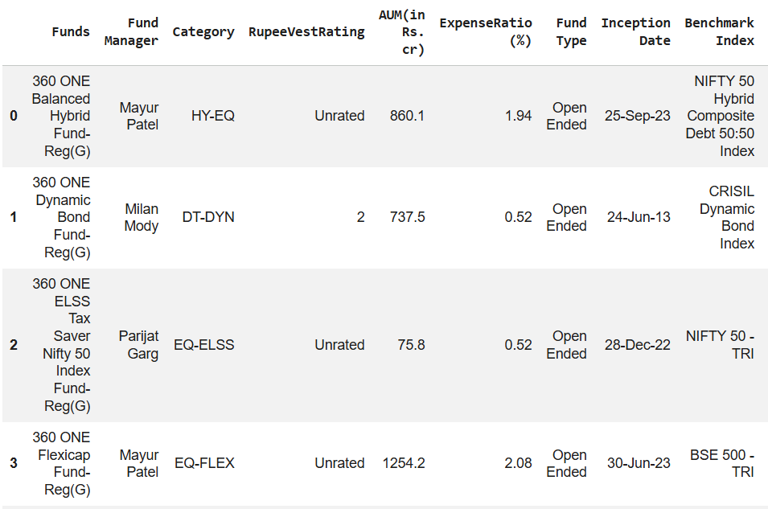
Dataset Description
The dataset includes:
Fund Name
Category
AUM (Assets Under Management)
Expense Ratio
Risk Level
Past Returns (1Y, 3Y, 5Y)
Target Variable: 1-Year Return

Slide 9
Data Preprocessing
Handling missing values: Checked for null values in the dataset and removed or filled them appropriately to ensure data consistency.
Removing irrelevant columns: Dropped unnecessary features such as identifiers that do not contribute to prediction accuracy.
Encoding categorical features: Converted categorical variables (like Category, Fund Type, Risk Level) into numerical format using encoding techniques.
Feature scaling: Standardized numerical features to bring them to a similar range and improve model performance.
Train-Test Split (80% – 20%): Divided the dataset into training data (80%) for model learning and testing data (20%) for evaluating performance on unseen data.
9

Slide 10
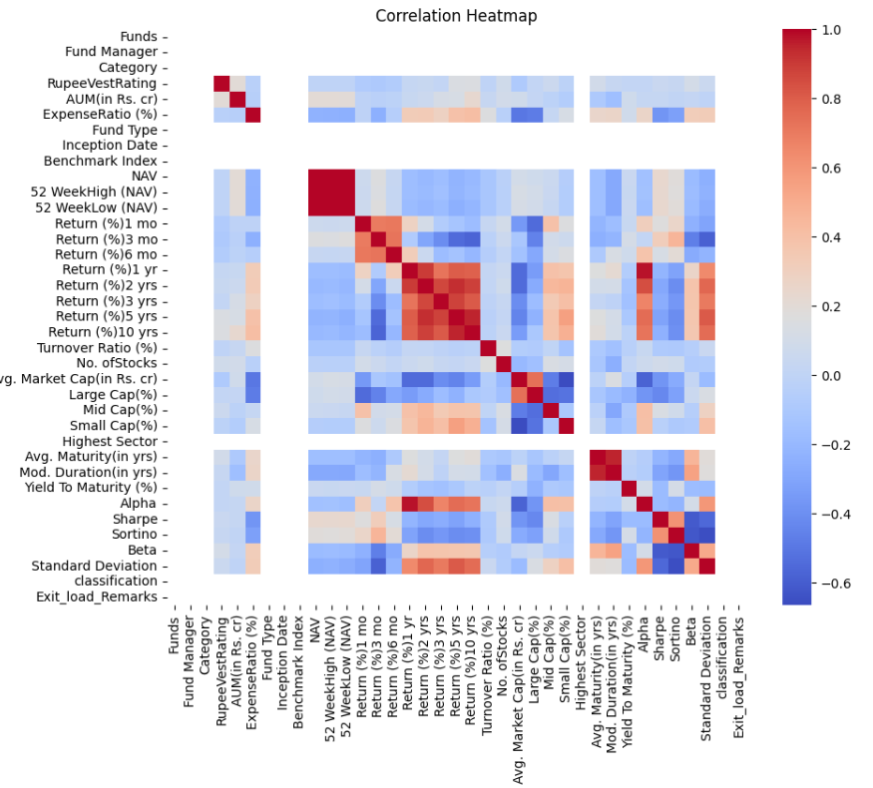
Exploratory Data Analysis (EDA)
Performed Exploratory Data Analysis to understand patterns and relationships in the dataset.
Used a correlation heatmap to identify the strength of relationships between numerical features.
Observed a strong positive correlation between past returns (3-Year, 5-Year) and 1-Year Return.
Identified important features such as Expense Ratio and AUM influencing fund performance.
10

Slide 11
Machine Learning Models Used
Linear Regression: A basic regression algorithm that models the relationship between independent variables and the target variable using a linear equation. It helps in understanding how features influence the 1-Year Return.
Random Forest Regressor: An ensemble learning algorithm that builds multiple decision trees and combines their predictions to improve accuracy and reduce overfitting. It handles complex and non-linear relationships better than linear models.

Slide 12
Model Evaluation
R² Score – Measures how well the model explains the variance.
MAE (Mean Absolute Error) – Average prediction error.
RMSE (Root Mean Square Error) – Penalizes large errors.
Model | R² Score | MAE | RMSE
Linear Regression | 0.982468 | 0.642592 | 1.219564
Random Forest | 0.973309 | 0.493689 | 1.504774

Slide 13
Results
Linear Regression achieved the highest R² Score of 0.982468, indicating strong predictive performance.
Random Forest also performed well but had slightly lower R² compared to Linear Regression.
Past returns (3-Year and 5-Year) showed strong influence on predicting 1-Year Return.
Error metrics (MAE and RMSE) indicate that the model predictions are close to actual values.

Slide 14
Conclusion
Machine Learning techniques can effectively estimate mutual fund returns using historical data.
Among the implemented models, Linear Regression showed slightly better performance in this study.
The developed model supports data-driven investment decision-making.
However, due to market volatility and uncertainty, predictions cannot guarantee future performance.

Slide 15
Future Scope
Integrate real-time financial data using APIs for live prediction.
Apply advanced Time-Series models such as LSTM for better temporal analysis.
Implement portfolio optimization techniques for risk-adjusted returns.
Deploy the model using Streamlit or Flask as a web application.
Use cloud platforms for scalable and real-time deployment.

Slide 16
THANK YOU

