Slide 1

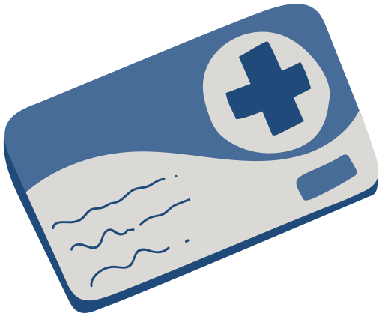
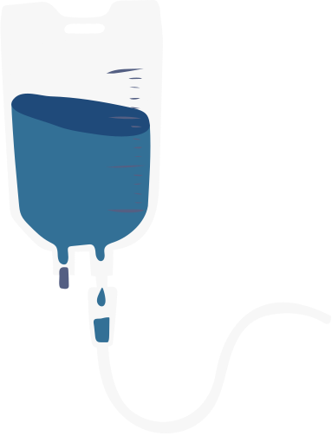

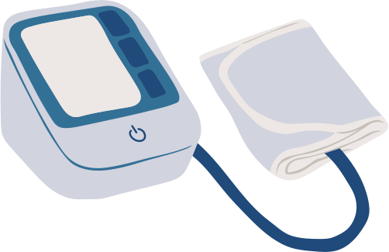
MEDIGUARD
Smart IoT-Based Medicine Reminder & Assistance System
Team : CTRL + CARE
Domain : Health tech and bio wearables

Slide 2

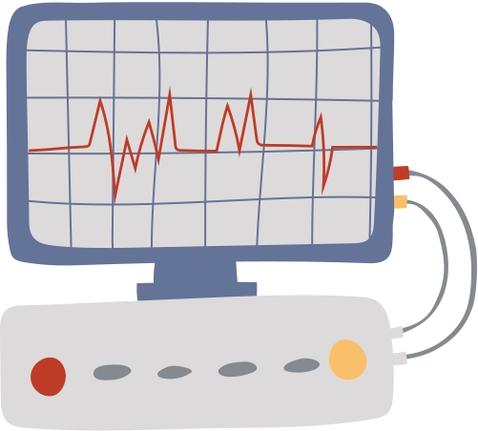

The Problem
Medication is often missed because of:
  ⏰ Forgetting scheduled medicine times
  👴 Difficulty managing multiple medicines
  🔔 Conventional alarms only provide a basic reminder
  📱 No immediate notification to a caregiver when medicine is missed
  🚨 No dedicated mechanism for requesting emergency assistance
Our Goal
To develop a low-cost smart medicine box that can remind the user, detect whether the medicine was taken, notify remotely, and provide emergency assistance.

Slide 3
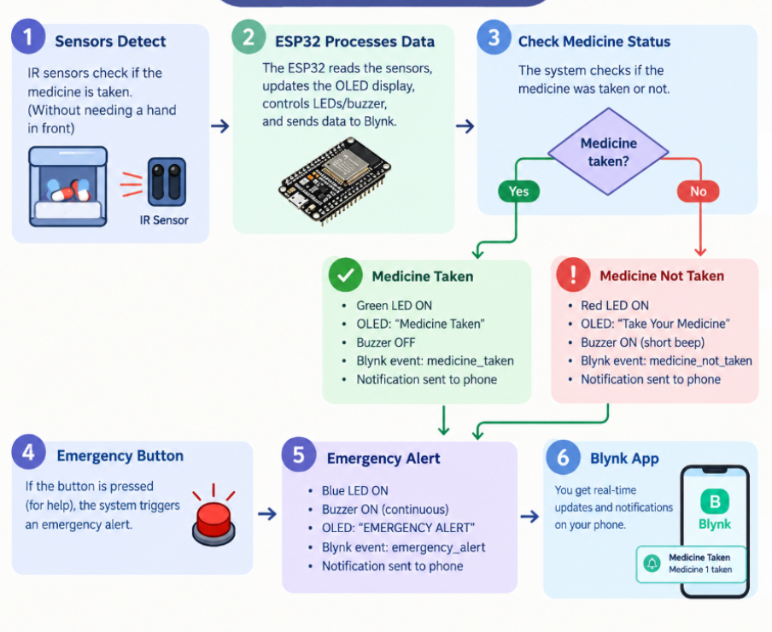
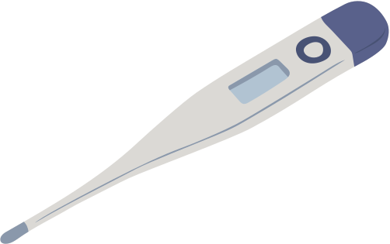
Working
Controller
ESP32 acts as the central controller and connects the system to Blynk IoT.

Slide 4
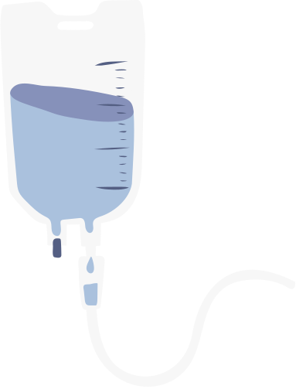

Key Features
Smart Reminder
Automatic compartment opening with buzzer, LED and OLED indication
IoT Monitoring
Blynk notifications and medicine status monitoring
Away Mode
Temporarily suppresses scheduled reminders when the user is away
Emergency Mode
Help button activates buzzer, blue LED and caregiver notification
Medicine Status:
READY → TAKEN / NOT TAKEN / SKIPPED - AWAY

Slide 5

System Overview and Impact
Hardware
  ESP32 • 2× Servo Motors • 2× IR Sensors • OLED • DS3231 RTC • Buzzer • LEDs • Push Buttons
Software
  Arduino IDE • ESP32 • Blynk IoT • C/C++
Expected Impact
  Reminder → Detection → Notification → Assistance
MEDIGUARD aims to make medication management more organized, interactive and connected, while providing an additional way for users to request help.
Future Scope
  Mobile caregiver dashboard
  More medicine compartments
  Medication history
  Voice-based reminders
  Improved caregiver monitoring

Slide 6
Presented by:
Thank You

