Slide 1
Educational Attainment Analysis
Information Visualization Project
Ciaușu Nicoleta
Tender Laura

Slide 2
Context & Goals
Context
Dataset
Problem statement
We were wondering how Romania is doing compared to other European countries when it comes to education attainment
Official Eurostat dataset “Population by educational attainment level, sex and age (%) - main indicators”
Find out how Romania compares to other European countries
Explore and describe internal trends in education attainment within the country

Slide 3
Defining attainment
Educational attainment = last study cycle completed
Our dataset is split into 3 percentage groups:
Population that attained Secondary school or below (dropped out before high school)
Population that graduated High School
Population that went on to complete university studies
Also split by Sex, Age group, Country and Year

Slide 4
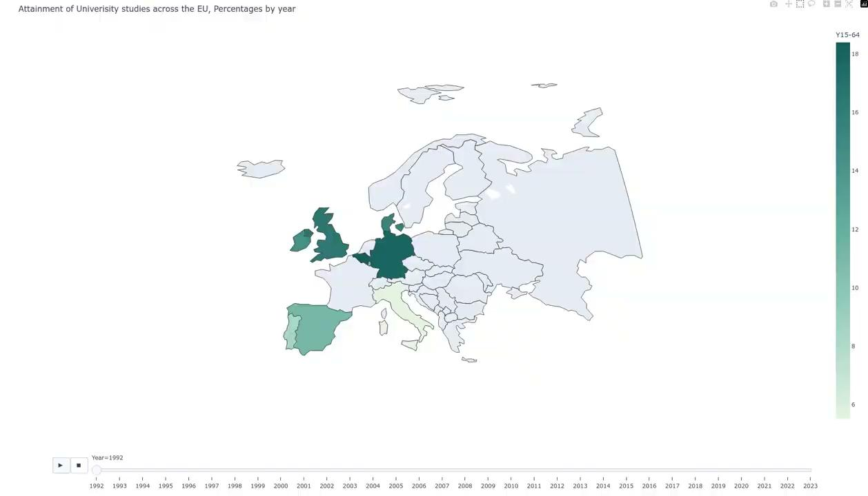
How has the percentage of people with university degrees
changed in the last 30 years? (EU)
Notes:
First big question - is university becoming more or less popular compared to 30 years ago? Let’s watch this timelapse showing the percentages of people that have university degrees changing across europe from 1992 til 2023.
(play pana la final si vorbit un pic de final)
Devine mai popular
Romania parca n arata prea bine let s zoom in on the data

Slide 5
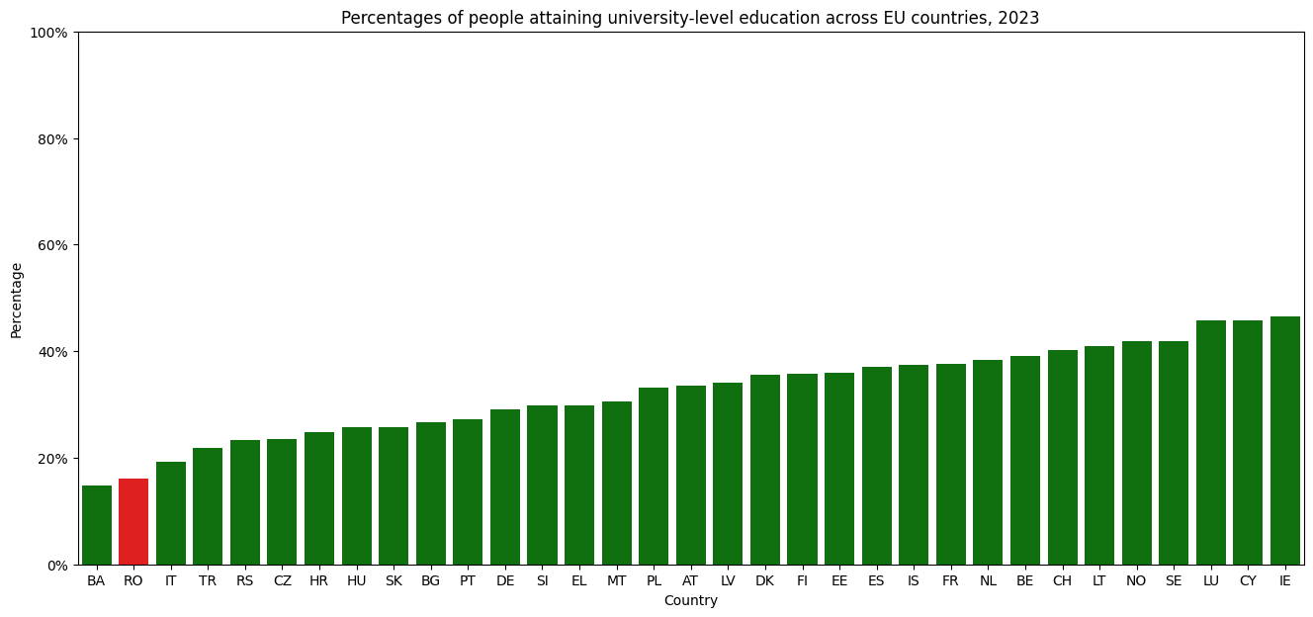
University attainment in 2023 - Snapshot
Notes:
Now for a zoomed in view in anul current
Romania sta cam prost al 2 lea de la coada
Irlanda, cipru luxemburg literally dublu

Slide 6
Where is the difference coming from?
We noticed that university attainment in Romania is one of the lowest in Europe.
Let’s dive deeper by comparing the educational level distribution in Romania with the average.

Slide 7
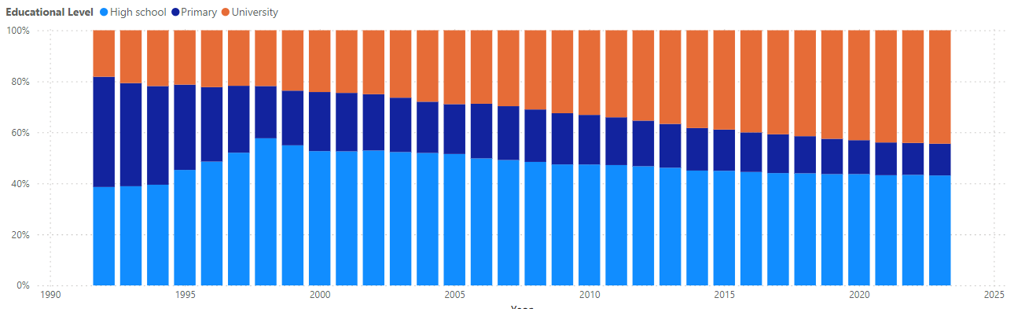
European average vs Romania
Education attainment across time, 25-34 age group, Europe
Notes:
Cu timpul scade procentul de oameni care se opreste la scoala primara
Creste cel cu liceul dar mai ales cu facultate
Aproape egala pondere intre liceu si facultate

Slide 8
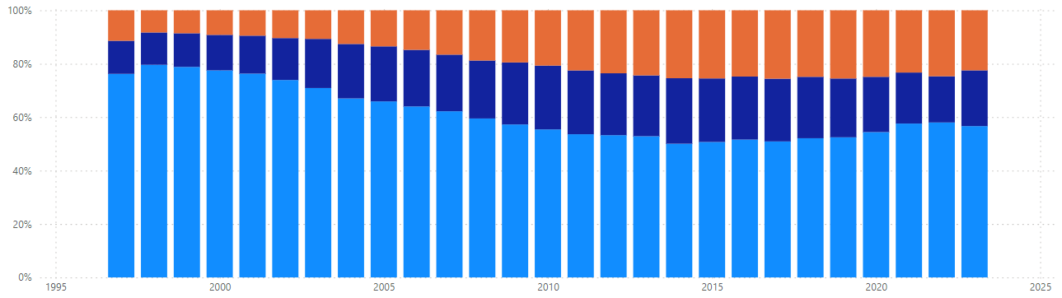
European average vs Romania
Education attainment across time, 25-34 age group, Romania
Notes:
La noi arata altfel situatia
La fel ca in restul europei creste procentul de university
E

Slide 9
European average vs Romania - side by side

Slide 10
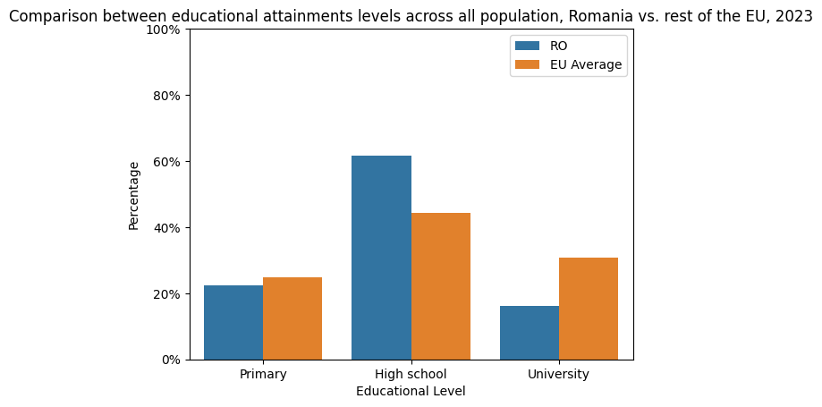
Notes:
Let;s now focus on the current year
Primary has dropped
University is lagging behind

Slide 11
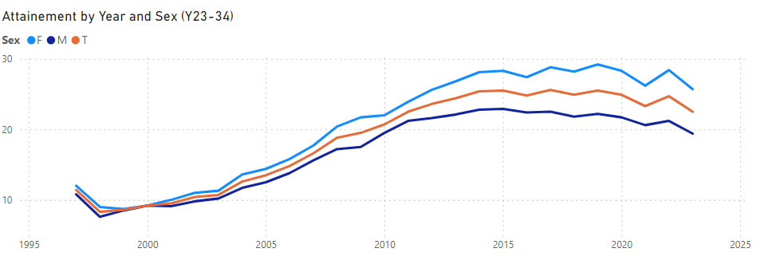
Notes:
Finally, let’s focus on an age group and talk about the distribution across sexes. The gender gap is 5% between men and women.

Slide 12
Insights & Conclusions
Upward trend in educational attainment in Romania and Europe
We are still behind most European countries
No significant influence of gender is noticed
More people than average only finish high school and do not pursue superior studies

