Slide 1

Exploring Process optimization methods for biopharmaceutical manufacturing
By: Meha Patel

Slide 2
Agenda
Personal Introduction
Project Objectives
PCA and PLS
Dataset Introduction (Industrial-Scale Penicillin Simulation: IndPenSim)
Optimization Analysis Results
Conclusion

Slide 3

Meha Patel
M.S. Applied Statistics from California State University Long Beach (CSULB)
B.S. Mathematics, Data Science concentration, Statistics minor from University of California Irvine (UCI)
“Mean Imputation and Stochastic Coordinate Descent for Linear Systems with Missing Data” published in SIURO
Summer 2024 Kite nMSAT Graduate Intern
Multivariate Statistical Process Control

Slide 4
Multivariate statistical methods for process optimization
Goal: To leverage multivariate statistical methods, specifically Principal Component Analysis (PCA) and Partial Least Squares (PLS), to identify key process parameters that optimize Penicillin yield in biopharmaceutical manufacturing.
Inclusion of interdependent variables interactions
Especially useful in cases of highly correlated variables
Increased efficiency when handling high-dimensional data
Benefits to data-driven process control

Slide 5
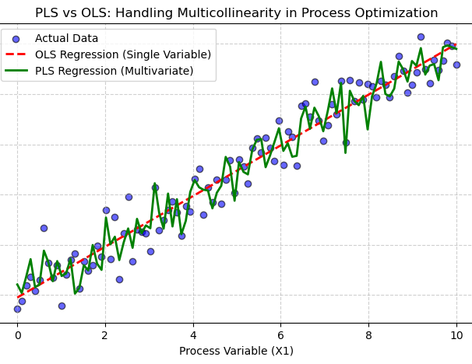
Limitations of ordinary least squares (OLS)
Outlier sensitive
Linearity assumption
Inability to account for multicollinearity

Slide 6
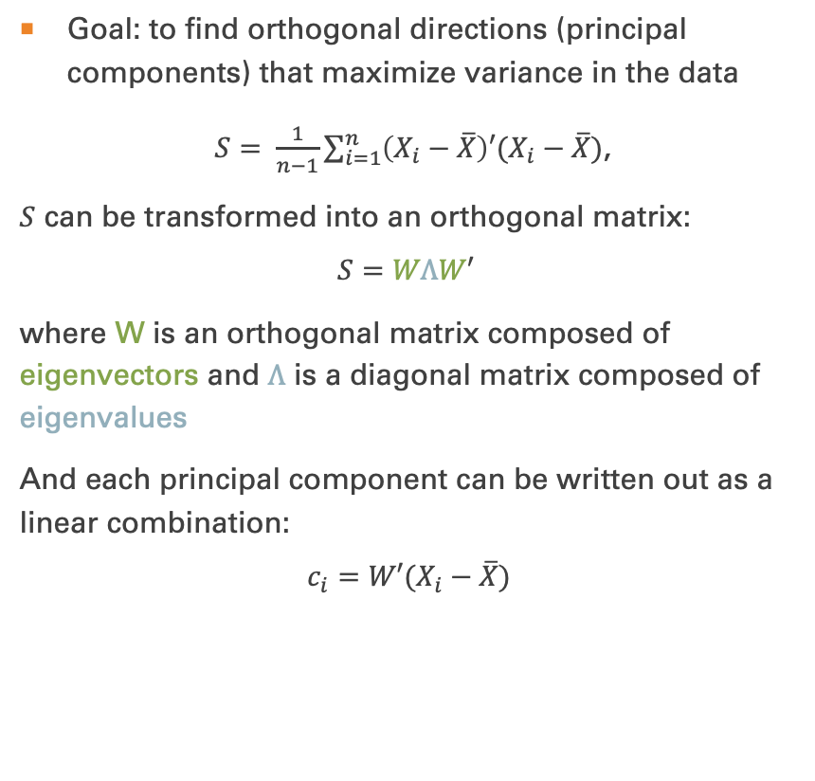
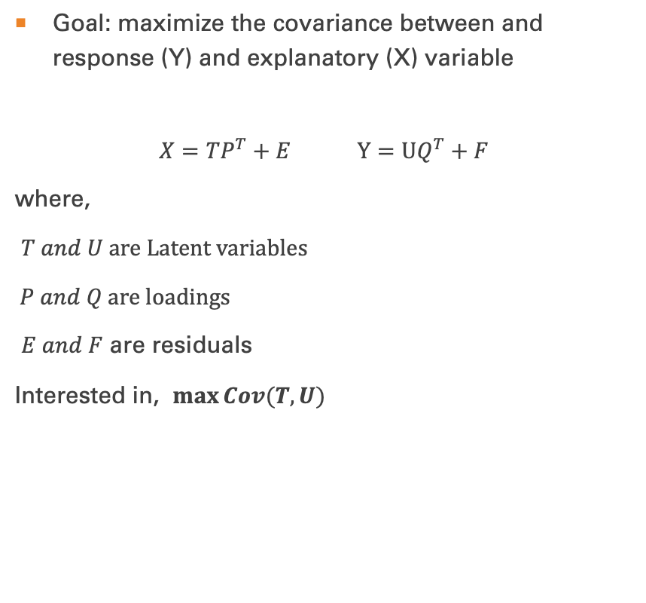
PCA
PLS
Goal: to find orthogonal directions (principal components) that maximize variance in the data
$S= \frac{1}{n−1}\sum_{i=1}^{n}{\left(X_{i}−\overline{X}\right)′(X_{i}−\overline{X})}$,
$S$ can be transformed into an orthogonal matrix:
$$S=WΛW′$$
where W is an orthogonal matrix composed of eigenvectors and $Λ$ is a diagonal matrix composed of eigenvalues
And each principal component can be written out as a linear combination:
$$c_{i}=W′(X_{i}−\overline{X})$$
Goal: maximize the covariance between and response (Y) and explanatory (X) variable
$$X=TP^{T}+E Y=UQ^{T}+F$$
where,
$T and U$ are Latent variables
$P and Q$ are loadings
$E and F$ are residuals
Interested in, $\max{Cov(T, U)}$

Slide 7
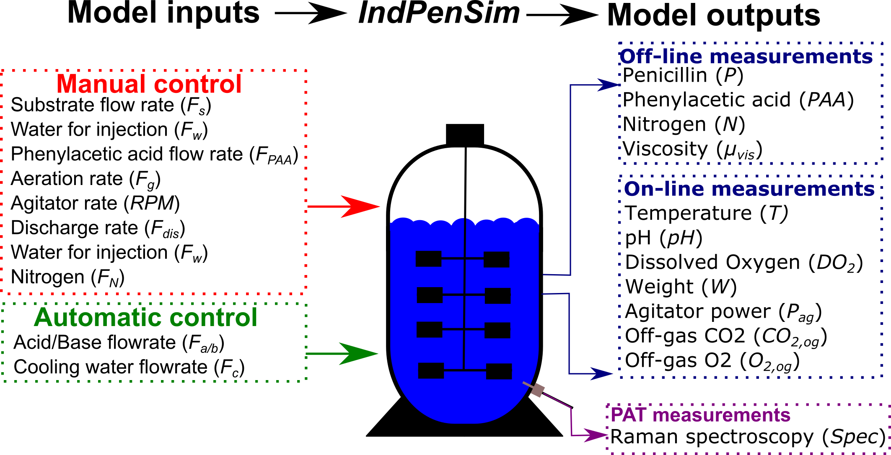
Data structure
Mathematically simulated data of of a 100,000 liter penicillin fermentation system referenced as IndPenSim
39 variables, 1 target (Penicillin concentration)
100 total batches
Batches 1-30: Controlled by recipe driven approach
Batches 31-60: Controlled by operators
Batches 61:90: Controlled by an Advanced Process Control (APC) solution using the Raman spectroscopy
Batches 91:100: Contain faults resulting in process deviations

Slide 8
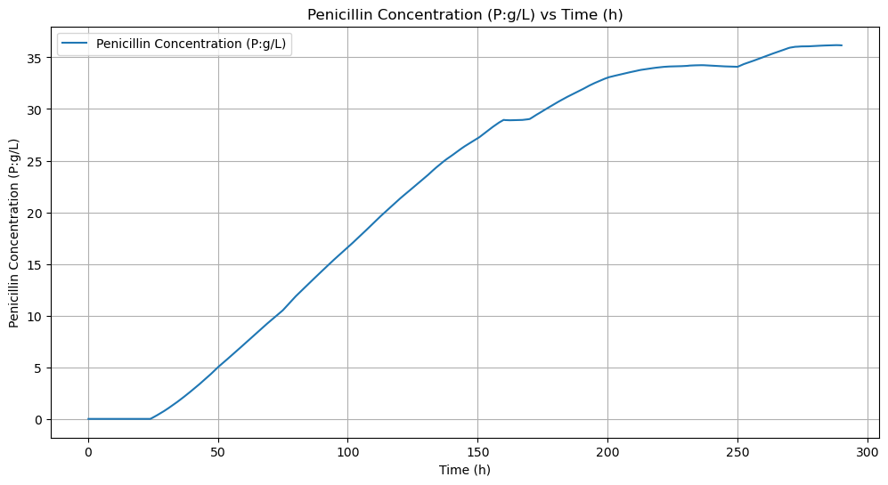
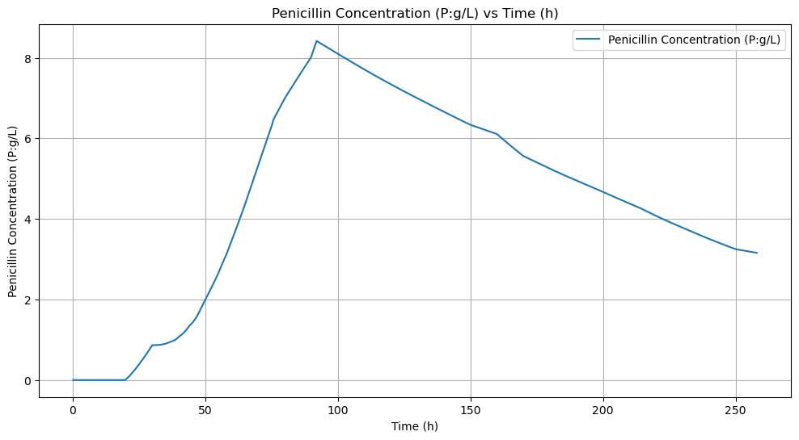
Comparison of penicillin concentrations
Highest batch concentration: 36.183 P:g/L
Lowest batch concentration: 3.335 P:g/L

Slide 9
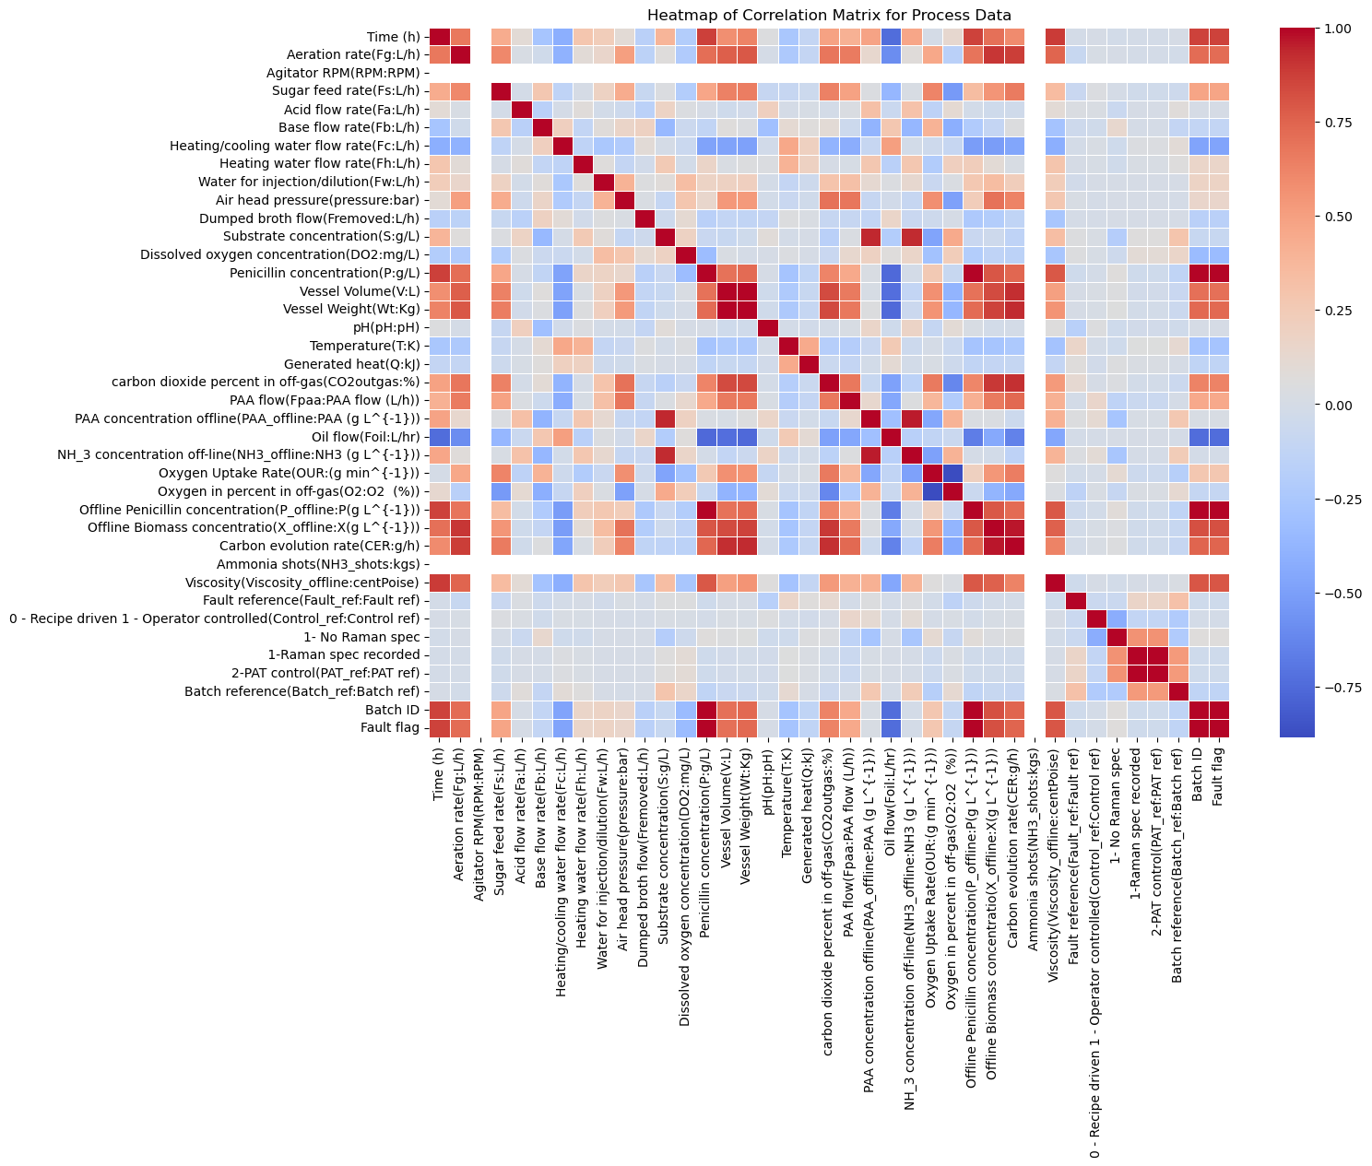
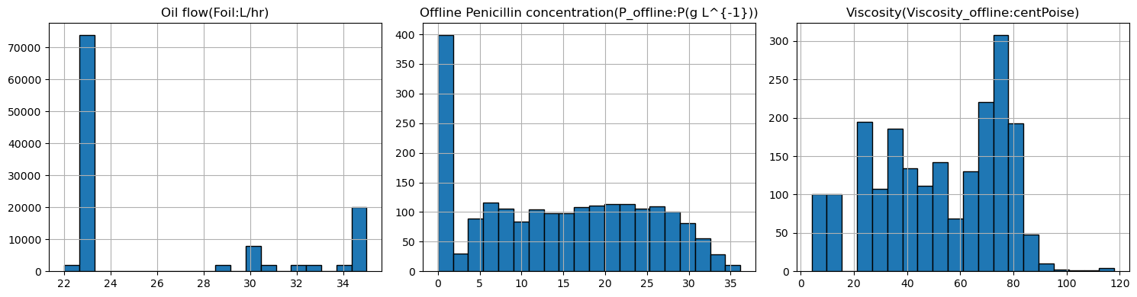
Correlations and distributions

Slide 10
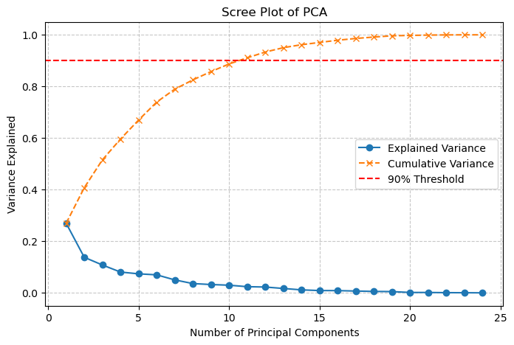
Number of principal components
Based on the cumulative variance explained, we chose 10 principal components

Slide 11
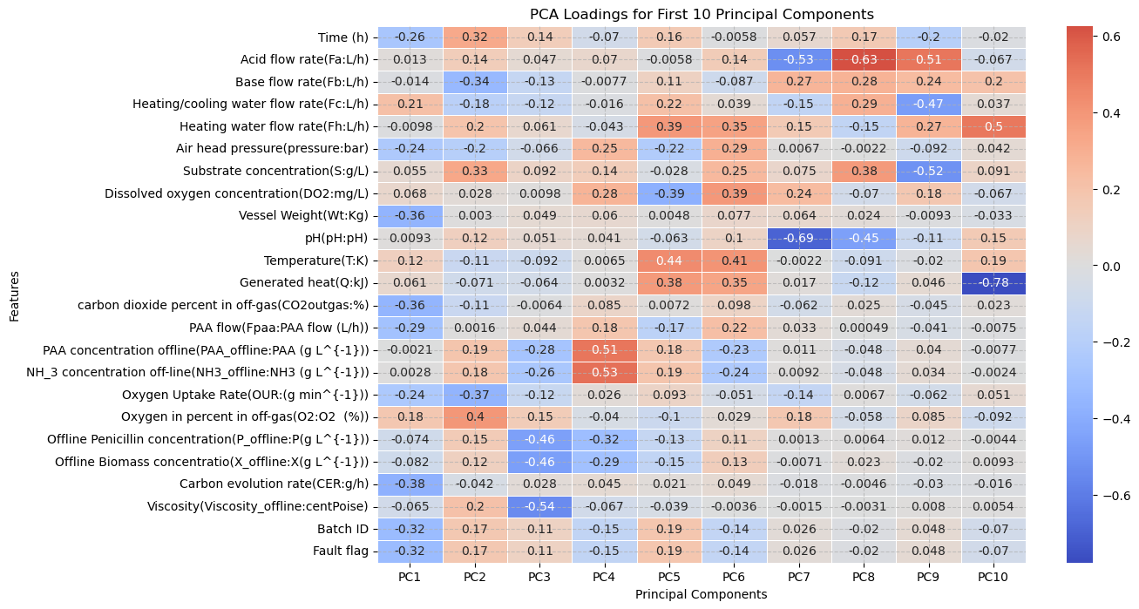
FACTOR LOADINGS
can now use our loadings from PCA as the input for PLS analysis

Slide 12
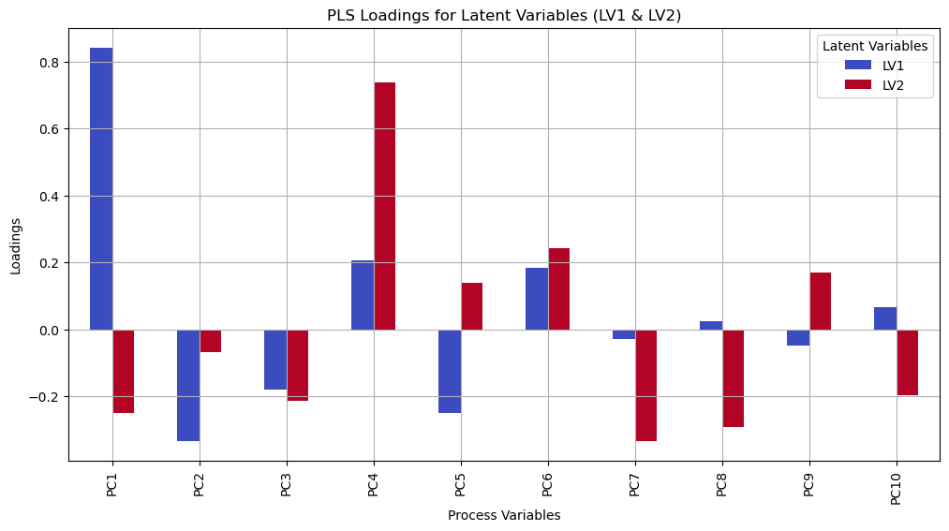

Latent variable composition
$X=TP^{T}+E$
$Y=UQ^{T}+F$

Slide 13
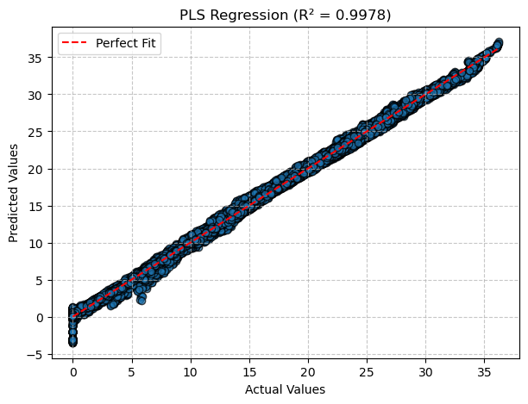
Pls performance
RMSE: 0.4680
R²: 0.9978

Slide 14
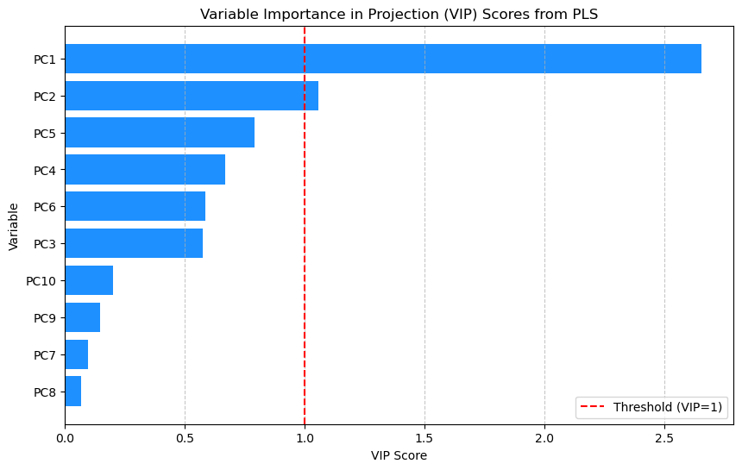
Variable importance
VIP > 1 implies large influence
VIB < 1 implies small influence

Slide 15
Conclusion and future work

Slide 16
Thank you!
Questions?

