Slide 1

Internship Report
P . Mehar Srinivas Chowdari
- Intern at ADP

Slide 2
Contents
Internship
Area of study
Elastic search
Requirements
Contribution to the project
Utilization in project
Other requirements
Learning outcome
Queries

Slide 3
Internship
Project
Project target
Learning Domains
N8 output tax compare
Compare the output files from Mainframe system and N8 cloud
Elastic Search
Cloud computing
Python (pandas,boto3)

Slide 4
Area of study
Elastic search
Aws cloud
Python
Implementing it in local and storing 2D data into it
AWS serverless services like Lambda,S3,SQS,SES
Frameworks and packages like boto3,pandas etc..
Database
Testing
Tools
Understand DB’s like DynamoDB and Aurora DB
Understand how unit testing and pytest works
JIRA (Story management),
GIT (code versioning)

Slide 5
Elastic Search
Data given
Learnt the concept of Elastic search
Created mapping structure to insert the data
Inserted data according to the requirement.
Querying the data according to the requirement.
An Excel sheet data will be given and the fields are
agency_name
form_name
ids_with_errors
ids_without_errors
There may be any number of forms with a single agency and a single form contains many ids(with and without error)

Slide 6
Task
Need to insert the data into elastic search in such a way that requirements are satisfied by querying on the data
Requirement 1
Requirement 2
Need to get agencies having all of it’s ids passed under all the forms.
Need to get forms having all of it’s ids passed
Requirement 3
Get all the failed ids irrespective of the form and agency

Slide 7
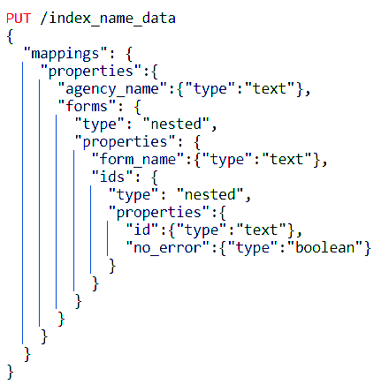
Data mapping
Selected a suitable mapping with nested structures.
Level 1 with “agency_name” and array of “forms”.
Level 2 with “form_name” and array of “ids” in array of forms.
Level 3 with “id” and “no_error” in array of ids.

Slide 8
Data Insertion
The data I will be having with columns
agency_name
form_name
ids_with_errors
ids_without_errors
Firstly checking for the agency_name in the index.
If agency_name is present in the index it will be retrieved and modified and inserted in the total document again using same document id.
If the agency_name is not present then the new document is created.
If the agency_name is present and the form_name is not present in array of forms then it is added to the array and the document is inserted with the same document id
Similarly all the data will be inserted in the index

Slide 9
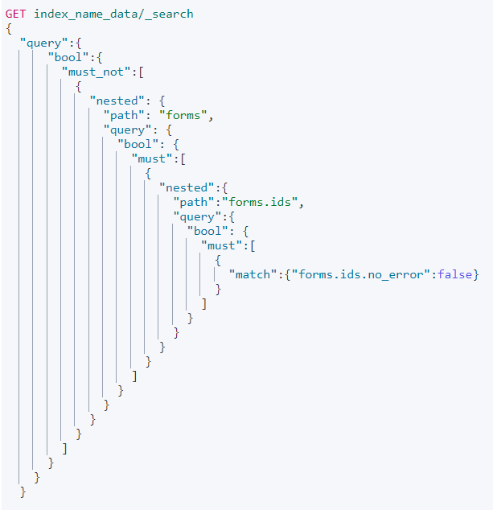
Querying
The query is to retrieve agency_name in which there are no id_with_errors
I used nested query inside a bool query
First checked that there is no id_with_errors in ids and then checked for no forms with failed checks in ids and finally for no form_name failure in forms
Similarly other two queries are also done

Slide 10
Contribution to the project in Elastic search
Querying
1
2
3
Data Insertion
Output
According to the requirement the querying is done
With a particular mapping structure using nested mappings data insertion is done
The ouput of the queries are taken and stored in excel files

Slide 11
Utilization of my work in project
As I wrote the code for data insertion and data querying the code helped the project in identifying
- agencies with no error ids
- forms with no error ids and
- ids with errors
Code was implemented using AWS opensearch.
Python boto3 module is used in connecting with the opensearch dashboard.

Slide 12
Work on python pandas
When data is loaded into data frames those consume more memory usage for loading the data.
The data is in deque files when those are loaded into data frames then all the column fields are in same data type this consume more memory.
My task is to reduce the memory while loading the data into data frames.
Successfully completed my part to reduce the data consumption while loading into data frames.

Slide 13
Learning outcome
80%
60%
40%
20%
Elastic search
AWS
Inserting ,querying and visualisation
Serverless services
Database
Others
understanding cloud based data bases
Docker, JIRA, GIT, agile process etc...

Slide 14

Any Queries ?

Slide 15


