Slide 1

Intern Demo
P. Mehar Srinivas Chowdari

Slide 2
Contents
Internship
Technical stack
Requirement
Miscellaneous
Questions

Slide 3
Internship
Project
Requirements
N8 Tax Compare
Pull client level data from batch runs
Increase code coverage

Slide 4
Technical stack
ELK
AWS cloud
Python
Implementing elastic search to storing 2D data
AWS serverless services like Lambda,S3,SQS,SES
boto3,pandas,open search
Database
Testing
Tools
Understand DB like OpenSearch, DynamoDB and Aurora DB
Understand and implement pytests to increase test coverage
JIRA (Story management),
GIT (code versioning)

Slide 5
Requirement
Phase I
Requirement:
Show all the students with every subject passed at semester level
Learning:
Concepts of elastic search
Mapping
CURL operations
Data:
Requirement is explained with the student example, given student name and subject details(pass/fail).
Approach:
Using bool query checked each subject pass /fail status and returned the pass students.

Slide 6
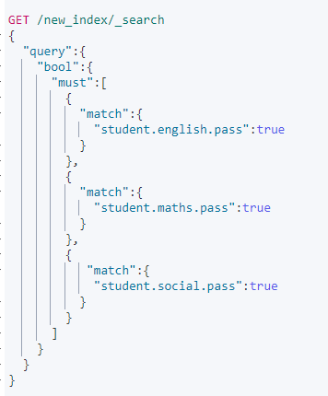
Phase I Query:

Slide 7
Requirement
Phase II
Requirement:
Show all the students with every subject passed, Here bool querying is not possible by checking every subject with it’s name.
Data:
Added complexity to Phase I, subjects and number of subjects are different for each student.
Approach:
Here used a “nested” structure for mapping in which we can store array of values(subject details) and using bool query to show only passed students

Slide 8
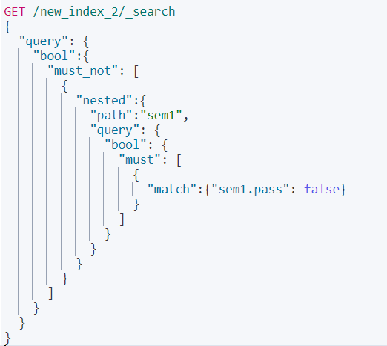
Phase II Query:

Slide 9
Requirement
Phase III
Requirement:
Query for the students who passed the all semesters.
Data:
Added a more semesters under student, semesters will contain subjects details.
Approach:
Here used a “nested” mapping to store subject level details and used bool query to check passed subjects and an outer bool query for every semester pass checking.

Slide 10
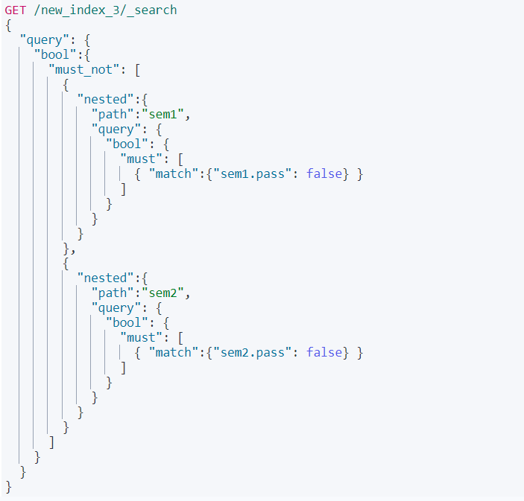
Phase III Query:

Slide 11
Requirement
Phase IV
Requirement:
Query for the students who passed the all semesters
Data:
The may be unknown number of semesters under student.
Approach:
Here used a “nested” mapping to store subject and semester level details, used bool query to check passed ids and an outer bool query for every semester pass checking and a final bool query to display the passed students.

Slide 12
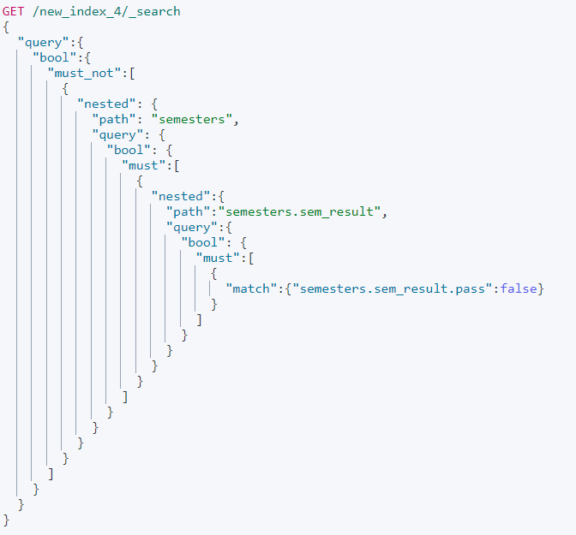
Phase IV Query:

Slide 13
Student Example to actual requirement
Phase V
Student is considered as “company_name”
Semester will be as “agency_name”
Subject will be “form_name”
Changed implementation to match the exact requirement

Slide 14
Requirement Explanation
Linear data with student and fixed subjects in single semester
2D data with students and fixed semesters
Connecting it to the oc requirement
I
III
V
II
IV
Linear data with different number of subjects in single semester
2D data with unknown number of semesters

Slide 15
Reports
Requirement 1
Requirement 2
Need to get ids having all of it’s forms passed under all the forms.
Need to get passed forms form a particular id.
Requirement 3
Need to get all the failed ids from the id selected

Slide 16
Miscellaneous
Worked on Python pandas to reduce the memory consumption while loading into the data frames.
Created an AWS lambda function to convert CSV file into JSON file when uploaded into a S3 bucket.
Learnt AWS cloud services S3, SQS, SES and database like Dynamo DB and OpenSearch.
Token Validation for Aurora DB connection
Observed the code coverage by running pytests

Slide 17

Any Queries ?

Slide 18


Slide 19
Annexure

Slide 20
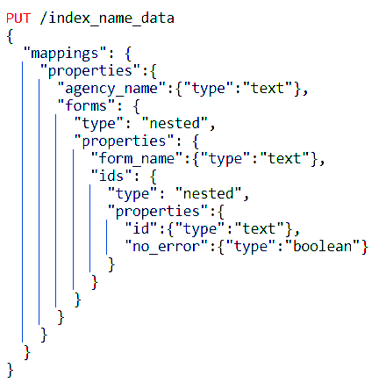
Data mapping
Selected a suitable mapping with nested structures.
Level 1 with “agency_name” and array of “forms”.
Level 2 with “form_name” and array of “ids” in array of forms.
Level 3 with “id” and “no_error” in array of ids.

Slide 21
Data Insertion
The data I will be having with columns
agency_name
form_name
ids_with_errors
ids_without_errors
Firstly checking for the agency_name in the index.
If agency_name is present in the index it will be retrieved and modified and inserted in the total document again using same document id.
If the agency_name is not present then the new document is created.
If the agency_name is present and the form_name is not present in array of forms then it is added to the array and the document is inserted with the same document id
Similarly all the data will be inserted in the index

Slide 22
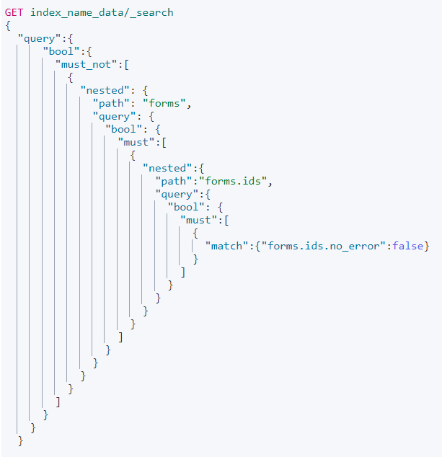
Querying
The query is to retrieve agency_name in which there are no id_with_errors
I used nested query inside a bool query
First checked that there is no id_with_errors in ids and then checked for no forms with failed checks in ids and finally for no form_name failure in forms
Similarly other two queries are also done

Slide 23
Requirement Querying
Here used a “nested” mapping to store id and form level details, used bool query to check no error ids and an outer bool query to check all the forms are error free and a final bool query to display only the agencies with no errors.
Used inner hits in form level nested query and retrieved passed forms from the above query output, inner hits is used display content matched with the bool query in nested query.
Used inner hits in id level nested query and retrieved the failed id details.

