Slide 1

Internship Report
P . Mehar Srinivas Chowdari
- Intern at ADP

Slide 2
Contents
Internship
Area of study
Elastic search
Sample Example & Requirement
Contribution to the project
Utilization in project
Other requirements
Learning outcome
Questions

Slide 3
Internship
Project
Project target
Learning Domains
N8 output tax compare
Compare the output files from Mainframe system and N8 cloud
Elastic Search
Cloud computing
Python (pandas,boto3)

Slide 4
Area of study
Elastic search
Aws cloud
Python
Implementing it in local and storing 2D data into it
AWS serverless services like Lambda,S3,SQS,SES
Frameworks and packages like boto3,pandas etc..
Database
Testing
Tools
Understand DB’s like DynamoDB and Aurora DB
Understand how unit testing and pytest works
JIRA (Story management),
GIT (code versioning)

Slide 5
Elastic Search
Data given
Learnt the concept of Elastic search
Created mapping structure to insert the data
Inserted data according to the requirement.
Querying the data according to the requirement.
An Excel sheet data will be given and the fields are
agency_name
form_name
ids_with_errors
ids_without_errors
There may be any number of forms with a single agency and a single form contains many ids(with and without error)

Slide 6
Student Example
Firstly started with a Student example but not with the actual requirement.
I
Data given is student_name and different subjects pass/fail details.
I was asked to get students who passed all the subjects
Using bool query checked each subject pass /fail status and returned the pass students.
II
Added complexity to stage1
Subjects and number of subjects are different for each student
So manual querying using subject is not possible
Then for this I used “nested” which can store array of values(subject details)

Slide 7
Student Example
III
Here semesters are introduced and student should pass each subject in each semester.
This is done using a bool query in nested and that nested should return true for all semesters
Using a bool query checked all the semesters are passed or not.
IV
Added one more complexity to stage3
Number of semesters are also unknown.
So I used “nested” for semesters also.
Finally got a mapping with nested inside a nested
So here I used bool queries inside the nested and checked for no Fail subject

Slide 8
Requirement Explanation
Final requirements for the project
Linear data
2D data
I
III
V
II
IV
Linear data with unknown values
2D data with unknown values

Slide 9
Task
Need to insert the data into elastic search in such a way that requirements are satisfied by querying on the data
Requirement 1
Requirement 2
Need to get agencies having all of it’s ids passed under all the forms.
Need to get forms having all of it’s ids passed
Requirement 3
Get all the failed ids irrespective of the form and agency

Slide 10
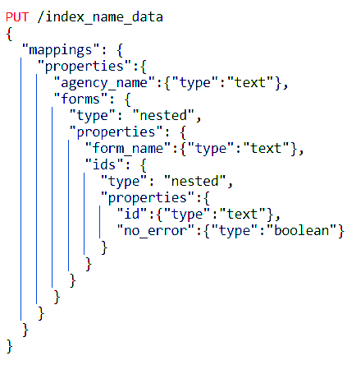
Data mapping
Selected a suitable mapping with nested structures.
Level 1 with “agency_name” and array of “forms”.
Level 2 with “form_name” and array of “ids” in array of forms.
Level 3 with “id” and “no_error” in array of ids.

Slide 11
Data Insertion
The data I will be having with columns
agency_name
form_name
ids_with_errors
ids_without_errors
Firstly checking for the agency_name in the index.
If agency_name is present in the index it will be retrieved and modified and inserted in the total document again using same document id.
If the agency_name is not present then the new document is created.
If the agency_name is present and the form_name is not present in array of forms then it is added to the array and the document is inserted with the same document id
Similarly all the data will be inserted in the index

Slide 12
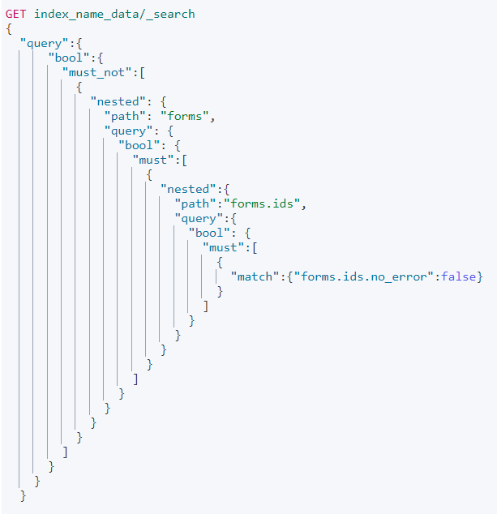
Querying
The query is to retrieve agency_name in which there are no id_with_errors
I used nested query inside a bool query
First checked that there is no id_with_errors in ids and then checked for no forms with failed checks in ids and finally for no form_name failure in forms
Similarly other two queries are also done

Slide 13
Contribution to the project in Elastic search
Querying
1
2
3
Data Insertion
Output
According to the requirement the querying is done
With a particular mapping structure using nested mappings data insertion is done
The ouput of the queries are taken and stored in excel files

Slide 14
Utilization of my work in project
As I wrote the code for data insertion and data querying the code helped the project in identifying
- agencies with no error ids
- forms with no error ids and
- ids with errors
Code was implemented using AWS opensearch.
Python boto3 module is used in connecting with the opensearch dashboard.

Slide 15
Work on python pandas
When data is loaded into data frames those consume more memory usage for loading the data.
The data is in deque files when those are loaded into data frames then all the column fields are in same data type this consume more memory.
My task is to reduce the memory while loading the data into data frames.
Successfully completed my part to reduce the data consumption while loading into data frames.

Slide 16
Learning outcome
80%
60%
40%
20%
Elastic search
AWS
Inserting ,querying and visualisation
Serverless services
Database
Others
understanding cloud based data bases
Docker, JIRA, GIT, agile process etc...

Slide 17

Any Queries ?

Slide 18


