Slide 1

Elasticsearch
Search and analysis

Slide 2

What is Elasticsearch ?
Elasticsearch is a distributed, open-source search engine or an analytics database which is fast and scalable built on Apache Lucene and developed in Java.
It process JSON requests and give you back JSON data.
Data is stored as documents which is just a unit of information.

Slide 3
Elasticstack
The Elastic Stack is a group of products designed to take data in any format, and search, analyze and visualize that data in real time.
Elasticstack includes :
Kibana – Data visualization and Analysis
Logstash – Data collection and processing
Elasticsearch – Storage and indexing
X-pack – Adds additional features to Elasticsearch and kibana
Beats – Data collection and enhancement

Slide 4

Architecture
A node refers to an instance of elasticsearch
We can run any number of nodes in a single machine
A cluster is a collection of related nodes and each cluster is independent of each other
Each unit of data we store is called documents which are JSON objects
Every document in elasticsearch is stored in index and grouped together with indices.

Slide 5
SHARDING
Sharding is a way to divide indices into smaller pieces each referred as shard and it’s main purpose is to horizontally scale the data volume
Contains one shard by default and can be increased using Split API and reduced using Shrink API
REPLICATION
Elasticsearch support replication of shards
Primary shard and replica shard are called replication group
Replication configured at the index level
Replica shards are never in the same node

Slide 6
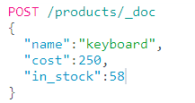
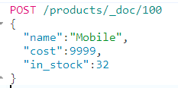
Adding and Deleting indices
PUT /my_index
Creates a new index named my_index
DELETE /my_index
Deletes an index named my_index
Document Insertion
Document without ID(random)
Document with ID

Slide 7
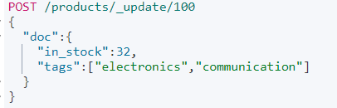
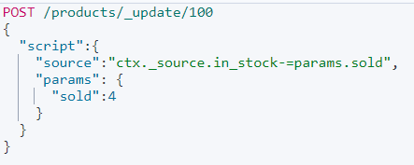
Updating documents
We can update the existing fields and add more fields also.
Scripted updates
We an update the doc using scripts
We can update the documents conditionally using scripted updates.

Slide 8
Deleting documents
DELETE /my_index/_doc/100
Deletes the document with id 100
Bulk Requests
Used to delete, update, create all at once.
Bulk API is used for bulk requests
POST /_bulk
Routing
Routing is process of resolving a shard number for a document

Slide 9
Analyze API
The Analyze API shows how an analyzer breaks text into tokens.
Values for a text filed are analyzed and the results are stored with in an inverted index.
Each filed has dedicated inverted index.
Terms are alphabetically sorted for performance reasons.
Created and maintained by Apache Lucene, not elastic search.
Inverted index enable fast searches.
Elastic searches uses other Data Structures as well
BKD trees for numerical values
Dates and geospatial data

Slide 10
Mapping
There are two types of mapping techniques
Explicit mapping
We define the mapping for the fields ourselves and give the data accordingly.
Dynamic mapping
Elasticsearch dynamically assigns the mapping for the filed accordingly with the data given to it.

Slide 11
Data types
NESTED data type:
Useful when indexing array of objects
Must use “nested” query to query data in nested data type
Nested objects are stored as hidden documents
object, text, float, date, integer, long, double, boolean, short, ip,…
OBJECT data type :
Used for any JSON object
Objects may be nested (we can have objects in objects)
Mapped using the “properties” parameter
For an easy understanding we can think objects as dictionaries in python.
KEYWORD data type:
Used for exact matches of values
Used for filtering, aggregations and sorting
For full text searches we can use the “text” data type

Slide 12
DATE data type:
Date can be specified in one of three ways
Specially formatted strings
Milliseconds since the epoch
Seconds since the epoch
Epoch is referred to 1st of January 1970
Date can be with or without time
Date can be formatted according to the ISO 8061 specification
YYYY-MM-DD(“2019-01-14”)
“2019-01-14T13:07:41Z”(with time)
“2015-01-14T14:06+01:00”(utc+1)
Arrays
No such special concept as arrays, any field can contain 0ne or more values.
Arrays my contain nested arrays, those are flattened during indexing
[1,[1,2]] becomes [1,1,2]
Type coercion
If a string is passed and if it is completely a numeric value then it converts automatically as int or long
If another data type is given it gives an error
Disabling coercion can be done on your wish

Slide 13
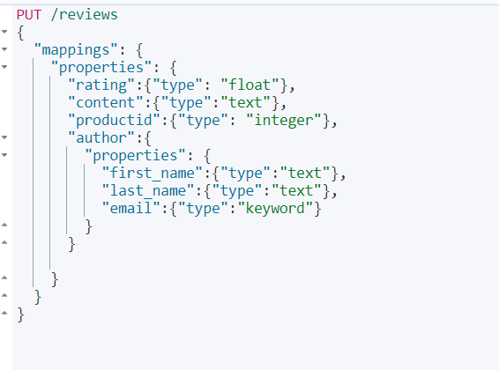
Adding Explicit Mapping
Retrieve Mappings
Using mapping API we can retrive mappings
GET /reviews/_mapping
Retrieves the mappings of the index reviews.
GET /reviews/_mapping/field/content
Shows mapping of the content field in reviews index.
GET /reviews/_mapping/filed/author.email
Mapping of the inner filed can be achieved using the outer field followed by period with inner filed.
We cannot change mapping fields if once added but we can add more fields to the existing mapping
When we declare an object we use properties to name the fields inside object

Slide 14
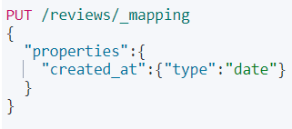
Mapping parameters
Mapping fields can be added afterwards
Missing fields:
All fields in elasticsearch are optional
Adding a filed mapping does not make a filed required
Searches automatically handle missing fileds
Format parameter:
Used to compare the format for date fields
Properties parameter:
Defines nested fields for object & nested fields
Coerce parameter:
Used to enable or disable coercion of value
doc_values:
Used for aggregations, sorting or scripting

Slide 15
Norms parameter:
Normalisation factors used for relevance scoring
Can be disabled to save disk space
null_value parameter:
NULL values cannot be indexed or searched
Used to replace all null values with certain word “NULL”
copy_to parameter:
used to copy multiple filed values into a group filed
Values are copied not terms/tokens
Updating existing mappings:
we cannot change the existing mapping
We cannot also remove the field mappings
The update by query API can be used to reclaim disk space

Slide 16
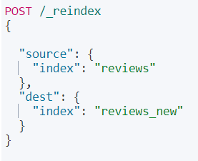
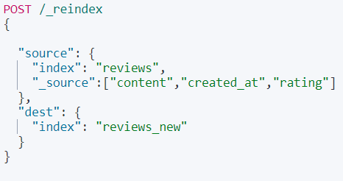
Reindex API
Source filtering (Removing fields)
Source filtering selects certain fields to reindex
Reindex is the concept of copying existing data from a source index to a destination index which can be inside the same or a different cluster.

Slide 17
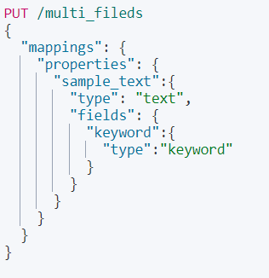
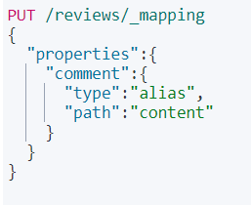
Batching and Throttling:
The reindex API performs operations in batches
It uses scroll API internally
Filed aliases:
Comment can be used in place of content as it is an alias
Multi-filed mappings:
One filed may contain more than one filed mapping for example text can be of two forms “text” as well as “keyword” data type

Slide 18
Index Templates
Updating an index template:
We can use the same configuration as we use in creation index templates and configure it with new template
Index templates can be retrieved and deleted using GET and DELETE verbs with same endpoint
An index template is a way to tell Elasticsearch how to configure an index when it is created.
An index template is a way to tell Elasticsearch how to configure an index when it is created
They are applied to indices that match one or more patterns
Pattern may include wilds cards(*)
We can use templates API to create index templates

Slide 19
Dynamic mapping
Dynamic mapping automatically assigns data types to the fields.
Data type | Default in elastic search
String | Text field with keyword mapping
Integer | long
Float | Float
Boolean | Boolean
Object | Object
Array | Depends on the first non-null value

Slide 20
Combination explicit and dynamic mapping
We can assign some of the field mappings and leave the reaming those will be handled by dynamic mapping.
Configure dynamic mapping:
In mappings filed we can set “dynamic” : false, it disables dynamic mapping, when non mapped fields are given they will be ignored and in searches but will be stored in _source field.
We can also set “dynamic” : “strict” this throws an error when try to index a non mapped filed
We can also enable the dynamic mapping to certain fields while total dynamic mapping is disabled.

Slide 21
Stemming and stop words
Analysers
Built-in analysers:
Stemming analyser
Changes all the main words to its root form
When a search query is performed then that word or sentence will be changed to it root forms
Standard analyser (split by word)
Splits text words(standard tokenizer)
Lowercases letters by default
Contains stop filter token(disabled)
Stemming reduces words to their root form
Stop words are the words that are filtered out during text analysis
E.g. “a”, “the”, “at”, “of”, “on” etc.,
Stop words should be filtered out during analysis because the have more effect on relevance score more than the required words

Slide 22
Simple analyzer:
Splits when encountered other than letters
Lowercases by default
White space analyzer:
Splits when white space detected
Doesn’t lowercase letters
Pattern analyzer:
A regular expression is used to match token
The matches will be split
Lowercases letters by default
Open and closed indices:
An open index is available for indexing and searching requests
A closed index will refuse requests
Read and write requests are blocked necessary for performing some operations
Dynamic and static settings:
Dynamic settings can be changed without closing the index
Static settings required the index to be closed first

Slide 23
Search methods
Searching in elasticsearch is done using search API
There are two ways for searching
Searching with request URI
Query DSL
Searching with request URI
A single line query statement
GET /sample_index/_search?q=name:abc
GET /sample_index/_search?q=name:abc AND age:20
These are used when to search using simple queries

Slide 24
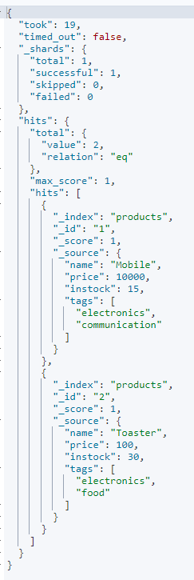
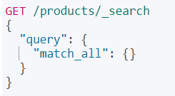
Query DSL
This is a sample match_all query which matches every document in the index
Relevance scoring:
Elasticsearch calculates the score of matching documents
Query results:
Matching documents are shown under hits object contains array of hits which matches the documents according to the query
Relevance scoring is given as _score at it is a match all query it shows score as 1
Query context calculates the relevance scores for the matches the text.
Filter context doesn't calculates relevance score that matches the text

Slide 25
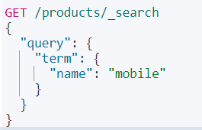
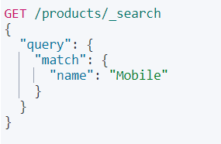
Term level queries:
Term level queries searches for exact matches
The term “Mobile” is stored as “mobile” in inverted index, so searching for “Mobile” doesn’t matches any query as it is a term level query.
Query is not analyzed
Full text queries :
Unlike term level queries full text queries are analysed using the standard analyser (used while indexing)
Here full text is matched irrespective of the case as both are analysed with same analyser.

Slide 26
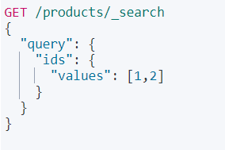
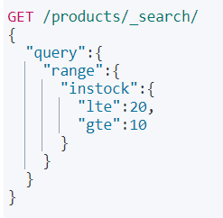
Matching documents based on range values
For the above query the instock with values in range 10,20 (inclusive)
Retrieve documents based on ids:
Whatever ids are given in the values will be matched by the search query

Slide 27
We can use dates also in the range field which returns values within the date range
The parameters we can use in range
Dates can be reduced/increased up to some extent using 2010-01-01||-1y-1d date reduced by one year and one day
Notation | Effective
y | Years
M | Months
w | Weeks
d | Days
h/H | Hours
m | Minutes
s | Seconds
Short notation | Represents
gte | Greater than or equal
lte | Less than or equal
gt | Greater than
lt | Less than

Slide 28
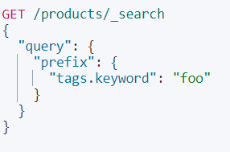
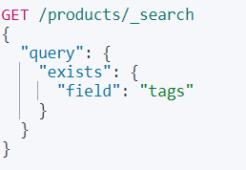
Matching values with non-null values :
We can use “exists” and check weather the “tags” field is present or not in a particular document.
This query matches all the documents with tags field
Matching based on prefixes:
We can also use wild cards to match the queries
* - matches none or more characters
? - matches exactly one character
Wild card queries are slow searchable.

Slide 29
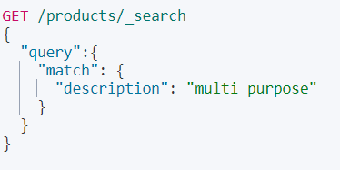
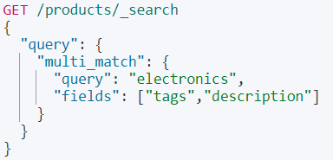
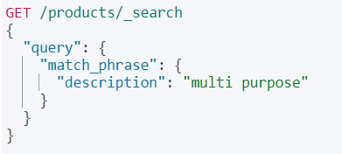
match query and matching sequences:
Above query matches any of the text in description
This matches description in same sequence
Searching multiple fields:
This multi match query searches for the query in all the fields given fields array
Searches multiple fields all at a time

Slide 30
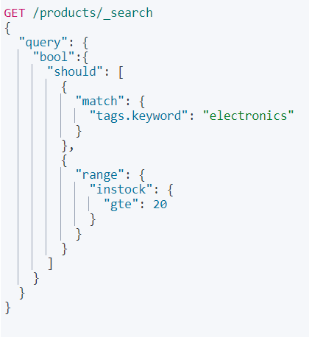
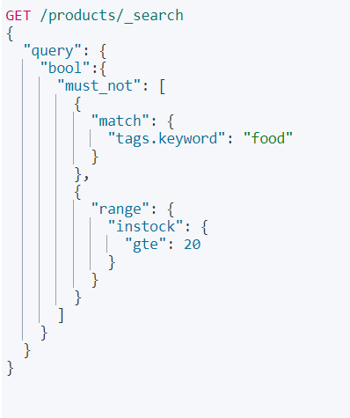
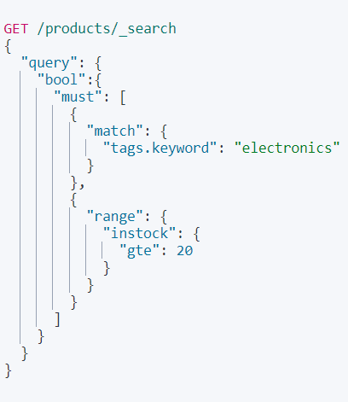
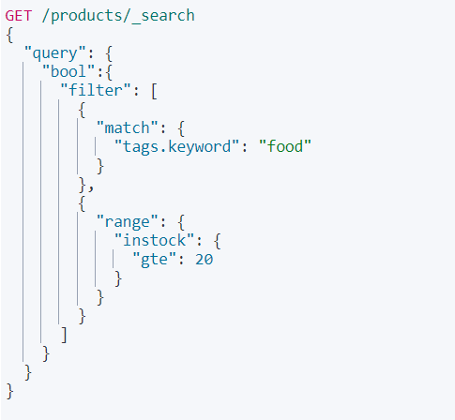
Querying Boolean logic:
In bool query we use different parameters
must – satisfy all fields
should – satisfy any one field
must_not – doesn’t satisfy all fields
filter – satisfy all fields but doesn’t give relevance scores

Slide 31
Nested fields :
The nested type is a specialized version of the object data type that allows arrays of objects to be indexed in a way that they can be queried independently of each other.
Queried with the nested query.
Sorted with nested sorting.
Retrieved and highlighted with nested inner hits.
The parameters for nested fileds
path
query
inner hits
While searching path is mandatory
Firstly in mapping they should be declared as nested otherwise it will not be treated as nested
We can write a query in a nested query

Slide 32
Joining queries
Has child:
Returns parent documents whose joined child documents match a provided query.
Has parent:
Returns child documents whose joined parent document matches a provided query.
Parent ID:
Returns child documents joined to a specific parent document.
It contains
Nested
Has child
Has parent
Parent ID
Nested query searches nested field objects as if they were indexed as separate documents. If an object matches the search, the nested query returns the root parent document.

