Slide 1

Internship Report
P . Mehar Srinivas Chowdari
- Intern at ADP

Slide 2
Contents
Internship
Area of study
Elastic search
Sample Example & Requirement
Contribution to the project
Utilization in project
Other requirements
Learning outcome
Questions

Slide 3
Internship
Project
Requirement
Technical Stack
N8 output tax compare
Insert and Query the data in elastic search
Elastic Search(ELK)
Cloud computing(AWS)
Python (pandas,boto3)

Slide 4
Area of study
Elastic search
Aws cloud
Python
Implementing it in local and storing 2D data into it
AWS serverless services like Lambda,S3,SQS,SES
Frameworks and packages like boto3,pandas etc..
Database
Testing
Tools
Understand DB like
OpenSearch DynamoDB and Aurora DB
Understand and implement pytests
JIRA (Story management),
GIT (code versioning)

Slide 5
Requirement
Phase I
Learning:
Learnt concepts of elastic search, mapping, insertion and querying data.
Data:
Requirement is explained with the student example, given student name and subject details(pass/fail).
Requirement:
Show all the students with every subject passed
Approach:
Using bool query checked each subject pass /fail status and returned the pass students.

Slide 6
Requirement
Phase II
Data:
Added complexity to Phase I, subjects and number of subjects are different for each student.
Requirement:
Show all the students with every subject passed, Here manual querying is not possible by checking every subject with its name.
Approach:
Here used a “nested” structure for mapping in which we can store array of values(subject details) and using bool query to show only passed students

Slide 7
Requirement
Phase III
Data:
Added a field semesters under student, semesters will contain subjects details.
Requirement:
Query for the students who passed the all semesters.
Approach:
Here used a “nested” mapping to store subject level details and used bool query to check passed subjects and an outer bool query for every semester pass checking.

Slide 8
Requirement
Phase IV
Data:
The may be unknown number of semesters under student.
Requirement:
Query for the students who passed the all semesters.
Approach:
Here used a “nested” mapping to store subject and semester level details, used bool query to check passed ids and an outer bool query for every semester pass checking and a final bool query to display the passed students.

Slide 9
Student Example to actual requirement
Phase V
Student is considered as “agency_name”
Semester will be as “form_name”
Here there will be unknown number of forms in one agency.
Hence will use a nested structure to store each form and its inner data.
There will be unknown number of ids in each form same as subjects in one semester.
To store these ids we will use an another nested structure inside each form it contains “id” as subject and “no_error” as pass (Boolean)

Slide 10
Requirement Explanation
Linear data with student and subjects
2D data with students, semesters and subjects
Connecting it to the requirement
I
III
V
II
IV
Linear data with different number of subjects
2D data with unknown number of semesters

Slide 11
Given Requirements
Requirement 1
Requirement 2
Need to get agencies having all of it’s ids passed under all the forms.
Need to get forms having all of it’s ids passed
Requirement 3
Get all the failed ids irrespective of the form and agency

Slide 12
Requirement Querying
Here used a “nested” mapping to store id and form level details, used bool query to check no error ids and an outer bool query to check all the forms are error free and a final bool query to display only the agencies with no errors.
Used inner hits in form level nested query and retrieved passed forms from the above query output, inner hits is used display content matched with the bool query in nested query.
Used inner hits in id level nested query and retrieved the failed id details.

Slide 13
Miscellaneous
Worked on Python pandas to reduce the data while loading into the data frames.
Created an AWS lambda function to convert CSV file into JSON file while uploaded into a S3 bucket.
Learnt AWS cloud services S3, SQS, SES and database like Dynamo DB and OpenSearch.
Token Validation for Aurora DB connection

Slide 14

Any Queries ?

Slide 15


Slide 16
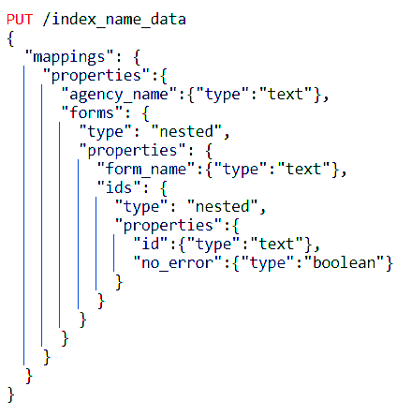
Data mapping
Selected a suitable mapping with nested structures.
Level 1 with “agency_name” and array of “forms”.
Level 2 with “form_name” and array of “ids” in array of forms.
Level 3 with “id” and “no_error” in array of ids.

Slide 17
Data Insertion
The data I will be having with columns
agency_name
form_name
ids_with_errors
ids_without_errors
Firstly checking for the agency_name in the index.
If agency_name is present in the index it will be retrieved and modified and inserted in the total document again using same document id.
If the agency_name is not present then the new document is created.
If the agency_name is present and the form_name is not present in array of forms then it is added to the array and the document is inserted with the same document id
Similarly all the data will be inserted in the index

Slide 18
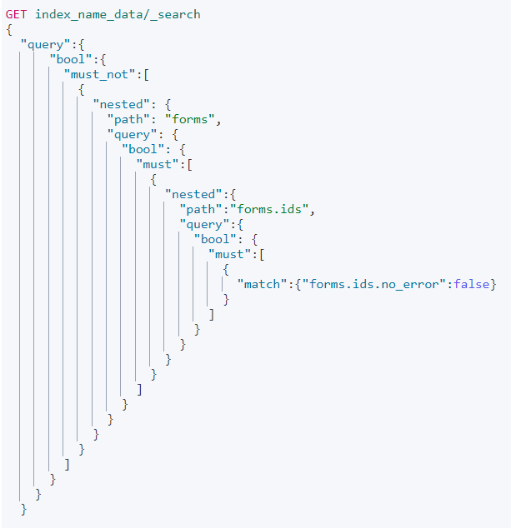
Querying
The query is to retrieve agency_name in which there are no id_with_errors
I used nested query inside a bool query
First checked that there is no id_with_errors in ids and then checked for no forms with failed checks in ids and finally for no form_name failure in forms
Similarly other two queries are also done

