Slide 1
ROCK, PAPER,
SCISSORS
Image Classification Using MobileNetV2
Presented by: Abdullah Afzal
Roll No: SU92-BSCSM-F23-473
Class: BSCS-7B
Subject: Deep Learning
Submitted to: Dr. Munir Ahmad

Slide 2
Project Overview
A three-class computer vision classification system
Recognizes hand gestures in images.
Classes: Rock, Paper, and Scissors.
Uses MobileNetV2 transfer learning.
Provides predictions through a Streamlit web application.
Abdullah Afzal | BSCS-7B | Deep Learning 2

Slide 3
Problem Statement & Objectives
Problem: automatically identify one of three hand-gesture classes from an image.
Prepare and preprocess a labelled image dataset.
Train a transfer-learning model with data augmentation.
Evaluate validation performance and deploy an interactive application.
Abdullah Afzal | BSCS-7B | Deep Learning 3

Slide 4
Dataset & Input Pipeline
Dataset: Kaggle — drgfreeman/rockpaperscissors.
Three labels: Rock, Paper, Scissors.
Training/validation split: 80% / 20%.
Image size: 160 × 160 RGB; batch size: 32.
Random seed: 42; prefetching used in the input pipeline.
Abdullah Afzal | BSCS-7B | Deep Learning 4

Slide 5
Preprocessing & Data Augmentation
Resize images to 160 × 160 pixels.
Use pixel rescaling expected by the model pipeline.
RandomFlip introduces horizontal variation.
RandomRotation(0.05) adds small rotation variations.
Augmentation helps the model generalize to image variations.
Abdullah Afzal | BSCS-7B | Deep Learning 5

Slide 6
Model Architecture: MobileNetV2
MobileNetV2 uses ImageNet-pretrained weights.
The pretrained backbone is frozen during this training stage.
GlobalAveragePooling2D converts feature maps into a feature vector.
Dropout (0.3) helps reduce overfitting.
Dense layer with 3 softmax outputs predicts the classes.
Abdullah Afzal | BSCS-7B | Deep Learning 6

Slide 7
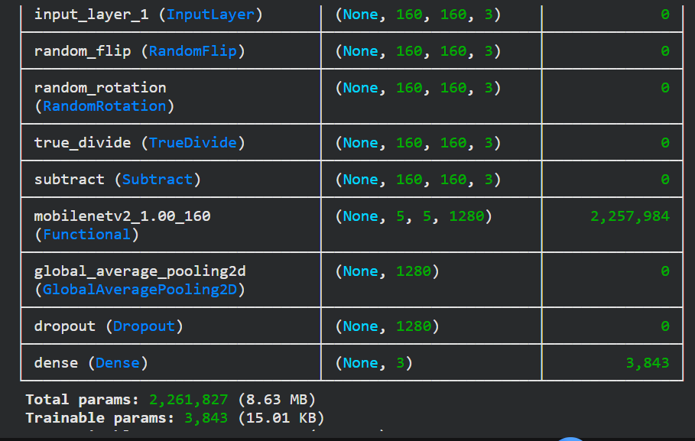
Model Summary
Values taken from the supplied model-summary screenshot
Input shape: (160, 160, 3).
Output shape: (3,) — one score for each class.
Total parameters: 2,261,827.
Trainable parameters: 3,843.
Most backbone parameters are frozen and are not updated.
Abdullah Afzal | BSCS-7B | Deep Learning 7

Slide 8
Training Configuration
Epochs: 8.
Optimizer: Adam; learning rate: 0.001.
Loss: sparse categorical crossentropy.
Batch size: 32.
Training performed using a Colab T4 runtime.
Abdullah Afzal | BSCS-7B | Deep Learning 8

Slide 9
Training Results
Final metrics from Epoch 8
99.54%
Training accuracy
99.31%
Validation accuracy
0.0195
Training loss
0.0168
Validation loss
Abdullah Afzal | BSCS-7B | Deep Learning 9

Slide 10
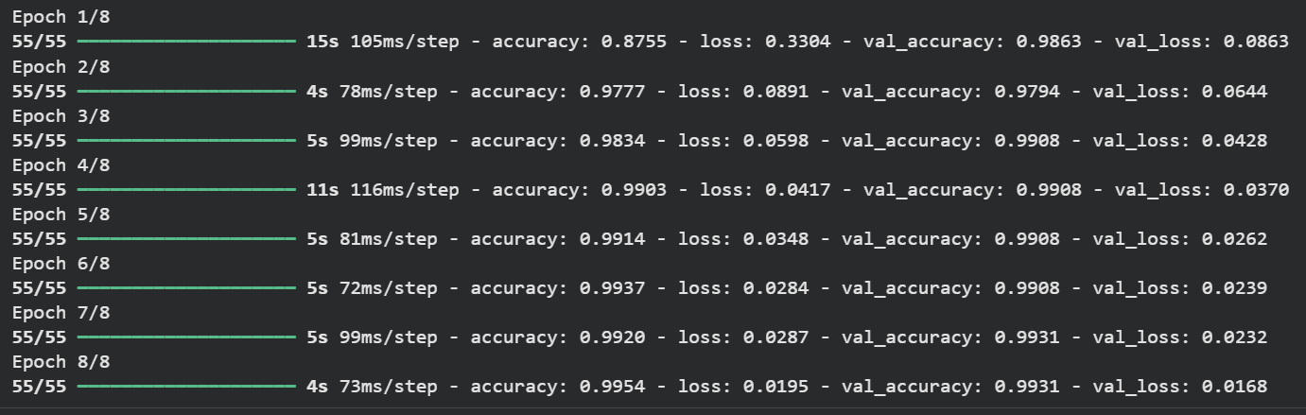
Training Curve Log
Screenshot of all 8 training epochs
Abdullah Afzal | BSCS-7B | Deep Learning 10

Slide 11
Streamlit Deployment
The trained model is loaded by a Streamlit application.
The user uploads an image of a hand gesture.
The application resizes and prepares the image for inference.
The model returns the predicted class: Rock, Paper, or Scissors.
A duplicate preprocessing step was removed during debugging to correct inference.
Abdullah Afzal | BSCS-7B | Deep Learning 11

Slide 12
Limitations & Future Work
Current model supports only three gesture classes.
Validation accuracy is not a substitute for a separate test-set evaluation.
Test more lighting, backgrounds, camera angles, and hand positions.
Add a confusion matrix and class-wise precision, recall, and F1-score.
Improve the interface with confidence scores and clearer instructions.
Abdullah Afzal | BSCS-7B | Deep Learning 12

Slide 13
Conclusion
Built a Rock-Paper-Scissors image classifier using MobileNetV2.
Completed 8 training epochs.
Final training accuracy: 99.54%; validation accuracy: 99.31%.
Integrated the model into a Streamlit application.
Demonstrates transfer learning, augmentation, evaluation, and deployment.
Abdullah Afzal | BSCS-7B | Deep Learning 13

Slide 14
Thank You
Questions?
Presented by: Abdullah Afzal
Roll No: SU92-BSCSM-F23-473
BSCS-7B | Deep Learning
Submitted to: Dr. Munir Ahmad
Abdullah Afzal | BSCS-7B | Deep Learning 14

