Slide 1

Project: Factored based smt + NMT
By: Mehar Bhatia
Mentor: Saumitra Yadav
LTRC, IIIT-hyderabad

Slide 2
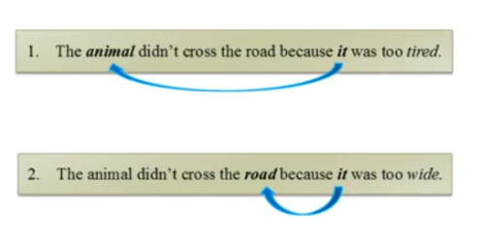
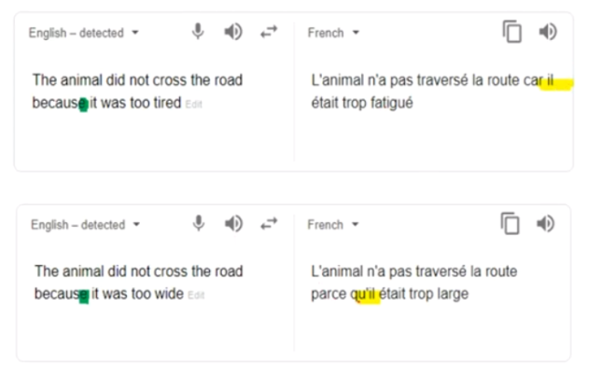

Lets take an example…

Slide 3
WEEK 1 (22nd May – 28th May)
Literature review to understand the workings of:
  Statistical Machine Translations (SMT) and
  Neural Machine Translators (NMT).
Papers reviewed:
  Paper1: Sequence to Sequence Learning with Neural Networks by Ilya Sukskever (Google, 2014)
  Paper 2: Neural Machine Translation by jointly learning to assign and translate by Bahdanau (2015)
  Paper 3: Effective Approaches to Attention-based Neural Machine Translation. (Stanford, 2016)
  Paper 4: Case markers and morphology: Addressing the crux of the fluency problem in English-Hindi SMT (IIT-B)
  Paper 5: Linguistic Input features improve Neural Machine Translation (University of Edinburgh, 2016)

Slide 4
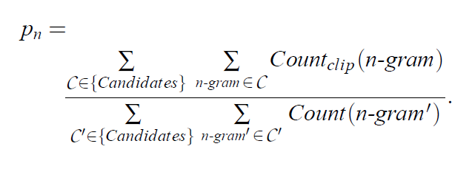
Metric to calculate accuracy of translations…
Objective: How to calculate the accuracy of each output?
Reference paper:
A metric: BLEU (Bilinguial Evaluation Understudy)
Methods:
  Method1: Measure the closeness to one or more human references using some numeric metric.
    Pros/Cons?
  Method2: Modified Precision
    Example:
    Reference 1: The cat is on the mat.
    Reference 2: There is a cat on the mat.
    MT output: The cat the cat on the mat.
Bigrams | Count | ClipCount
The cat | 2 | 1
cat the | 1 | 0
cat on | 1 | 1
on the | 1 | 1
the mat | 1 | 1
Modified Precision = Sum of number of clip counts/Number of bigrams
Here modified precision = 4/6
Notes:
Modified Precision: give each word credit according to the max number of times that it has occurred in the references.

Slide 5
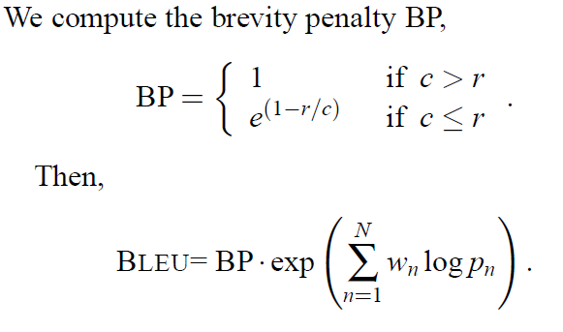
Metric to calculate accuracy of translations…
  3. Method 3: Combine all the modified precisions of various n-gram sizes into a single metric.
    Evaluation should also consider sentence length of translation should be neither too short nor two long.
    Introduce a new metric and then calculate the BLEU score.
Conclusion
Where
c = length of machine translation
r = eff reference corpus length

Slide 6
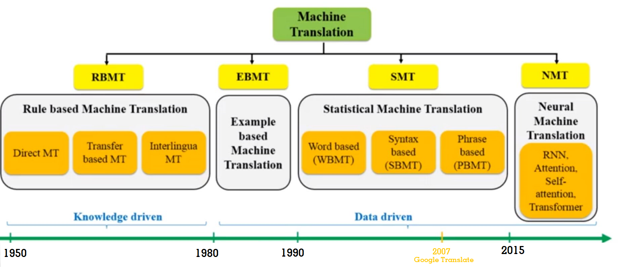
Rise of SMTs and NMTs…
Source: https://www.freecodecamp.org/news/a-history-of-machine-translation-from-the-cold-war-to-deep-learning-f1d335ce8b5/

Slide 7
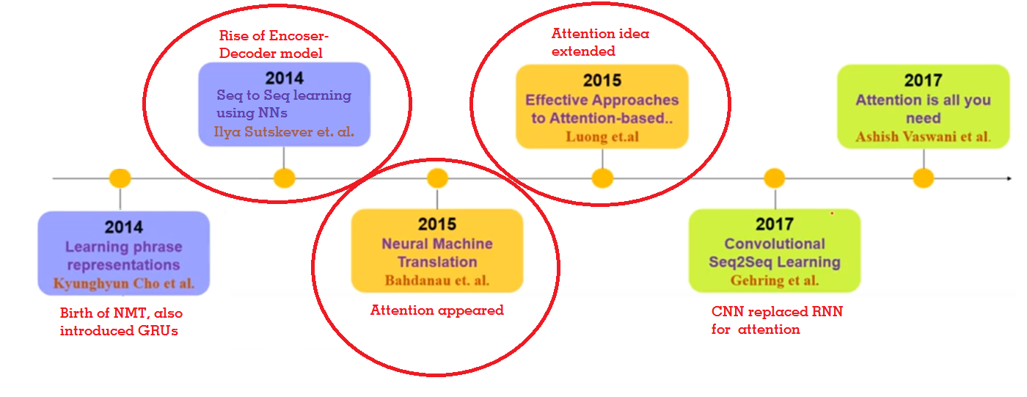
Literature review…

Slide 8
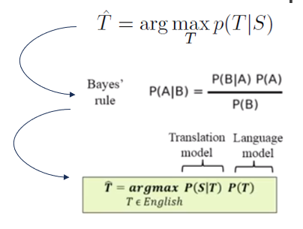
Statistical machine translations (SMT)…
Source(S) → Target(T)
  Translation is a conditional probability problem of T given S

Slide 9
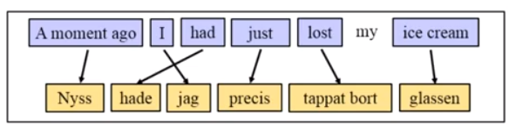
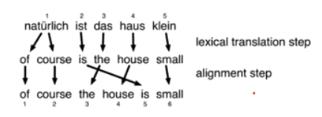
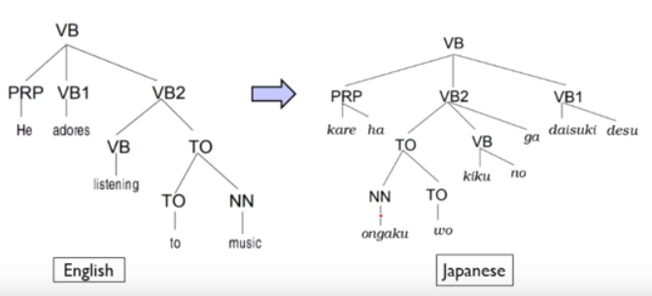
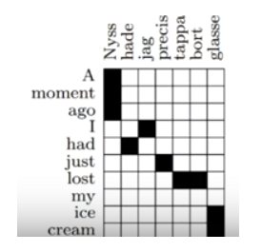
Types of smt…
Word Based (WBMT)
Syntax Based (SBMT)
Phrase Based (PBMT)
Word is unit of translation.
Example:
Translate syntactic units
  Construct parse trees.
Example:
Use phrases and single words of units of translation.
Example:
Notes:
Translate syntatic units.
Construct parse tree.

Slide 10
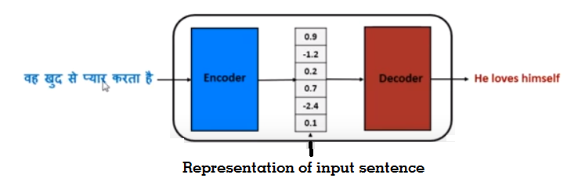
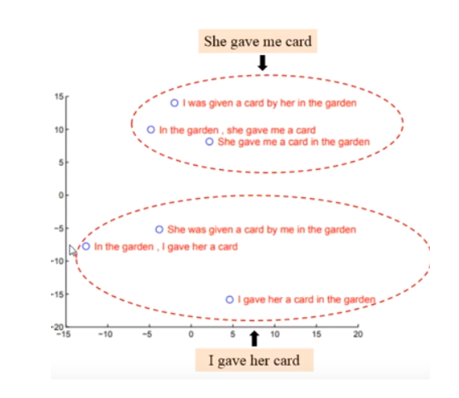
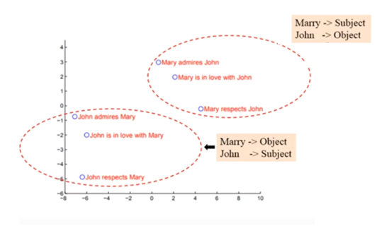
Neural machine translations (Nmt)…
Directly models the conditional probability p(y|x) of translating a source sentence, x1, x2…xn to a target sentence y1,…, ym.
How do we know that this vector is storing the meaning?
SOLUTION!
Applied PCA on sentences and plotted in XY plane. We see that similar sentences are clustered together
Examples →
Refer: Paper 1

Slide 11

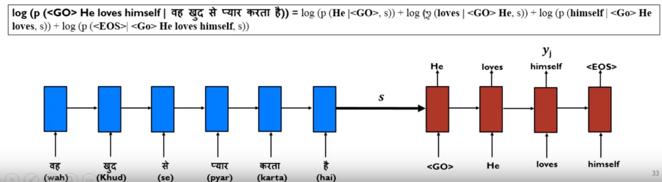
Components of NMT…
A basic form of NMT consists of two components.
  An encoder which computes a representation s for each source sentence
  A decoder which generates one target word at a time and hence decomposes the conditional probability as:
Refer: Paper 1

Slide 12
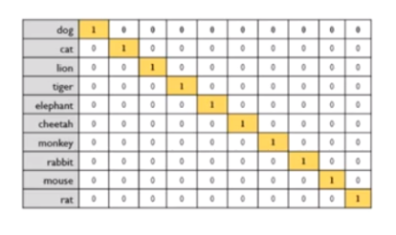
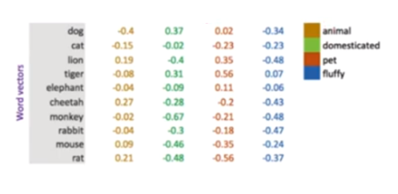
Localized and Distributed representation
Example:
One hot encoding
(Localized representation)
Word Embeddings
(Distributed representation)
Another example:
King – Man + Women = Queen
Refer: Paper 2

Slide 13
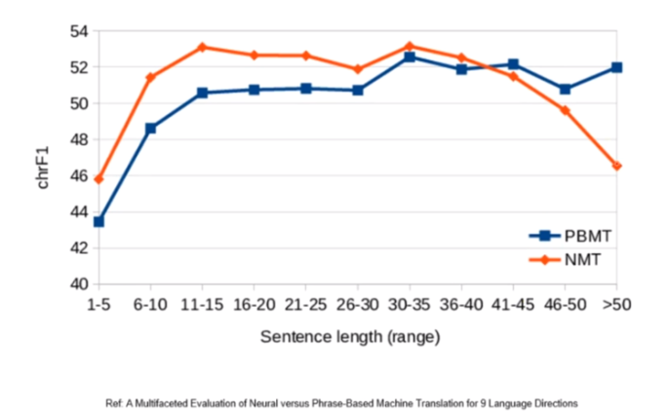
Attention
In a vanilla encoder-decoder:
  In MT task,
    Encoder reads the entire sentence, word to word and compresses all information into a fixed-length vector. (embedding the entire sentence).
    Decoder then generates the translation, word by word based on this fixed length vector only.
  Performance of NMT system decreases as source sentence length increases.
    Reasons:
      Reliability of fixed length vector
        Solution1: Increase the length of the vector by increasing number of neurons in hidden layer or increase the number of hidden layers.
        However, we are increasing the weight parameters which will require more data, memory and computation time.
      Long-range dependencies in longer sentences.
        There is information loss for the initial words of the input sentence, due to vanishing gradient problem of RNNs.
        Last words might have more influence in the fixed-length vector.
Attention is basically, “Where to focus”.
  Mathematically, it is just a vector of real values known as weights.
  Helps in making the RNN work better by letting the network know where to look as it is performing its task.
Notes:
“Where to focus”.
Mathematically, it is just a vector of real values known as weights.
Helps in making the RNN work better by letting the network know where to look as it is performing its task.

Slide 14
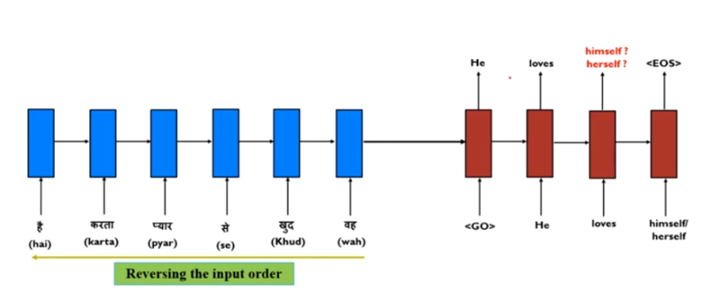
Solution 1: reversing the order
Refer: Paper 1

Slide 15
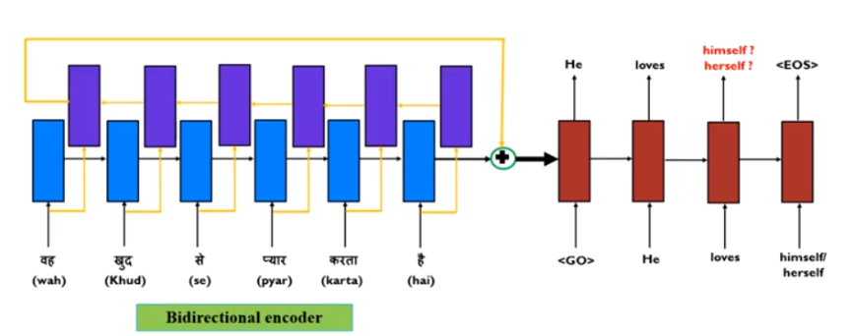
Solution 2: use bi-directional encoder
  Use two different encoders. One reading forward and one reading backward over the input sequence.
  Combine hidden states of both by concatenation and feed to decoder.
A human does not the read the entire sentence in one go and then start translating.
Human translates the sentence in chunks i.e. phase by phase.
We will apply the same approach for machine translation. It is called ATTENTION MECHANISM
Refer: Paper 2

Slide 16
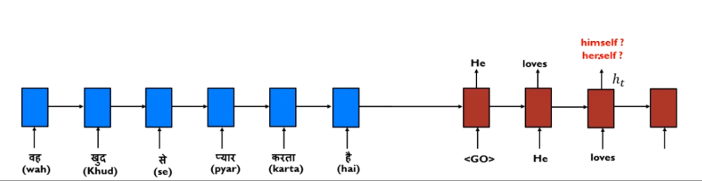
Solution 3: Attention mechanism
Instead of discarding the hidden states, the attention mechanism provides an approach that allows the decoder to peek at them and retrieve some contextual information. (like a dynamic memory)
Example:
  Decoder has already calculated hidden state for t^{th} word(himself/herself) which is h_t.
  But decoder is not sure…
  Allow decoder to peek at the source states and generate “himself”
Refer: Paper 3

Slide 17
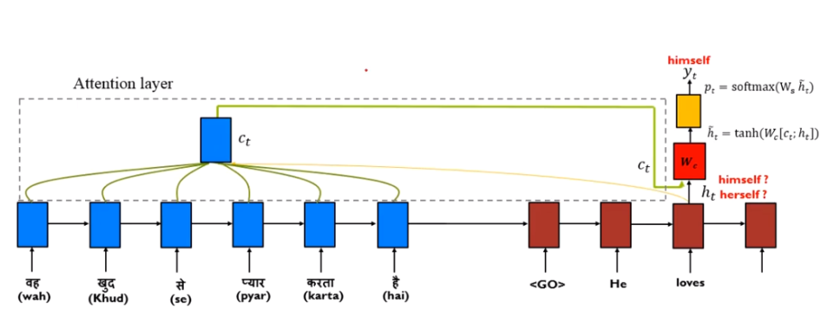
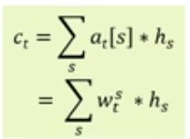

Attention mechanism: how does it work?
With attention, we generate a source side context vector c_t contains required information of the word ‘himself/herself’.
  From the context vector c_t we can produce an attentional hidden state by concatenating both vectors h_t and c_t.
  This is then fed through softmax layer to produce the probability distribution.
Here, the context vector is a weighted average of some/all source states.
Local attention
Global attention
Here, a_t is called the alignment vector which is composed of weights.
Denotes the weight of the jth source hidden state is to produce the t^{th} target word of decoder.
Refer: Paper 3

Slide 18
To do next…
THANK YOU

