Slide 1

Project: Factor based smt + NMT
By: Mehar Bhatia
Mentor: Saumitra Yadav
LTRC, IIIT-hyderabad

Slide 2
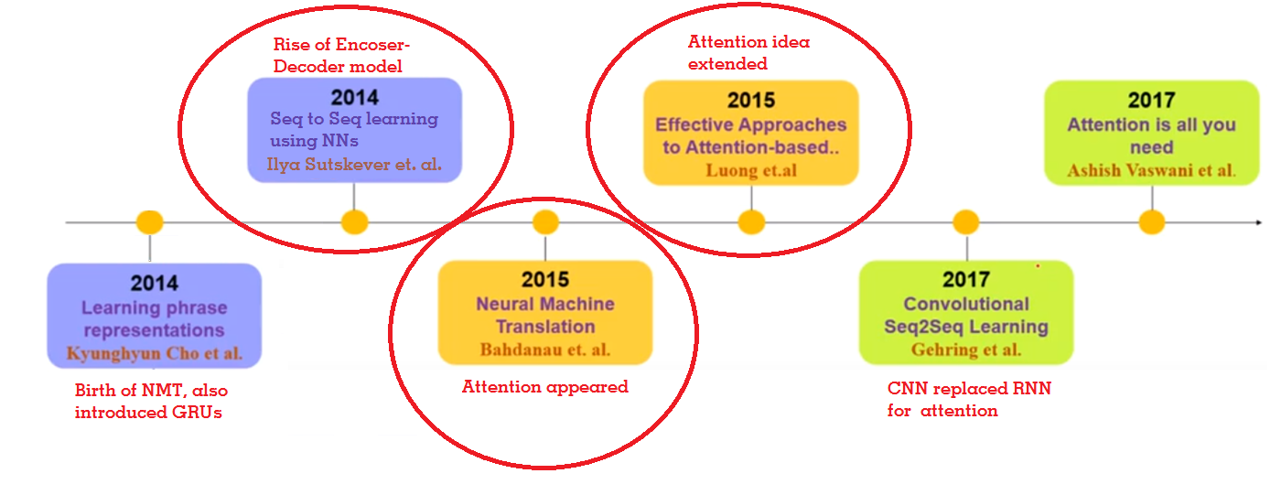
Recall: week 1 summary
Paper 1
Paper 3
Paper 2
Keywords: SMTs, NMTs, Encoder-Decoder, Attention mechanism, BLEU score

Slide 3
After Week 1, arrived at a conclusion that this vanilla attention-mechanism was not enough.
As parallel data is sparse, exploiting other knowledge sources and linguistic features is crucial for performance!
Coming literature is about improving the performance taking above model as a baseline.

Slide 4
Paper 4: Case markers and Morphology: Addressing the crux of the fluency problem in English-Hindi SMT
The fluency and fidelity in the Hindi increases if accurate case markers and suffixes are produced.
So, what entity on the English side encodes information contained in case markers and suffixes on the Hindi side?
Proposes that suffix + semantic relation → case marker/suffix is a very useful translation factor,
Hindi is a relatively free word-order language.
Result: Better fluency and adequacy are achieved with the use of semantic relations.
Notes:
Fidelity: the degree of exactness, accuracy
While in English, the major constituents of a sentence (subject, object, etc.) can usually be identified by their position in the sentence,
Hindi is a relatively free word-order language. Constituents can be moved around in the sentence without impacting the core meaning.
Example Mary ne John ko dekha, John ne Mary ko dekha.

Slide 5
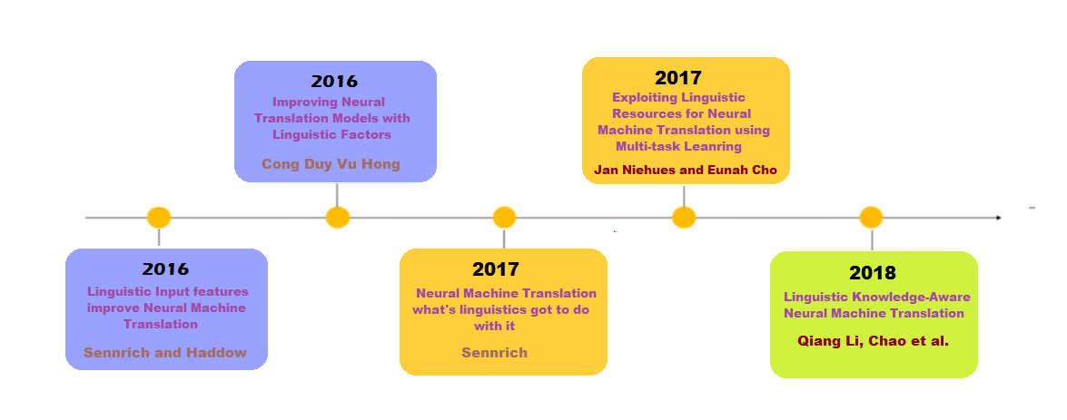
Literature review timeline…
Paper 6
Paper 8
Paper 5
Paper 7
Paper 9

Slide 6
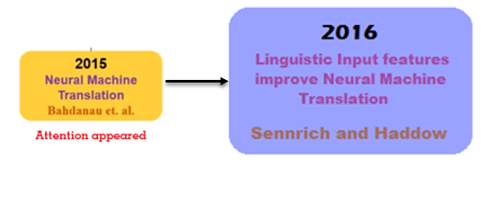

Paper 5: Linguistic Input Features Improve Neural Machine Translation
Paper 5
Paper 2
Considers only Global Attention
Proposed that the various linguistic annotations can be valuable for NMT.
Lemmatization: reduce data sparseness
POS or Syntactic Dependency labels: help in disambiguation.
Sub-word tags: (BPE encoding, propose IOB format for chunking and NER)
Morphological features
Notes:
Byte Pair Encoding…
IOB (marking if a symbol beginning (B), inside (I), or end (E) of a word. A separate tag (O) is used if a symbol corresponds to the full word.

Slide 7
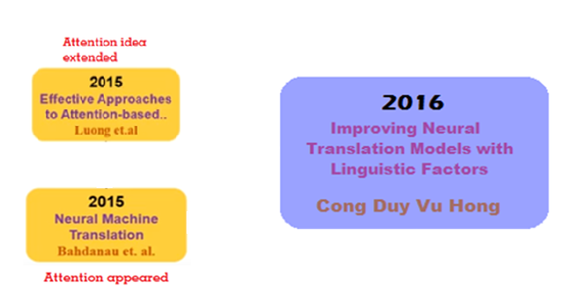
Paper 6: Improving Neural Translation Models with Linguistic Factors
Explored different linguistic annotations at the word level like:
Lemmatization
Word-clusters
Part of Speech tags
Labeled Dependency relations
Proposed a different neural attention architecture to integrate these additional features into NMT framework.
Multi-factored Encoder-Decoder
Multi-factored Attention architecture
English German
Paper 3
Paper 6
Paper 2
Notes:
As an initial work, we aim to find how the neural model can benefit from incorporating the additional linguistic factors in source language.
Review and extend the attentional encoder-decoder NMT for this above setting.

Slide 8
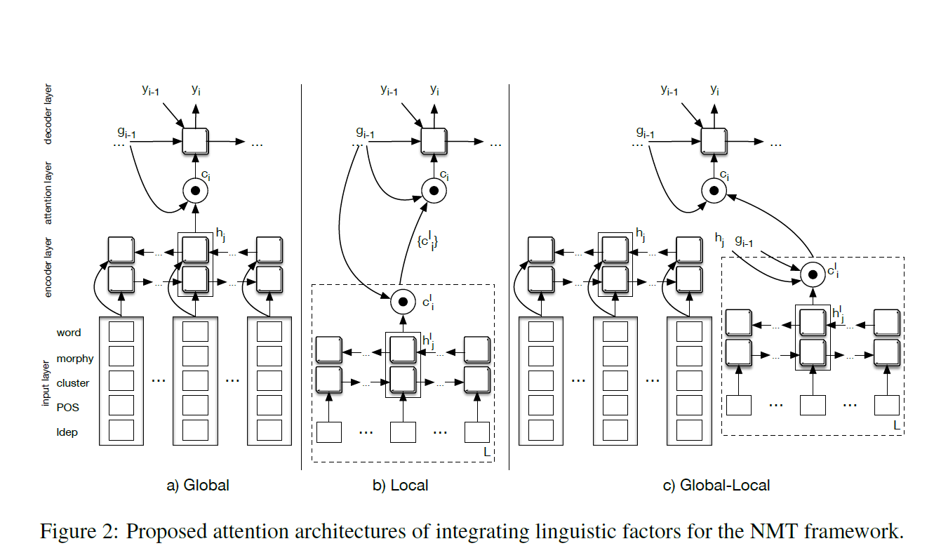
Multi-factored attention mechanism
Global Attention: One shared attention vector for all annotation layers. Stack them up and use them in place of word embeddings to construct source context from decoder
(Loss of individual effects that potentially exist in each layer)
Local Attention: Different attentions for linguistic layers, compute the layer-specific context vectors and stack them up.
(Not much improvement in result. Difficulties in deciding which factors to attend to)
Hybrid Global-Local Attention: Makes use of the global hidden representation across all layers in generating local attentions.
GAVE BEST RESULTS (Significant improvement compared to vanilla attention model)
Notes:
Global attention: Stacking the representations of all the input embeddings into one vector.

Slide 9
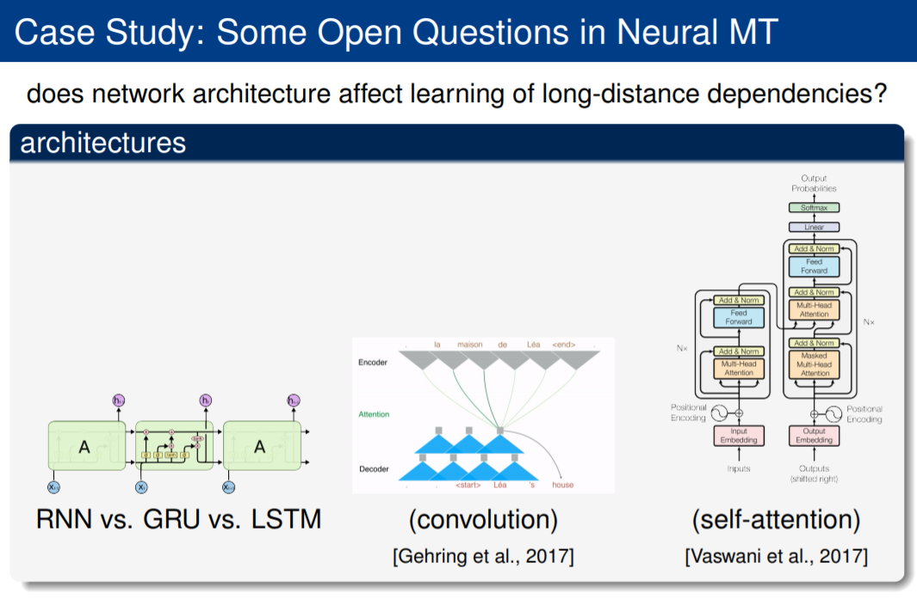
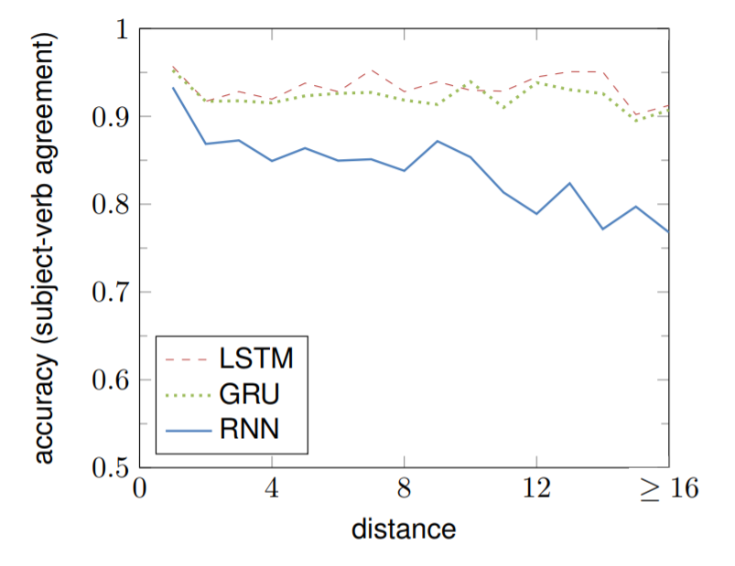
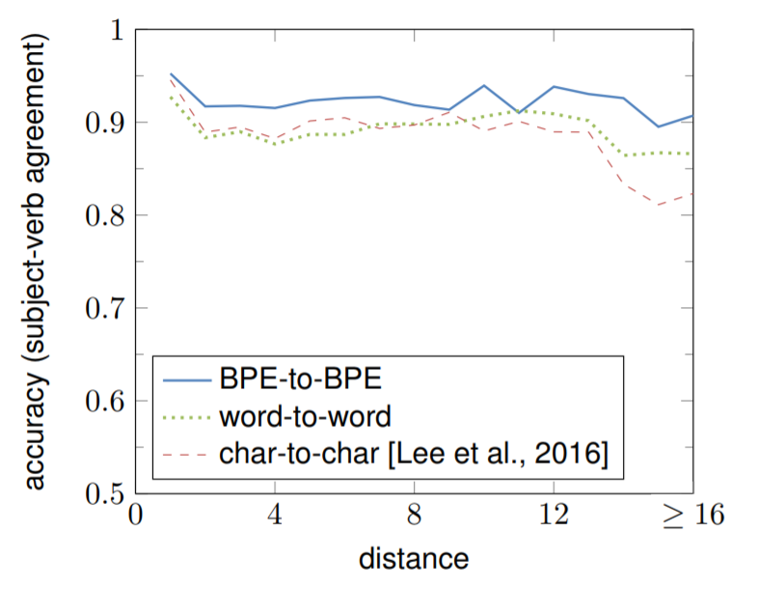
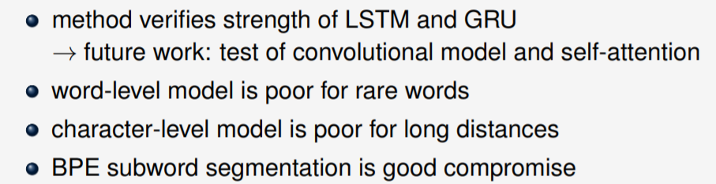
Paper 7: Neural Machine Translation what’s linguistics got to do with it?

Slide 10
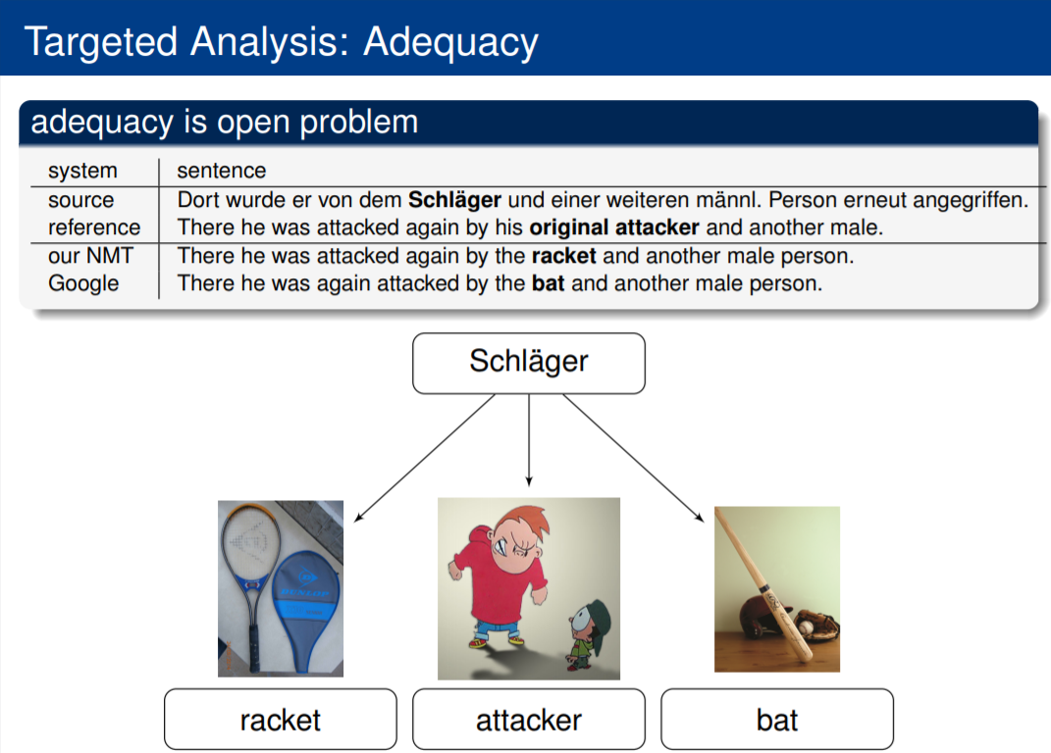
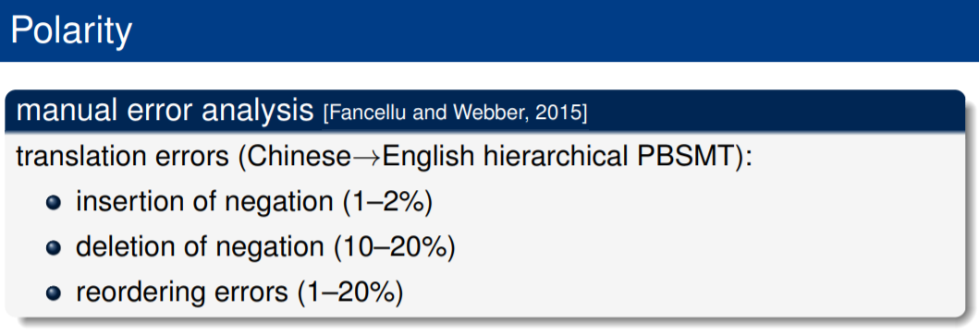
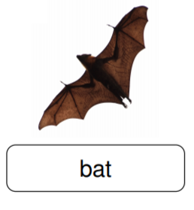
Paper 7: Neural Machine Translation what’s linguistics got to do with it?
This is also an example of Word Sense Disambiguation. Challenging esp for rare word senses.

Slide 11
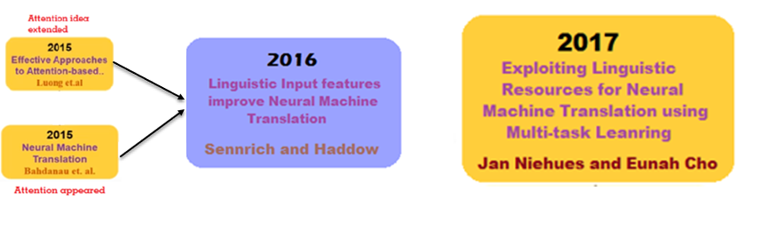
Paper 8: Exploiting Linguistic Resources for Neural Machine Translation Using Multi-task Learning
Paper 8
Paper 3
Paper 5
Paper 2
German English
German English
Proposes multi-task learning approach. Jointly training several NLP tasks in one system.
Annotate parallel data using POS tool. (Done in Paper 5, Sennrich)
Use annotated data directly to train the model.
Use attention based sequence-to-sequence model
Notes:
Shows that multi-task learning is a successful and easy approach to introduce an additional knowledge in an end-to-end neural attentional model.
Jointly training several NLP tasks in one system.

Slide 12
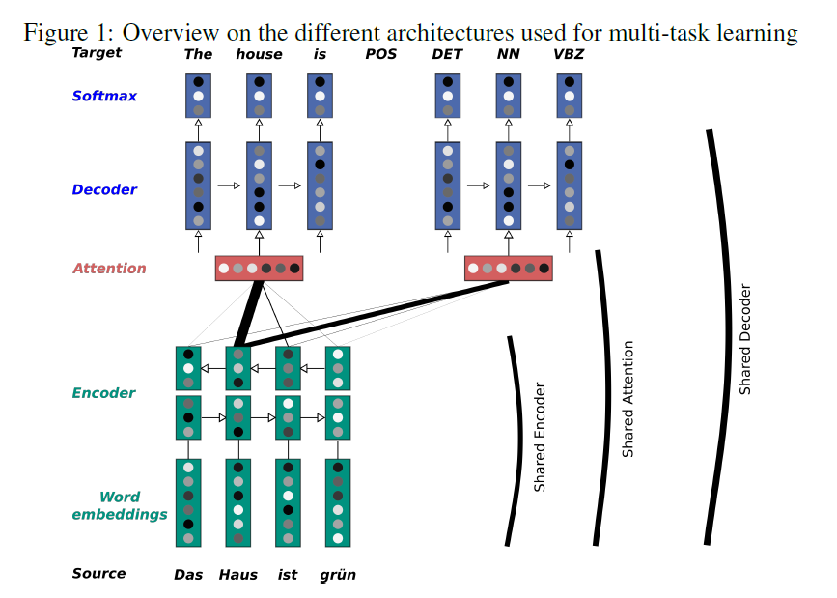
Multi-task learning
Combining the statistical models used for POS
tagging and NER might not be straightforward.
Build one model for all three NLP tasks. Use the
attention based encoder-decoder model
Baseline: Consider scenario – separate models
for each task. Total 9 components.
E(MT), E(POS), E(NER), A(MT), A(POS) etc.
Architecture:
Shared Encoder
Shared Encoder + Shared Attention
Shared Encoder + Shared Attention + Shared Decoder
Notes:
For example, the system will learn that the probability of a word being a named entity is higher if the word is marked as a noun.
Instead of using the output of a model as input for another one, for example, we can build one model for all tasks.

Slide 13

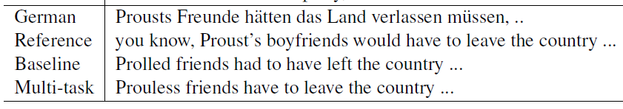
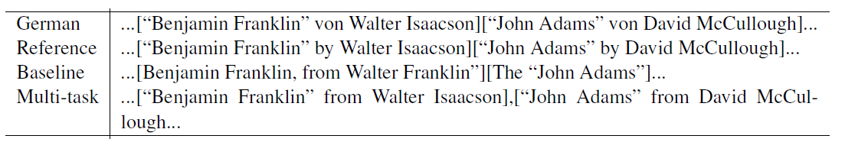
Results for paper 8
All experiments were evaluated on BLEU, BEER, characTER.
Model 3, sharing the most (Shared Encoder + Shared Attention + Shared Decoder) performs better than the baseline but worse than 1 and 2.
Is it helpful to share the attention layer (Model 2) or not (Model 1)?
Another experiment. Consider three task combinations POS+MT, NER+MT, POS+NER+MT (Adapted).
For model 1: Better improvements in score when using adapted schedule (POS+NER+MT)
For model 2: No improvement in score when using adapted schedule.
EXAMPLES:
Google Translate still having this issue of translating names or rare words correctly
Notes:
BEER: BEtter Evaluation as Ranking

Slide 14
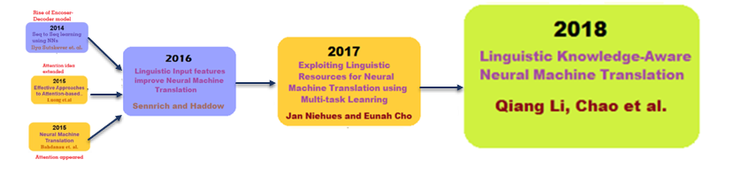
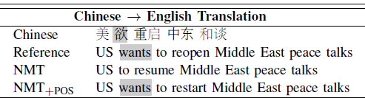
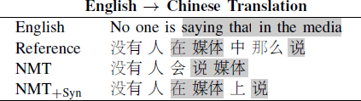
Paper 9: Linguistic Knowledge-Aware Neural Machine Translation
Paper 5
Paper 8
Paper 9
Paper 1
EXAMPLES:
Paper 3
Paper 2
Chinese English
No one said that in the media
No one will say the media
No one said in the media
Vanilla attention-based NMT models have difficulties in learning and interpreting the linguistic information in the source sentence.
Limitation of NMT in capturing the syntactic information of a sentence, does not account for the syntactic interpretations of sentence structure.
Notes:
Therefore, we
believe, in many aspects, linguistic knowledge can help to
explain the complex sentence phenomena, and to some extent,
contribute to the improvement in the translation.

Slide 15
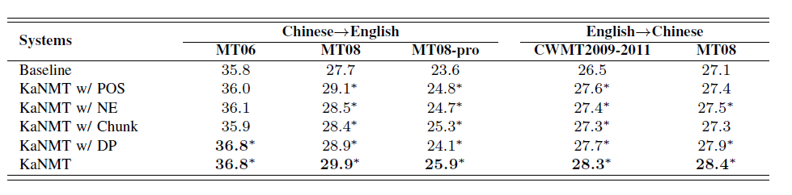
Paper 9: Linguistic Knowledge-Aware Neural Machine Translation
Proposed novel architecture: Knowledge-Aware NMT.
Additional RNN encoder (Knowledge encoder) to encode sequence of linguistic features parallel to encoder of word sequence.
Knowledge Block: represents variable number of linguistic features for a word
Different linguistic features:
POS tags, NER info, Chunk tags (also called Shallow Parsing, classify a phrase into verb phrase or noun phrase), Dependency relations (Expresses the structure of the source sentence)…
Results show that it is better than vanilla NMT model and model proposed by Sennrich.

Slide 16
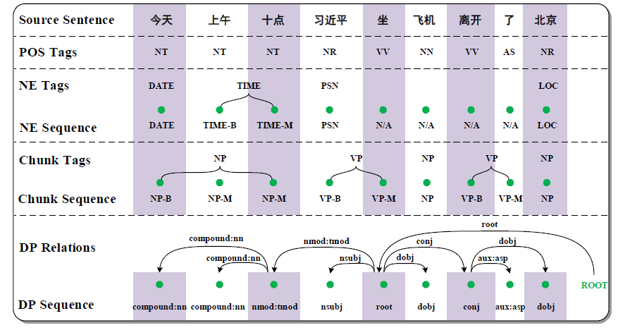
Paper 9: Linguistic Knowledge-Aware Neural Machine Translation
At 10 o'clock this morning, Xi Jinping left Beijing by plane.
plane
10 in the morning
10 this morning
left

Slide 17
Nematus – open source by university of edinburgh
Attention-based encoder-decoder model for neural machine translation built in Tensorflow.
https://github.com/EdinburghNLP/nematus
Built for this Paper and a few others
Paper 5

Slide 18
FAIRSEQ - Facebook AI Research Sequence-to-Sequence Toolkit
Facebook AI Research Sequence-to-Sequence Toolkit written in Python.
Allows researchers and developers to train custom models for translation, language modeling etc.
https://github.com/pytorch/fairseq
Paper 3
Built for this Paper

Slide 19
To do next…
THANK YOU
Notes:
ASK GOOGLE TRANSLATION QUESTION
If google translate can solve all these issues. What is the issue?

