Slide 1

PROJECT: FACTOR BASED SMT + NMT
BY: MEHAR BHATIA
MENTOR: SAUMITRA YADAV
LTRC, IIIT-HYDERABAD

Slide 2
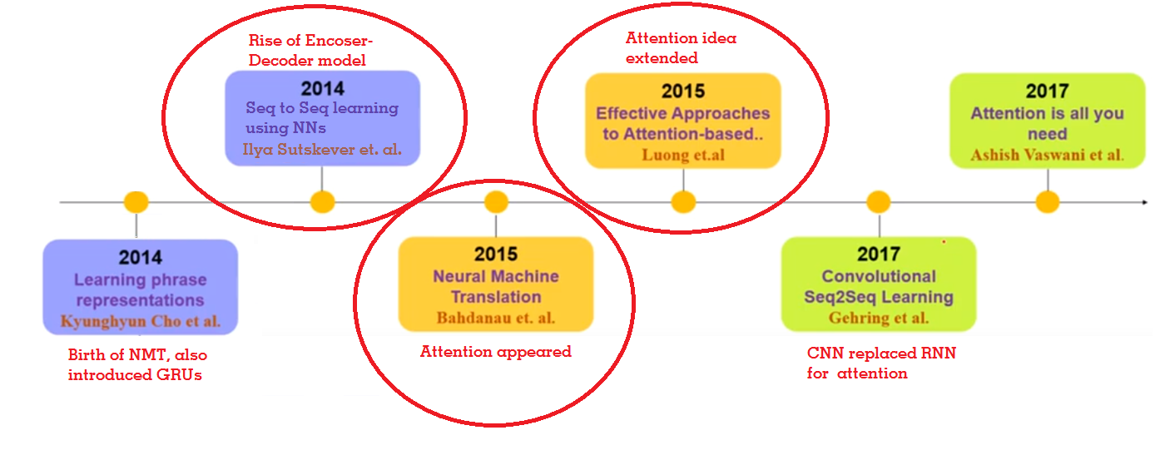
RECALL: WEEK 1 SUMMARY
Paper 1
Paper 3
Paper 2
Keywords: SMTs, NMTs, Encoder-Decoder, Attention mechanism, BLEU score

Slide 3
After Week 1, arrived at a conclusion that this vanilla attention-mechanism was not enough.
As parallel data is sparse, exploiting other knowledge sources and linguistic features is crucial for performance!
Coming literature is about improving the performance taking above model as a baseline.

Slide 4
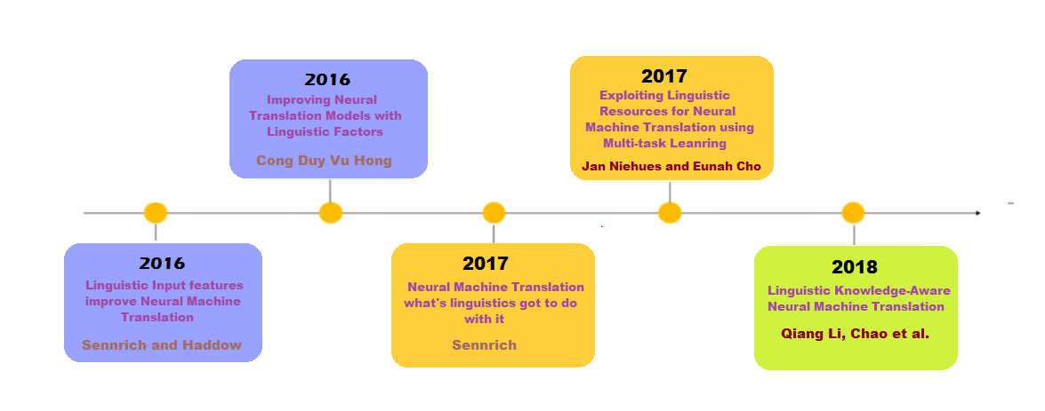
RECALL: WEEK 2 SUMMARY
Paper 6
Paper 8
Paper 5
Paper 7
Paper 9

Slide 5
FAIRSEQ - FACEBOOK AI RESEARCH SEQUENCE-TO-SEQUENCE TOOLKIT
Facebook AI Research Sequence-to-Sequence Toolkit written in Python.
Allows researchers and developers to train custom models for translation, language modeling etc.
https://github.com/pytorch/fairseq
Paper 3
Built for this Paper

Slide 6
NEMATUS – OPEN SOURCE BY UNIVERSITY OF EDINBURGH
Attention-based encoder-decoder model for neural machine translation built in Tensorflow.
https://github.com/EdinburghNLP/nematus
Built for this Paper and a few others
Paper 5

Slide 7
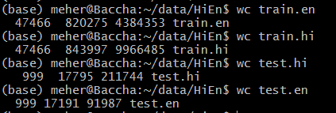
DATA

Slide 8
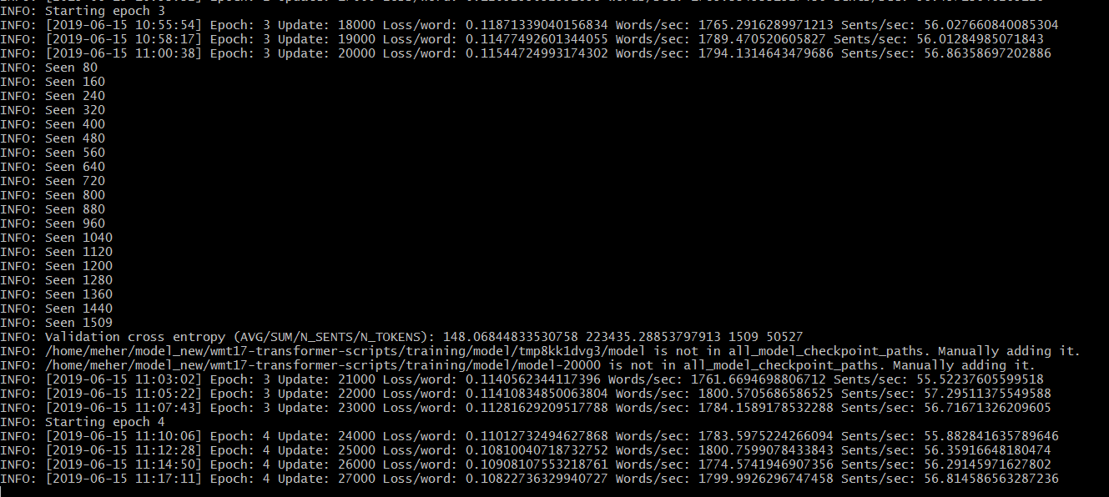
BASELINE MODEL
Preprocessing
Training
Evaluation

Slide 9
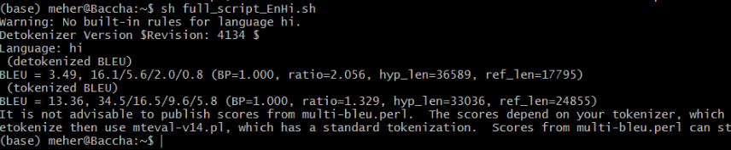
RESULTS AFTER 5 EPOCHS

Slide 10
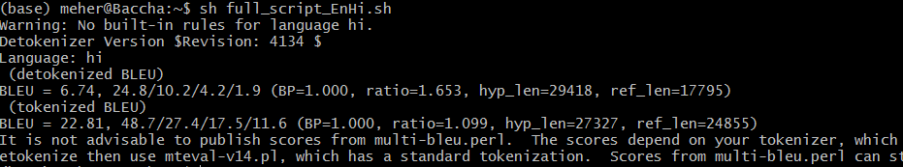
RESULTS AFTER 10 EPOCHS

Slide 11
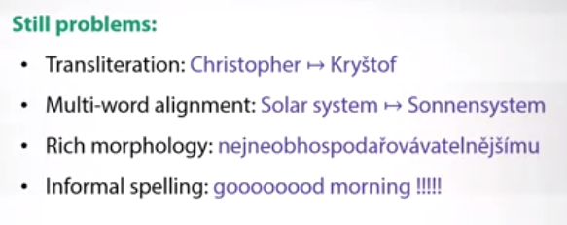
Rare Words or Out-Of-Vocabulary Words
Copy mechanism --- Usage of <UNK> tokens and then word alignments
Sub-word modeling
Word-Character hybrid models
Byte-Pair Encoding
Notes:
UNK tokens..when we dont have them in the vocab.
Transliteration is the process of transferring a word from the alphabet of one language to another. Transliterationhelps people pronounce words and names in foreign languages.

Slide 12


UNDERSTANDING BPE
Notes:
Start with the characters
Iteratively replace the most frequent pair with one unit...till you reach vocab size.

Slide 13
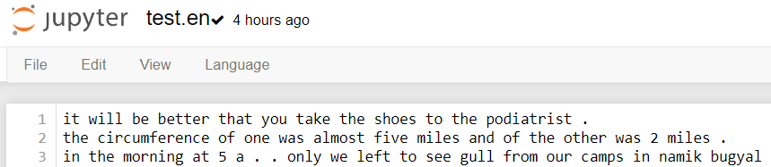
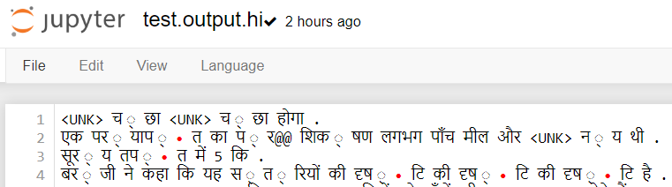
SNIPPETS FROM THE DATA

Slide 14
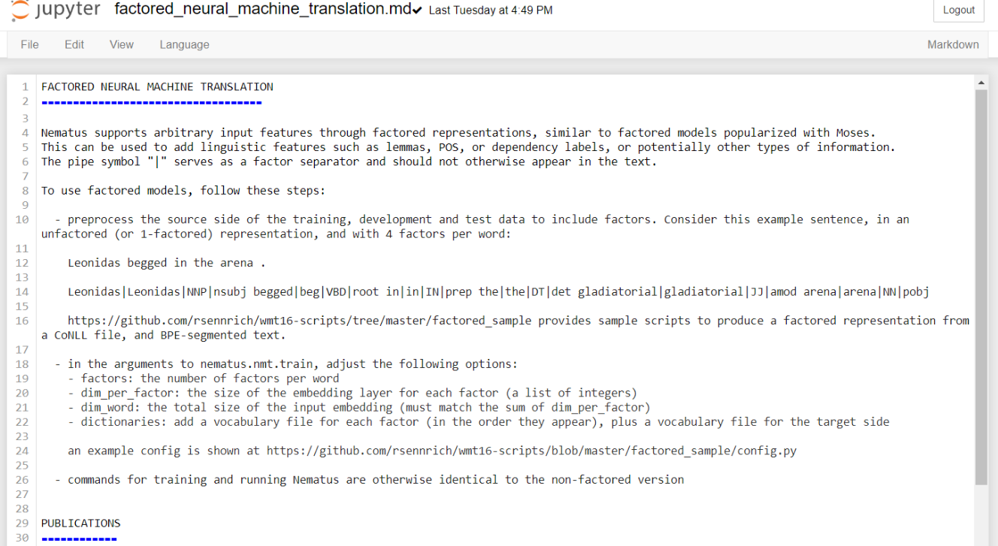

Slide 15
To do next…
THANK YOU
Notes:
ASK GOOGLE TRANSLATION QUESTION
If google translate can solve all these issues. What is the issue?

