Slide 1

PROJECT: FACTOR BASED SMT + NMT
BY: MEHAR BHATIA
MENTOR: SAUMITRA YADAV
LTRC, IIIT-HYDERABAD

Slide 2
Problem STATEMENT?
Investigate whether linguistic information is beneficial to neural translation models or whether their strong learning capability makes linguistic features redundant.
Language: English to Hindi translations

Slide 3
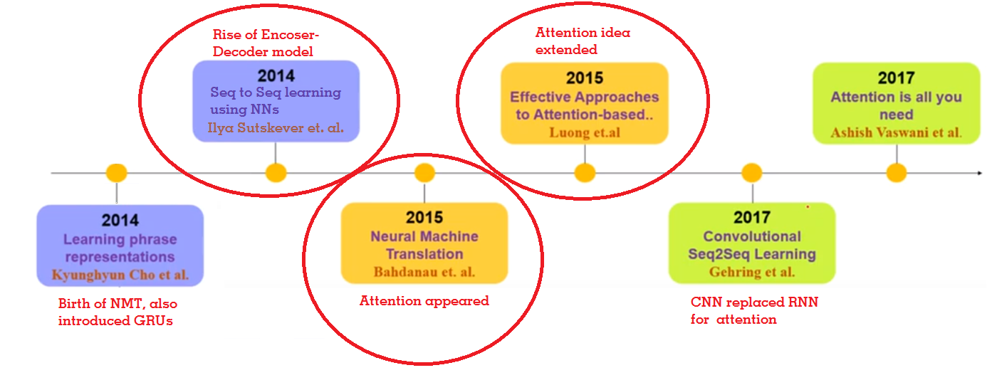
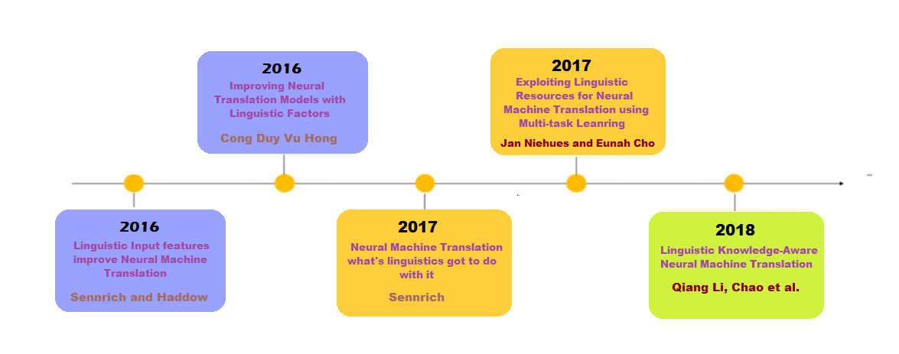
PAPERS READ

Slide 4
After arrived at a conclusion that this vanilla attention-mechanism was not enough.
As parallel data is sparse, exploiting other knowledge sources and linguistic features is crucial for performance!
Need to improve the performance taking above model as a baseline.

Slide 5
Nematus – open source by university of edinburgh
Attention-based encoder-decoder model for neural machine translation built in Tensorflow.
https://github.com/EdinburghNLP/nematus
Built for this Paper and a few others
Paper 5

Slide 6
DATA
Training Corpus: 47466 sentences for English and Hindi Data.
Testing Data: 999 sentences for English and Hindi Data

Slide 7
Linguistic features
Considering the following linguistic features:
Subword Tags: using segmentation using byte pair encoding (BPE)
Lemmatization: should reduce data sparseness and allow inflectional variants of the same word to explicitly share a representation in the model.
POS tags
Dependency labels, both should help in disambiguation.
NER tags
That makes it 24 different combinations

Slide 8
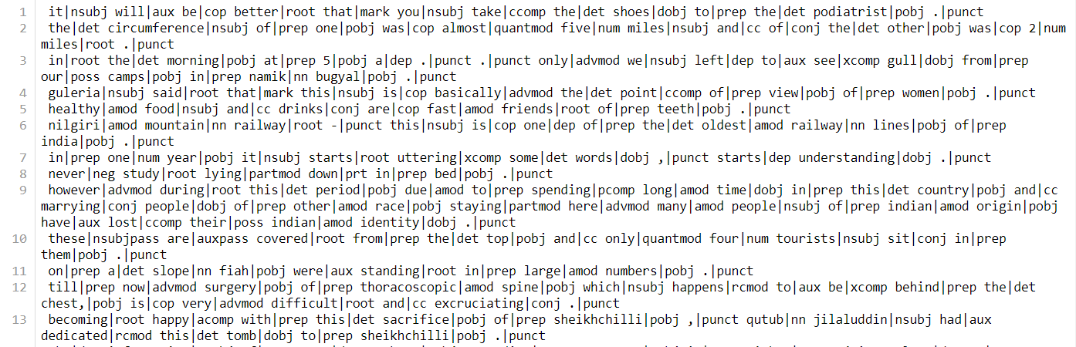
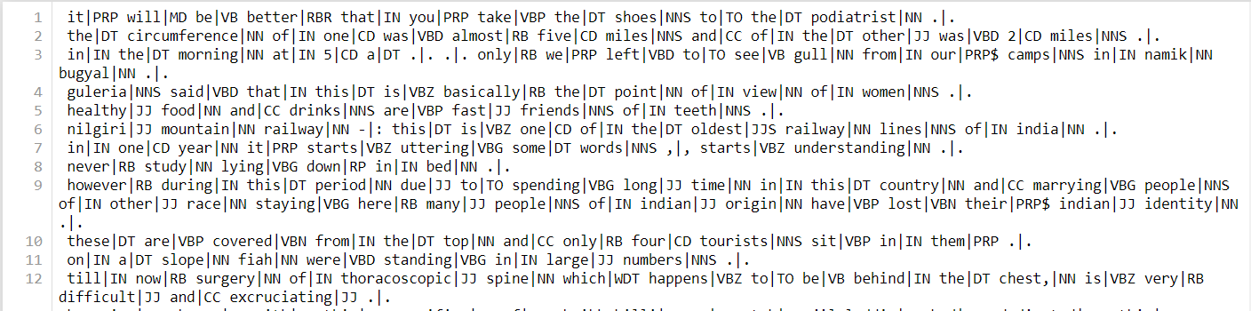
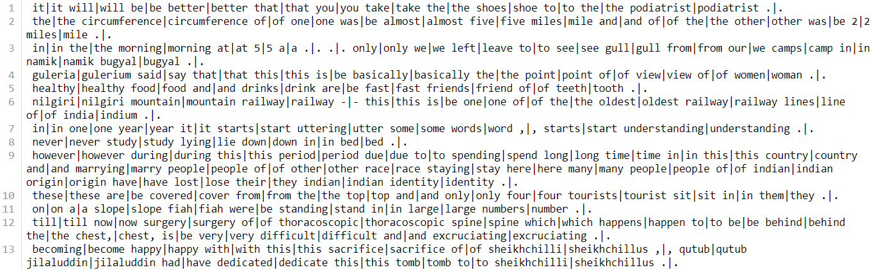
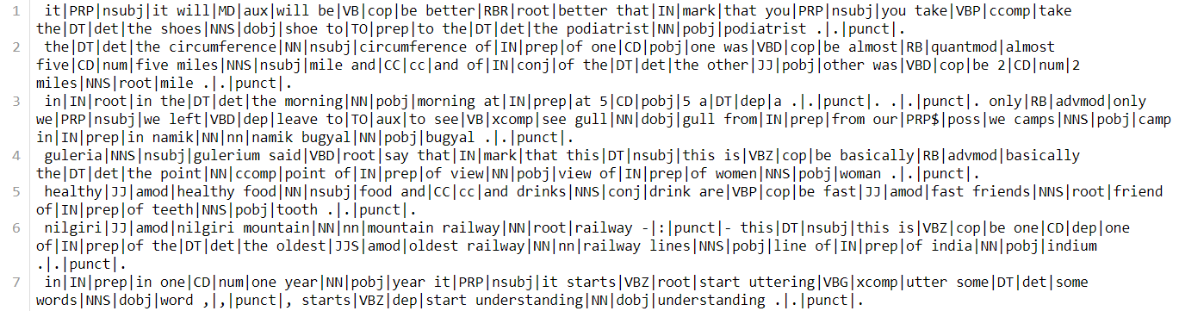
Factored pipeline (SNIPPETS)
POS + BPE
DEP + BPE
POS + DEP+ LEMMA+ BPE
LEMMA + BPE

Slide 9
RESULTS/ISSUES
BLEU score and Manual evaluation of desired 200 sentences for all models for clear introspection.
Last week results (Training on 150 epochs): NOT GOOD.
Need to train more for the model to generalize well.
All scripts ready!
Can train only one model at a time!

