Slide 1
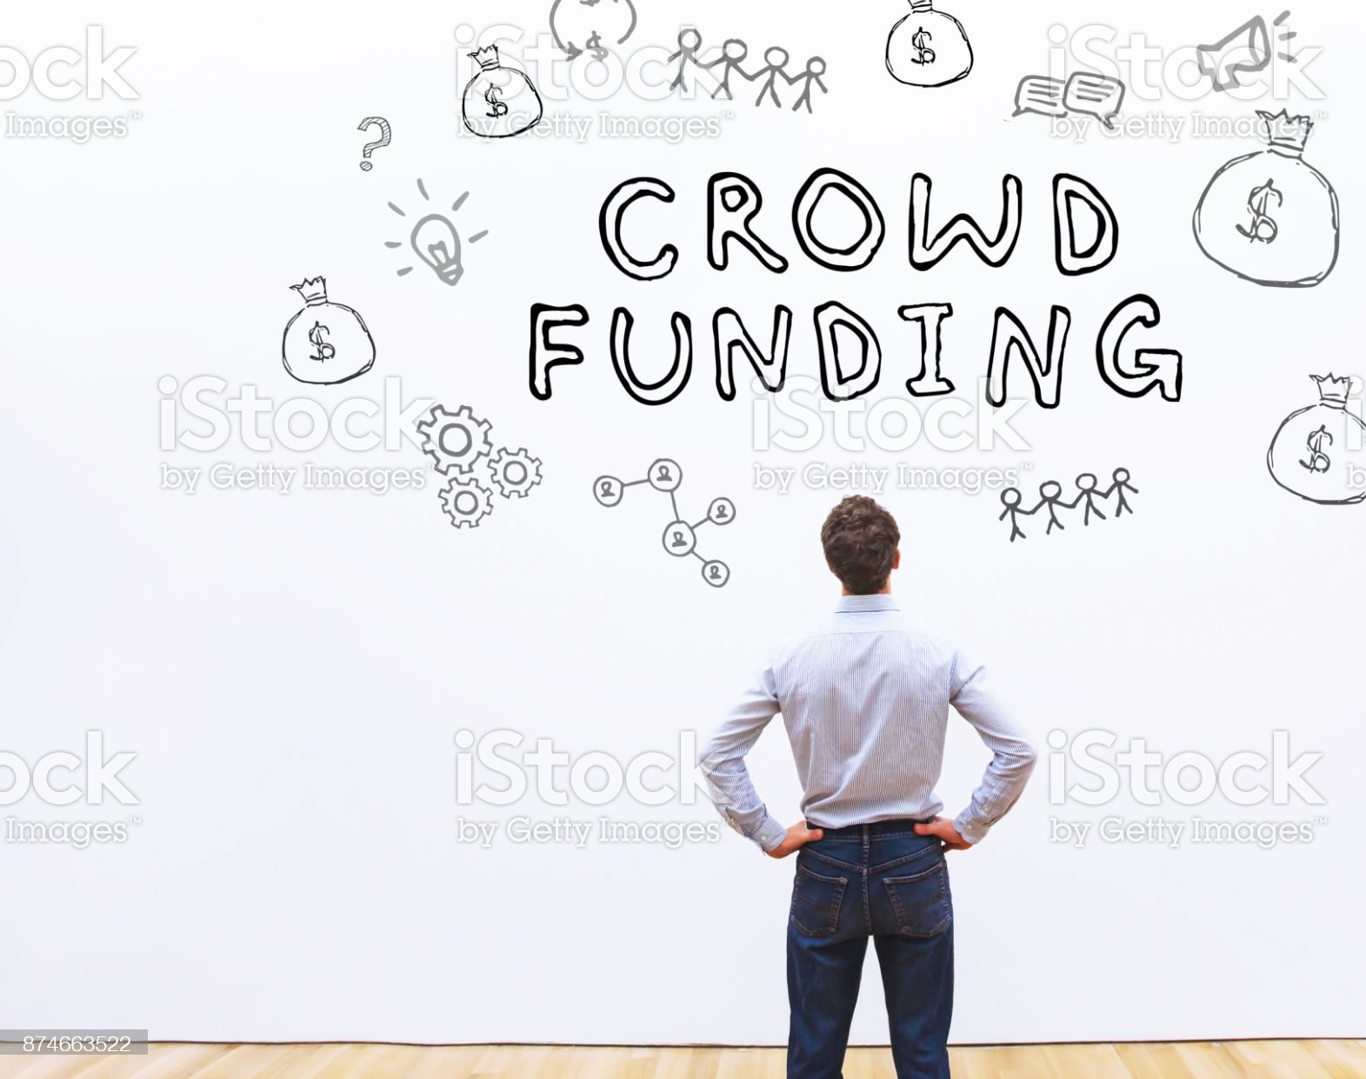
Crowdfunding Across Borders:
Hassan Mehmood
06/25/2023

Slide 2
OUTLINE
Executive Summary
Introduction
Methodology
Results
Discussion
Conclusion
Appendix

Slide 3
Executive Summary
This Project explores the dynamics of crowdfunding campaigns, focusing on factors that contribute to their success.
We Analyzed data from companies across different countries, considering variables such as :
Pledged Money
Number of Backers
Duration of the campaign
Ultimate outcome of the pledge.
Through comprehensive data analysis, we identified key insights and patterns that can guide future crowdfunding endeavors.
This analysis also sheds light on the additional data that should be gathered to enhance decision making.

Slide 4
Points Focused
The objective of the analysis is to extract valuable insights from the collected data.
Identify areas requiring additional data collection and focus.
Discover and analyze any discernible patterns or trends present in the data.
Establish a starting point for further advancement and development.
Determine which areas are yielding the highest returns on the invested efforts.

Slide 5
Methodology
Extract Transform Load
Gathering data
Data Wrangling
Loading the data as csv and into SQL database.
Exploratory Data Analysis
Data Mining
Descriptive Statistics
Analyzing the dataset
Statistical Analysis
Data distribution
Correlations
Illustrations and Dashboard
Tableau
Matplotlib
Results
Discussion
Conclusion and Appendix

Slide 6
Key Findings:
Majority of pledges belong to the 'theater' category.
Philanthropes show less interest in journalism, photography, and food.
76.3% of the pledges originate from the United States.
The analysis of pledge count and duration indicates that a 5-month campaign is optimal.
Out of all pledges, 36.4% resulted in failure, while 56.5% were successful.

Slide 7
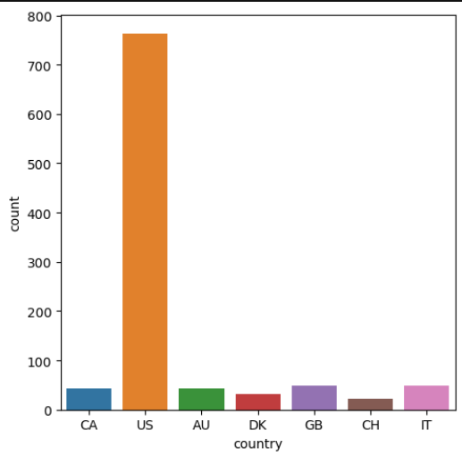
As it is evident from the graph, with over 700 pledges US is leading other areas.

Slide 8
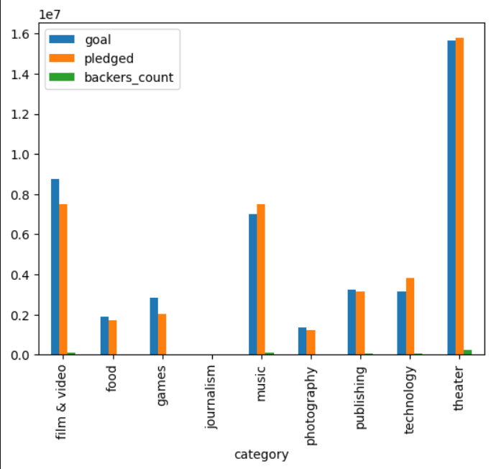
This graph illustrates how the number of pledges are distributed over categories.
According this graph ‘Theater’ is the most favored while ‘journalism’ is the least favored category.

Slide 9
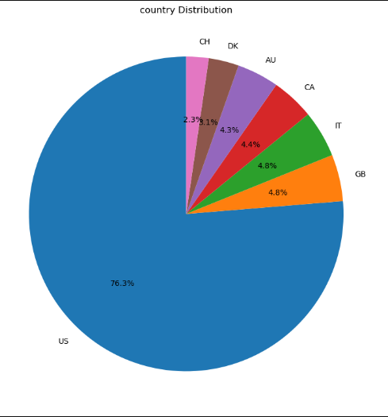
As shown here England follows US in the number of pledges.

Slide 10
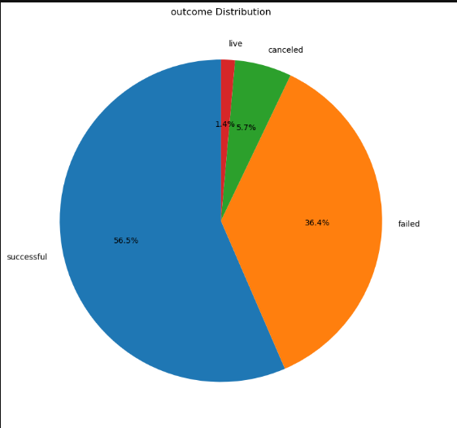
Out of all the pledges 36.4% fail,
while 5.7% were cancelled.

Slide 11
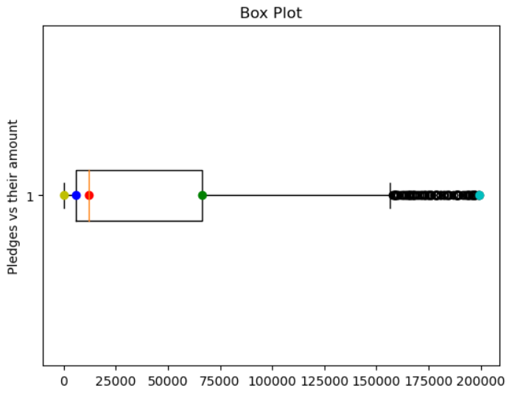
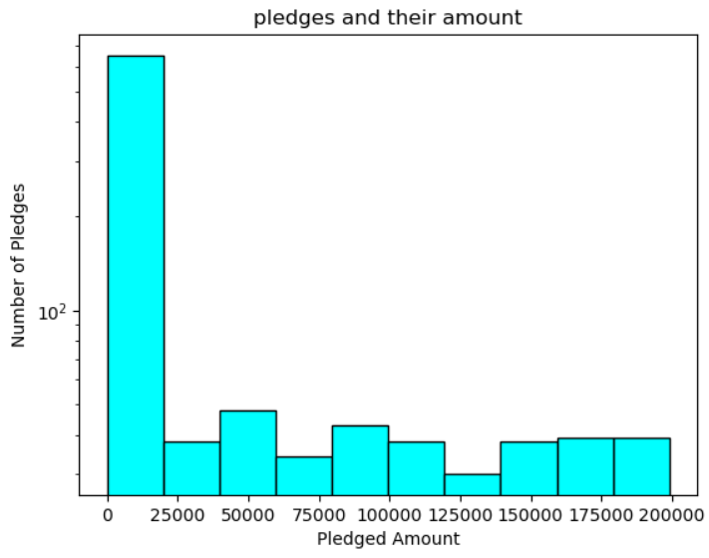
The first figure show the distribution of the pledges and important statistical landmarks.
The second image shows that the most of pledges are under the amount of 25000$
Min
3rd quantile
Max
1st quantile and Median.

Slide 12
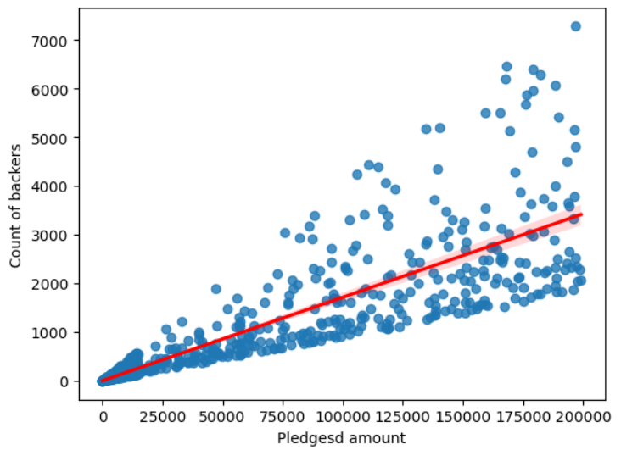
This Regression confirms that the amount of pledge is strongly correllated with the number of backers.

Slide 13
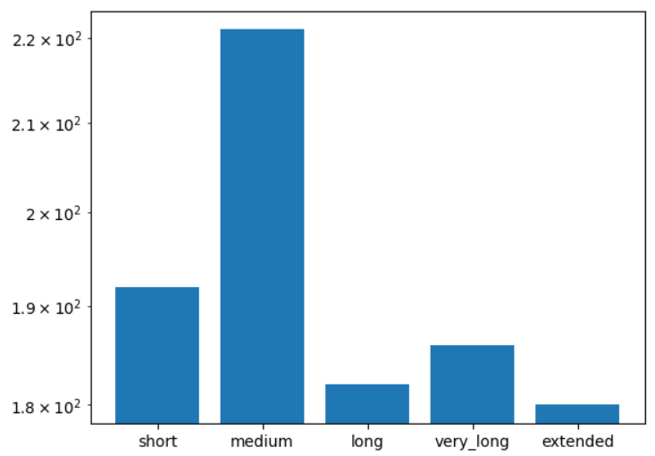
The optimum number of days for the campaign are 140 – 150 days.
Following is how the ranges were determined :
Short : 75 days
Medium : 150 days
Long : 225 days
Very Long : 300 days
Extended : 375 days

Slide 14
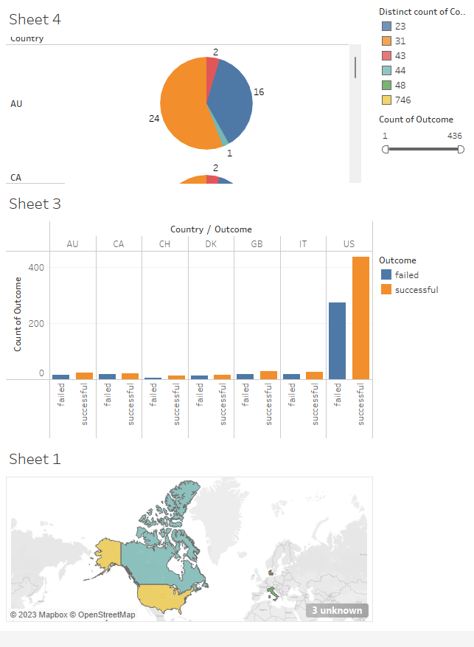
Dashboard
https://public.tableau.com/views/Book1_16877502494710/Dashboard1?:language=en-US&publish=yes&:display_count=n&:origin=viz_share_link

Slide 15
Implications, Discussion and Path forward:
Utilizing Classification Models: Implementing models to predict pledge outcomes enables optimized resource allocation and prioritization of follow-up efforts.
Gathering Specific Data: Further data collection is needed to address important questions:
Analyze resource distribution among countries to improve resource allocation.
Investigate patterns among failed pledges to identify underlying factors.
Establish a dedicated database for crowdfunding organizations' data.

Slide 16
Appendix
Data Source : Non-Profit Organization.
Methodology:
ETL
EDA
Statistical Analysis
Illustrations
Note: Dataset and methodology details available upon request.

