Slide 1
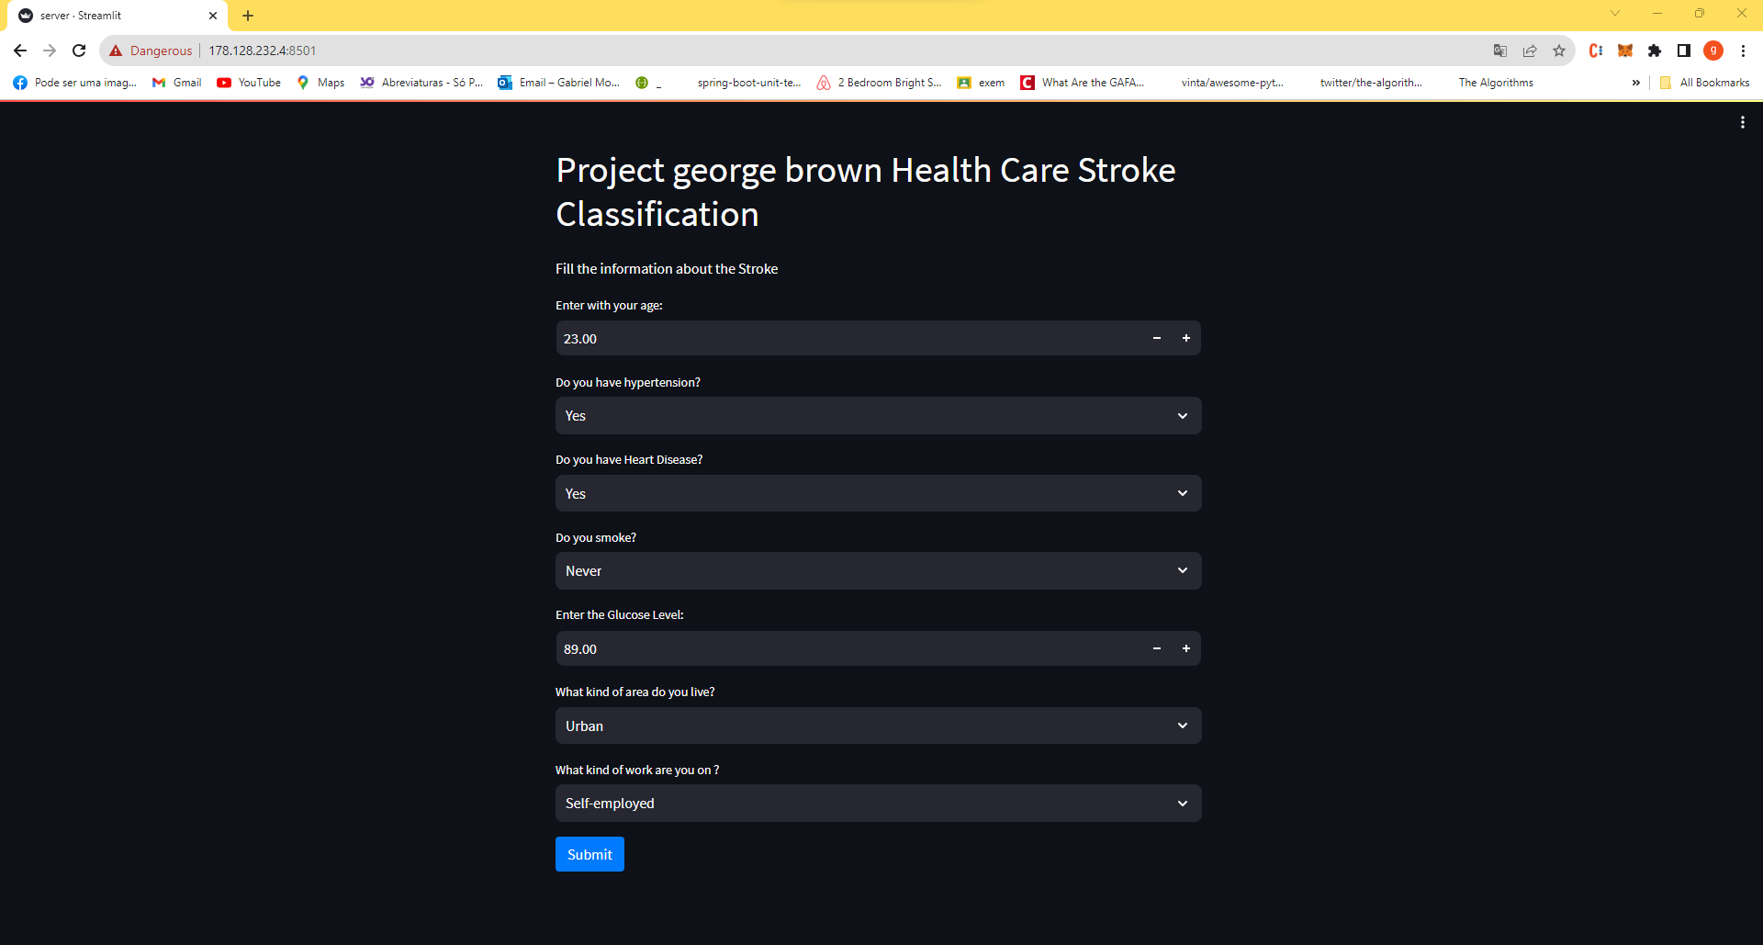
Application to make this model discover a product

Slide 2
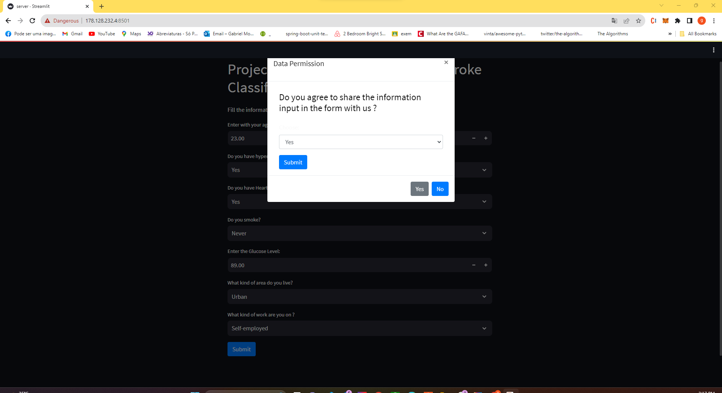
Ask for permission to use the data filled from the user

Slide 3
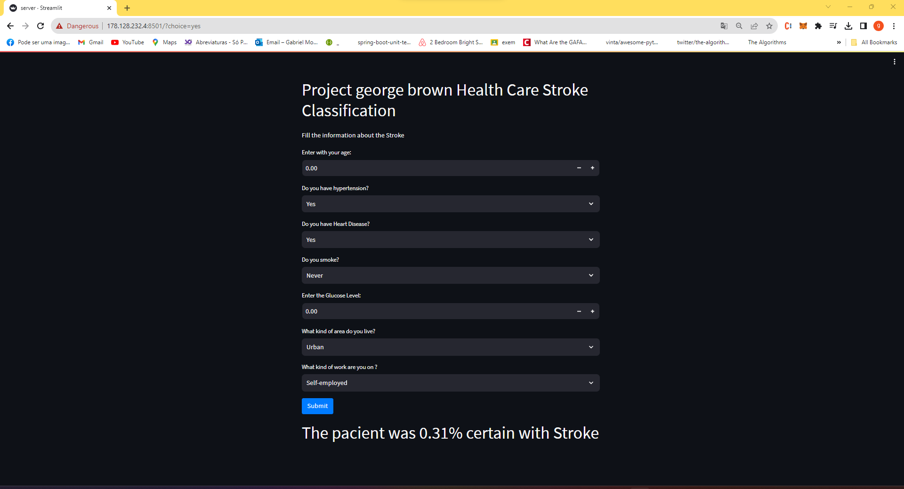
After the approve from the patient the data is send to the server and return the prediction about stroke

