Slide 1

GROUP 5
NLP Project
Hessa-Amal-mehdhar-Ahmad

Slide 2
AGENDA
Data explore & Preprocessing
Model Training & Evaluation
Model selection
test on real data
Challenges

Slide 3

Goal of the Project:
Develop and evaluate machine learning models for text classification.
Compare ML models .
Address challenges

Slide 4
Data explore & Preprocessing

Slide 5
Data processing:
convert text into numerical using TF-IDF
split the
data
load the data
Explore the data
clean text

Slide 6



explore the data:
The dataset contains 39,942 entries with the following columns:
title
subject
(headline of the news article)
(category of the news)
label
(0 or 1, indicating class labels)
text
date
(full article content)
(publication date)

Slide 7
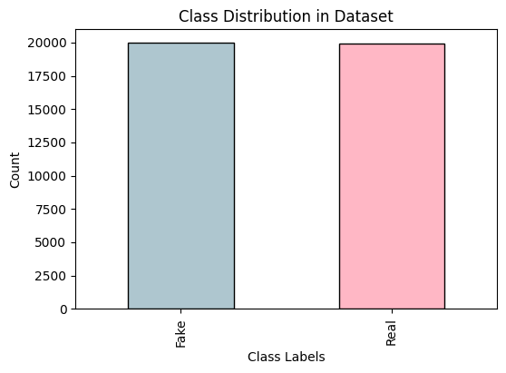
explore data labels:

Slide 8
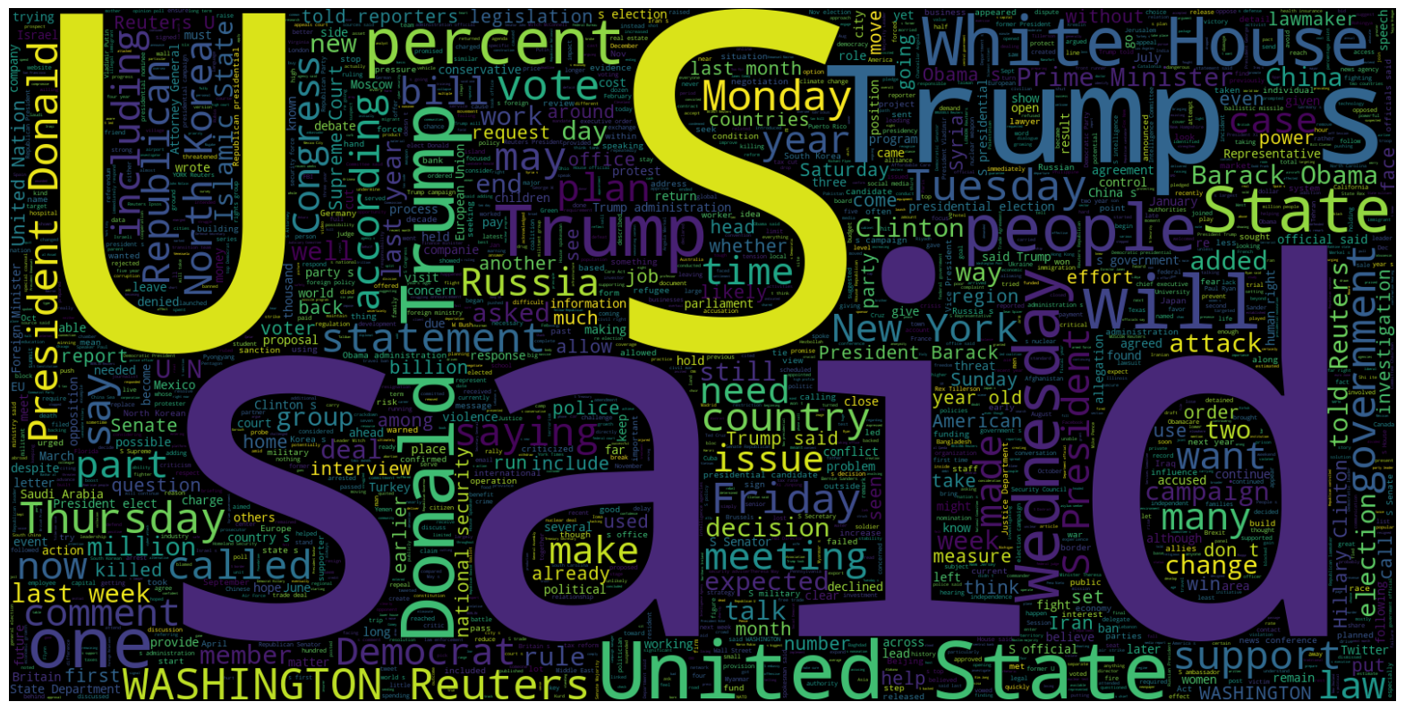
word cloud(Real):

Slide 9

word cloud(Fake):

Slide 10
Model Training & Evaluation:

Slide 11
The models we used:
LOGISTIC REGRESSION | NAÏVE BAYES | RANDOM FOREST | SUPPORT VECTOR MACHINE (SVM)

Slide 12
comparing table:
 | Logistic Regression | Naïve Bayes | Random Forest | Support Vector Machine (SVM)
Accuracy
the
best
a
good one
98.57%
91.05%
99.69%
99.16%
F1-Score
99%
91%
100%
99%
Precision
99%
91%
100%
99%
Recall
99%
91%
100%
99%

Slide 13
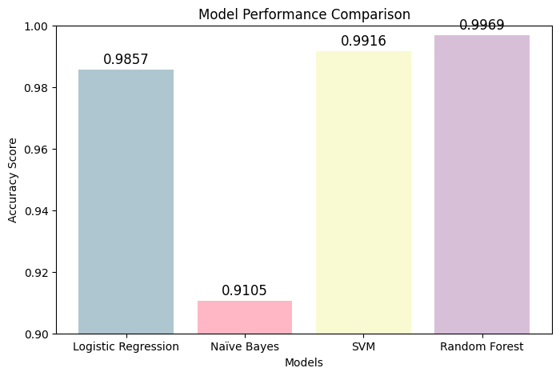
Model performance graph:

Slide 14
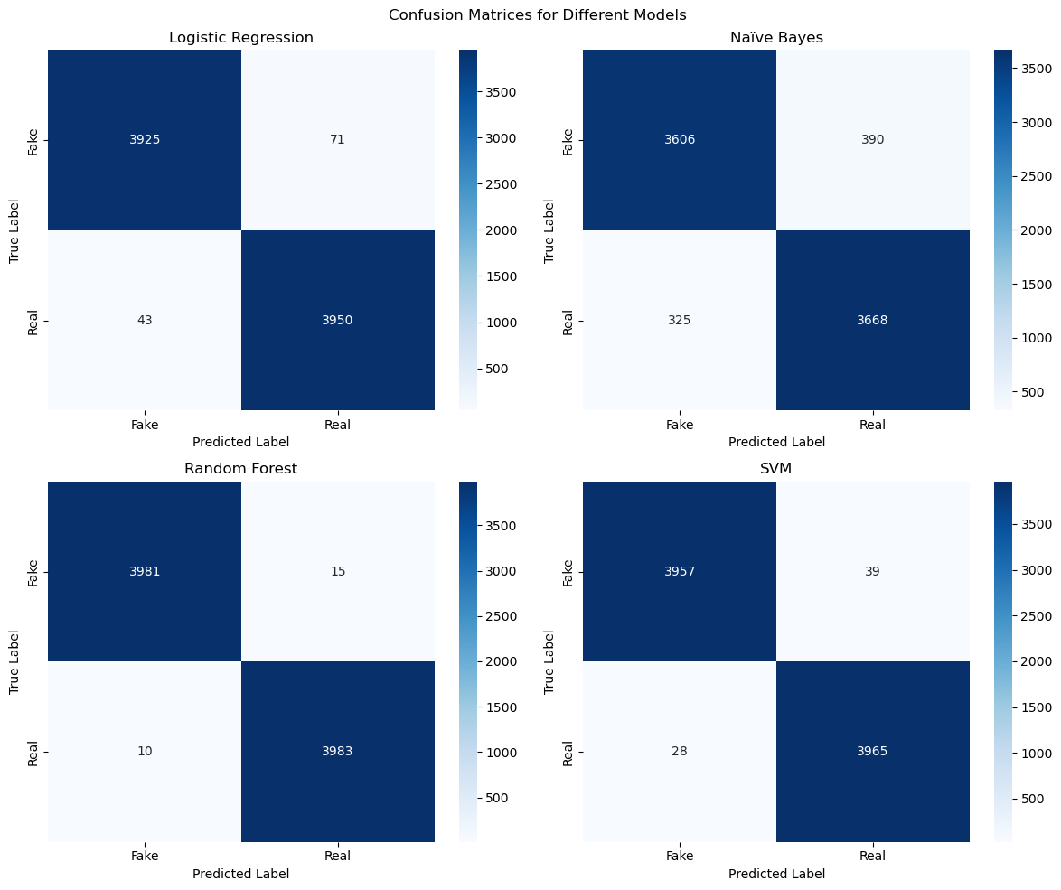

Model Performance:

Slide 15
Model Performance :

Slide 16
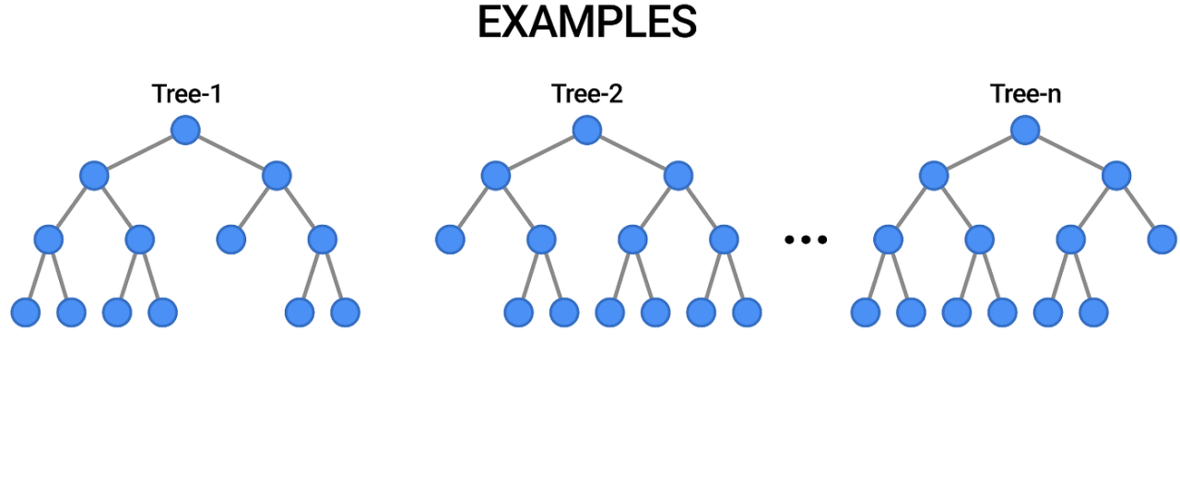
The best model:
Random forest regression

Slide 17
predict label for real data

Slide 18
test real data steps:
pre process the real data.
predict the label for the real data(Real,Fake).

Slide 19
explore and pre process the real data:
title
subject
(headline of the news article)
(category of the news)
label
text
date
two
(full article content)
(publication date)

Slide 20
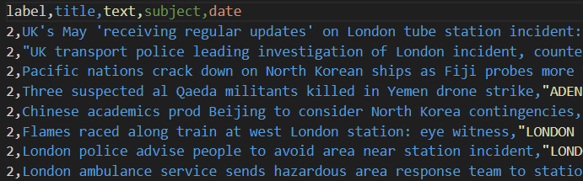
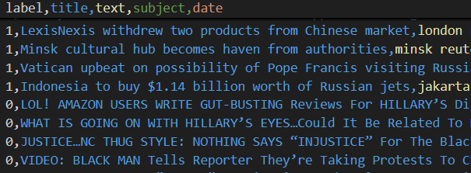
predict the label for the real data(Real,Fake):
before labeling
after labeling

Slide 21
Challenges & Limitations:
Overfitting Risks
Choice of Models
Misclassification Risks

Slide 22
Team work:
 | Mehdhar | Hessa | Ahmad | Amal
members
task
coding/presentation
coding/presentation
coding/presentation
coding/presentation
progress
25%/25%
25%/25%
25%/25%
25%/25%

Slide 23
THANK YOU !

