Slide 1

Introduction to GIT
M. Abbasi
Kharazmi University
Fall 2021

Slide 2

Why GIT?
Dead Line
Thesis-1.docx
Thesis-2.docx
Thesis-final.docx
Thesis-final-2.docx
20 MB
20.2 MB
20.5 MB
21 MB
20 + 20.2 + 20.5 + 21 = 81.7 MB

Slide 3
Why GIT?
Team work
Transfer source codes
Adding features
Bug Fix
Mistakes and ERRORS
Git makes collaboration easier
Solution: Version Control Systems (VCS)

Slide 4
How Git works?
Dead Line
Thesis-1.docx
Thesis-2.docx
Thesis-final.docx
Thesis-final-2.docx
20 MB
20.2 MB
20.5 MB
21 MB
20 + 20.2 + 20.5 + 21 = 81.7 MB
Only diff.
20 + 0.2 + 0.5 + 1 = 21.7 MB

Slide 5

How Git works?
Server Base
Advance files managing
tracks the changes you make to files

Slide 6
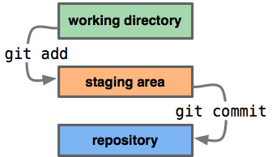
Definitions
Repository:
the history of all changes made to the files in your project
Stage:
simply to prepare files finely for a commit
Commit:
a snapshot of the project's
currently staged changes.
Commit is unchangeable object.

Slide 7
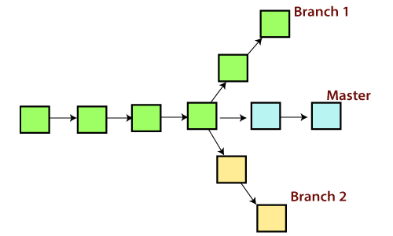
Definitions
Branch:
a pointer to a specific commit

Slide 8


Git or GitHub?
Git is a version control system that lets you manage and keep track of your source code history.
GitHub is a cloud-based hosting service that lets you manage Git repositories.

Slide 9

Web-based hosting services
Both are web-based hosting services for GIT.
GitHub is not open-source but GitLab community Edition is free and open-source.
GitLab has everything GitHub has, but with extra features and increased control over repositories. (it offers its very own CI/CD)

Slide 10
Let's get hands dirty

Slide 11


Install GIT
Windows: https://git-scm.com
MAC OS: https://git-scm.com
Linux:
Checking installation:

Slide 12
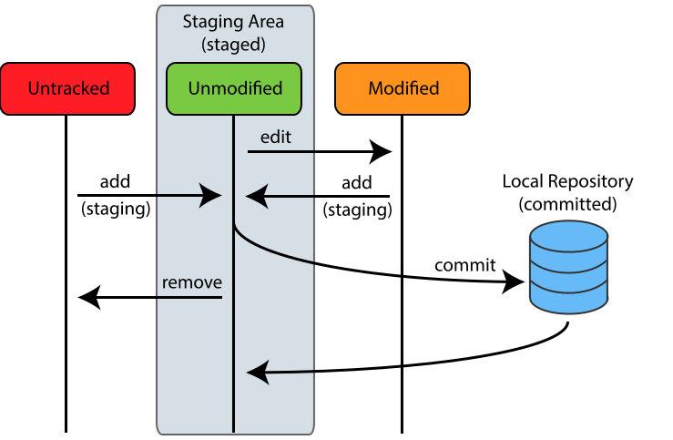
Git file status

Slide 13
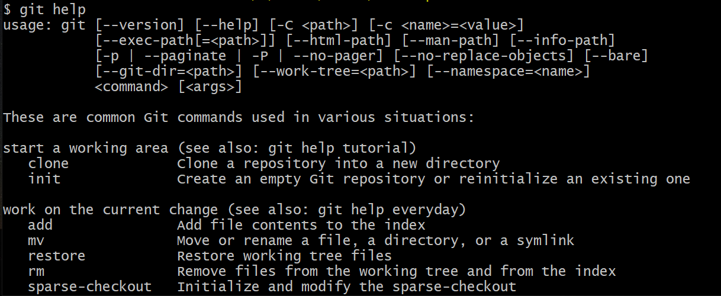
GIT Commands
Git help:

Slide 14
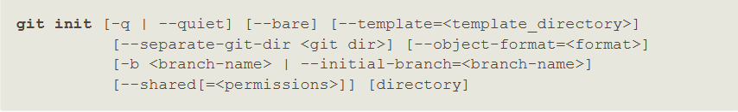
GIT Commands
Git init: Create an empty Git repository or reinitialize an existing one.
Git status: Show the working tree status.

Slide 15
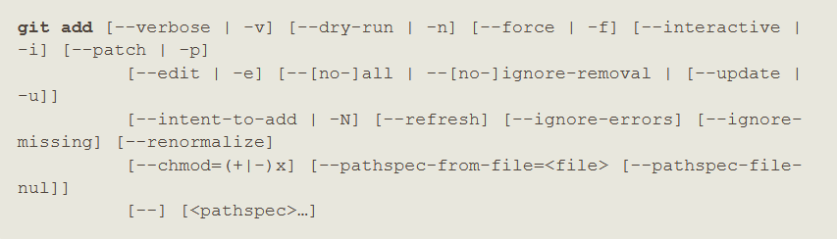
GIT Commands
Git add: Add file contents to the index (stage changes)

Slide 16
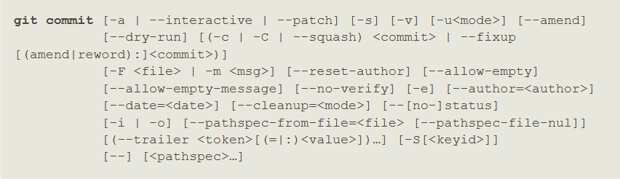
GIT Commands
Git commit: Record changes to the repository.

Slide 17
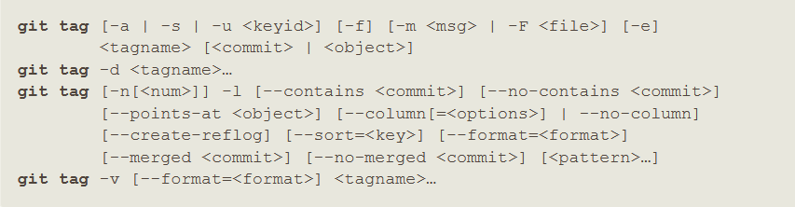
GIT Commands
Git log: Show commit logs.
Git tag: Create, list, delete or verify a tag object signed with GPG. Lightweight & Annotated

Slide 18
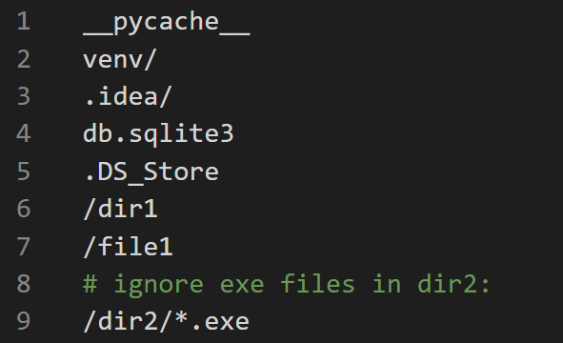
GIT Commands
Gitignore: Specifies intentionally untracked files to ignore.
A gitignore file specifies intentionally untracked files that Git should ignore.
Each line in a gitignore file specifies a pattern.

Slide 19
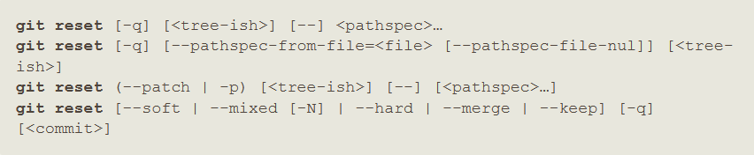
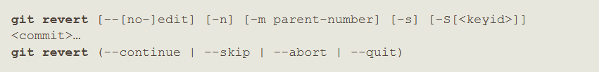
GIT Commands
Git reset: Reset current HEAD to the specified state.
Git revert: Revert some existing commits.

Slide 20
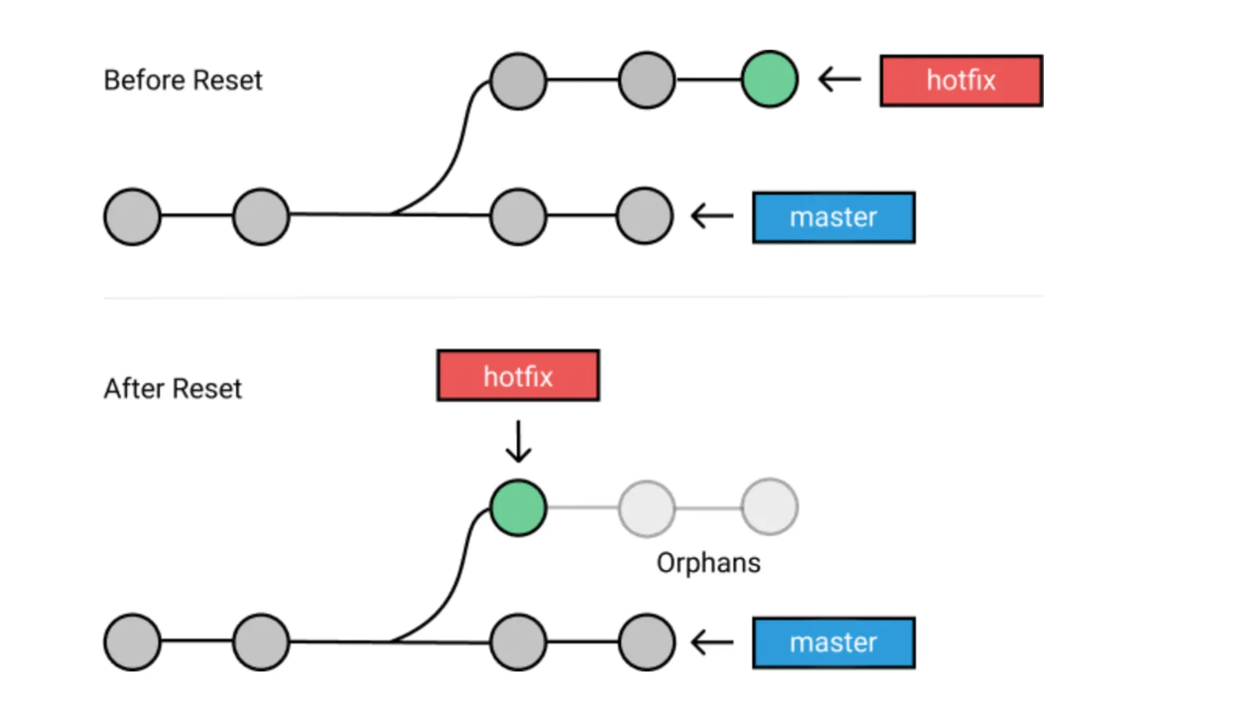
GIT Commands: revert vs reset

Slide 21
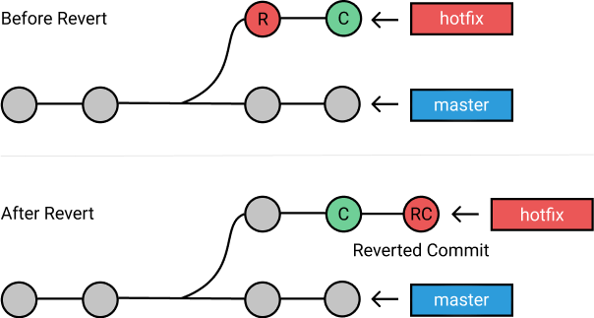
GIT Commands: revert vs reset

Slide 22
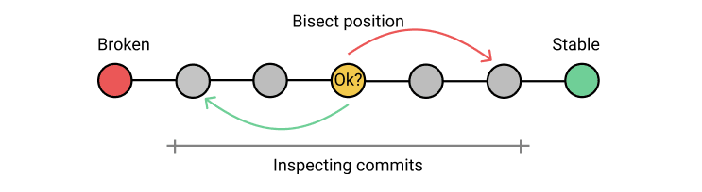
GIT Commands
Git bisect: Use binary search to find the commit that introduced a bug.

Slide 23
Branch & Merge

Slide 24
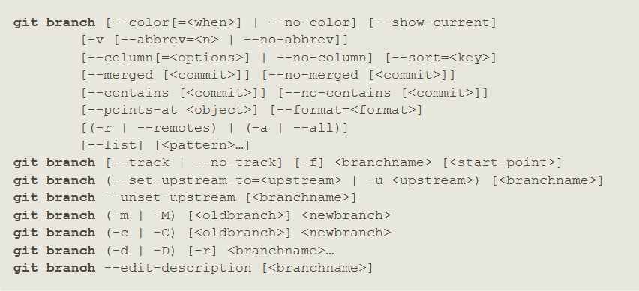
GIT Commands
Git branch: List, create, or delete branches.

Slide 25
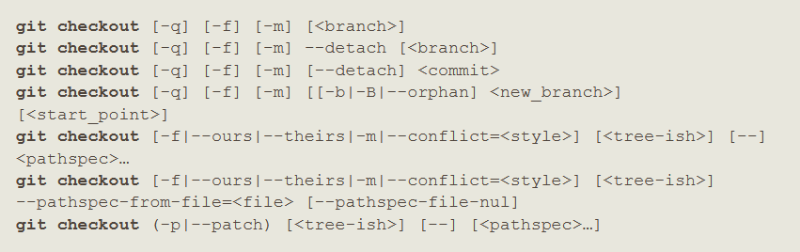
GIT Commands
Git checkout: Switch branches or restore working tree files.

Slide 26
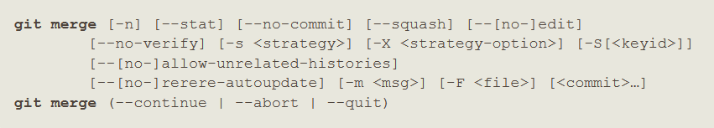
GIT Commands
Git merge: Join two or more development histories together.

Slide 27
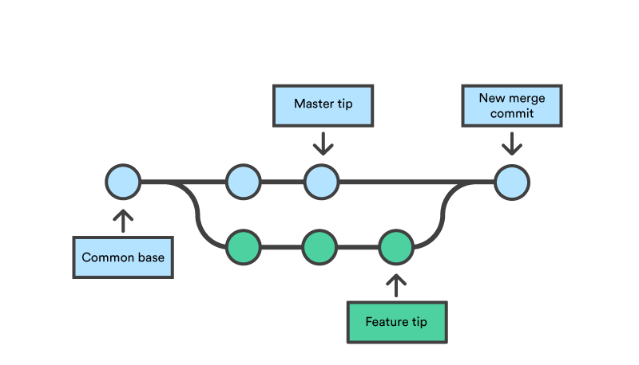
GIT Commands: Merge

Slide 28
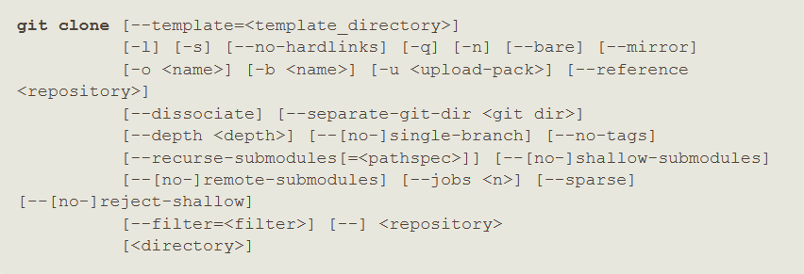
GIT Commands
Git clone: Clone a repository into a new directory.

Slide 29
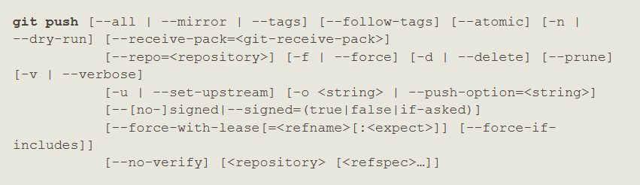
GIT Commands
Git pull: Fetch from and integrate with another repository or a local branch.
Git push: Update remote refs along with associated objects.

Slide 30

GitHub
How to create new repository in GitHub?
How to Pull Request in GitHub?
What is GitHub fork?
Try to clone, push, and pull in GitHub.
Personal Web Site > Username.github.io

Slide 31
“Talk is cheap. Show me the code.” ― Linus Torvalds

