Slide 1
Mapping of vulnerable populations - Covid-19
Applied Data Science Capstone
IBM Data Science Professional Certificate

Slide 2
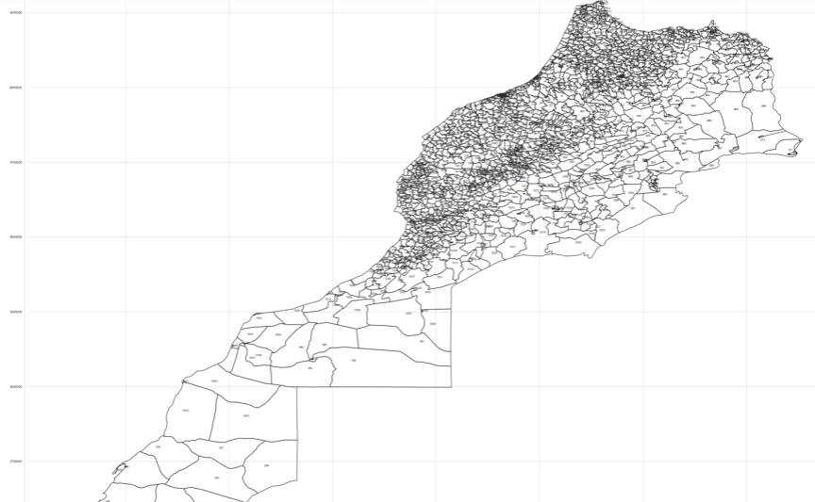
Moroccan Map

Slide 3
Part 1: Problem Description
To overcome the health crisis in the best possible conditions, the Moroccan authorities are mobilizing all the resources and goodwill of the country today. In order to contribute to this national effort, we formulated the project "Mapping of vulnerable populations to Covid-19",

Slide 4
Part 1: General objectives of the project
1. Facilitate the operation of confinement of the population, in particular the most vulnerable fringes in socioeconomic and epidemiological terms,
2. Direct the mobilization of public resources (financial and in-kind aid) to the areas where the needs are most pressing,
3. Identify potential clusters for the spread of the epidemic and guide a possible targeted testing policy.

Slide 5
Part 1: Expected products
1. 1. maps for the use of public authorities are available, making it possible to identify on the scale of neighborhoods the areas of socio-economic and epidemiological vulnerability.
2. Numerical estimates will be available on the number, statistical and geographic distribution of the households most vulnerable, in socio-economic and epidemiological terms, to the spread of the virus.

Slide 6
Part 2: Data We Need (1/4)
The analysis of data from the general population and housing census (RGPH 2014) and the mapping of the territory (at the finest level) makes it possible to identify, in urban districts, the areas of concentration of populations most vulnerable to the spread of the epidemic, across two overlapping categories:
1. The socio-economic difficulty in respecting the confinement instructions (daily workers),
2. Epidemiological vulnerability (households with at least or exclusively one (s) member (s) older than 60 years or presenting with chronic disease (s)).

Slide 7
Part 2: Data We Need (2/4)
Step 1: collecting databases
The first step is to collect the following data sets:
▪ The RGPH micro-database (2014), “individual” file including the GPS location of the respondent's island2, and corresponding metadata (HCP data),
▪ The RGPH micro-database (2014), “households and dwellings” file including the GPS location of the household block, and corresponding metadata, (HCP data),
▪ The digital cartography of the administrative division of the territory at the finest scale. As regards the urban environment, the most conducive to the spread of the epidemic, it is a question of obtaining a cartography at the infra-district scale, making it possible to link a territory to the corresponding local authority (data Interior).

Slide 8
Part 2: Data We Need (3/4)
Step 2: cleaning and harmonization of databases
This step consists in making the various data sets communicate, to obtain a single database, comprising the following elements:
- Each individual (respondent) is affiliated with a household,
- Each household is geolocated,
- Each household is part of an administrative division,
- The administrative divisions cut across all households,
- Each household has a binary indicator, taking the value "1" if a case of contamination or significant contact with an infected person has been confirmed within the same administrative division. If a dataset including the locations (at least one level of an administrative division) of contaminated people is provided at the start of the project, this data can be included.

Slide 9
Part 2: Data We Need (4/4)
Step 3: construction of socioeconomic and epidemiological vulnerability indicators
This step consists in using the degree of socioeconomic (Vse) and epidemiological (Vep) vulnerability measures of each Moroccan household.

Slide 10
Resualts (1/3)
The using of the k-Means methods let’s to have several clusters. The districts of the same clusters are similar regarding these indictors.
Label | Definition
IPM | Multidimensional poverty index (MPI, percent)
IPP | Poor people deprivation intensity (percent)
TPM | Multidimensional poverty rate (percent)
TPG | Global poverty rate (percent)
compEdu | MPI education component (percent)
compHabitat | MPI housing component (percent)
compInfrastrut | MPI infrastructure component (percent)
compSante | MPI health component (percent)
distribPMonetaire | Distribution of monetary poverty only (percent)
distribPMonetaireMultidim | Distribution of monetary and multidimensional poverty (core, percent)
distribPMultidim | Distribution of multidimensional poverty only (percent)

Slide 11
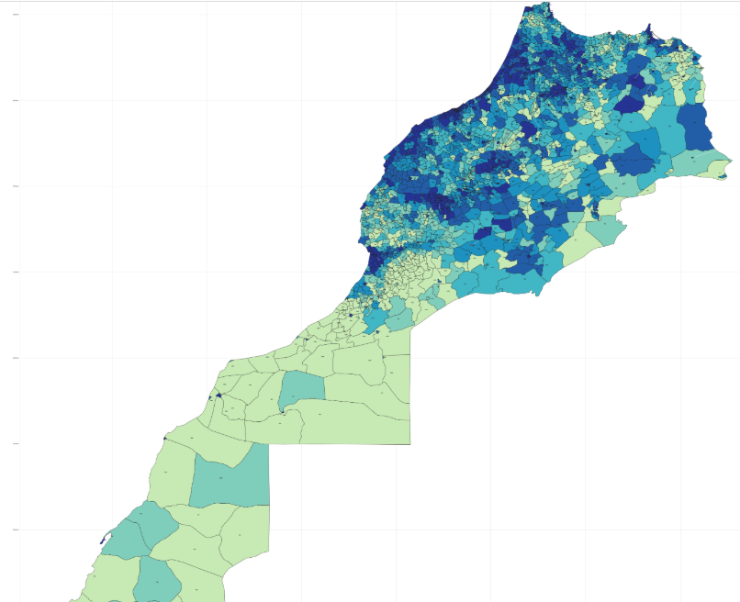
Resualts (2/3)
The visualisation of the cluster is given as below:

Slide 12
Resualts (3/3)
identification of socio-economic and epidemiological vulnerability zones / clusters
This step consists in identifying the zones (each block and corresponding administrative division) which concentrate the percentage of households with the greatest socioeconomic and / or epidemiological vulnerabilities.
A table can be generated for each administrative division, showing the distribution of the most vulnerable households within the administrative division. It is also possible to generate maps showing the points where the most vulnerable households are located, in order to direct the efforts of the authorities.

Slide 13
THANKS

