Slide 1
Smart Application in Artificial Intelligence and Machine Learning: Study and Understanding
6
ML modules
Professor: EL MKHALET MOUNA
Student: To be completed
Executable desktop app, report, presentation and English video
.exe
desktop delivery
01

Slide 2
TABLE OF CONTENT
Presentation roadmap
1. Foundation
2. Workflow
3. Architecture
AI and machine learning basics.
how each module runs an experiment.
interface, algorithms, visualization and packaging.
4. Demonstration
5. Methods and applications
6. Defense plan and conclusion.
screenshots and module results.
algorithms, domains and limits.
Close the project story and prepare for questions.
02

Slide 3
REQUIREMENTS
The project must prove execution, understanding and communication.
Executable Windows application required for validation.
Report title and structure follow the official PDF.
Presentation stays concise for a maximum 7-minute defense.
English video script is prepared for the final package.
Validation
Executable
Report
Presentation
03

Slide 4
FOUNDATION
AI and machine learning convert data into useful decisions.
AI combines data, algorithms, models, evaluation and deployment.
Machine learning learns patterns instead of hard-coding every rule.
The project uses random data to make experiments controlled and repeatable.
Core idea
Data
Model
Decision
04

Slide 5
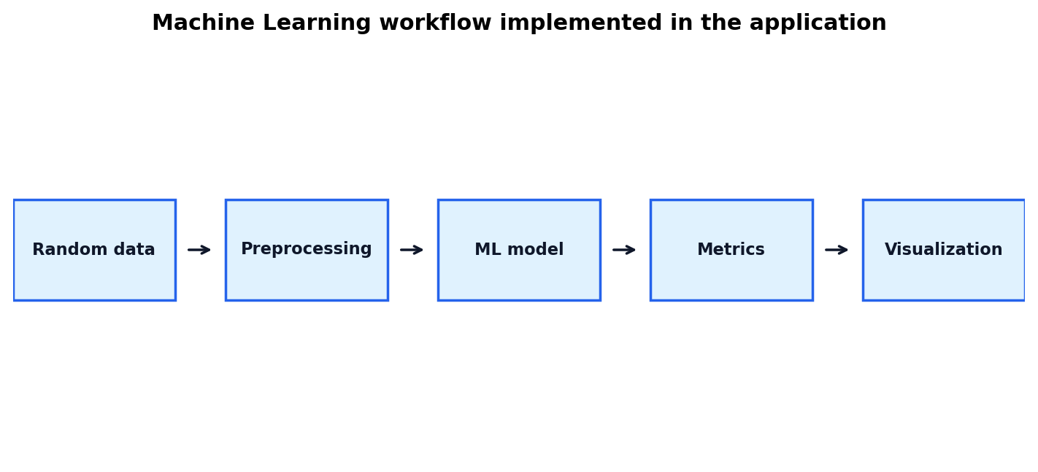
WORKFLOW
Each module follows one clear scientific workflow.
Choose parameters with sliders.
Generate random data using numpy.random.uniform.
Train the model and calculate metrics.
Interpret the graph and the result together.
05

Slide 6
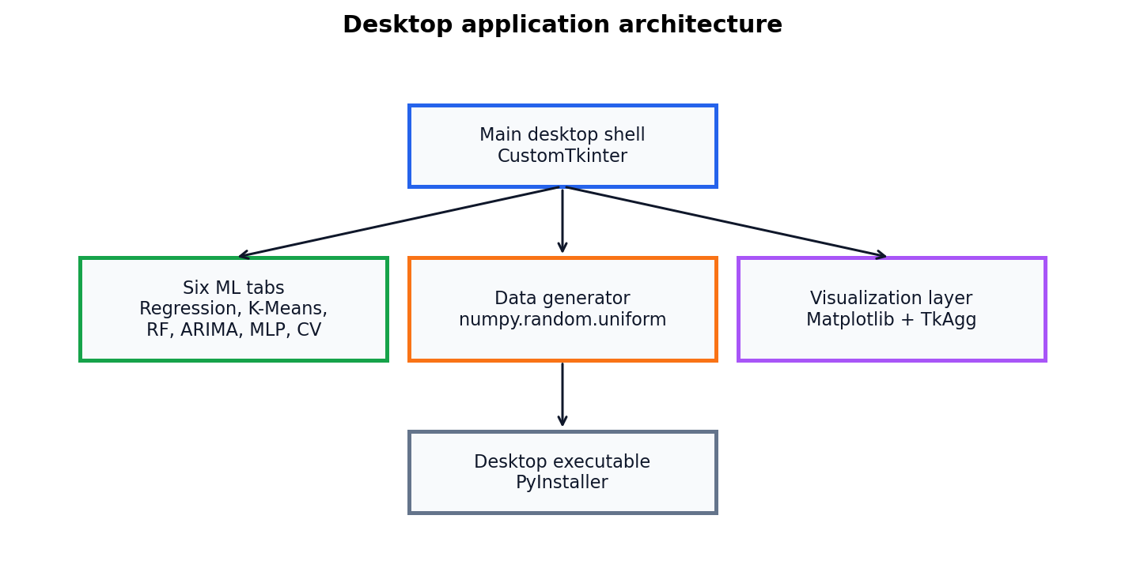
ARCHITECTURE
The application is modular and packaged as a desktop executable.
CustomTkinter provides the interface.
scikit-learn and statsmodels provide the algorithms.
Matplotlib displays embedded visualizations.
PyInstaller generates the final .exe.
06

Slide 7
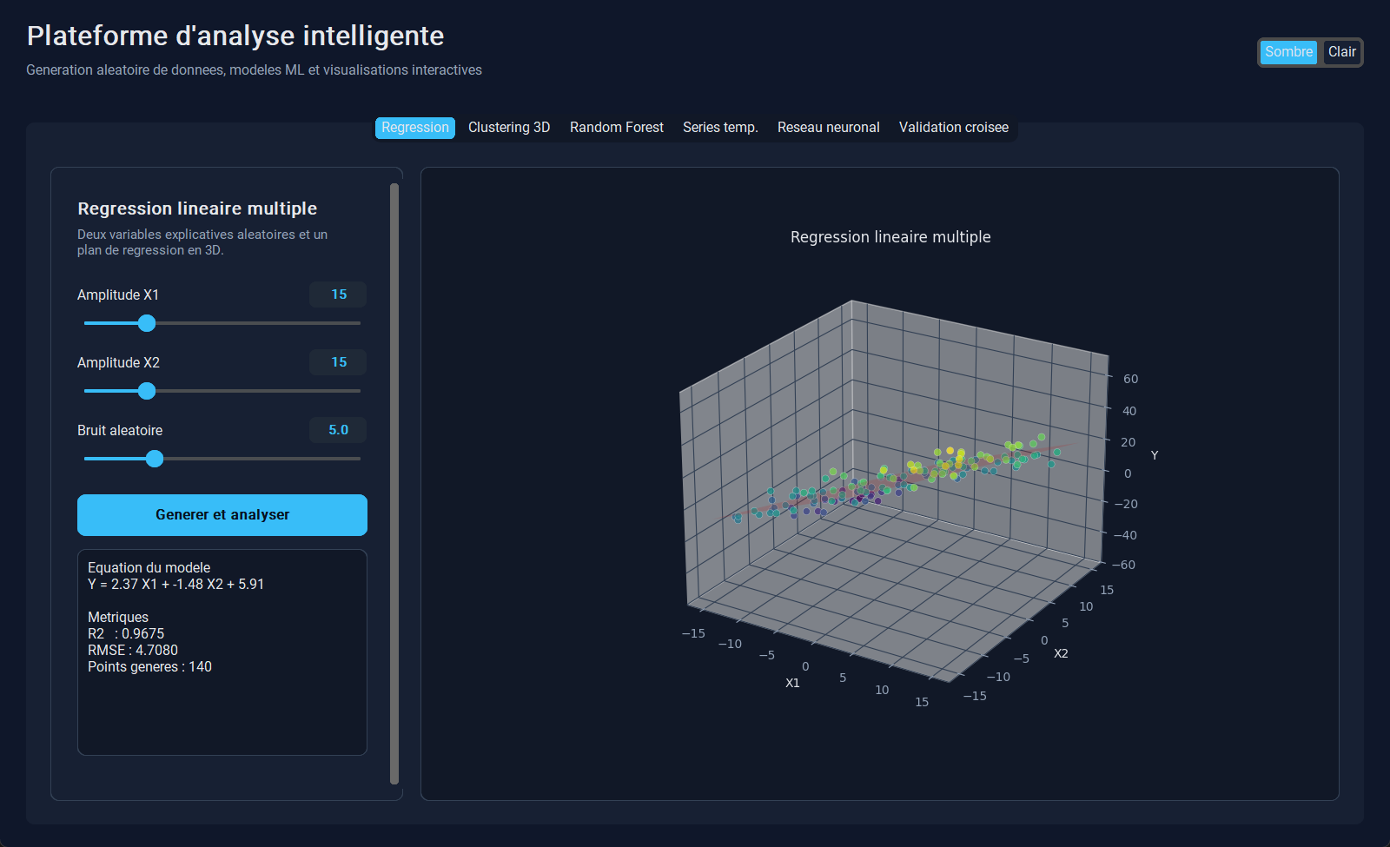
SCREENSHOT
The regression tab demonstrates a complete ML experiment.
The user controls input ranges and noise.
The model estimates coefficients and intercept.
R2 and RMSE explain model quality.
07

Slide 8
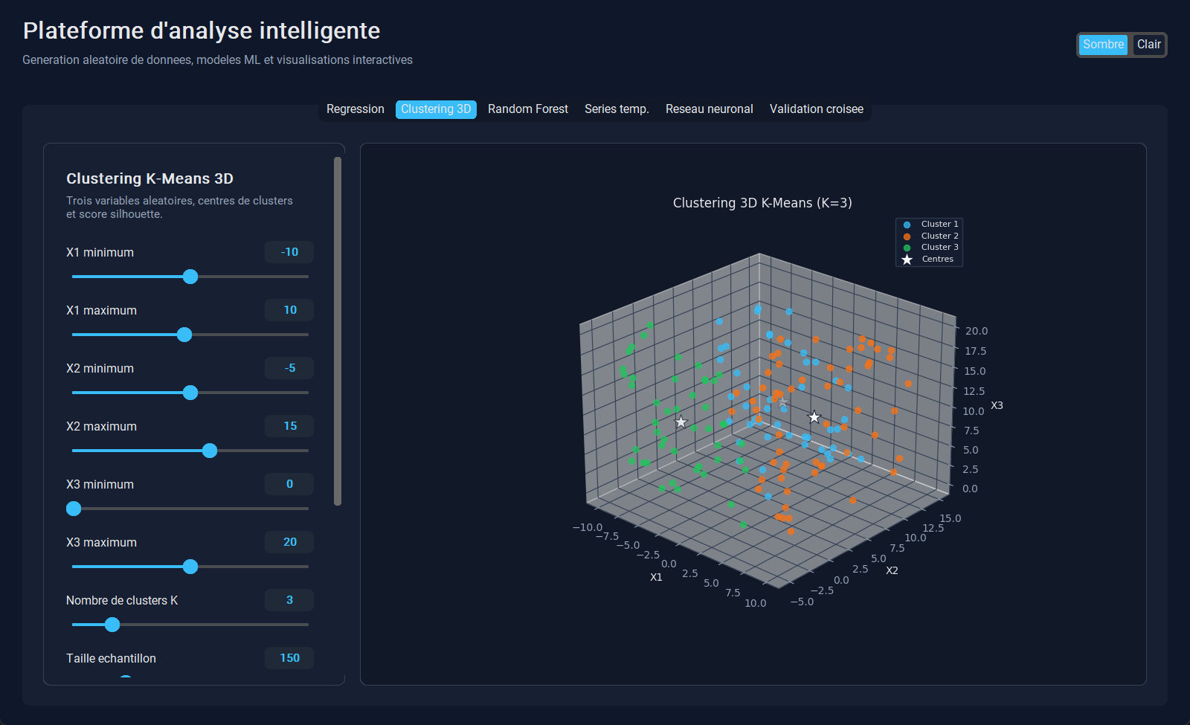
SCREENSHOT
The clustering tab shows unsupervised learning in 3D.
K-Means discovers groups without labels.
The 3D view shows separation between clusters.
The silhouette score summarizes cluster quality.
08

Slide 9
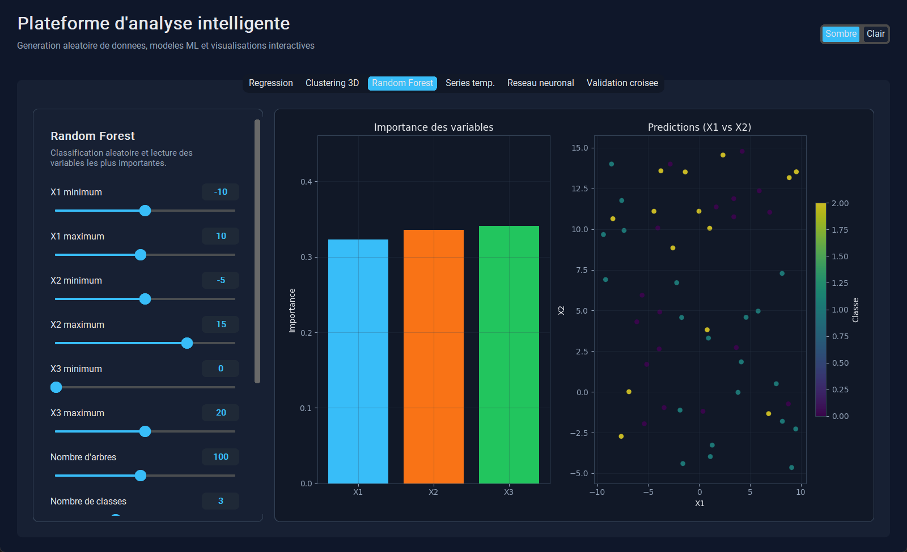
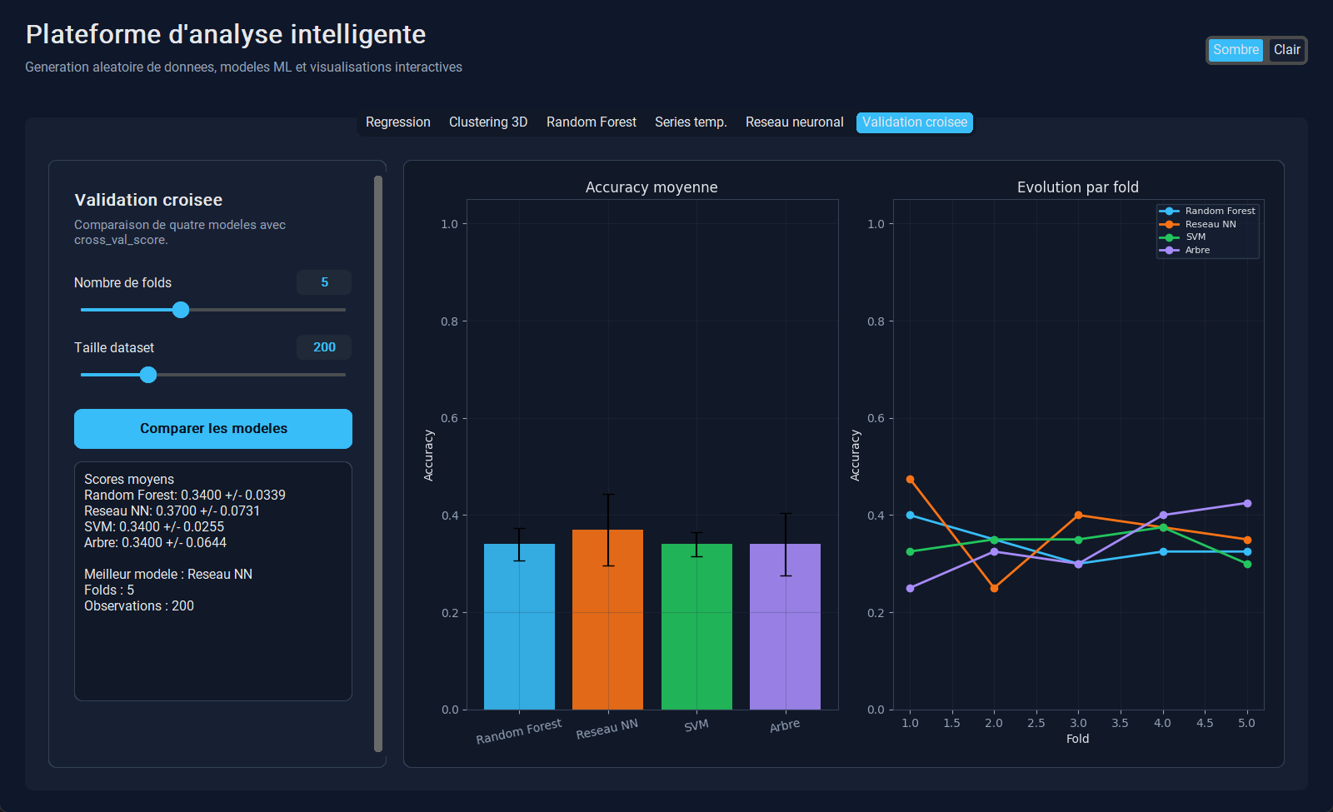
SCREENSHOTS
Classification and validation show performance comparison.
Random Forest explains accuracy and feature importance.
Cross-validation reduces dependence on one split.
The application compares several models in one place.
09

Slide 10
MODULES
The six tabs cover the required machine learning families.
Regression
Clustering 3D
Defense focus
continuous prediction.
unsupervised grouping.
Explain what it does
Read the metric
Connect to the report
Random Forest
ARIMA, neural network and cross-validation complete the TP.
ensemble classification.
ARIMA, neural network and cross-validation complete the TP.
10

Slide 11
METHODS
The report also studies additional algorithms.
SVM, Naive Bayes, Gradient Boosting and PCA.
DBSCAN, Apriori, Hidden Markov Models and Autoencoders.
Defense focus
SVM, Naive Bayes, Gradient Boosting and PCA.
DBSCAN, Apriori, Hidden Markov Models and Autoencoders.
Explain what it does
Read the metric
Connect to the report
Each method is explained with use cases, strengths and limits.
Each method is explained with use cases, strengths and limits.
11

Slide 12
APPLICATIONS
The same ML logic applies to three options.
Development: bug prediction, logs, DevOps monitoring.
Cybersecurity: anomaly detection, phishing and threat classification.
Artificial Intelligence: prediction, segmentation and decision support.
Three options
Development
Cybersecurity
AI
12

Slide 13
LIMITS
Machine learning needs evaluation and human interpretation.
Random data is useful for learning but less realistic than production data.
Overfitting, drift and poor data quality can reduce reliability.
Metrics must be interpreted with graphs and domain knowledge.
Risks
Data
Overfitting
Drift
13

Slide 14
7-MIN PLAN
The oral presentation is timed to stay under seven minutes.
1 minute: context, objective and AI/ML foundation.
3 minutes: application workflow, architecture and screenshots.
2 minutes: methods, domains, limits and perspectives.
1 minute: conclusion and questions.
Target
15 slides
About 28 sec each
Max 7 minutes
14

Slide 15
CONCLUSION
The final project is a complete academic and professional package.
The report proves scientific understanding.
The executable proves implementation.
The presentation and video prove communication.
GitHub or LinkedIn publication turns it into a portfolio asset.
Final message
Research
Implementation
Communication
15

