Slide 1
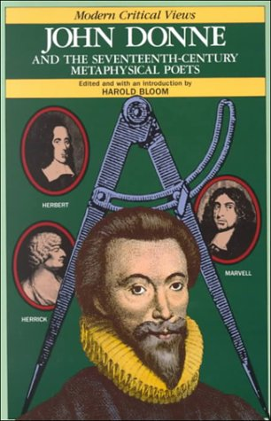
John Donne and Metaphysical Poets (1572-1631)
Prepared by Shadi Mohyeddin Ghomshei

Slide 2
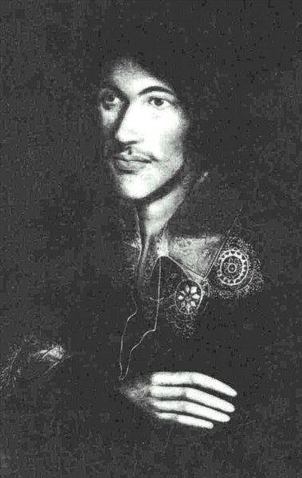
Background and Biography
Born into a Catholic family in 1572, during a strong anti-Catholic period in England.
He entered Oxford University and later the University of Cambridge, but never received degrees, due to his Catholicism.
As a Catholic in Protestant England, growing up in decades when anti-Roman feeling reached new heights, Donne could not expect any kind of public career, nor even to receive a university degree.
During the 1590s, he spent much of his inheritance on women, books and travel.
He wrote most of his love lyrics and erotic poems during this time.

Slide 3
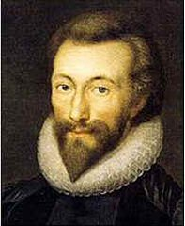
Life
he became known as a “rake” short for “rakehell” or "hellraiser"), a historical term applied to a man who has no moral code, particularly with women.
Often, a rake was also prodigal, wasting his (usually inherited) fortune on gambling, wine, women and song, and ending up indebted.
Donne’s career as a “rake” or ladies’ man ended after he met Anne More.
she was a teenager at the time, fresh from the countryside, and he was a secretary to her uncle Sir Thomas Egerton.
Donne was dismissed from his work and imprisoned for secretly marrying Anne.
During the next 10 years Donne lived in poverty

Slide 4
Donne’s mother was the great-niece of the Roman Catholic martyr, Thomas More. This tradition of martyrdom would continue among Donne's closer relatives- many were executed or exiled for religious reasons.
In 1593, John Donne’s brother, Henry, was convicted of Catholic sympathies and died in prison soon after. The incident led John to question his Catholic faith and inspired some of his best writing on religion.
At some point in the 1590s, having returned to London after travels abroad, and having devoted some years to studying theological issues, Donne converted to the English church.
In 1617, John Donne’s wife died shortly after giving birth to their 12th child. The time for writing love poems was over, and Donne devoted his energies to more religious subjects.(Holy Sonnets)

Slide 5
Religion
One of two anti-Catholic works he published, Pseudo-Martyr, earned him the favor of King James I because it argued Catholics could pledge allegiance to the king without renouncing their faith.
The object of his poetry now became God. He reasoned, "God is love.“
Friends encouraged Donne to become a priest in the Church of England. Donne repeatedly refused, lamenting that "some irregularities of my life have been so visible to some men." But when King James refused to employ him anywhere but the church, he relented.

Slide 6
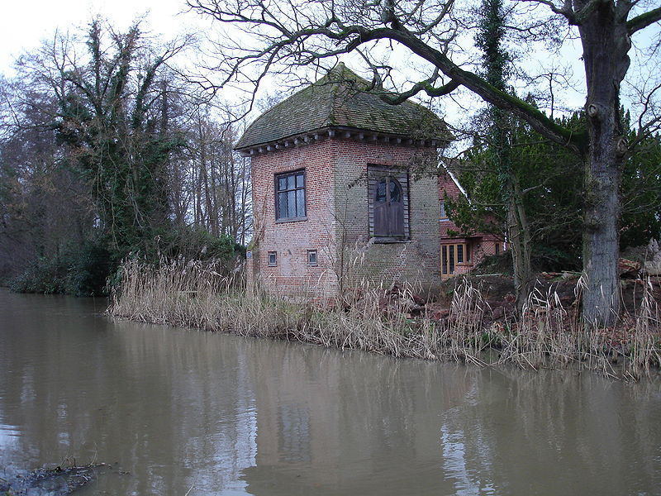
John Donne’s House
In 1615 he gave up Catholic faith and entered the Anglican Church and soon became Dean of Saint Paul's Church. As the most famous preacher during the time, he wrote many religious sermons and poems. And these were known as his sacred verses.

Slide 7
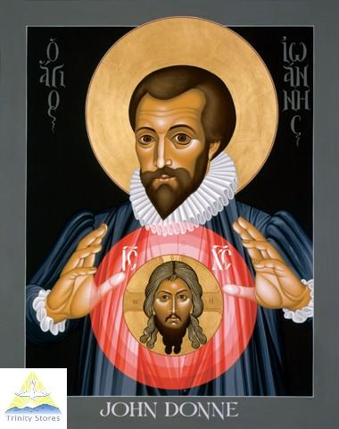
Donne wrote some of the most passionate love poems and most moving religious verse in the English language.
He wrote FIVE different types of poems:
Satires
Elegies
Verse Letters
Songs & Sonnets
Holy Sonnets or “Divine Poems”

Slide 8
What Does Metaphysical Mean?
The word 'meta' means 'after’, ‘beyond’, so the literal translation of 'metaphysical' is ‘beyond the physical.' Basically, metaphysics deals with questions that can't be explained by science. It questions the nature of reality in a philosophical way.
Here are some common metaphysical questions:
Does God exist?
Is there a difference between the way things appear to us and the way they really are? Essentially, what is the difference between reality and perception?
Is everything that happens already predetermined? If so, then is free choice non-existent?
Metaphysics can cover a broad range of topics from religious to consciousness; however, all the questions about metaphysics ponder the nature of reality. And of course, there is no one correct answer to any of these questions. Metaphysics is about exploration and philosophy, not about science and math.

Slide 9
Metaphysical poetry is a classification of poetry, not a genre.
The main poets of this group didn't read each other's work and didn't know that they were even part of a classification.
Literary critic and poet Samuel Johnson first coined the term 'metaphysical poetry' in his book Lives of the Most Eminent English Poets (1179-1781).
In the book, Johnson wrote about a group of 17th-century British poets that included John Donne, George Herbert, Richard Crashaw, Andrew Marvell and Henry Vaughan. He noted how the poets shared many common characteristics.

Slide 10
John Donne is known as the founder of the Metaphysical Poetry.
Their poems are all highly intellectualized, use rather strange imagery, use frequent paradox and contain extremely complicated thought.
It’s poetic style in which philosophical and spiritual subjects were approached with reason and often concluded in paradox.
Metaphysical Poets are known for their ability to shock the reader and persuade new perspective.
poets were examining serious questions about the existence of God or whether a human could possibly perceive the world….
The poetry often mixed ordinary speech with paradoxes and puns. The results were strange, comparing unlikely things, such as lovers to a compass or the soul to a drop of dew. These weird comparisons were called conceits.

Slide 11
John Donne is considered a master of the conceit, an extended metaphor that combines two vastly unlike ideas into a single idea, often using imagery.
Unlike the conceits found in other Elizabethan poetry, most notably Petrarchan conceits, which formed clichéd comparisons between more closely related objects (such as a rose and love), when such typical Petrarchan conceits appear in Donne, they are mocked.
Metaphysical conceits go to a greater depth in comparing two completely unlike objects.
Donne liked to twist and distort not only images and ideas, but also traditional rhythmic patterns.

Slide 12
Holy Sonnets
also known as the Divine Meditations or Divine Sonnets
a series of nineteen poems
The poems are sonnets written in the style and form of the Italian poet Petrarch consisting of an octave and a sestet.
However, several rhythmic and structural patterns as well as the inclusion of couplets are elements influenced by the sonnet form developed by Shakespeare.

Slide 13
Many of the poems are believed to have been written in 1609 and 1610, during a period of great personal distress and strife for Donne who suffered a combination of physical, emotional, and financial hardships during this time.
This was also a time of personal religious turmoil as Donne was in the process of conversion from Roman Catholicism to Anglicanism, and would take take holy orders in 1615 despite profound reluctance and significant self-doubt about becoming a priest. (this struggle is evident in his poems)

Slide 14
Themes
In Holy Sonnets, Donne addresses religious themes of mortality, divine judgment, divine love, and humble penance while reflecting deeply personal anxieties
The poems explore the wages of sin and death, the doctrine of redemption, opening "the sinner to God, imploring God's forceful intervention by the sinner's willing acknowledgment of the need for a an attack upon his present hardened state" and that "self-recognition is a necessary means to grace.”
The personal nature of the poems "reflect their author's struggles to come to terms with his own history of sinfulness, his inconstant and unreliable faith, his anxiety about his salvation.”
Donne is concerned about the future state of his soul, fearing not the quick sting of death but the need to achieve salvation before damnation and a desire to get one's spiritual affairs in order.

