Slide 1
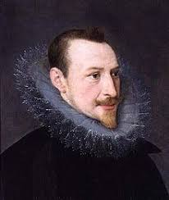
Edmund Spenser (1552-1599)
Prepared by: Shadi Mohyeddin Ghomshei

Slide 2
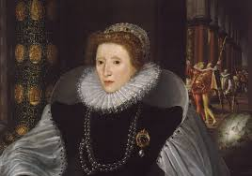
Literary works
The Faerie Queene
The Shepherd's Calendar
Amoretti (Sonnet Cycle)
The greatest non-dramatic poet of English Renaissance
Spenser is called the "poet's poet”- he influenced many later writers- they learnt the art of versification from him.
Received masters from Cambridge
Secretary for bishop of Kent- Queen Elizabeth’s court
Died while working on The Faerie Queene

Slide 3
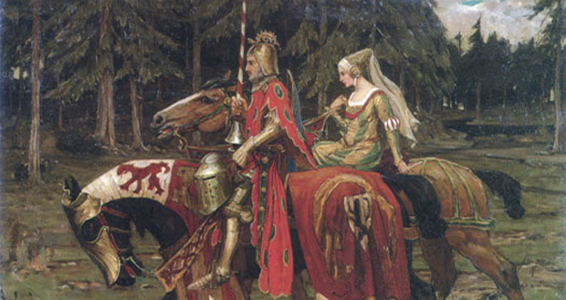
The Faerie Queene is an epic poem, an allegory, and a romance.
It is one of the longest poems in the English Language
A Romance is a long piece of narrative literature in either prose or verse, that tells the story of a chivalric hero who is on a long quest filled with misadventures and supernatural disturbances to save a damsel.

Slide 4
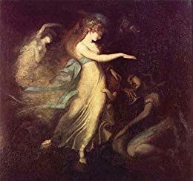
Influenced by Ariosto and Tasso, two major Italian epic writers in Renaissance and the Virgilian tradition (Latin epic writer)
Spenser also acknowledges the influences from Chaucer.
Spenser dedicated The Faerie Queene to Queen Elizabeth and earned the title “poet laureate” (premier poet of England) as well as 50 pounds annually.
Although The Faerie Queene (1590) was written during the Renaissance, it is set in the Middle Ages and written in language that resembles Middle English
Language is deliberately archaic.

Slide 5
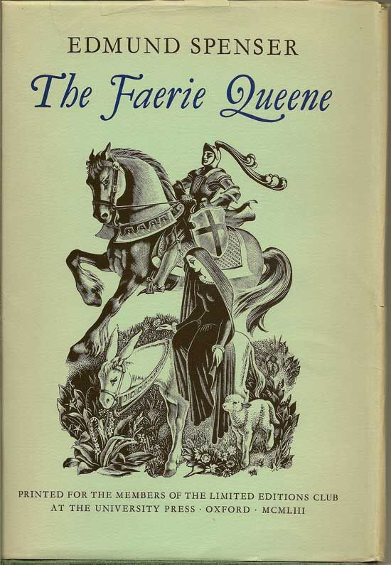
As originally planned, according to his introductory letter addressed to Sir Walter Raleigh, the work was to consist of 12 books, each made up of 12 cantos.
Only 6 books were completed, and published together for the first time in 1609.
The Faerie Queene is divided into six books, each one dedicated to a specific virtue:
Holiness, temperance, chastity, friendship, justice, courtesy.

Slide 6
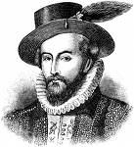
The Purpose of the Poem
In a letter to Sir Walter Raleigh, Spenser describes his poem as an allegory and invites us to interpret the characters and adventures in the several books in terms of the particular virtues and vices they enact or come to embody.
The poem is an allegorical tale created to teach its readers how to achieve the six virtues Spenser explores in each book. Instead of providing an instruction booklet about how to lead a sinless life, Spenser portrays each virtue and vice through the knights' quests.
The poem's general end, Spenser writes, is "to fashion a gentleman or noble person in vertuous and gentle discipline," and the individual moral qualities, taken together, constitute the ideal human being.

Slide 7
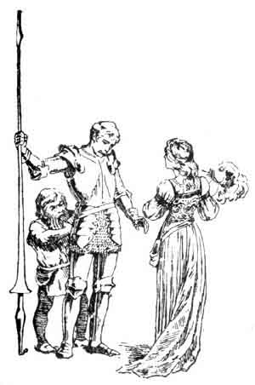
Each book concerns the story of a knight, representing a particular Christian virtue:
Holiness –The Red Cross Knight,
Temperance- self-control in the face of all temptations- Sir Guyon,
Chastity- Britomart, a female knight, chastity here meaning chaste love leading to marriage
Friendship- Triamond,
Justice- Artegall
Courtesy-Calidore

Slide 8
Allegory
Three layers of meaning:
1. The story
2. Moral and Religious allegory
3. Personal and Political allegory

Slide 9
Spenser’s Political Awareness
Though it takes place in a mythical land (fairyland), The Faerie Queen was intended to relate to Spenser's England, most importantly in the area of religion.
Spenser lived in post-Reformation England, which had recently replaced Roman Catholicism with Protestantism (specifically, Anglicanism) as the national religion. There were still many Catholics living in England, and, thus, religious protest was a part of Spenser's life. A devout Protestant and a devotee of the Protestant Queen Elizabeth, Spenser was particularly offended by the anti-Elizabethan propaganda that some Catholics circulated.
Like most Protestants near the time of the Reformation, Spenser saw a Catholic Church full of corruption, and he determined that it was not only the wrong religion but the anti-religion. This sentiment is an important backdrop for the battles of The Faerie Queene, which often represent the "battles" between London and Rome.

Slide 10
Gloriana, the queen of Fairyland, represents both glory, spiritual beauty and Queen Elizabeth I, in whose honor 12 knights, who represented the qualities of the chivalric virtues, engage in a series of adventures.
Throughout the whole poem, Arthur, disappears, and reappears, looking for Gloriana, with whom he has fallen in love. He desires to marry her. (The Legend of Arthur is revived)

Slide 11
Note: the heroes do not have the virtues they represent at the beginning of their adventures- they acquire them in the course of the book.
First Book:
Redcrosse Knight - He is the hero of Book I, the representation of holiness. (Reformed England) - Redcrosse represents: St. George, the patron saint of England.
It has 12 cantos, as Virgil’s Aeneid consists of 12 books.
The Redcrosse knight goes on a quest to free Una’s parents from the dragon.
His adventures represent the individual Christian’s struggle to maintain personal holiness while avoiding pride in all its forms.
Una is the truth- both an absolute spiritual truth and what Spenser sees as the true faith of the Protestant church (true religion). Her encouragement and help keeps the Knight from doom and helps to build him into a mighty warrior capable of defeating the dragon.

Slide 12
Book I is almost entirely self- contained
it has been called a “miniature epic” in itself
The spiritual allegory is similarly self-contained; it presents the Christian struggling heroically against many evils and temptations —doctrinal error, hypocrisy, the Seven Deadly Sins, and despair—to some of which he succumbs before finally emerging triumphant.

Slide 13
Good Versus Evil
Edmund Spenser was anti-Catholicism.
In the story, the good characters represent true religion, which he thought was Protestantism/Anglicanism.
The villains represent the Roman Catholic Church.
Redcrosse: He represents true Anglican man. Who must have faith always.
Una: She represents the truth.
The villains try to separate them
There is a villain who wears purple which represents the Pope.

Slide 14
The good people are subject to Faerie Queene and are called Faeries or Elves. They are human beings, though not much individualized. They undergo the trials and tribulations men undergo in ordinary world, but those events are told in a romantic, fantastic way in order to arouse wonder.
The bad creatures, people and monsters, are various vices, evils, and temptations, often revealed to the reader by their names or by short verse summaries at the beginning of each canto but not revealed to the hero until he has conquered them.

Slide 15
Spenserian Stanza
The Spenserian stanza is a fixed verse form invented by Edmund Spenser for his epic poem
It is a verse form composed of nine lines
The first eight in iambic pentameter and the last an alexandrine, in iambic hexameter.
The rhyme scheme is ababbcbcc.
(Alexandrine: in English poetry, a line of verse that has six iambic feet and usually a caesura after the third foot)
"Iambic" refers to the type of foot used, here the iamb, which in English indicates an unstressed syllable followed by a stressed syllable
Pentameter indicates a line of five "feet".
Hexameter" indicates a line of six "feet".

