Slide 1

Rumorless
Make an end to the infodemia
(fake news).
News
Rumorless

Slide 2



Problem
1
Rumors are fastly shared speacially in this crisis (covid-19)
Rumors has a negative impact on the person's personality and on his way how to look to the society therefore it will make certainly an impact on their social experience .as a conclusion rumors change the general opinions
Rumorless
2
Fake news has no limits so it can touche all the society. And this lies steal their rights of having honest mediatisation
3

Slide 3

Our solution :
We think about this problem and we find the best solution is to create Rumorless : application that will certainly make an end to this fake news.
so let's discover it together !

Slide 4

Timing
1
To have the most honest media in this crisis can help to fight in this war and to build a new confidence relation between the society and the goverment .
rumorless
Some people exploit this crisis to share their rumors becauce specially in this days people became more connected to social-media and all means of informations .
2

Slide 5

Competitive Advantages

Slide 6



Advantage 1
Allowed to the community to join and to participe in the cheking rumors
Advantage 2
Offer states that prove our credibility.

Slide 7


Advantage 3
Share news 100% true
(after check) so people can directly visite our application to see the daily news .
Advantage 4
By giving true answers users can develop their level of credibility .

Slide 8


INCOME
1
Sell states then we sell to companies which need these informations
2
Premium features
3
Adds.
Rumorless

Slide 9






Step 1
Networking
Step 2
Future Roadmap
Make data base
Step 3
Enlarge our relations
with the companies which need states
Step 4
Enlarge our network
to the international scale

Slide 10



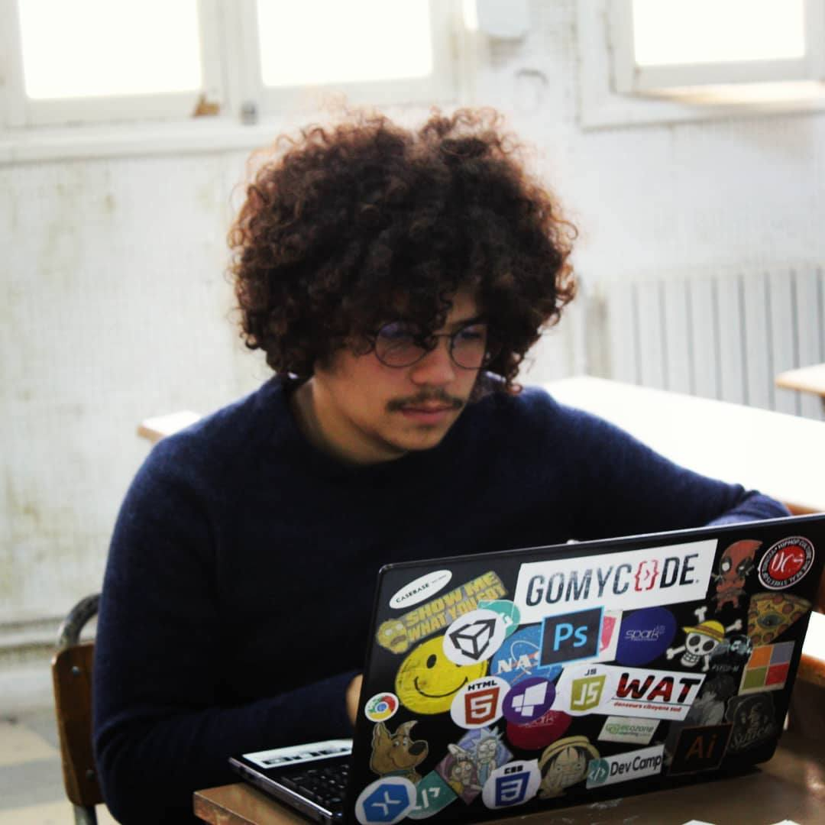
Eya Chaabene
The Team
Youssef Jammousi
Mehdi Bouzguenda

